Slide 1

Responsible AI in
Academic Research
Advancing Science Responsibly in the Age of AI

Slide 2
Strategic Framework
Aligning Artificial Intelligence with the standards of the Ministry of Education and Science of Ukraine

Slide 3





Information Retrieval & Synthesis
Advanced Search
Automated Summaries
Systematization
Identifying relevant scientific publications and archival materials across international databases using specialized criteria.
Organizing identified sources based on specific research problems, identifying key conceptual clusters.
Generating concise abstracts and thematic resumes of complex scholarly articles to expedite literature reviews.

Slide 4
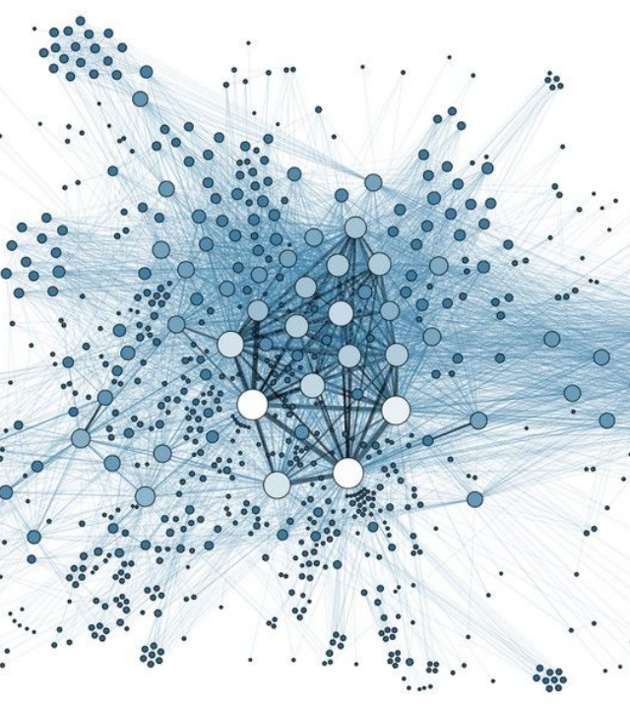
Data Analytics & Big Data
Empirical Precision
AI capabilities allow researchers to process vast datasets, uncovering hidden correlations and longitudinal patterns within Big Data.
Reproducibility: Ensuring adequate sample sizes to verify the adequacy, representativeness, and reproducibility of experimental results.

Slide 5
Expert Analysis & Risk Modeling
Scientific Novelty
Risk Assessment
Evaluating research results (hypotheses, concepts, models) for originality versus existing international prototypes.
Modeling potential risks, reliability, and safety of technological applications or experimental interventions.

Slide 6

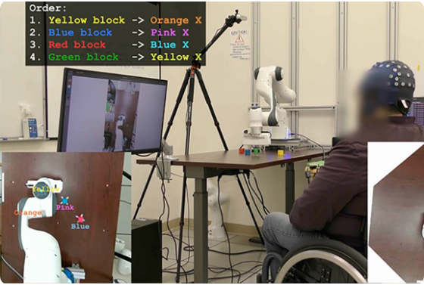
Ideation & Methodology
AI serves as a catalyst for creative research design, assisting in:
•
Selection of optimal research methods and methodologies.
•
Generating innovative directions for future exploration.
•
Cross-disciplinary application of existing scientific models (e.g., physical models applied to social sciences).

Slide 7
Technical Optimization
Metadata Indexing: Determining the optimal set of keywords and tags to ensure high searchability in global repositories.
Stylistic Alignment: Formatting text to meet the specific requirements of international publishers or conferences.
Bibliographic Standards: Automated styling of citations according to APA, MLA, IEEE, or specific journal formats.
Data Visualization: Creating interactive visualizations that simplify the communication of complex theoretical concepts.

Slide 8
Academic Integrity Mandate
“
"To prevent potential violations of academic integrity, researchers must explicitly state the role of AI in their work, detailing the prompts and modifications applied."
— Ministry of Education and Science Guidelines

Slide 9
The Attribution Framework
Parameter | Mandatory Requirement
Purpose | Clearly define why AI was used in this specific section.
Task | The exact function the AI was expected to perform.
Prompt | The verbatim prompt (query) used to generate the output.
Tool | The specific software or engine (e.g., GPT-4, Claude, Perplexity).
Processing | Details on whether the result was used "as is" or modified.

Slide 10



Visual Indicators of AI Use
"As Is" Generation
Modified Output
AI-Assisted Idea
Used when AI output is incorporated directly without significant researcher alteration.
Indicates substantial modification, critical analysis, or verification by the researcher.
AI was used solely for conceptual brainstorming or methodological suggestion.
Standardized icons may be used at the beginning or end of chapters to denote these levels.

Slide 11
Institutional Accountability
Zhytomyr Polytechnic Standards
Zero
Unauthorized or uncredited use of generative AI is categorized as a violation of academic integrity under the Code of Academic Integrity of Zhytomyr Polytechnic State University.
Tolerance for Plagiarism
Researchers bear full legal and ethical responsibility for the veracity and originality of their findings.

