Slide 1


Alternative diesel fuels.
BTL, HVO,Biodiesel
Ruslana Kolodnytska
Zhytomyr State Technological University, Ukraine
ERASMUS + teaching, May 2017, Coventry , UK
Ruslana Kolodnytsksa ruslanakolod@gmail.com Zhytomyr State Technological University, Ukraine

Slide 2
Content
Part I. Alternative fuels
Biodiesel, BTL and HVO
Part II. SPRAY
Droplet velocity. Spray parameters. Maximum entropy methods (biodiesel).
Part III. Combustion. HEMP Biodiesel
Cetane number. The heat of combustion.
Discussion. Low temperature properties.

Slide 3
Part1. Alternative fuels
Biodiesel, BTL and HVO
HVO production

Slide 4
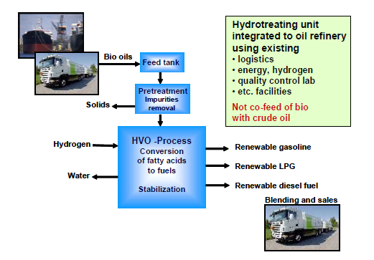
HVO production
In the HVO production
process,
hydrogen is used to
remove the oxygen
from the vegetable oil
LPG produced
as a side products
[Aatola, 2008]
NExBTL Neste Oil’s Porvoo oil refinery in Finland (2007)

Slide 5
Part 2. SPRAY
Droplet velocity
Spray parameters
Maximum entropy method ( biodiesel)

Slide 6
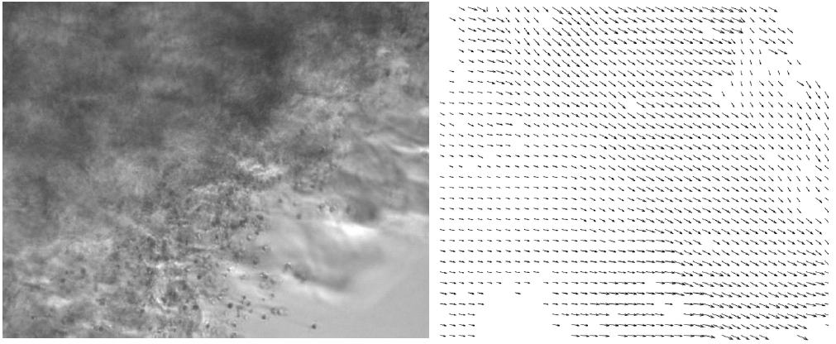
Droplet velocity (diesel fuel)
Spray image (23 mm from the nozzle) and resulting velocity vectors [Qubeissi,2014]

Slide 7
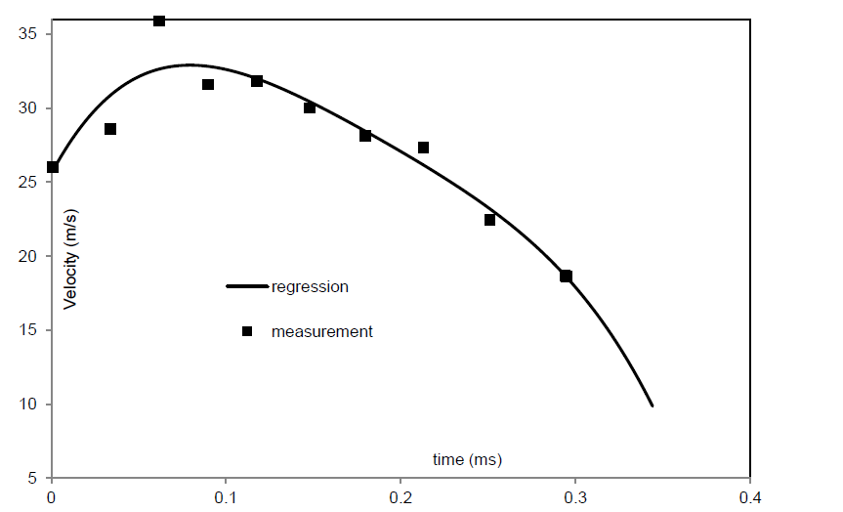
Droplet velocity (diesel fuel)
The measured and approximated droplet velocities (diesel) [Qubeissi,2014]

Slide 8
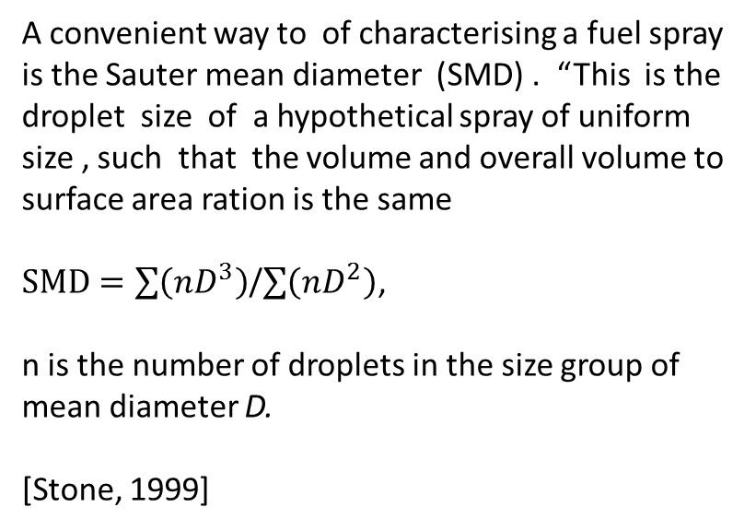
Spray parameters
Part II. SPRAY
Spray tip penetration
A convenient way to of characterising a fuel spray is the Sauter mean diameter (SMD) . “This is the droplet size of a hypothetical spray of uniform size , such that the volume and overall volume to surface area ration is the same
$SMD=\sum{\left(nD^{3}\right)}$/$\sum{\left(nD^{2}\right)}$,
n is the number of droplets in the size group of mean diameter D.
[Stone, 1999]
[Chen, 2013]
Spray parameters: SMD , spray penetration, cone angle, droplet distribution

Slide 9
Droplet diameter distribution diesel (line -) biodiesel (-----)
Part II. SPRAY
10 mm from nozzle 15 mm from nozzle

Slide 10
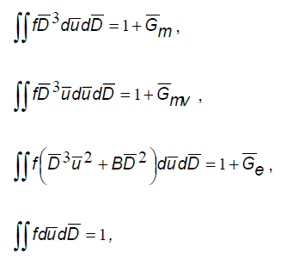







Maximum Entropy Method
Part II. SPRAY
Weber number
Mass mean droplet diameter
D30
Sources for mass, momentum , energy

Slide 11


Maximum Entropy Method
Part II. SPRAY
Classic dependence between the system entropy and the probability of microstates
The probability density function:
The maximal value of the entropy was
found by the Lagrangian multiplier method

Slide 12
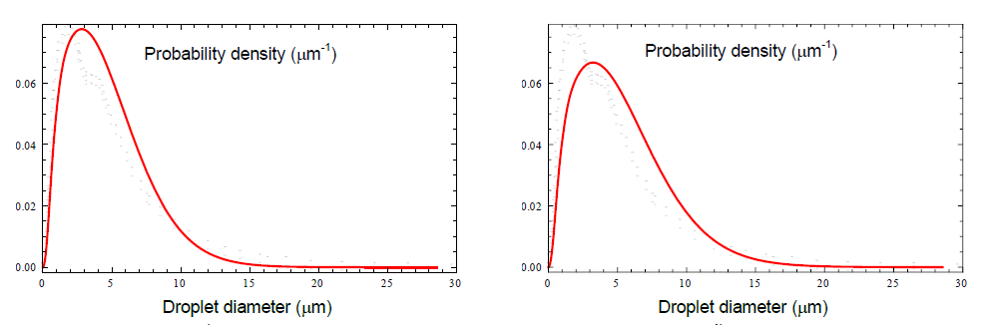
Application MA method to biodiesel spray
Part II. SPRAY
Diesel,
Biodiesel
Distance from the nozzle 15 mm, injection pressure 100 MPa, ambient atmospheric
Pressure, Delphi nozzle ( 0.135 microns),

Slide 13

Part III . Combustion. Hemp biodiesel
Cetane number
The heat of combustion
Stage of combustion
Hemp can save our world

Slide 14

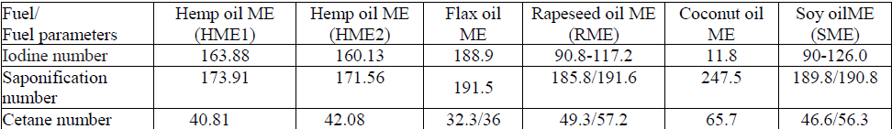
Cetane number
Part III.
Hemp biodiesel
Х1, Х2, Х3, Х4, Х5, Х6, Х7 і Х8 – the content (in percentage) of methyl esters fatty acids
X1- (С12:0 M), X2 - (С14:0 M), X3 - (С16:0 M), X4 - (С18:0 M), X5 - (C16:1 M), X6- (С18:1 M), X7- (С18:2M) and X8- (С18:3 M)
Ignition delay
Hemp can safe our world

Slide 15
The heat of combustion
Part III.
Hemp biodiesel
The higher heating value
 | HME1, % | HME2, %
C | 77.48 | 77.46
H | 11.66 | 11.62
0 | 10.86 | 10.92
The lower heating value
Fuel/ Fuel parameters | Hemp oil ME (HME1) | Hemp oil ME (HME2) | Flax oil ME | Rapeseed oil ME (RME) | Coconut oil ME | Soy oilME (SME)
LHV, MJ/kg | 37.67/37.13 | 37.76/37.18 | 36.92/37.03 | 37.15/37.82 | 35.34/36.29 | 37.13/37.55
Hemp can safe our world

Slide 16
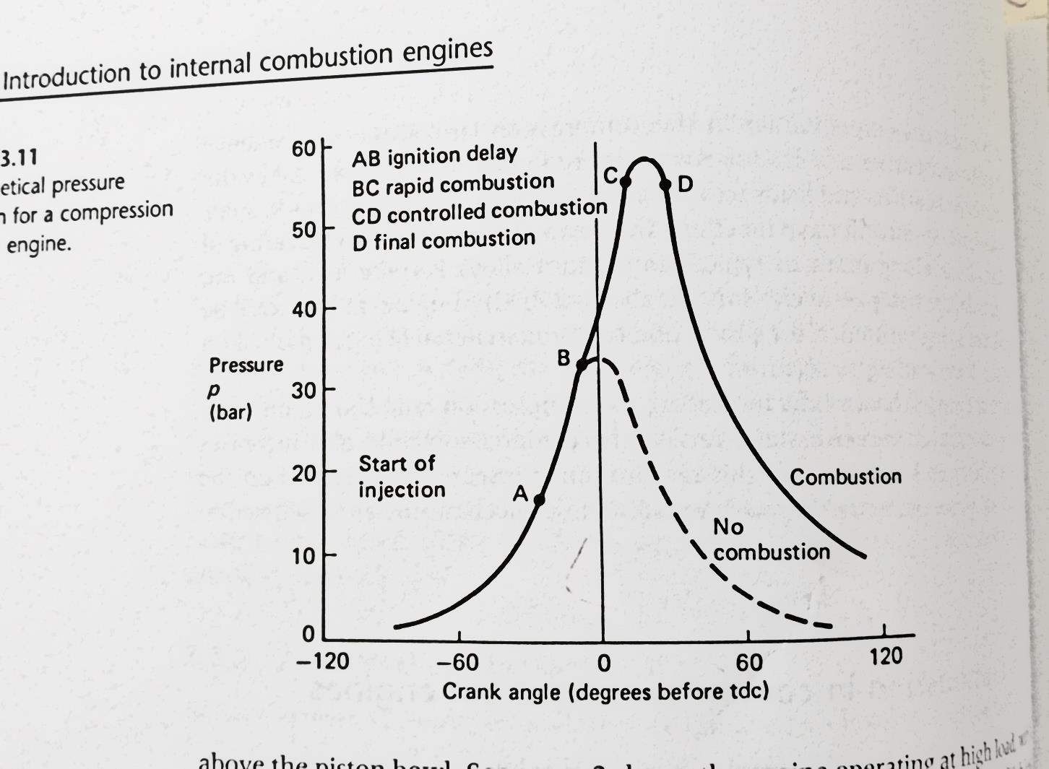
Combustion in compression ignition engine
[Stone, 1999]
Hypothetical pressure
diagram for a compression
ignition engine
[Figure 3.11]

Slide 17
The stage of combustion
There are several stages of combustion that not distinctly separated [Stone, 1999]:
Ignition delay. During this period the fuel is breaking up into droplets being vaporised, and mixing with air. Chemical reaction will be starting slowly.
Rapid or uncontrolled combustion. A very rapid rise in pressure caused by ignition of the fuel/air mixture prepared during the ignition delay period.
Controlled combustion. Combustion occurred at a rate determined by the preparation of fresh air/fuel mixture.
Final combustion. As with controlled combustion the rate of combustion is governed by diffusion until all the fuel or air is utilised.

Slide 19
Low temperature properties
Discussion
Hemp can safe our world

Slide 20
Literature
Mansour Al Qubeissi, Sergei S Sazhin, Guillaume de Sercey, Cyril Crua . ILASS – Europe 2014, Bremen, Germany

Slide 21
Thank you for your
attention

