Slide 1


BiodieSel. Fluid Mechanics
DR. Ruslana Kolodnytska
Zhytomyr State Technological University, Ukraine
ERASMUS + /mobility, May 2017, Coventry , UK
Ruslana Kolodnytska ruslanakolod@gmail.com Zhytomyr State Technological University, Ukraine

Slide 2
Contents
I Fluid properties
Thermodynamic properties of fluids (biodiesel and diesel).
Dimensionless parameters. Drag coefficient.
II SPRAY
Main parameters. Exit fluid velocity. Discharge coefficient.
III Flow analysis
Differential equation for fluid particle. Viscose flow.
Methods of drag reduction.
Biodiesel.
Fluid
mechanics
ERASMUS + /mobility, May 2017, Coventry , UK Ruslana Kolodnytska

Slide 3
Part I. Fluid Properties
Thermodynamic properties of fluids (biodiesel and diesel).
Secondary properties (vapour density !)
Dimensionless parameters (Drag coefficient).

Slide 4
Thermodynamic Properties of Fluids
Thermodynamic Properties | Biodiesel | Diesel
1. Pressure | 1 atm | 1 atm
2. Density, kg/m3 | 883 (15°C) | 837 (15°C)
3. Temperature
4. Internal energy
5. Enthalpy
6. Entropy
7. Specific heats cp/cv
8. Coefficient of viscosity, Pa×s | 3.16 (20°C) | 1.7 (20°C)
9. Thermal conductivity | [Perkins, 2011] | 0.149
Part I
Fluid properties
Last two properties called transport properties.
All nine of these properties are determined by the thermodynamic condition or state of the fluid.
Dynamic
(absolute)
viscosity
Coefficient of viscosity

Slide 5
Secondary thermodynamic properties
Thermodynamic Properties | Biodiesel | Diesel
Kinematic viscosity, mm2/s | 4.4 | 3.3
Surface tension, N/s | 33.2 ×10 -3 | 29.8 ×10 -3
Saturated vapour pressure, Pa | [Sazhin SS (et al) Fuel, 2014] | 1329
Vapour density | future work | future work

Slide 6
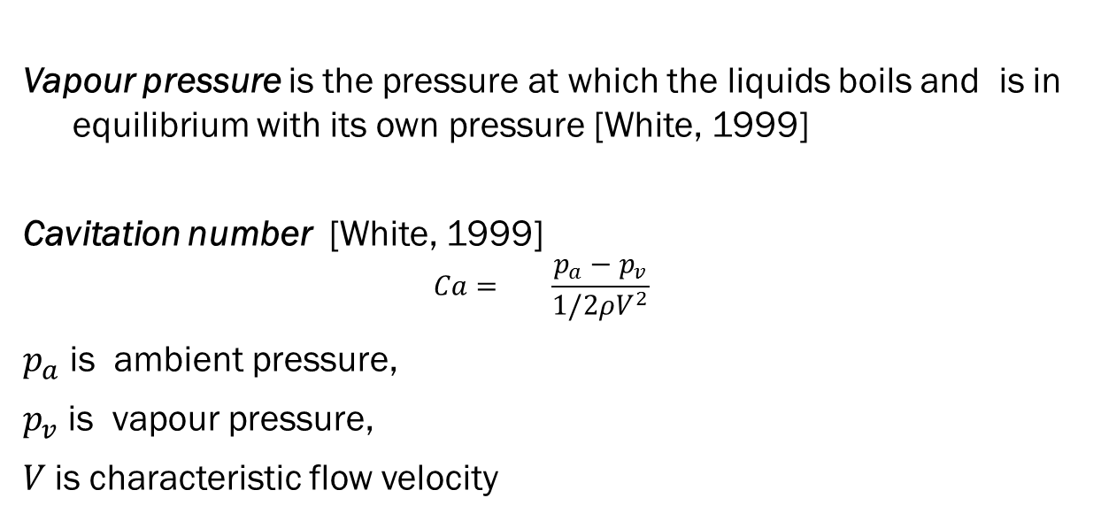
Vapour Pressure
Vapour pressure is the pressure at which the liquids boils and is in equilibrium with its own pressure [White, 1999]
Cavitation number [White, 1999]
$${Ca= \frac{p_{a}−p_{v}}{1/2ρV^{2}} }_{}$$
$p_{a}$ is ambient pressure,
$p_{v}$ is vapour pressure,
$V$is characteristic flow velocity
Part I
Fluid properties
Which fuel has the higher vapour pressure :
Diesel or Biodiesel ?
Q1:

Slide 7
Vapour Density
Density for saturated n-octane
vapour as a function of
the temperature
[Nikolay I. Kolev. Multiphase Flow Dynamics 3. Springer.,2007]
Part I
Fluid properties
Q2:
Any idea how to find the vapour density of biodiesel ?

Slide 8
question 3.
What’s the main difference between
The thermodynamic properties
of The biodiesel and diesel ?
Part I
Fluid properties
Q3.

Slide 9
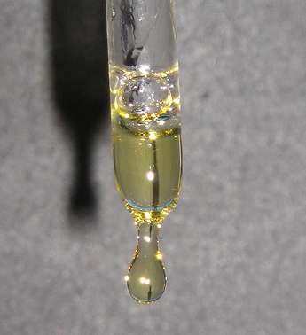
Exercise 1: Biodiesel viscosity
[Zhytomyr, experiment]
The absolute viscosity of a fluid is primary a function of
Density (b) Temperature (c) Pressure (d) Velocity (e) Surface tension
[White, 1999]
Q4:

Slide 10
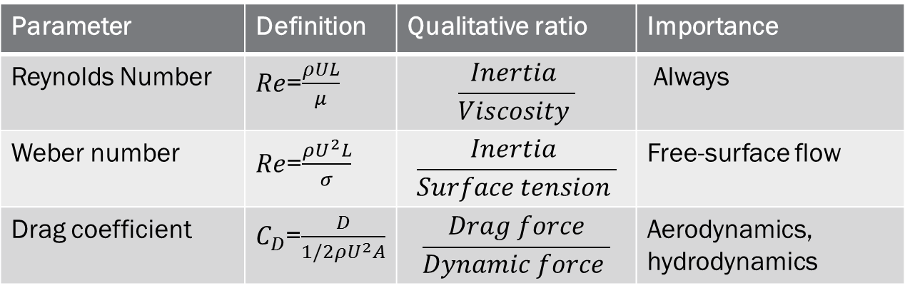
Dimensionless parameters
Parameter | Definition | Qualitative ratio | Importance
Reynolds Number | $Re$=$\frac{ρUL}{μ}$ | $$\frac{Inertia }{Viscosity }$$ | Always
Weber number | $Re$=$\frac{ρU^{2}L}{σ}$ | $$\frac{Inertia }{Surface tension }$$ | Free-surface flow
Drag coefficient | $C_{D}$=$\frac{D}{1/2ρU^{2}A}$ | $$\frac{Drag force}{Dynamic force }$$ | Aerodynamics, hydrodynamics
Parameter | Biodiesel | Diesel
Reynolds Number , Re
Weber number, We
Drag coefficient
Part I.
Fluid properties
Transition from laminar to turbulent flow occurs at
a Reynolds number of [White, 1999]
900 (B) 1200 (C) 1500 (D) 2100 E(3000)
The “correct “ answer :
Q5:

Slide 11
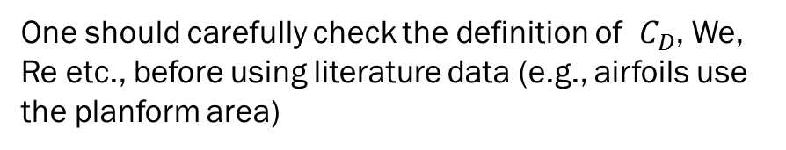
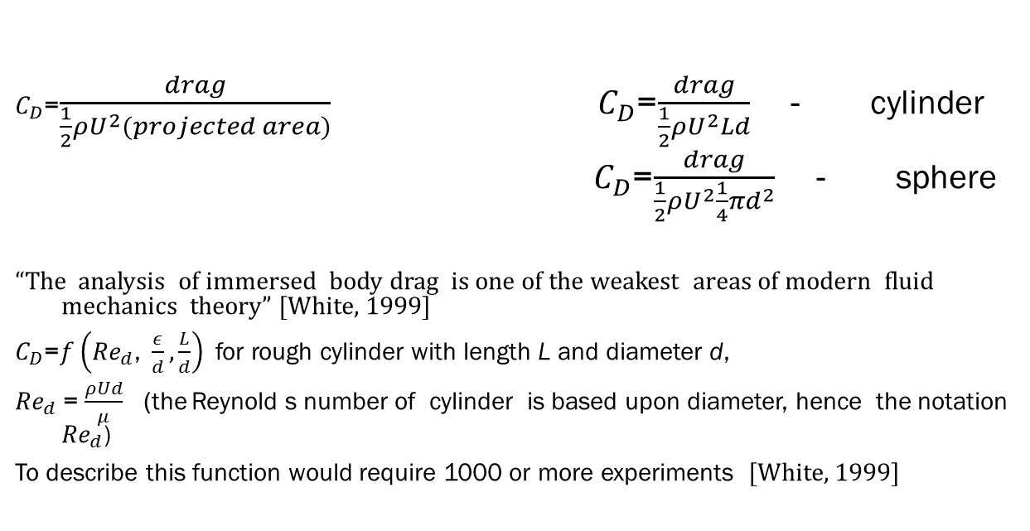
Drag coefficient
$C_{D}$=$\frac{drag}{\frac{1}{2}ρU^{2}(projected area)}$ ${ C}_{D}$=$\frac{drag}{\frac{1}{2}ρU^{2}Ld}$ - cylinder
$C_{D}$=$\frac{drag}{\frac{1}{2}ρU^{2}\frac{1}{4}πd^{2}}$ - sphere
“The analysis of immersed body drag is one of the weakest areas of modern fluid mechanics theory” [White, 1999]
$C_{D}$=$f\left({Re}_{d}\text{, }\frac{ε}{d},\frac{L}{d}\right)$ for rough cylinder with length L and diameter d,
${Re}_{d}$= $\frac{ρUd}{μ}$ (the Reynold s number of cylinder is based upon diameter, hence the notation ${Re}_{d}$)
To describe this function would require 1000 or more experiments [White, 1999]
One should carefully check the definition of $C_{D}$, We, Re etc., before using literature data (e.g., airfoils use the planform area)
Notice:

Slide 12
Part II. Spray
Main Spray parameters
Exit velocity. Discharge coefficient
Simple Spray models
Roisman spray model

Slide 13
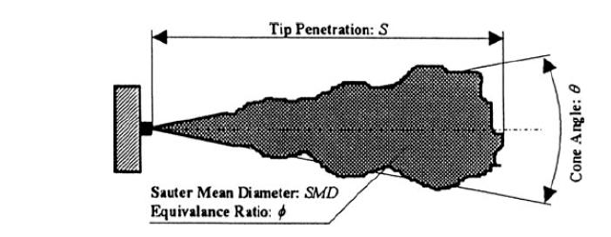
Main Spray parameters
[Assanis, 2011]
Part II
Spray

Slide 14


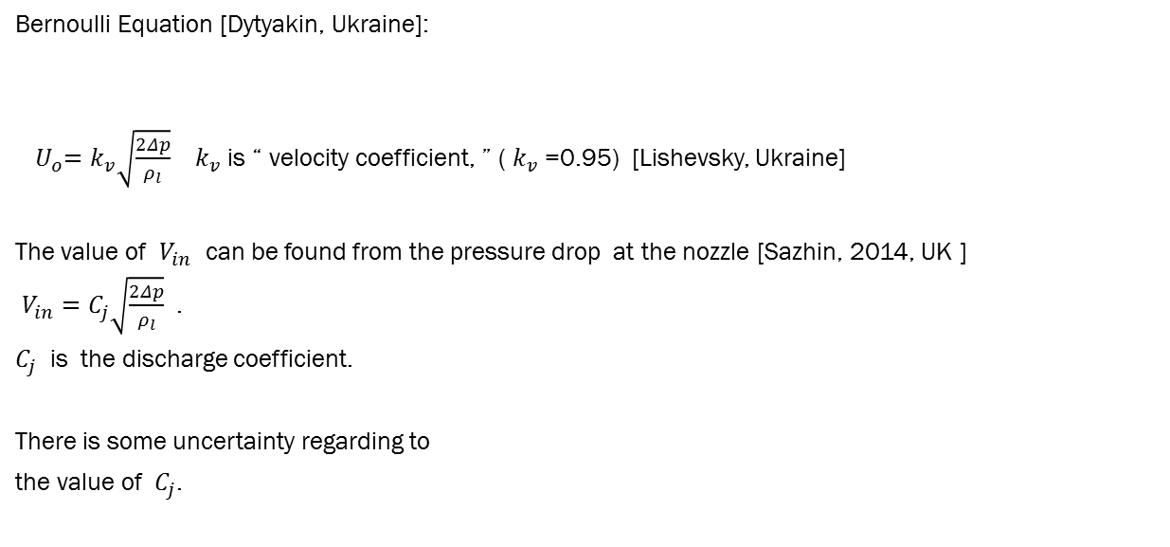
Exit velocity. Diesel Fuel
Bernoulli Equation [Dytyakin, Ukraine]:
${ U}_{o}=k_{v}\sqrt{\frac{2Δp}{ρ_{l}}}$ $k_{v}$ is “ velocity coefficient, ” ( $k_{v}$ =0.95) [Lishevsky, Ukraine]
The value of $V_{in}$ can be found from the pressure drop at the nozzle [Sazhin, 2014, UK ]
$V_{in}=C_{j}\sqrt{\frac{2Δp}{ρ_{l}}}$ .
$C_{j}$ is the discharge coefficient.
There is some uncertainty regarding to
the value of $C_{j}$.
Discharge coefficient | Literature
0.7 | [Liferbvre ]
0.39 | [Braco]
Part II
Spray
“The Bernoulli equation is a wonderful, historic relation,
but it is extremely restrictive and should always be viewed with
scepticism and care in applying it to real (viscous) fluid motion”
[White, 1999]
Bernoulli
Equation

Slide 15

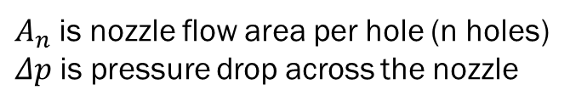

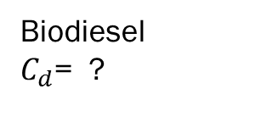
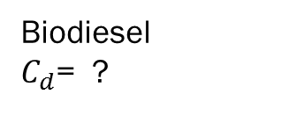
Discharge coefficient. Diesel Biodiesel.
and correlate the discharge coefficient $c_{d}$
In practice, we measure ${\dot{ m}}_{actual}$=$c_{d}{\dot{m}}_{aideal}$
[White, 1999, p 181]
${\dot{ m}}_{f}\text{=}C_{d}A_{n }\sqrt{2ρ_{l}Δp}$ [Stone, 1999] (1)
$A_{n}$ is nozzle flow area per hole (n holes)
$Δp$ is pressure drop across the nozzle
Biodiesel
$C_{d}$= ?
Biodiesel
$C_{d}$= ?
Part II
Spray
What is the difference between $C_{d}$ for diesel and biodiesel
Q6
(1) ?

Slide 16
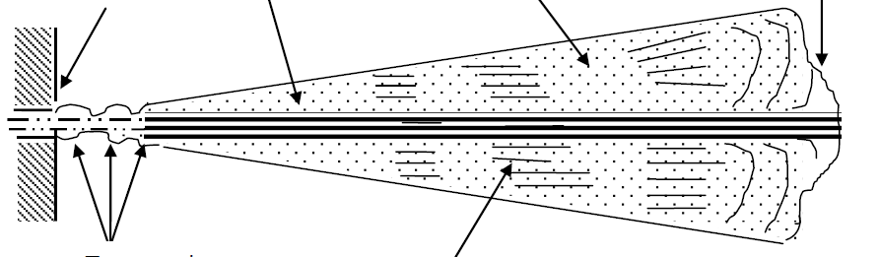
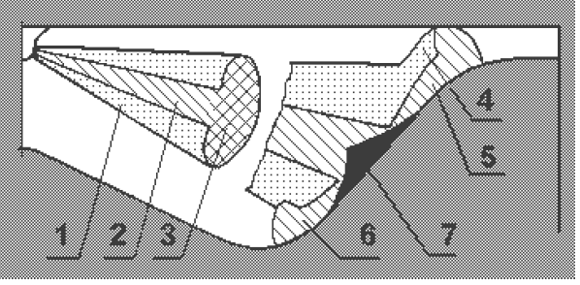
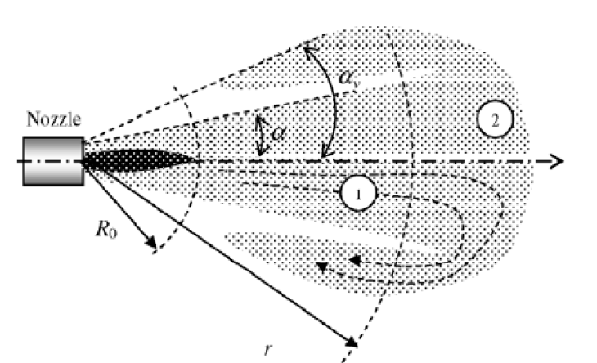
Simple Spray models
Lishevsky
model
Kuleshov model
Roisman model

Slide 17
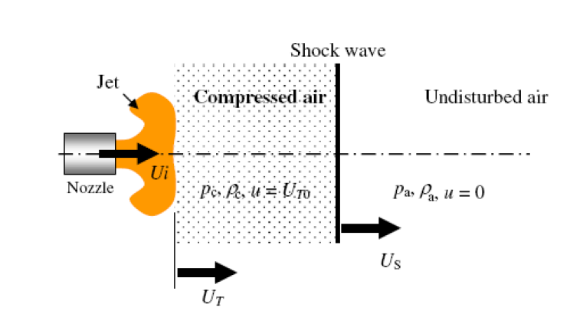




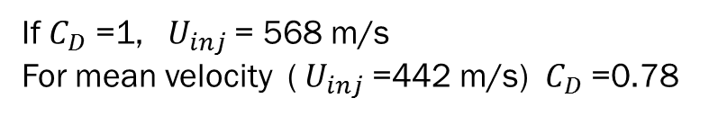

Roisman Model (Germany). Diesel Fuel
Zone that is very close to Nozzle
(r < Ro)
r >Ro
Radial expansion zone
Front zone
c is sound velocity
Part II
Spray
p = 1350 bar,
[Roisman, 2007]
$C_{d}$ or ($C_{D }$?)
If $C_{D}$ =1, ${ U}_{inj}$ = 568 m/s
For mean velocity (${ U}_{inj}$ =442 m/s) $C_{D}$ =0.78
($C_{D }is discharge coeffisient$

Slide 18
Exercise : Spray and Jet formation
[Crua, Brighton University, UK ]
Part II
Spray
Q7:
Which picture doe’s belong to biodiesel:
on the left or on the right ?

Slide 19

Diesel and Biodiesel Spray
Diesel fuel
Biodiesel
The initial jet formation at 40 MPA
into atmospheric pressure
[T.T. Shoba and C. Crua et al, ILASS 2011]

Slide 20
III Flow analysis
Steady Unsteady
Gas
Liquid
Incompressible
Compressible
Inviscid
Viscous
Constant
Inconstant
Viscosity
Constant
Inconstant
Density
Biodiesel
Diesel
Part III
Flow
analysis

Slide 21
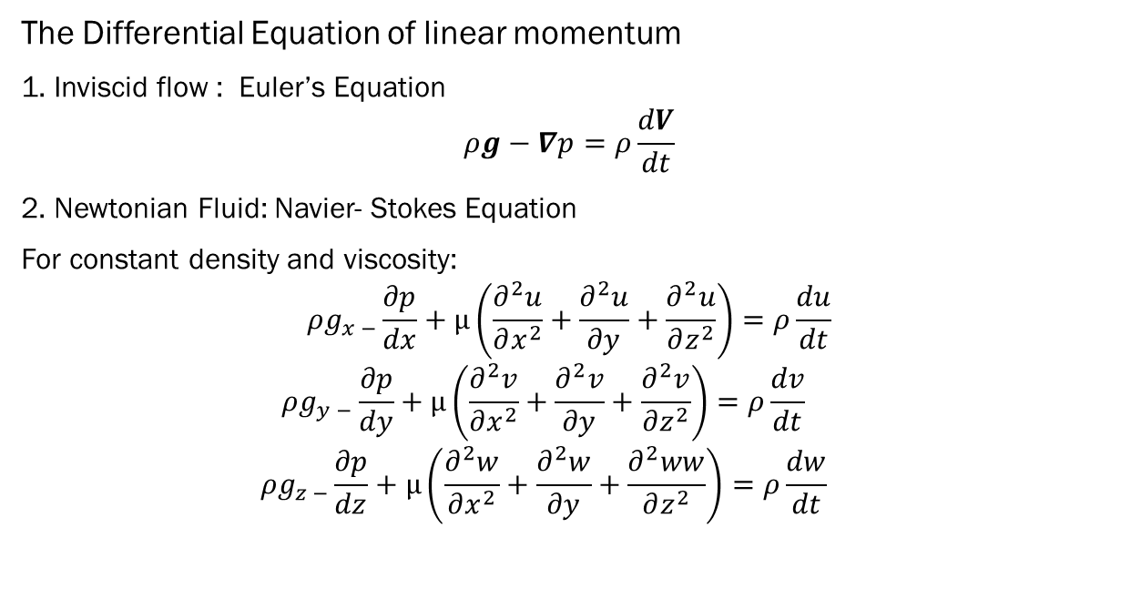
Differential Equations for Fluid Particle
The Differential Equation of linear momentum
1. Inviscid flow : Euler’s Equation
$$ρg−∇p=ρ\frac{dV}{dt}$$
2. Newtonian Fluid: Navier- Stokes Equation
For constant density and viscosity:
$$ρg_{x −}\frac{∂p}{dx}+μ\left(\frac{∂^{2}u}{∂x^{2}}+\frac{∂^{2}u}{∂y}+\frac{∂^{2}u}{∂z^{2}}\right)=ρ\frac{du}{dt}$$
$$ρg_{y −}\frac{∂p}{dy}+μ\left(\frac{∂^{2}v}{∂x^{2}}+\frac{∂^{2}v}{∂y}+\frac{∂^{2}v}{∂z^{2}}\right)=ρ\frac{dv}{dt}$$
$$ρg_{z −}\frac{∂p}{dz}+μ\left(\frac{∂^{2}w}{∂x^{2}}+\frac{∂^{2}w}{∂y}+\frac{∂^{2}ww}{∂z^{2}}\right)=ρ\frac{dw}{dt}$$
Part III
Flow
analysis
For a Newtonian fluid the viscous stress are proportional to
the element strain rates and the coefficient viscosity
Analysis
Navier- Stokes Equation has four unknowns p, u, v, w

Slide 22
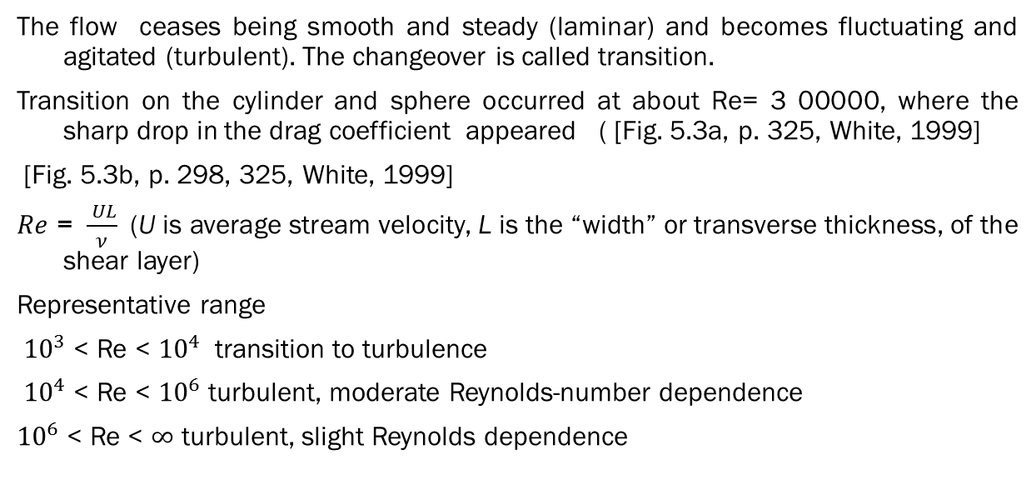
Viscous Flow in Ducts
The flow ceases being smooth and steady (laminar) and becomes fluctuating and agitated (turbulent). The changeover is called transition.
Transition on the cylinder and sphere occurred at about Re= 3 00000, where the sharp drop in the drag coefficient appeared ( [Fig. 5.3a, p. 325, White, 1999]
[Fig. 5.3b, p. 298, 325, White, 1999]
$Re$ = $\frac{ UL}{ν}$ (U is average stream velocity, L is the “width” or transverse thickness, of the shear layer)
Representative range
${10}^{3}$< Re < ${10}^{4}$ transition to turbulence
${10}^{4}$< Re < ${10}^{6}$ turbulent, moderate Reynolds-number dependence
${10}^{6}$< Re < $∞$ turbulent, slight Reynolds dependence
Part III
Flow analysis
No general analysis of fluid motion yet exist .
There are several practical solution, computer solution, and
a great experimental data.
Notice

Slide 23
Methods of drag reduction
Nearly compressible fluid ( High march number, [see p 465 White])
The classical method of drug reduction is streamlining
Other methods for drag reduction
Oil pipelines introduce an annular core of water to reduce the pumping power. The low viscosity water rides the wall and reduced friction up to 60%
Turbulent friction in liquid flow is reduced up to 60% by dissolving small amounts of high-molecular-weight polymer additive. Trans Alaska Pipeline system increased oil flow by 50% by injected small amount of polymer dissolved in kerosene .
Stream oriented surface vee-groove microriblets reduced turbulent friction by 8%
Small near wall large-eddy break-up devices – up to 10%
Air microbubbles injected at the wall of a water flow create a low –shear bubble blanket (80%)
Spanwise (transverse) wall oscillation -up to 30%
Part III
Flow analysis
Your own method to reduce drag force ?
Braine storm!

Slide 24
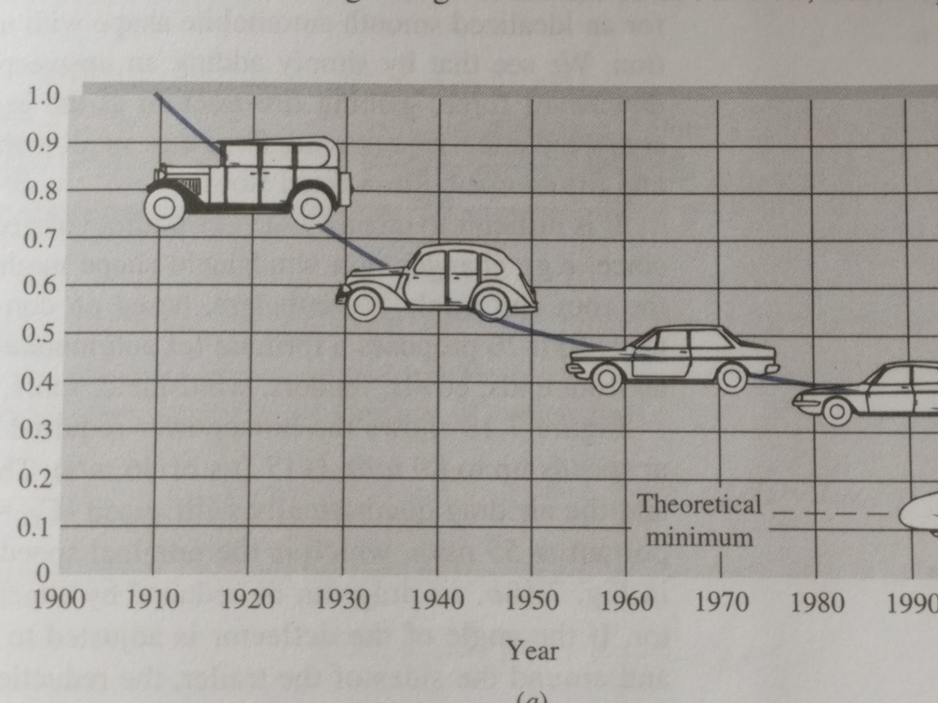

Q5. What is an average drag coefficient of modern cars ?
$$C_{D}$$
2017 ?
Part III
Flow
analysis
[White, 1999]

Slide 25
What is the drag coefficient for biodiesel ?
Viscosity difference
Density difference
Surface tension difference
  Velocity difference
Droplets form
Braine storm !

Slide 26
Literature
White F.M. Fluid Mechanics. McGraw Hill. Fourth edition, 1999.
Sazhin S.S., Al Qubeissi M., Kolodnytska R., Elwardany A.E., Nasiri R., Heikal M.R. Modelling of biodisel fuel droplet heating and evaporation. Fuel 115 (2014), 559-572.
Sazhin S. Droplets and Sprays. Springer. 2014
Dityakin Y. F et all. Liquid Spray, 1977. ( In Ukrainian)
Stone R. Introduction to Internal Combustion Engine. Macmillan, 1999.
Grabar IG, Kolodnytska RV, Semenov VG. Biofuels for diesel engine. 2011
( In Ukrainian)
6. Perkins RA, Huber ML. Energy fuel 2011, 25, p. 2383-2388.

Slide 27
acknowledgment
The author are grateful for ERASMUS +
of EU and to the Ministry of Education
of the Ukraine for their financial support
and also
Dr. Mansour Al Qubeissi , UK
as the project coordinator

Slide 28
Hemp biodiesel
Or hemp BTL?
Thank you !
All the students for listening
ERASMUS + teaching, May 2017, Coventry , UK
Ruslana Kolodnytsksa ruslanakolod@gmail.com Zhytomyr State Technological University, Ukraine
The next lecture is “Hemp car”

