Slide 1



HEMP CAR
(ALTERNATIVE BIOFUEL AND MATERIAL DESIGN)
Ruslana Kolodnytska
Associate Prof., Zhytomyr State Technological University, Ukraine
Hemp can save our world
Lotus Eco-Elise (Hemp),2009

Slide 2

ERASMUS + mobility, May 2017, Coventry , UK
Dr. Ruslana Kolodnytska ruslanakolod@gmail.com Zhytomyr, Ukraine
Project coordinator Dr. Mansour Quebissi, Coventry, UK

Slide 3
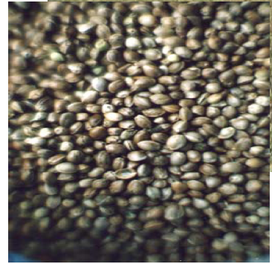
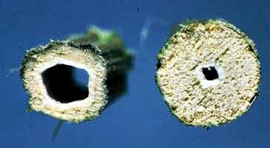
Why hemp car ?
World energy consumption grew
(CO2) increased
Industrial hemp is not psychoactive
HEMP CAR
Hemp waste
Hemp fibre
Automotive BIOFUEL
from Hemp waste
Automotive MATERIAL
from Hemp fibre and Hemp waste
Less soot emission,
Less CO and HC emissions
Less gravimetric consumption
(hydrotreated oil)
High strength
High toughness
High durability
Low weight
Good biodegradability, less energy, less water

Slide 4
Overview
Part I. HEMP FUELS
Biodiesel or Biomass to Liquid (BTL)?
Biofuel Spray
3. Hemp biodiesel evaporation
4. Biofuel combustion (emissions, consumption)
PART II. HEMP MATERIALS
5. Hemp car design
6. Hemp composite materials
PART III. DISCUSSION
Future hemp motorsport car
APPENDIX
Students’ work (ZSTU, Zhytomyr, Ukraine)

Slide 5
Part I. HEMP FUELS

Slide 6
Why hemp biofuel?
Biodiesel or BTL?
Hemp biodiesel or hemp BTL?
That is the question.
Ukraine is 4th place in the world for technical hemp production
What are the spray parameters of hemp biodiesel?
The LP-model can evaluate the spray penetration of a new type of alternative fuel in just 15 minutes!
ERASMUS +/ Mobility, May 2017, Coventry , UK
Ruslana Kolodnytsksa ruslanakolod@gmail.com Zhytomyr State Technological University, Ukraine

Slide 7
The fuel for future:CO2 emissions
Part I. HEMP FUELS
Biodiesel or BTL?
FUELS | FROM | Well to tank | Tank to wheel | Well to wheel
Hydrogen, electricity | From renewable energy
Compressed hydrogen | From wind | 7.6 | +0.0 | 7.6
Biofuels (second generation) | From biomass
Synthetic diesel | From waste wood | -116.7 | +126.8 | 10.1
NExBTL | From sunflower oil | -55.0 | +126.8 | 71.8
Biofuels (first generation) | From biomass
Compressed biogas | From organic waste | -75.6 | +107.6 | 32.0
Ethanol (100%) | From sugar cane | -114.5 | +135.9 | 21.4
 |  | -51.1 | +136.5 | 133.9
Natural gas (CNG), Hydrogen* | From natural gas (* made using steam reforming)
Compressed hydrogen |  | 82.2 | 0.0 | 82.2
Compressed natural gas |  | 26.3 | +107.6 | 133.9
Conventional fuels | From crude oil
Diesel |  | 25.1 | +131.1 | 156.2
Gasoline |  | 23.5 | +138.8 | 162.3
(CO2 emissions, g/km) [ adapted from www.autocar.co.uk, 2011]

Slide 8
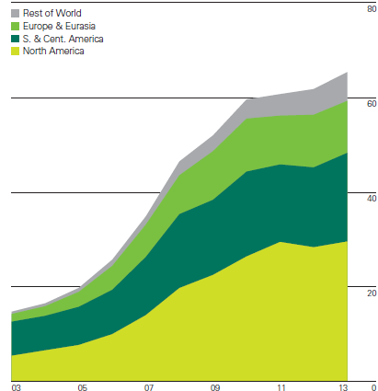
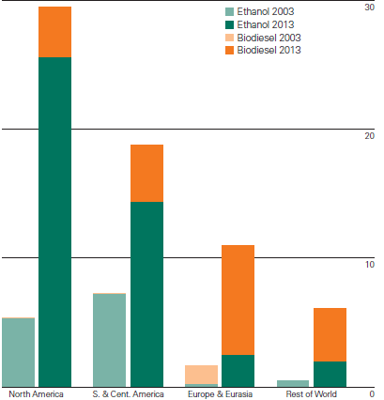
Biofuels production (biodiesel, ethanol)
increased by
6.1% in 2013
biodiesel sheared 78.2%
in European transport
Thousand tonnes oil equivalent
years
[BP, 2013]
regions

Slide 9
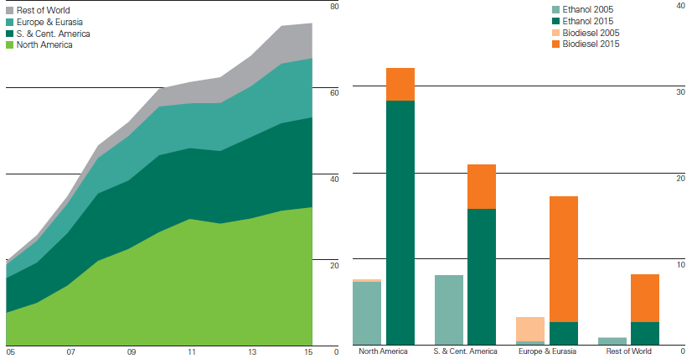
Biofuels (biodiesel, ethanol) production
Part I. HEMP FUELS
grew by
0.9%
Thousand tonnes oil equivalent
[BP, 2016]
years
regions

Slide 10
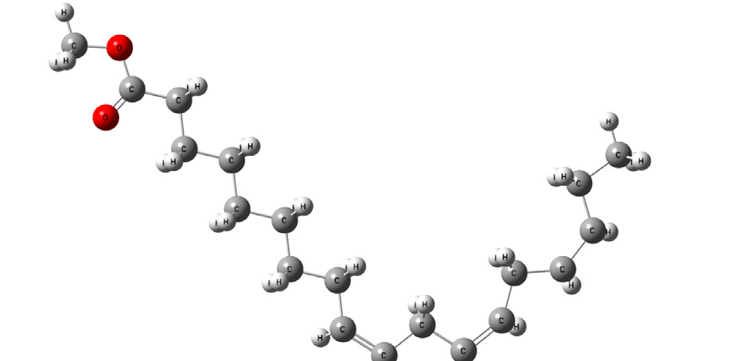
Diesel and biodiesel
Part I. HEMP FUELS
Biodiesel, (C18:2 M)
Typical diesel composition
Aromatics
[Sazhin SS,…Kolodnytska RV., /Fuel/, 2014]
Saturated
87.8%
The number of carbons
The number of double bonds
Seven PAHs have been listed in the
1999 EPA National Toxics Inventory
(Benzo(a)pyrene)
Cetane number indicates how readily the fuel self-ignites.
CN
[R.Stone, “Introduction to ICE”, 1999]

Slide 11
2. Biofuel Spray
Part I. HEMP FUELS

Slide 12

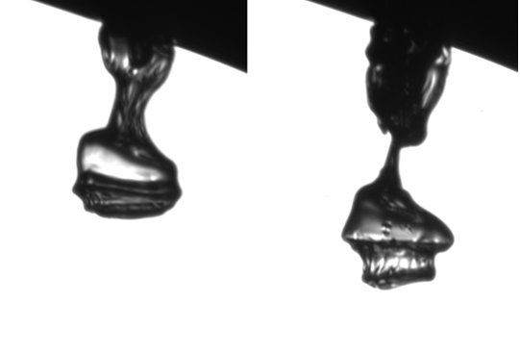
Diesel and Biodiesel Spray
Part I. HEMP FUELS
2. Biofuel spray
The initial jet formation at 100 MPA
into atmospheric pressure
Dual frame at nozzle exit (dt = 400 ns)
Diesel fuel
Biodiesel (RME)
Biodiesel
The initial jet formation at 40 MPA
into atmospheric pressure
[Shoba T.T. et al ILASS 2011]
[Crua C. et al, ICLASS 2012]

Slide 13
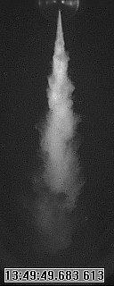
Spray Penetration Modelling
Part I. HEMP FUELS
2. Biofuel spray
Sazhin model (2005)
Roizman model (2007)
S
S_{tip}
Lishevsky model
Spray penetration: S_{tip}
[Grabar IG, Kolodnytska RV, 2011]

Slide 14
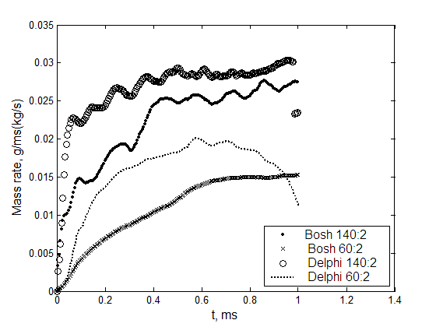
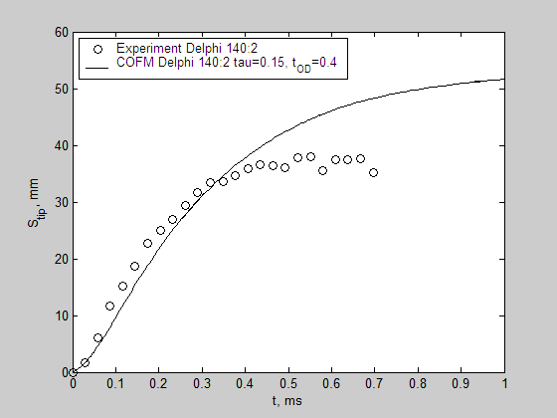
Spray Penetration Modelling,
СOFM – model
Part I. HEMP FUELS
2. Biofuel spray
[Kolodnytska RV. et al /International Congress of Propulsion Engineering/ 2008]

Slide 15
3. Hemp biodiesel evaporation
Part I. HEMP FUELS

Slide 16
Modelling of evaporation
(Biodiesel droplet)
Part I. HEMP FUELS
Hemp biodiesel
evaporation
diffusivity
latent heat
of evaporation
thermal conductivity
Liquid
density
viscosity
specific heat
capacity
vapour
pressure
vapour
diffusivity
Vapour
C24:0 M
C18:1 M
C18:2 M
C18:3 M
Biodiesel
components
C12:0 M
…..
Component property
(T, carbon number,
number of double bond)
Mixture rule
Biodiesel property
Property of air (gas)
Droplet
diameter
Droplet
velocity
Droplet
radius
Droplet
tempera-
ture

Slide 17
Evaporation of Hemp biodiesel
Part I. HEMP FUELS
HME1:
0.15%
C24:1M
(HME2:
0% C24:1M)
SME and HME1 droplet surface temperatures (Ts) and radii (Rd) versus time
predicted by the multi-component model. Gas temperature and pressure are assumed to
be equal to 880 K and 30 bar respectively. The initial droplet radius is assumed to be equal to
12.66 μm. The droplet is assumed to be moving with a constant velocity equal to 10 m/s.
[Ruslana Kolodnytska et al, /ILASS/, 2013]

Slide 18
4. Biofuel combustion (emissions, consumption)
Part I. HEMP FUELS

Slide 19
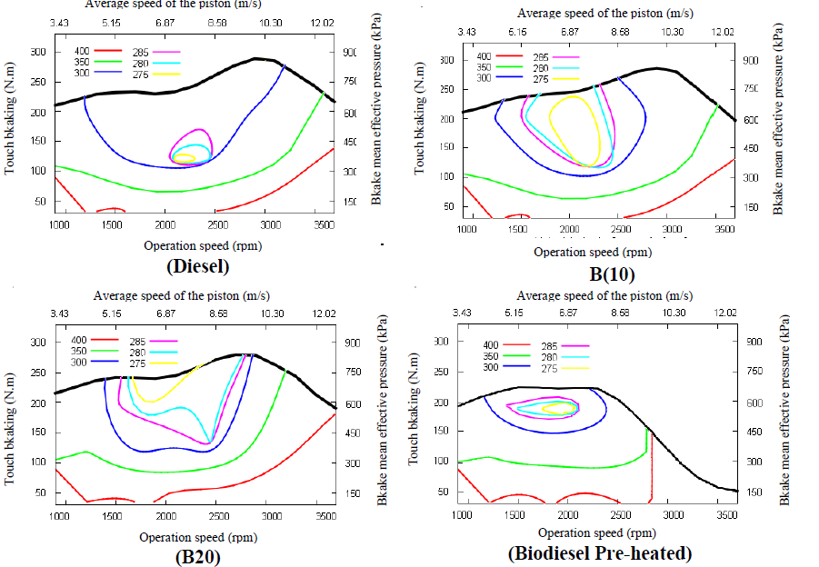
Perfomance map (diesel/bidiesel)
Part I. HEMP FUELS
4. Biofuel combustion
[Leonardo de A. Monteiro, 2013]
Performance maps obtained with the engine MWM Sprint turbo GMT 400

Slide 20
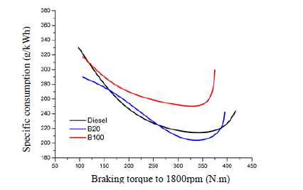
Specific fuel consumption
Part I. HEMP FUELS
4. Biofuel combustion
[Leonardo de A. Monteiro, 2013]
Castor biodiesel
(density 924.5 kg/m3)
Increase of specific fuel
consumption by around
10% comparing with diesel
(density 850.0 kg/m3)
Specific fuel consumption for preheated castor biodiesel (B100),
20% biodiesel (B20) and diesel with engine MWM 229 T6

Slide 21
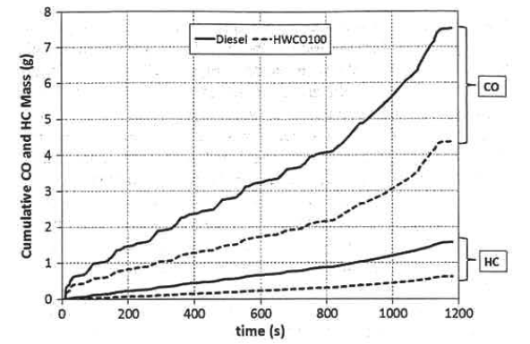
Biofuels emission (hydrotreated oils)
Part I. HEMP FUELS
4. Biofuel combustion
Renewable diesel (HVO)
C_{n}H_{2n+2}
Cetane number >80
(diesel: CN=56.5)
Density at 60° C 756 kg/m³
(diesel 832 kg/m³)
Kinematic viscosity 40°C
3.691 mm²/s
(diesel 3.236 mm²/s )
Heating value 44 MJ/kg
(diesel 43 MJ/kg)
Evolution of cumulative CO and HC mass during the NEDC for
diesel and hydrotreated waste cooking oil (HWCO).
Light-duty common-rail Euro-5 diesel engine (Toyota IND)
[Kousoulidou, /J. Energy Eng/., 2013]

Slide 22

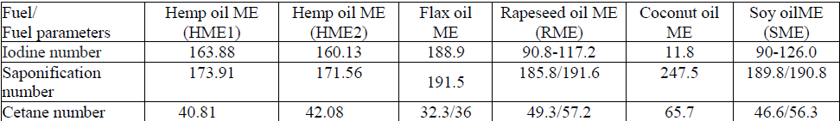
Hemp biodiesel cetane number
Part I. HEMP FUELS
Х1, Х2, Х3, Х4, Х5, Х6, Х7 і Х8 –
the content (in percentage) of methyl esters fatty acids
X1: (С12:0 M); X: (С14:0 M); X3 : (С16:0 M); X4 : (С18:0 M); X5: (C16:1 M); X6: (С18:1 M); X7: (С18:2M) and X8: (С18:3 M)
Ignition delay
Hemp can save our world

Slide 23
HEMP Biodiesel. Summary
Part I. HEMP FUELS
1. The spray and evaporation properties of Hemp biodiesel are very close to Soy biodiesel.
2. To improve the combustion characteristics of Hemp biodiesel it is better to remove the molecular C18:3 from biodiesel.

Slide 24
PART II. HEMP MATERIAL
Hemp car design
Hemp composite materials

Slide 25

Lotus Eco-Elise (hemp)
PART II. HEMP MATERIAL
Hemp car design
Hemp composite:
body panels
hardtop
the spoiler
reduced the weight
by 2 lb/1 kg per panel
comparing with typical
fiberglass
Lotus Eco-Elise. [ British International Motor, 2009]

Slide 26
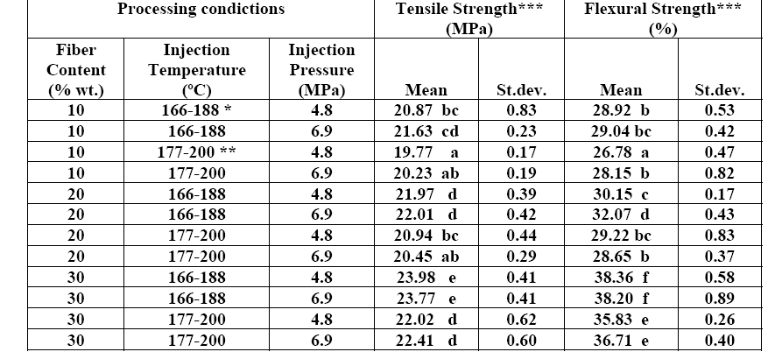
Flax and polyethylene composite
Temperature setting at injection moulding machine: * D=166ºC, C=182ºC, B=188ºC and A=188ºC; **D=177ºC, C=190ºC, B=200ºC and A=200ºC; ***Average of 5 testing specimens; a - e: values in the same group are not significantly different at 5% level. [Panigrahi et al., 2008]

Slide 27
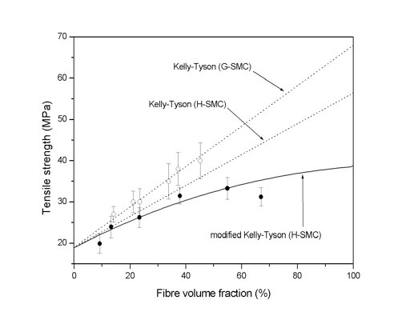
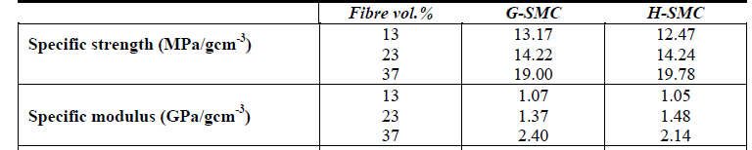
Hemp Fibre as an Alternative to Glass Fibre
Orthophthalic unsaturated polyester
(UP) resin (DSM Resins, UK)
was used as resin system.
Tensile strength of (●) H-SMC composites and (o) G-SMC composites as a function of fibre volume fraction.
The dotted lines represent the Kelly-Tyson model predictions for G-SMC and H-SMC
and the solid line the modified Kelly-Tyson model predictions for H-SMC.
Hemp and glass fibre mat properties
[Patela H.K. , Ren G., Hogg P.J. , Peijsa T. http://uhra.herts.ac.uk/]

Slide 28
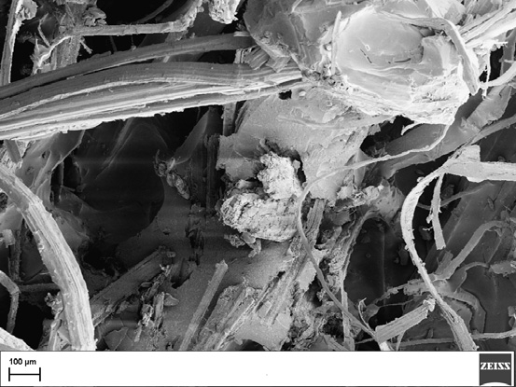
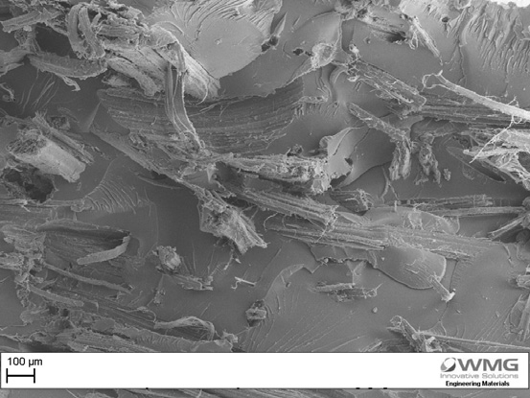
Use of lignin as a compatibiliser in hemp/epoxy composites (1)
SEM image of hemp/epoxy
composite with 2.5 % w/w lignin added
SEM image of hemp/epoxy composite with 0% w/w lignin added
[Benjamin M. Wood, Composites Science and Technology, 2011]
University of Warwick, Coventry

Slide 29
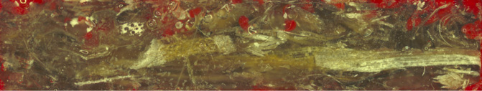
Use of lignin as a compatibiliser in hemp/epoxy composites (2)
Dark field optical micrograph of hemp/epoxy composite with 0% w/w lignin.
Dark field optical micrograph of hemp/epoxy composite with 2.5% w/w lignin.
All samples show evidence of porosity signified by the red colour of the resin used to mount the samples.
[Benjamin M. Wood, Composites Science and Technology, 2011]

Slide 30
Q. Is the strength of composite increased when we add more lignin?
6. Hemp composite materials

Slide 31
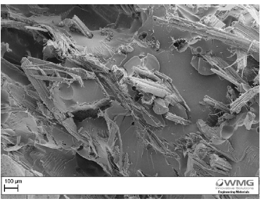
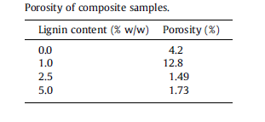

Hemp/epoxy composite with 5% w/w lignin
6. Hemp
composite materials
The reduction in tensile strength compared to 2.5% lignin addition can be attributed
to the increase in porosity
SEM image of hemp/epoxy composite
with 5% w/w lignin added
Dark field optical micrograph of hemp/epoxy composite with 5% w/w lignin.
[Benjamin M. Wood, 2011,
University of Warwick].

Slide 32
III Discussion

Slide 33
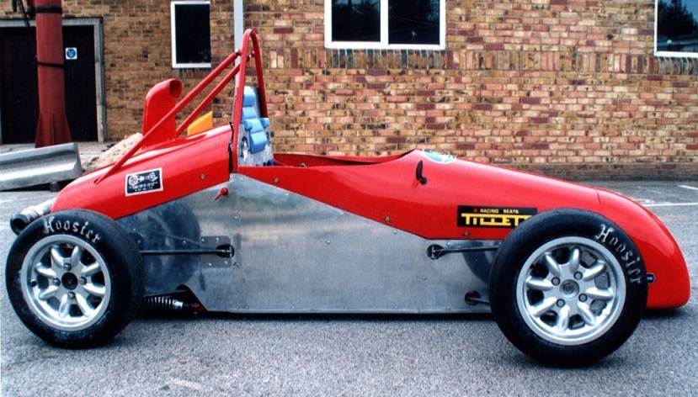
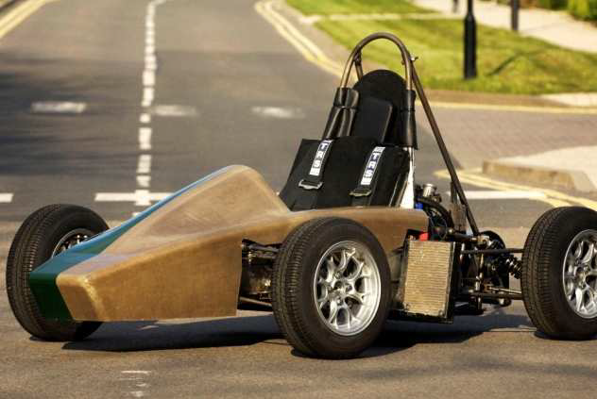
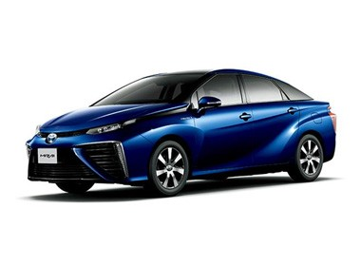
What is the best car for motorsport ?
http://racing.herts.ac.uk/cars/uh1/
http://go.warwick.ac.uk/wrap/51907
Toyota Launches the Mirai
Fuel-Cell Electric Car [ITM Power, 2014]
Lotus Eco-Elise. 2009

Slide 34
Thank you for your
attention

Slide 35
Appendix
From MSc. students’ work.
ZSTU. Zhytomyr, Ukraine
Supervisor Dr. Ruslana Kolodnytska

Slide 36

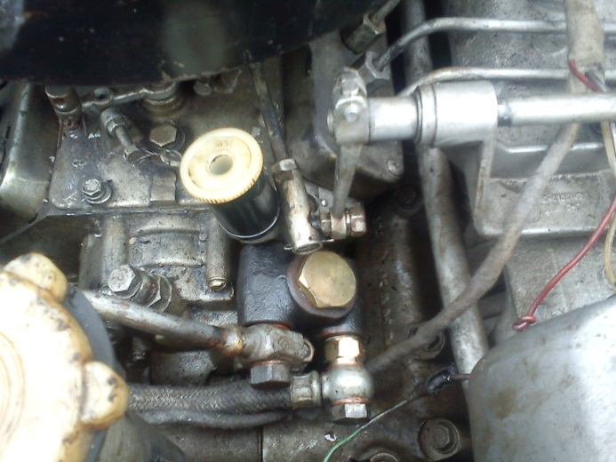
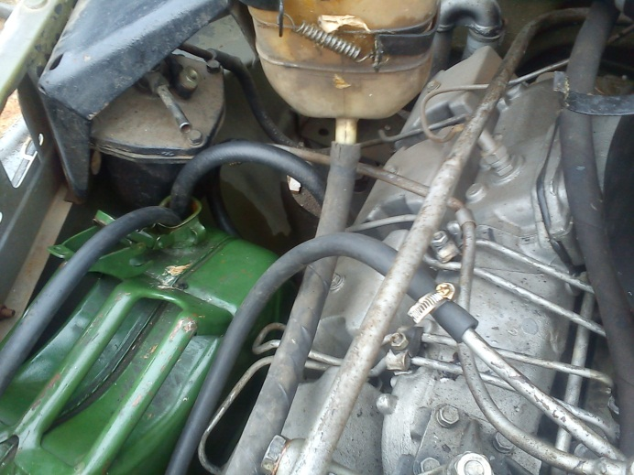
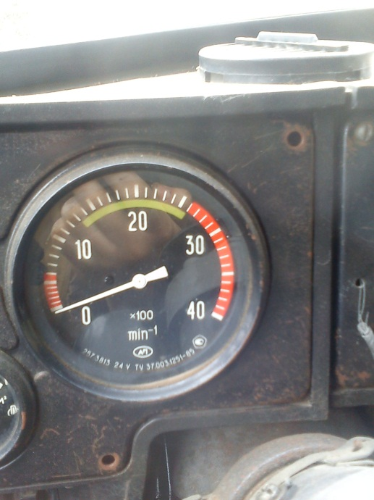
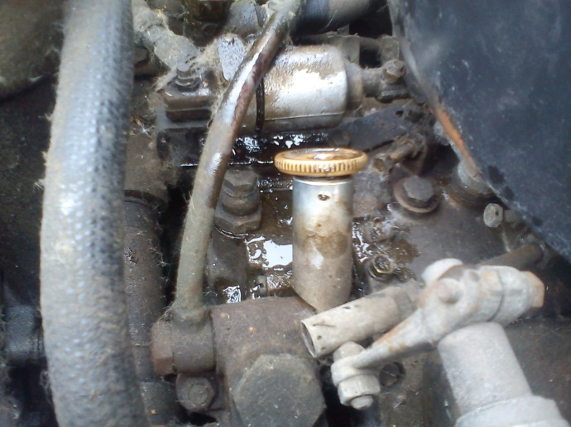
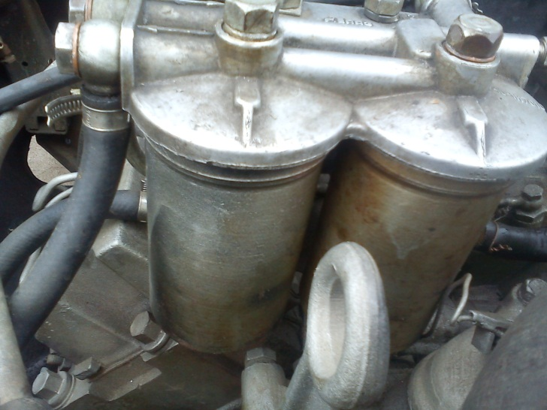
Fuel consumption experiments
ZSTU, Ukraine (MSc. Povarchuk), 2013

Slide 37
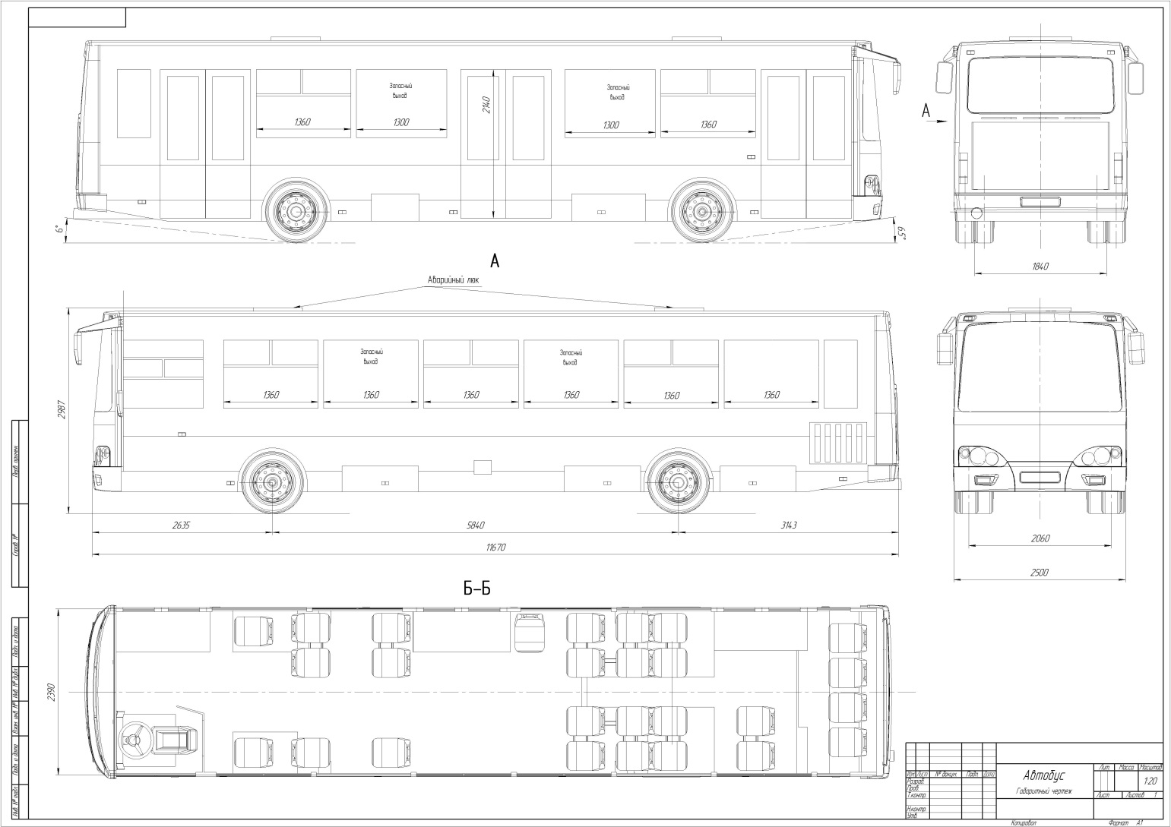
Hemp bus ( MSc. Lyashko),
ZSTU, Ukraine 2006

Slide 38
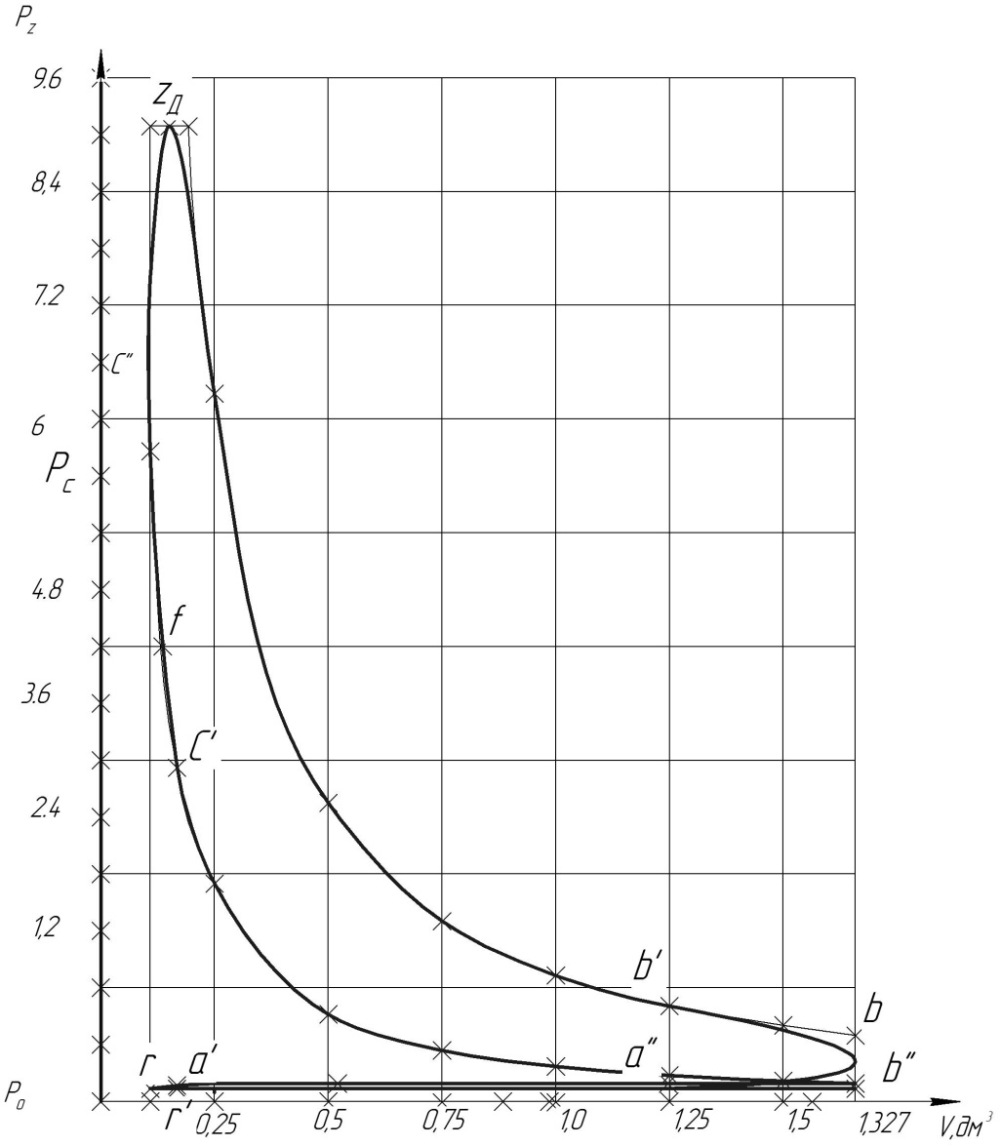
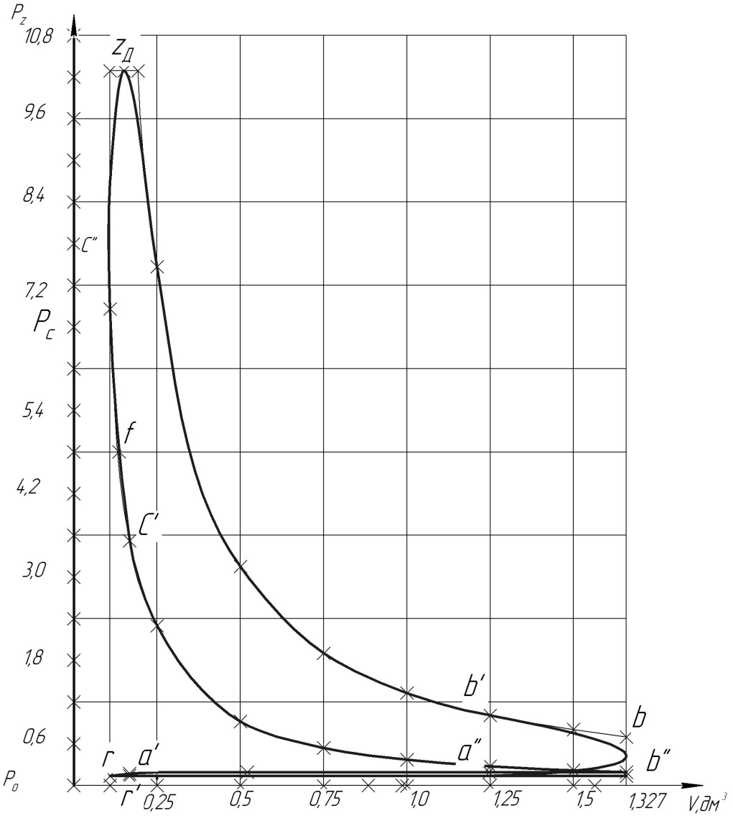
P-V diagram
ZSTU, Ukraine (MSc. Povarchuk), 2013
Diesel
Biodiesel

Slide 39
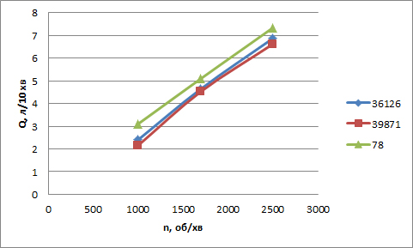
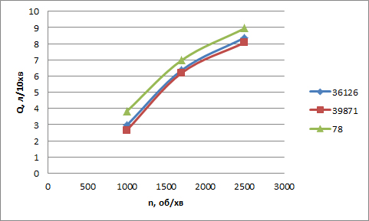
Fuel consumption
ZSTU, Ukraine (MSc. Povarchuk), 2013
Diesel
Biodiesel
Залежність витрати палива від частоти обертання колінчастого валу для двигунів з різним пробігом від початку експлуатації (або після капітального ремонту)
(Ukrainian language)

