Slide 1




Biofuel spray modelling
UKRAINE
UK
Dr. Ruslana Kolodnytska
Ass. Professor of Mechanical Engineering Department
Zhytomyr State Technological University, Ukraine
ERASMUS + /Mobility, May 2017, Coventry , UK
Ruslana Kolodnytsksa ruslanakolod@gmail.com Zhytomyr State Technological University, Ukraine

Slide 2
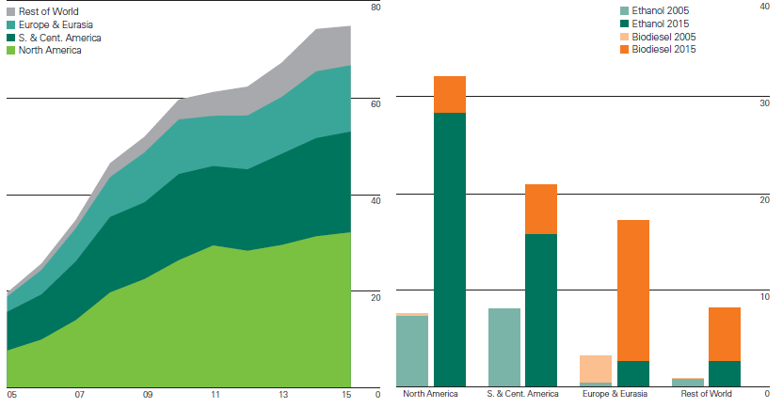
Biofuels (biodiesel, ethanol) production
grew by
0.9%
Thousand tonnes oil equivalent
[BP, 2016]
years
regions

Slide 3
What are the spray parameters of hemp biodiesel?
“To be a hemp biodiesel or not to be ?”
That is the question.
Ukraine is the 4th place in the world for technical hemp production
The LP-model can evaluate the spray penetration of a new type of alternative fuel in just 15 minutes!
ERASMUS +/ Mobility, May 2017, Coventry , UK
Ruslana Kolodnytsksa ruslanakolod@gmail.com Zhytomyr State Technological University, Ukraine

Slide 4
CONTENT
Part I. Fuel spray
1. Spray parameters
2. Fluid parameters
Part II. Spray penetration
3. Correlations for diesel and biodiesel fuels
4. LP-model for biodiesel
5. LP-model for renewable diesel and Biofuel to Liquid (BTL) fuel.
Part III. Droplet distribution
6. Maximum entropy method
ERASMUS + teaching, May 2017, Coventry , UK
Ruslana Kolodnytsksa ruslanakolod@gmail.com Zhytomyr State Technological University, Ukraine

Slide 5
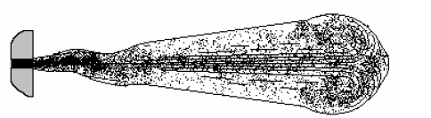
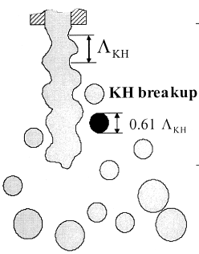
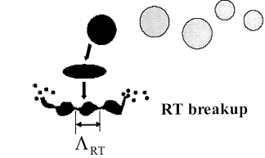
Diesel fuel jet and droplet breakup
Part I. Fuel spray
Fuel jet
Droplet breakup
[Kuleshov, 2006]
[Lee & Park, 2002]
[Lee & Park, 2002]

Slide 6
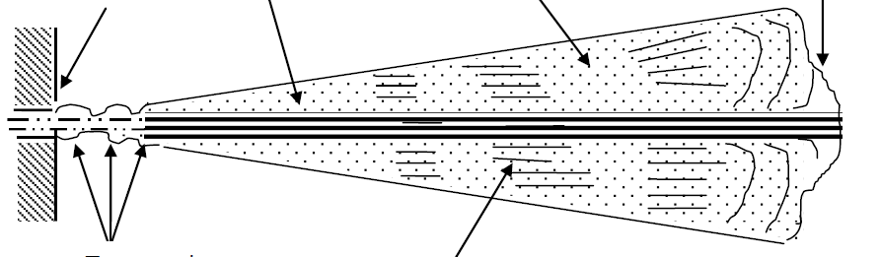
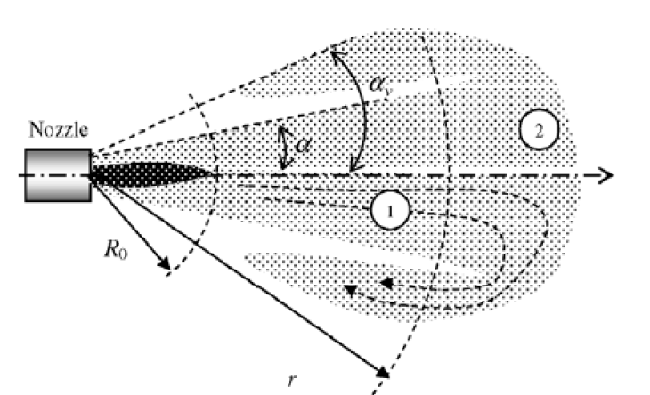
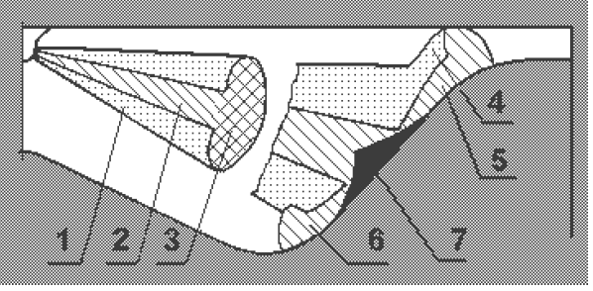
Simple Spray models
Part I. Fuel spray
Lishevsky
Model, Ukraine
Kuleshov model (Diesel RK)
Roisman model, Germany

Slide 7
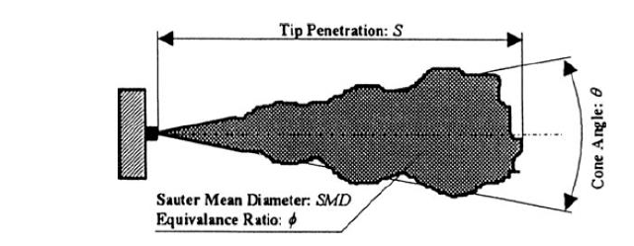
Main Spray parameters
Part I. Fuel spray
1. Spray parameters
Spray penetration
Cone Angle
Sauter Mean Diameter
(SMD)
[Assanis, 2011]
Spray penetration (SP) [Saszin, 2014]:
practical importance ( e.g. optimization of SP in internal combustion engine)
is easily measurable, so can be used for validation of the models
the correct prediction of the SP can indirectly indicate the correctness of complex models of spray formation

Slide 8
Part I. Fuel spray
1. Spray parameters
SMD of Different Biodiesel
(methyl esters of vegetable oils)
[ Kolodnytska R., 2006]

Slide 9
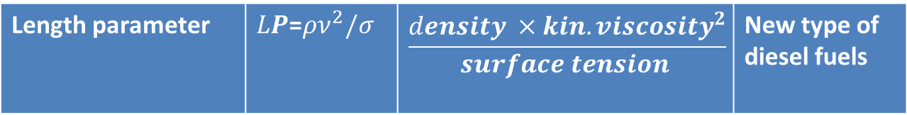
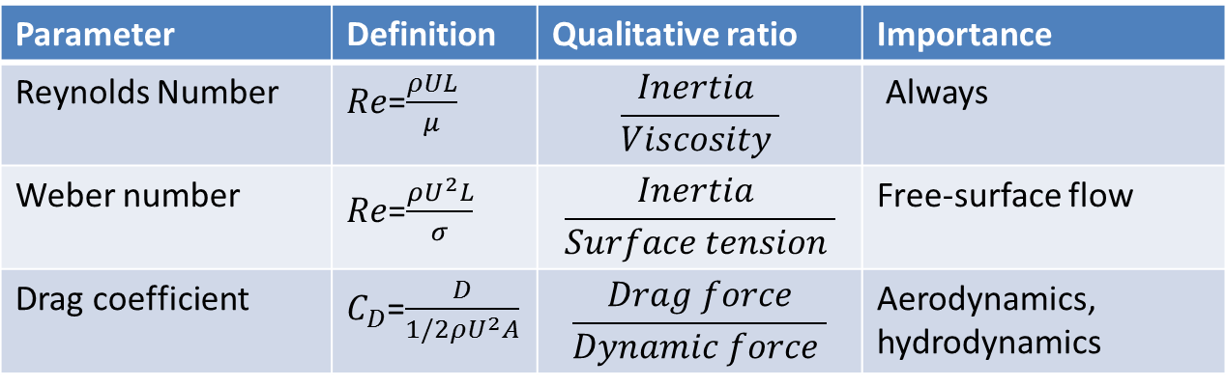
Dimensionless fluid parameters
Part I. Fuel spray
2. Fluid parameters
Parameter | Definition | Qualitative ratio | Importance
Reynolds Number | $Re$=$\frac{ρUL}{μ}$ | $$\frac{Inertia }{Viscosity }$$ | Always
Weber number | $Re$=$\frac{ρU^{2}L}{σ}$ | $$\frac{Inertia }{Surface tension }$$ | Free-surface flow
Drag coefficient | $C_{D}$=$\frac{D}{1/2ρU^{2}A}$ | $$\frac{Drag force}{Dynamic force }$$ | Aerodynamics, hydrodynamics
New length parameter
Parameter | Definition | Qualitative ratio | Importance
Length parameter | $LP$=$ρν^{2}/σ$ | $$\frac{density {×kin. viscosity}^{2}}{surface tension }$$ | New type of diesel fuels

Slide 10

Biodiesel ligament breakup.
Length parameter (LP)
Part I. Fuel spray
Length parameter
for biodiesel spray SMD
[Kolodnytska, 2006]
Length parameter
for hemp biodiesel spray SMD
[Kolodnytska, 2010]
Viscosity
Density
Surface tension
LP
[mm]
Length and time parameters
for liquid jet breakup
[Eggers, 1997]
Primary atomization within first 2.1 mm from the nozzle for diesel (left) and biodiesel (right). Injection pressure is 40 MPa; gas pressure is 0.1 MPa [Crua et al., 2015]

Slide 11
Part II. Spray penetration

Slide 12
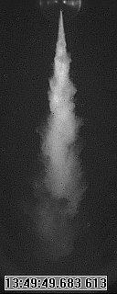
Spray Penetration Modelling
Part II.
Spray Penetration
Sazhin model (2005)
Roizman model (2007)
S
S_{tip}
Lishevsky model
Spray penetration: S_{tip}
[Grabar IG, Kolodnytska RV, 2011]

Slide 13
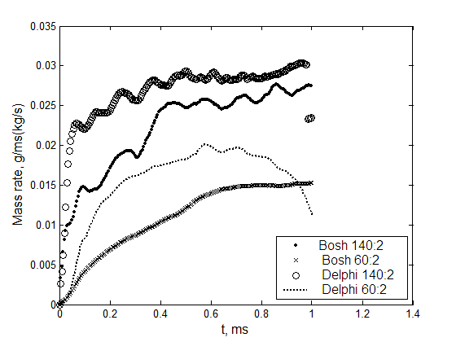
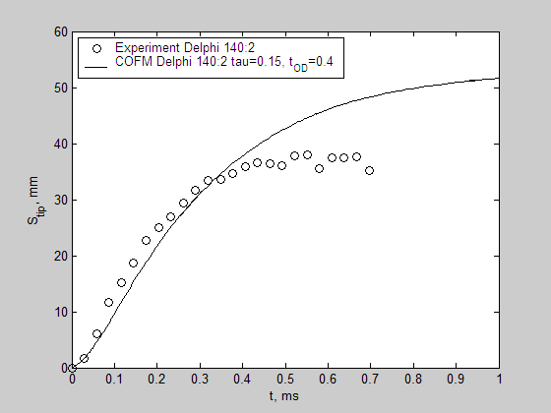
Spray Penetration Modelling,
СOFM – model
Part II.
Spray Penetration
[Kolodnytska RV. et al, International Congress of Propulsion Engineering, 2008]

Slide 14
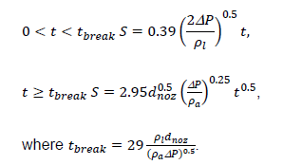

Spray penetration correlations.
Diesel fuels
Part II. Spray
penetration
Hiroyasu and Arai’s equations [Heywood, 1988]
University of Birmingham, UK [Wang Z. et al. , 2016]
Back Pressure | K1 | g | f
under 60 MPa | 0.14785/ 0.1520* | 0.02695/ 0.016* | -0.1047/ -0.034*
120 MPa | 0.7077 | 1.0917 | 0.6294
60 MPa | 0.7620 | 1.0713 | 0.7123
* Low temperature

Slide 15
Physical properties of fuels
Part II. Spray penetration
Case 1.
Physical properties [Kolodnytska, 2010] of biodiesel and diesel fuels, 80°C
Case 2.
Physical properties [Desantes et al, 2009] of biodiesel and diesel fuels
 | HME * | SME | RME | Diesel
Density | 845 | 841 | 841 | 788
Kinematic viscosity | 1.96×10⁻⁶ | 2.01×10⁻⁶ | 2.58×10⁻⁶ | 1.09×10⁻⁶
Surface tension | 27.41×10⁻³ | 27.15×10⁻³ | 27.82×10⁻³ | 24.14×10⁻³
 | Diesel | BDP | BDC
Density (15°C) | 830 | 874.4 | 885.1
Kinematic viscosity (30°C) | 3.36×10⁻⁶ | 5.53×10⁻⁶ | 4.45×10⁻⁶
Surface tension (25°C) | 25.5×10⁻³ | 26.2×10⁻³ | 25.7×10⁻³
HME –hemp oil biodiesel
SME – soy biodiesel
RME rapeseed oil biodiesel
BDP – biodiesel from palm oil
BDC – biodiesel from cooked oil
Case 3.
New alternative to diesel fuels
 | Renewable diesel (HWO) | Biomass to Liquid (BTL)

Slide 16


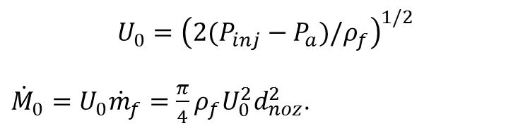

Biodiesel spray penetration
Part II. Spray penetration
$$U_{0}={\left(2(P_{inj}−P_{a})/ρ_{f}\right)}^{1/2}$$
${\dot{M}}_{0}=U_{0}{\dot{m}}_{f}=\frac{π}{4}ρ_{f}U_{0}^{2}d_{noz}^{2}$.
$M_{0}$ is momentum flux
“spray momentum remains constant along the spray travel”
“the spray momentum flax was really similar for all fuels” (B5, B30, RME)
[Deasantes et al., 2009]
It has been found that injected mass of the fuel is influenced
by viscosity (when injection time is short)
by density ( when injection time is longer)
The injected mass was
lower with biodiesel for low injection time
higher when the time became longer
[Desantes et al., 2009] Universitat Politecnica de Valencia

Slide 17
3. LP-model for biodiesel
Part II. Spray penetration

Slide 18

LP-model for spray penetration of biodiesel fuels
Part II. Spray penetration
Spray Penetration is proportional to LP ^{0.1}
LP for biodiesels (Case 1, 80°C)
Nozzle diameter - Injection pressure-
Gas density – LP- injection time [ms]
Fuel | HME | SME | RME | Diesel
Length parameter LP
LP [m] | 1.18×10⁻⁷ | 1.25×10⁻⁷ | 2.01×10⁻⁷ | 0.388×10⁻⁷
LP [micron ] | 11.8 | 12.5 | 20.1 | 3.88
LP for biodiesels (Case 2)
Fuel | Diesel | BDP | BDC
Based on fuel properties:
LP [m] | 3.67×10⁻⁷ | 10.21×10⁻⁷ | 6.81×10⁻⁷
LP [micron ] | 36.7 | 102.1 | 68.1
Viscosity – Density -
Surface tension

Slide 19
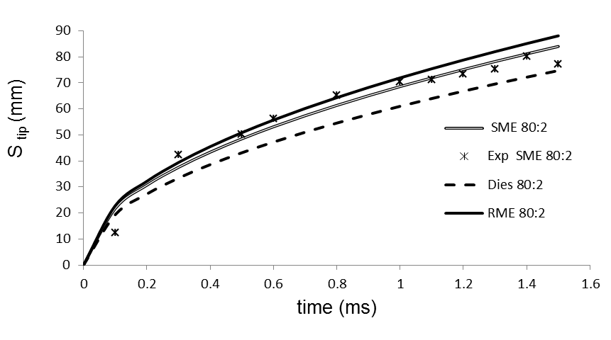
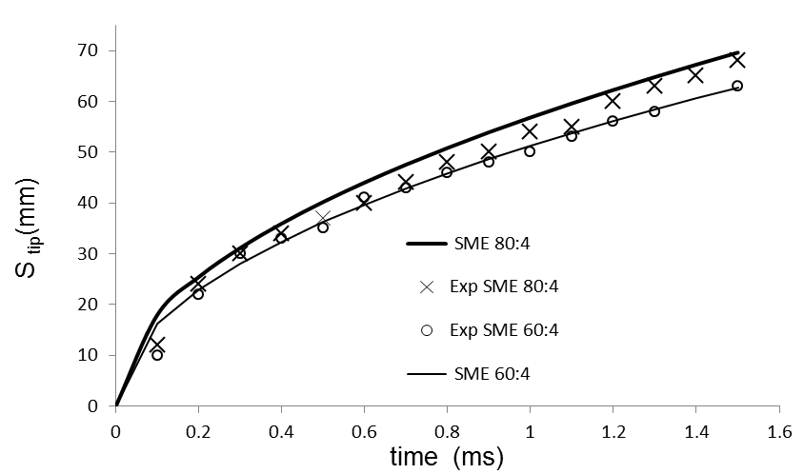
LP-model for biodiesel, 80 C (Case 1)
Part II. Spray penetration
Spray penetration for diesel, RME and soy
biodiesel (SME). Injection pressure is 80 MPa.
Ambient pressure is 2 MPa.
Spray penetration for SME:
injection pressures 60 MPa, 80 MPA
comparing with experimental data.
Ambient pressure is 4 MPa.
ALP= 0.066 when the time t_{inj} is in [ms]
The plots for hemp biodiesel (HME ) are very close
to SME and are not shown in the Figures .

Slide 20
LP- model for biodiesel (Case 2), 1
Part II. Spray penetration
Diesel and biodiesel from cooked oil (BDC).
Gas density is 15 kg/m³; injection pressures are 100 MPa and 200 MPa
Diesel and biodiesels from cooked oil (BDC) and palm oil (BDP). Injection pressure is 200 MPa; gas density is 15 kg/m³

Slide 21
LP- model for spray penetration of biodiesel fuels (Case 2), 2
Part II. Spray penetration
Diesel and biodiesel from cooked oil (BDC).
Gas density is 15 kg/m3 ; injection pressure is 300 MPa
Diesel fuel ( diesel 300:30) and biodiesel from cooked oil (BDC 300:30). Injection pressure is 300 MPa; gas density is 30 kg/m³

Slide 22
LP- model for spray penetration.
The values of the coefficients A_{LP} (Case 2)
Part II. Spray penetration
The values of the coefficients A_{LP} for LP- model
Injection pressure/Gas density | Diesel | BDP | BDC
100 MPa/15.5 kg m⁻³ | 0.3 | 0.3 | 0.3
200 MPa/15.5 kg m⁻³ | 0.27 | 0.27 | 0.27
300 MPa/15.5 kg m⁻³ | 0.25 | 0.25 | 0.27
300 MPa/30 kg m⁻³ | 0.23 | 0.21 | 0.23
The values of the LP ^{0.1}
The plots of BDP spray tip penetration S_{tip} versus time of injection predicted by LP –model for biodiesel from palm oil (BDP 300:30). Experimental data of S_{tip} for BDP (exp BDP 300:30) taken from [Figure 4, Wang, X., et al , 2010]. Injection pressure is 300 MPa; gas density is 30 kg/m³(300:30)
Fuel | Diesel | BDP | BDC
LP ^{0.1} | 0.23 | 0.25 | 0.24

Slide 23
LP- model for different alternative fuels. (Case 3)
Part II. Spray penetration
Comparison of physical properties [Dragomirov et. al, 2013] and LP of biodiesel and GTL
Comparison of physical properties [Millo et al., 2015] and LP of biodiesel blends, HVO blend and diesel fuels
Fuel/ Properties | Diesel | RME 30 | HVO 30
Density (15°C) | 837.5 | 853 | 812.2
Kinematic viscosity (40°C) | 2.681×10⁻⁶ | 3.183×10⁻⁶ | 2.545×10⁻⁶
Surface tension (20°C) | 30.4×10⁻³ | 31.3×10⁻³ | 28.0×10⁻³
LP [m] | 1.98×10⁻⁷ | 2.76×10⁻⁷ | 1.88×10⁻⁷
LP ^{0.1} | 0.214 | 0.221 | 0.213
Fuel/ Properties | RME | GTL
Density (15°C) | 883 | 779.4
Kinematic viscosity (40°C) | 4.5×10⁻⁶ | 2.74×10⁻⁶
Surface tension (25°C) | 31.0×10⁻³ | 26.04×10⁻³
LP [m] | 5.77×10⁻⁷ | 2.25×10⁻⁷
LP ^{0.1} | 0.24 | 0.22
ERASMUS + teaching, May 2017, Coventry , UK
Ruslana Kolodnytsksa ruslanakolod@gmail.com Zhytomyr State Technological University, Ukraine

Slide 24
Evaluation of spray penetration for different alternative fuels using LP
Part II. Spray penetration
Physical properties [Desantes et. al, 2009 ] and LP of biodiesel (RME) and RME blends
(CASE 3)
Physical properties [Crua et. al, 2015 ] and LP of diesel, biodiesel (RME) and kerosene.
(CASE 3)
 | B5 | B30 | RME
Density (15°C) | 831 | 851 | 879
Kinematic viscosity (40°C) | 2.38 ×10⁻⁶ | 3.12×10⁻⁶ | 4.47×10⁻⁶
Surface tension (20°C) | 23.0×10⁻³ | 25.00×10⁻³ | 28×10⁻³
LP [m] | 2.05×10⁻⁷ | 3.31×10⁻⁷ | 6.27×10⁻⁷
LP ^{0.1} | 0.21 | 0.22 | 0.24
 | RME | Diesel | Kerosene
Density | 883 | 837 | 803
Kinematic viscosity | 4.4×10⁻⁶ | 3.3×10⁻⁶ | 1.2×10⁻⁶
Surface tension | 33.2×10⁻³ | 29.8×10⁻³ | 27.7×10⁻³
LP [m] | 5.15×10⁻⁷ | 3.06×10⁻⁷ | 0.417×10⁻⁷
LP ^{0.1} | 0.24 | 0.22 | 0.18
LP ^{0.1} (CASE 3 )
Fuel | B5 | B30 | RME
RME | Diesel | Kerosene
LP ^{0.1} | 0.21 | 0.22 | 0.24
0.24 | 0.22 | 0.18
Fuel | Diesel | RME 30 | HVO 30
RME | GTL
LP ^{0.1} | 0.214 | 0.221 | 0.213
0.24 | 0.22

Slide 25
Part III. Droplet distribution

Slide 26
Droplet diameter distribution diesel (line -) biodiesel (-----)
Part III. Droplet Distribution
10 mm from nozzle 15 mm from nozzle
[Experiments: C. Crua, Brighton and BP, 2007]

Slide 27
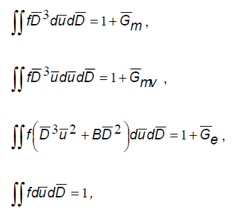







Maximum Entropy Method, 1
Part III. Droplet Distribution
Weber number
Mass mean droplet diameter
D30
Sources for mass, momentum , energy

Slide 28


Maximum Entropy Method,2
Part III. Droplet Distribution
Classic dependence between the system entropy and the probability of microstates
The probability density function:
The maximal value of the entropy was
found by the Lagrangian multiplier method

Slide 29
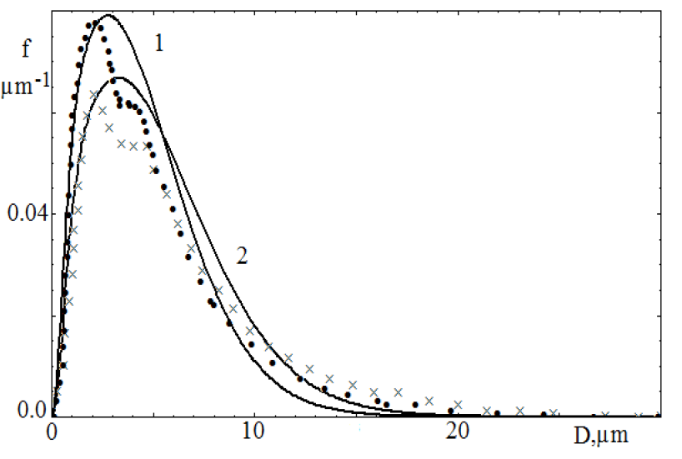

Application of MA method to biodiesel spray
Part III. Droplet Distribution
Diesel
Weber number
We = 2500
Biodiesel
Probability density function at distance from the nozzle of 15 mm.
Injection pressure 100 MPa, ambient atmospheric pressure,
Delphi nozzle ( 0.135 microns)

Slide 30
Conclusions
Simple model (LP-model) for biodiesel spray penetration under conditions relevant to internal combustion engines was proposed.
A parameter referred to as “length parameter” (LP) is introduced to define the fuel properties.
Spray penetrations for Biodiesels from Hemp oil, Rapeseed oil, Soybean oil, Palm oil and Cooked oil comparing with those of diesel fuel were calculated under different injection conditions and ambient pressures.
The model gives a good agreement with experimental data that available for biodiesel and diesel fuels.
Length parameters of new types of alternative diesel fuels: Hydrogenated Vegetable Oil (HVO) and Biomass to Liquid (BTL) were evaluated.
ERASMUS + teaching, May 2017, Coventry , UK
Ruslana Kolodnytsksa ruslanakolod@gmail.com Zhytomyr State Technological University, Ukraine

Slide 31
Literature
Sazhin S.S., Al Qubeissi M., Kolodnytska R., Elwardany A.E., Nasiri R., Heikal M.R. Modelling of biodisel fuel droplet heating and evaporation. Fuel 115 (2014), 559-572.
Sazhin S. Droplets and Sprays. Springer. 2014
Grabar IG, Kolodnytska RV, Semenov VG. Biofuels for diesel engine. 2011(In Ukrainian)
Kolodnytska R.V. Analytical study for atomization of hemp oil biodiesel. //Visnik SNU im. Volodimira Dalya.- 2010- №6 (148).- P.41-46 (In Ukrainian).
Kolodnytska R. LP-model for Biodiesel Spray Penetration. ILASS – Europe 2016, 27th Annual Conference on Liquid Atomization and Spray Systems, 4-7 September 2016, Brighton, UK.

Slide 32
Hemp biodiesel
Or hemp BTL?
Thank you !
ERASMUS + teaching, May 2017, Coventry , UK
Ruslana Kolodnytsksa ruslanakolod@gmail.com Zhytomyr State Technological University, Ukraine
The next lecture is “Hemp car”

Slide 33
What is the future alternative diesel fuels?
“Renewable diesel easily replaces petroleum diesel with no equipment modifications and no expensive infrastructure changes”
http://www.aiche.org/chenected/2016/02/renewable-diesel-big-winner-after-paris-climate-accord-and-vws-diesel-gate
ERASMUS + teaching, May 2017, Coventry , UK
Ruslana Kolodnytsksa ruslanakolod@gmail.com Zhytomyr State Technological University, Ukraine

