Slide 1




BIODIESEL FUEL: transport and thermodynamic properties
ERASMUS +/ MOBILITY, Coventry University, UK, May 2017.
ILASS 25th European conference
Chain, Crete
Dr. Ruslana Kolodnytska
Department of Mechanical Engineering,
Zhytomyr State Technological University, Ukraine
UKRAINE
UK
Zhytomyr State
Technological University

Slide 2
Biofuels (biodiesel and ethanol) production, 2010
grew by
13.8%
Thousand tonnes oil equivalent
[BP, 2010]
regions
years

Slide 3
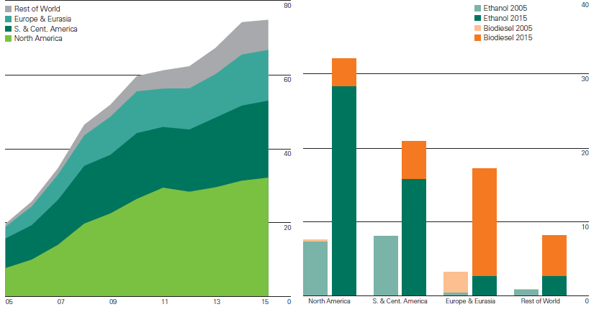
Biodiesel and ethanol production, 2016
grew by
0.9%
Thousand tonnes oil equivalent
[BP, 2016]
years
regions

Slide 4
Lecture content
I Biodiesel Fuels
II Biodiesel: liquid properties of components
Density
Viscosity, diffusivity,
Heat capacity,
Latent heat of evaporation
III Biodiesel fuel: vapour properties
Saturated vapour pressure
Vapour heat capacity
Application
Heat and Evaporation model
Spray modelling
Conclusions
Work in progress

Slide 5
Learning outcomes
To understand the fundamental of biodiesel chemistry
To discuss liquid and vapour properties of biodiesel components
To understand the application of biodiesel properties for biodiesel spray and evaporation

Slide 6
Part I. Biodiesel Fuels
Biodiesel fuels are methyl or ethyl
esters of vegetable oils/fat
You can make your own biodiesel at home
Biodiesel =vegetable oil/fat +alcohol +catalyst
NaOH or KOH

Slide 7
Biodiesel across the world
First generation biodiesel
RME (Europe)
SME (USA)
PME (Africa)
Rapeseed Methyl Ester
Soybean Methyl Ester
Palm Methyl Ester
Second generation biodiesel:
uneatable and waste (in progress)
HME1 (Ukraine)
HME2 (Germany)
Hemp Methyl Esters
from hempseed oil

Slide 8

Properties of rapeseed oil, biodiesel and diesel fuel
RME – rapeseed methyl ester
Q1. How to reduce the viscosity of vegetable oil?
Smart bus, (Abingdon, Oxfordshire, UK)

Slide 9
How to reduce the viscosity of vegetable oil/fuel ?
Heating
Transesterification process
Fuel blends
Fuel Additives
Electromagnetic field

Slide 10
Molar fractions of biodiesel components
20.67%
Hemp biodiesel, Ukraine
(Methyl ester of
Hempseed oil)
C22:0 (2.5%)
C24:0 (2.3%)
C24:1 (1.5%)
11.88%
C18:3
C18:1
C18:2
(56.71 %)
7.2%
24.0%
Soy biodiesel
(methyl ester of
soybean oil)
C18:2
(52.8%)
C18:1
Part I.
Biodiesel Fuels

Slide 11
Chemical structures of methyl stearate
(C18:0), and methyl oleate (C18:1)
Part I.
Biodiesel
Fuels
Oxygen atoms
Double bond

Slide 12
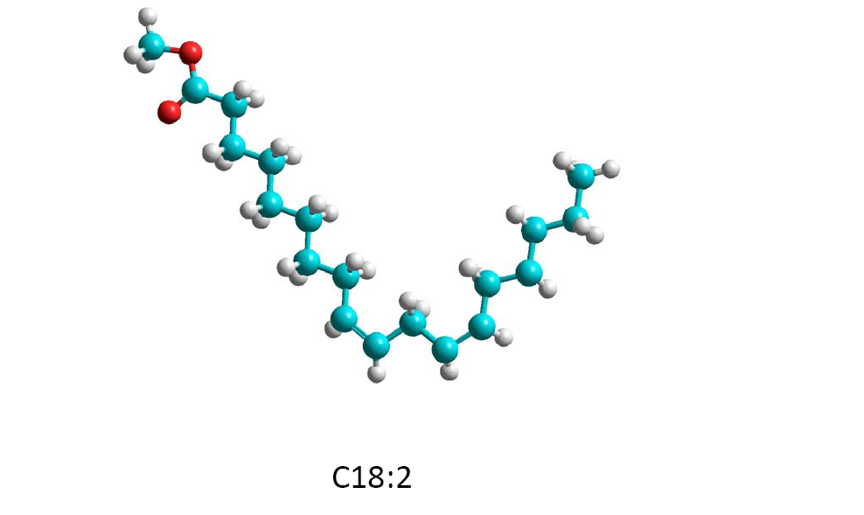
Chemical structures of
Methyl linoleate (C18:2)
Part I.
Biodiesel
Fuels
Carbon atoms
DB: number of
double bonds
Hydrogen atoms
Double bond
Double bond

Slide 13
Biodiesel (methyl ester) component
Ukraine
Germany
Components | Chem. form. | Palm ME | Hemp1 ME | Hemp2 ME | Rapeseed ME | Soy ME
С12:0 М | C₁₃H₂₆O₂ | 0.0026 | 0 | 0 | 0 | 0
С14:0 М | C₁₅H₃₀O₂ | 0.0129 | 0 | 0 | 0 | 0
С16:0 М | C₁₇H₃₄O₂ | 0.4513 | 0.0662 | 0.0651 | 0.0495 | 0.109
С17:0 М | C₁₈H₃₆O₂ | 0 | 0.0021 | 0 | 0 | 0
С18:0 М | C₁₉H₃₈O₂ | 0.0447 | 0.0206 | 0.0246 | 0.0167 | 0.044
C20:0 М | C₂₁H₄₂O₂ | 0.0035 | 0.0045 | 0.009 | 0.0056 | 0.004
C22:0 М | C₂₃H₄₆O₂ | 0 | 0.0025 | 0 | 0 | 0
С24:0 М | C₂₅H₅₀O₂ | 0 | 0.0023 | 0 | 0 | 0
С16:1 М | C₁₇H₃₂O₂ | 0.0021 | 0.0033 | 0 | 0 | 0
С18:1 М | C₁₉H₃₆0₂ | 0.3839 | 0.1188 | 0.1188 | 0.2671 | 0.24
C20:1 М | C₂₁H₄₀O₂ | 0.0017 | 0.0027 | 0.009 | 0 | 0
C22:1 М | C₂₃H₄₄O₂ | 0 | 0.0017 | 0 | 0.2204 | 0.003
С24:1 М | C₂₅H₄₈O₂ | 0 | 0.0015 | 0 | 0.0077 | 0
С18:2 М | C₁₉H₃₄O₂ | 0.0916 | 0.5671 | 0.5482 | 0.2484 | 0.528
С18:3 М | C₁₉H₃₂O₂ | 0.0019 | 0.2067 | 0.2007 | 0.0973 | 0.072
Other |  | 0.0038 | - | 0.0246 | 0.0873 | -

Slide 14
Part II. Biodiesel fuel: liquid properties
Density
Viscosity, diffusivity
Heat capacity
Latent heat of evaporation

Slide 15
Liquid density of
biodiesel component
Part II.
Biodiesel fuel:
liquid properties
Density modelling, (Lapuerta, 2010 )
Parameters
nacid
DB
DB is the number of double bonds
is the number of carbons in fatty acids

Slide 16
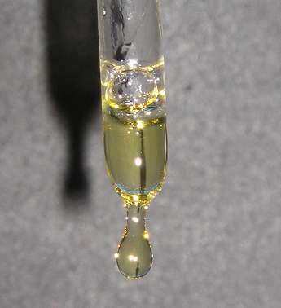
Liquid Viscosity
Part II.
Biodiesel fuel:
liquid properties
Necking
(liquid bridge)

Slide 17

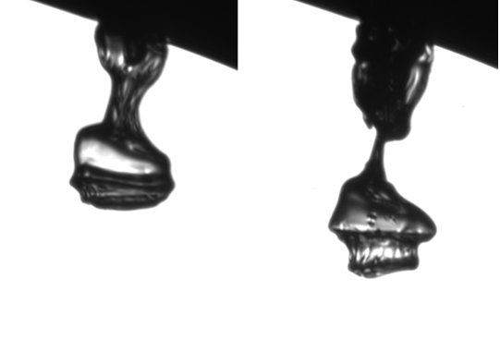
Diesel and Biodiesel jet
Part II.
Biodiesel fuel:
liquid properties
The initial jet formation at 100 MPa
into atmospheric pressure
Diesel fuel
Biodiesel
Biodiesel
The initial jet formation at 40 MPA
into atmospheric pressure
[T.T. Shoba and C. Crua et al, ILASS 2011]
[C. Crua et al, ICLASS 2012]

Slide 18
Part II.
Biodiesel fuel:
liquid properties
Liquid Viscosity of
biodiesel components
Parameters
nacid
DB
Viscosity of saturated molecular
M
2. Viscosity modelling (Orrick and Erbar method)
M is molecular weight
is the number of carbons in fatty acids
DB is the number of double bonds

Slide 19
Boiling and critical points of biodiesel components
Part II.
Biodiesel fuel:
liquid properties
Parameters
Boiling point
M
M is molecular weight
Critical point
[Hallet & Clark, 2006]

Slide 20
Latent heat of evaporation
Part II.
Biodiesel fuel:
liquid properties
Parameters
M
[Hallet & Clark, 2006]
M is molecular weight
Latent heat of evaporation for saturated methyl esters (T=298.15 K)

Slide 21
Liquid heat capacity
Part II.
Biodiesel fuel:
liquid properties
Liquid heat capacity
T is temperature
[Hallet & Clark, 2006]

Slide 22
Liquid thermal conductivity
Part II.
Biodiesel fuel:
liquid properties
Liquid thermal conductivity (Latini method)
A*=0.0713
Boiling point:
Critical point:

Slide 23
Liquid diffusivity
Part II.
Biodiesel fuel:
liquid properties
Wilke-Chang approximation:
The liquid diffusivity for PME, SME, and HME2

Slide 24
Alternative approximation for liquid diffusivity
Part II.
Biodiesel fuel:
liquid properties
Liquid diffusivity [Hayduk and Minhas]
- Molar volume
- Lennard-Jones length
New approximation for saturated molecules (DB=0, T=293.15K )
nacid
=2 for saturated methyl esters ( C12:0 M – C24:0 M)

Slide 25
Part III. Biodiesel fuel: vapour properties
Saturated vapour pressure
Vapour heat capacity

Slide 26
Saturated vapour pressure of biodiesel component
Part III
Biodiesel
vapour properties
Saturated vapour pressure
Parameters
.
nacid
DB
[Diaz, Schoeggl, 2012]

Slide 27
Vapour heat capacity
Part III Biodiesel
vapour properties
Parameters
New approximation:
M
vapour heat capacities of components
nacid
.
DB

Slide 28
Applications
Biodiesel Heat and Evaporation model
Biodiesel Spray modelling
Palm Methyl Ester (PME);
Hemp Methyl Esters from hempseed oil (Ukraine ) (HME1)
Hemp Methyl Esters (European Union) (HME2);
Rapeseed oil Methyl Ester (RME), produced from rapeseed oil in the Ukraine;
Soybean oil Methyl Ester (SME), produced from soybean oil.

Slide 29
Modelling of Biodiesel properties from properties of components
Application 1.
Spray
Liquid
heat
capacity
thermal
conductivity
density
viscosity
diffusivity
latent heat of
evaporation
vapour
vapour
pressure
vapour
diffusion
coefficient
vapour heat
capacity
Biodiesel
components
C12:0 M
C24:0 M
C18:1 M
C18:2 M
C18:3 M
…..
Other
Component property = f (T, c_acid)
Mixture rule
Biodiesel property
Property of air (gas)

Slide 30

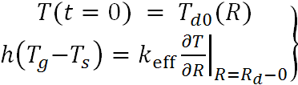


Heat and evaporation models
Application 1.
Spray
Transient heat conduction equation:
Input parameters
fuel temperature= 375 K
droplet radius= 12.66 µm
gas pressure= 30 bar
gas temperature=880 K
The droplet relative velocity= 10 m/s
Initial and boundary conditions
(heat transfer)
Species mass transfer equation:
Initial and boundary conditions
(evaporation):
model takes into account temperature gradient and recirculation
inside droplets and species diffusion within them.

Slide 31
Evaporation model
Application 2.
Evaporation
Droplet evaporation rate
Assumption: the mixture of vapour species is a separate gas
(similar: mixture of nitrogen, oxygen an carbon dioxide is air)
Biodiesel vapour diffusion coefficients:
p is ambient pressure (bars)

Slide 32
The plots of SME and HME1 droplet surface temperatures (Ts) and radii (Rd)
Application 2
Evaporation
Evaporation time for Hemp Methyl Esters is very close to that of Soybean oil Methyl Esters

Slide 33
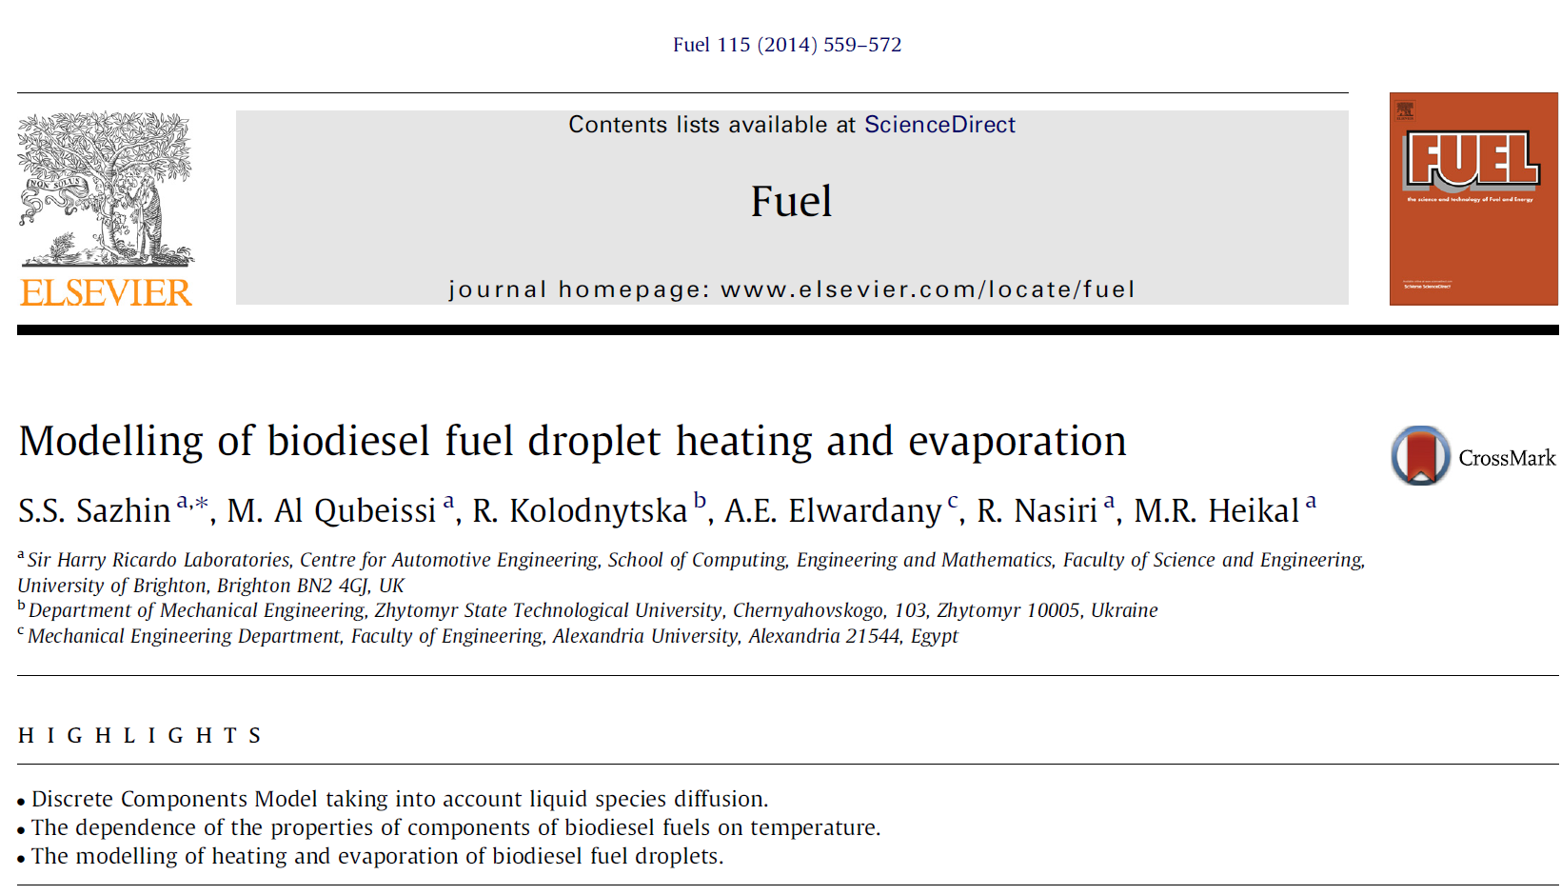
Joint publication

Slide 34
Application 1.
Spray
Sauter Mean Diameter (SMD)
for Biodiesel Spray
NEW MODEL
Sauter mean diameter:
SMD= 0.001 l_{ν} ^{0.29} (New model)
Hemp
Biodiesel
SMD=23.55 µm
Soy
Biodiesel
SMD=23.87 µm
Diesel
SMD=18.3 µm
l_{ν} = μ_{f} /(σρ_{f})
Length parameter based on fuel properties
Dynamic viscosity
Density
Input parameter for
evaporation modelling
droplet radius= 12.66 µm
Surface tension

Slide 35
Application 1.
Spray
Sauter Mean Diameter (SMD)
for Biodiesel Spray
Sauter mean diameter:
SMD= 3.08ν_{f} ^{0.385}(σρ_{f})^{0.737}ρ_{g}^{0.06} ΔP^{-0.54} (Elcotb model)
Gas Density
ΔP is the pressure difference
Biodiesel
kinematic viscosity
Biodiesel Density
Surface tension

Slide 36
Surface tension modelling (biodiesel)
1. The surface tension of components (molecules)
[P] - Parachor (temperature independent parameters)
To calculate surface tension we need to know
Liquid density
Vapour density
Molecular mass
2. Surface tension of biodiesel (mixture of components)

Slide 37
Application 1.
Spray
Surface tension of Biodiesel (necking and pedant droplet measurement)
Surface tension modelling
H - is the space droplet coefficient
Hempseed oil: Ukraine

Slide 38
Conclusions
A detailed comparative analysis of transport and thermodynamic properties of biodiesel fuels and components of these fuels (methyl esters) are presented.
The analysis has been focused on five types of biodiesel fuels: Palm Methyl Ester (PME); Hemp Methyl Esters, produced from hempseed oil in the Ukraine (HME1) and European Union (HME2); Rapeseed oil Methyl Ester (RME), produced from rapeseed oil in the Ukraine; and Soybean oil Methyl Ester (SME), produced from soybean oil.
Up to 16 components of these fuels are considered. The results are applied to the analysis of biodiesel Spray and fuel droplet heating and evaporation in Diesel engine-like conditions
Our results show that the evaporation time for Hemp Methyl Esters is very close to that of Soybean oil Methyl Esters.

Slide 39
Work in Progress
Application 2
Evaporation
Modeling of hempseed Biodiesel Properties (surface tension)
Vapour density

Slide 40
Vapour Density
Density for saturated n-octane
vapour as a function of
the temperature
[Nikolay I. Kolev. Multiphase Flow Dynamics 3. Springer,2007]
Q2:
Any idea how to find the vapour density of biodiesel ?

Slide 41
Publications
Sazhin, S.S., Al Qubeissi, M., Kolodnytska, R., Elwardany, A.E., Nasiri, R. and Heikal, M.R. (2013) Modelling of biodiesel fuel droplet heating and evaporation. Fuel 115 (2014) 559-572.
Al Qubeissi, M., Kolodnytska, R., and Sazhin, S.S. (2013) Biodiesel Fuel Droplets: Modelling of Heating and Evaporation Processes. Proceedings of Ilass-Europe 25th, Chania, Greece.
Kolodnytska, R., Al Qubeissi, M., Sazhin, S.S. (2013) Biodiesel fuel droplets: transport and thermodynamic properties. Proceedings of the ILASS – Europe 2013, 25th European Conference on Liquid Atomization and Spray Systems, Chania, Greece
I.G. Grabar, R.V. Kolodnytska, V. G. Semenov. Biofuels Based on Oil for Diesel Engines. (ZDTU, Zhytomyr, 2011) (In Ukrainian).
R.V. Kolodnytska, Analytical study for atomization of hemp oil biodiesel. Visnik Shydno-Ukrainskogo Natyonalnogo Universitetu imeni Volodymira Dalya 6 (148), 41-46 (2010) (In Ukrainian).

Slide 42
Acknowledgements
I am grateful for ERASMUS + (EU) and to the Ministry of Education of the Ukraine for their financial support

Slide 43
Hemp biodiesel
Or hemp BTL?
Thank you !
Any Questions?
ERASMUS + /mobility, May 2017, Coventry , UK
Ruslana Kolodnytska ruslanakolod@gmail.com Zhytomyr State Technological University, Ukraine

Slide 44
New Fuel Parameters
New parameters
Length Time
ρ_{f} – fuel density , σ – fuel surface tension, μ _{f} – fuel dynamic viscosity
l_{ν} =
μ_{f} ²/(σρ_{f})
t_{ν}=
μ_{f} /(σ²ρ_{f} )

Slide 45
Asymptotic of viscous breakup
The dimensionless coordinates (Eggers and Villermaux, 2008) :
l_{ν} =
μ_{f} ²/(σρ_{f})
t_{ν}=
μ_{f} /(σ²ρ_{f} )
(Eggers and Villermaux, 2008)
A similarity equation for the scaling function
and

Slide 46
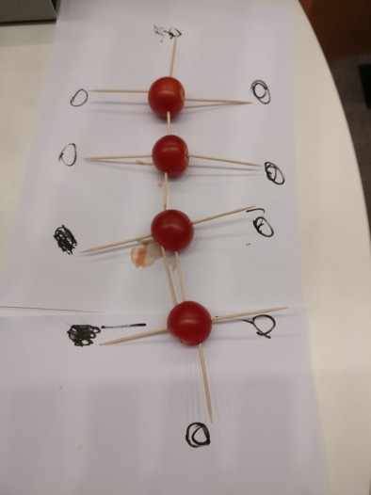
Diesel engine. Alternative fuels
Q1. Are you using the alternative fuels for own car ?
The fossil fuels are not good for your health and environment
Q2. Could you change your mind if alternative fuels were cheaper and better for your car than fossil fuels?
Fuel chemistry
Biodiesel Fuels (first generation)
Rapeseed oil (RME), Soybean oil (SME), Palm oil (PME)
☹
Second generation of biodiesel:
Algae, biodiesel from waste (hemp)
We are hungry !

