Slide 1
Corpus annotation
https://www.english-corpora.org/

Slide 2
Outline
Corpus annotation
Standards for corpus annotation
The encoding of annotations
Evaluation of annotation
EEBO Corpus

Slide 3
Corpus annotation
the practice of adding interpretative linguistic information to a corpus
the addition of tags - part-of-speech tagging (POS tagging or PoS tagging or POST), also called grammatical tagging is the process of marking up a word in a text (corpus) as corresponding to a particular part of speech, based on both its definition and its context.
Present
present_NN1 (singular common noun) present_VVB (base form of a lexical verb) present_JJ (general adjective)

Slide 4
other types of annotation
phonetic annotation
semantic annotation
the noun cricket
pragmatic annotation: ok
discourse annotation
the horses in: I'll saddle the horses and bring them round
stylistic annotation
lexical annotation
lying has the lemma LIE.

Slide 5
Why annotate?
Manual examination of a corpus
Automatic analysis of a corpus
Re-usability of annotations
Multi-functionality

Slide 6
Standards for corpus annotation
Annotations should be separable
Detailed and explicit documentation should be provided
The annotation practices should be linguistically consensual
Annotation practices should respect emergent de facto standards
EAGLES

Slide 7
The encoding of annotations
the actual symbolic representations used
Why do we need an annotation manual?
Geoffrey Sampson (1995) - explained in detail the parsing scheme of the SUSANNE corpus
(a) a list of annotation devices
(b) a specification of annotation practices
NN1 singular common noun (e.g. book, girl) NN2 plural common noun (e.g. books, girls) NP1 singular proper noun (e.g. Susan, Cairo)

Slide 8
A specification of annotation practices
segmentation: assignment of POS tags assumes a prior segmentation of the corpus into words. This may involve 'grey areas' such as how to deal with hyphenated words, acronyms, enclitic forms such as the n't of don't.
embedding: in parsing, some units, such as words and phrases, may be included in other units, such as clauses and sentences; certain embeddings, however, may be disallowed. A grammar of the parsing scheme has to be supplied. Even POS tagging has to involve some embedding when we come to segment examples such as the New York-Los Angeles flight.
the rules or guidelines for assigning particular annotation devices to particular stretches of text.

Slide 9
Evaluation of annotation
the linguistic realism of the categories
Accuracy refers to the percentage of words (i.e. word tokens) in a corpus which are correctly tagged
Recall is the extent to which all correct annotations are found in the output of the tagger. Precision is the extent to which incorrect annotations are rejected from the output.
tagging is often followed by a post-editing stage
inter-rater agreement
A more sophisticated measure of inter-rater consistency is the so-called kappa coefficient (K).

Slide 10
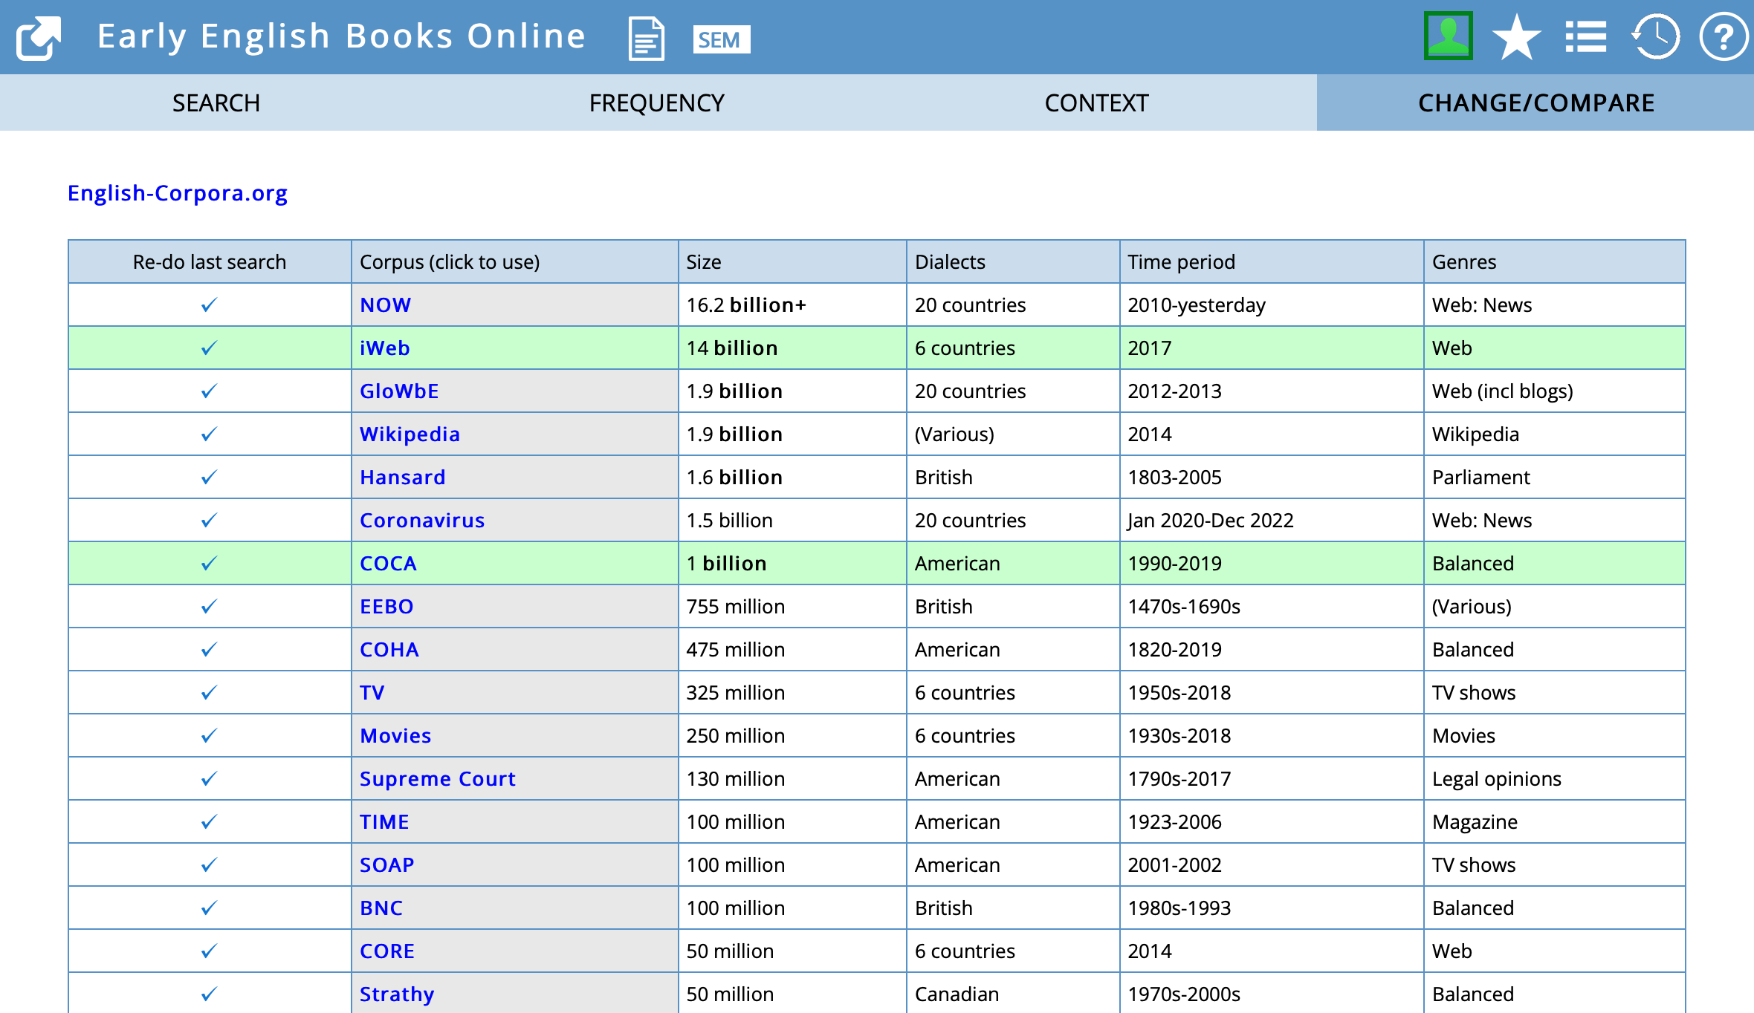

Slide 11
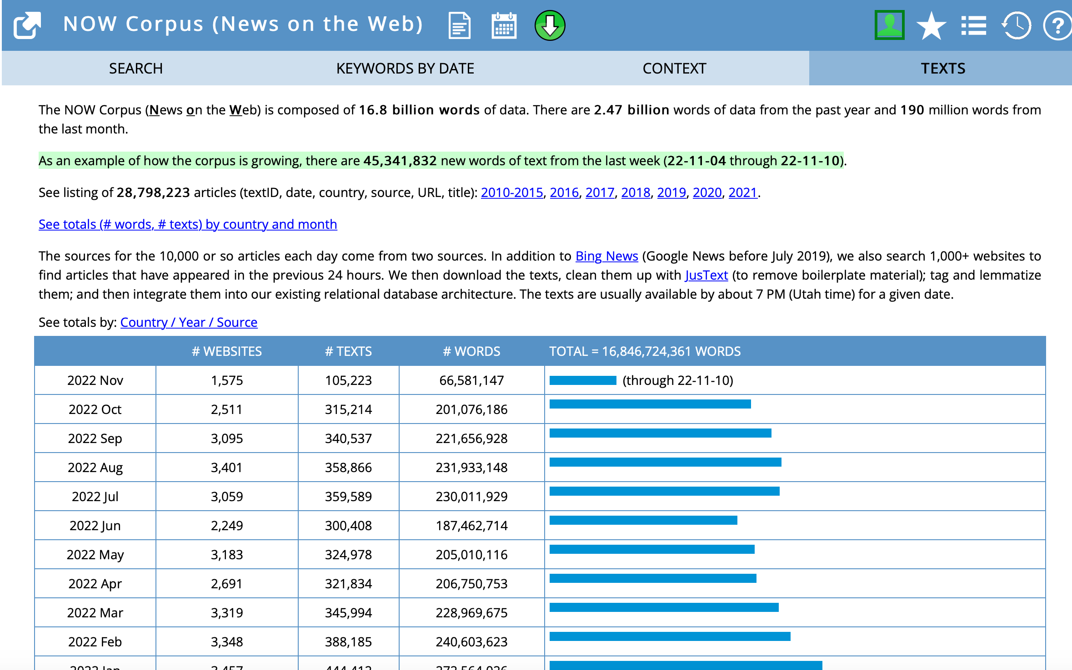

Slide 12
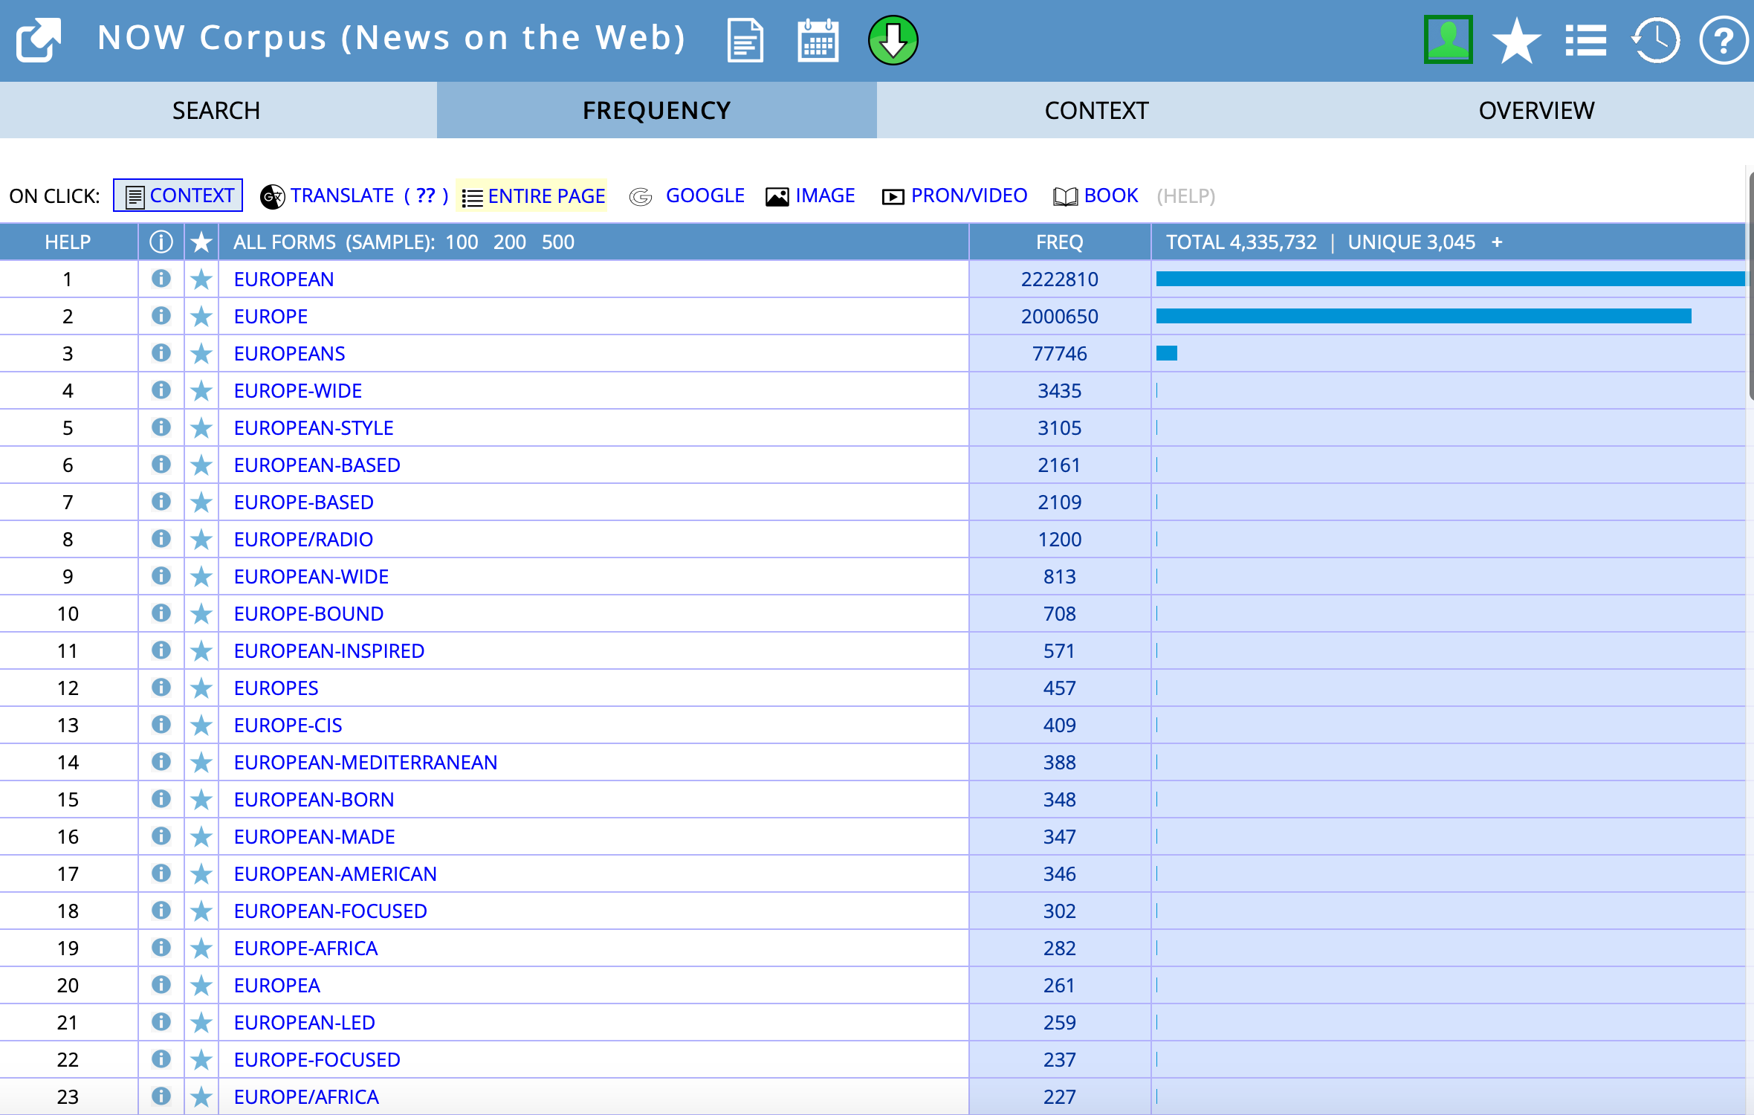

Slide 13
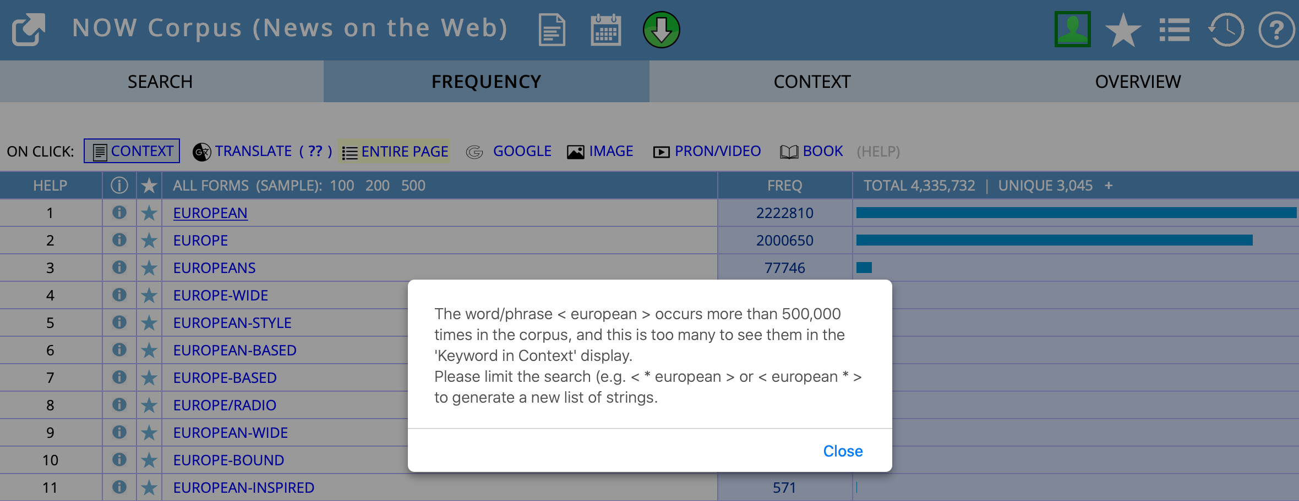

Slide 14
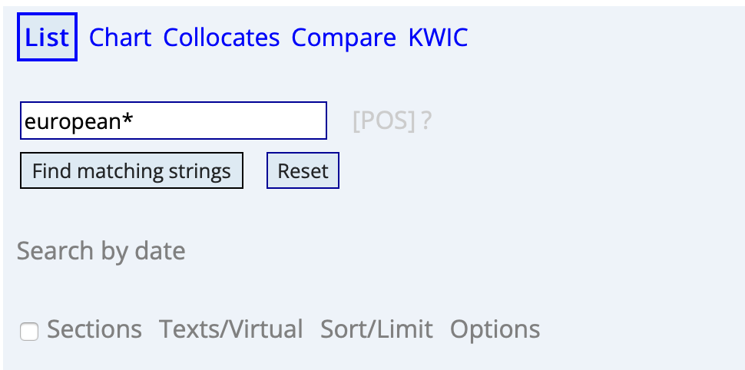
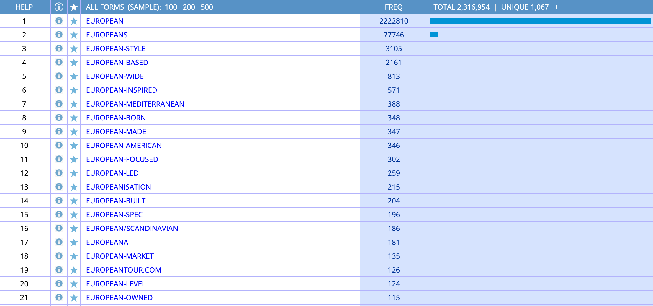

Slide 15
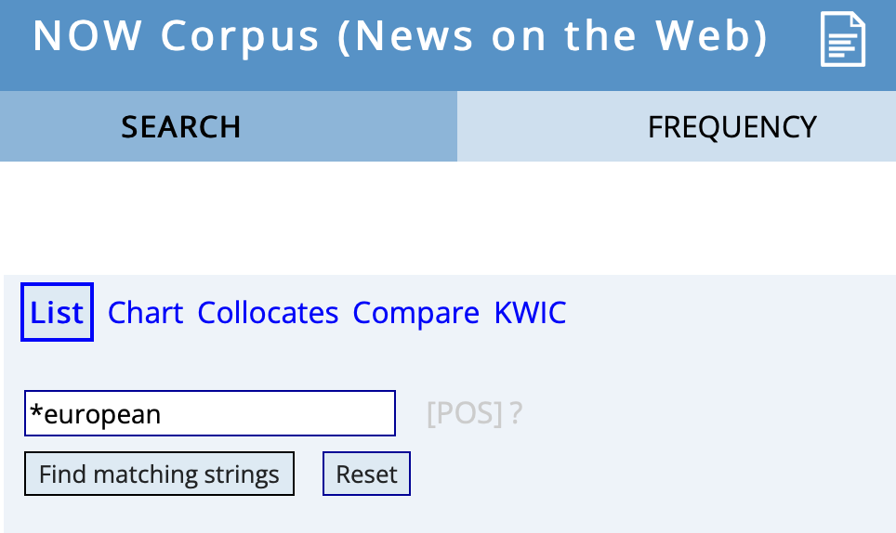
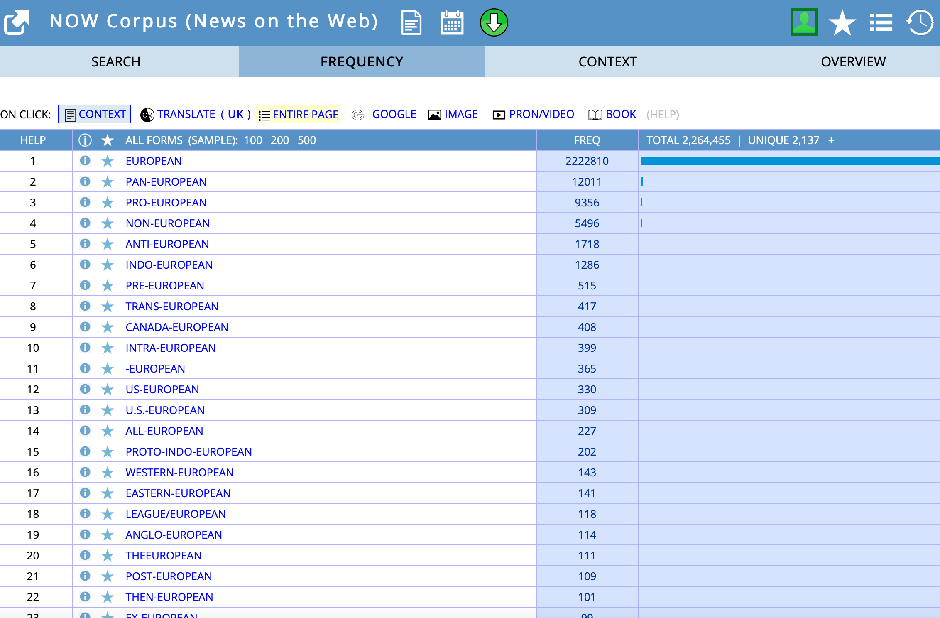

Slide 16
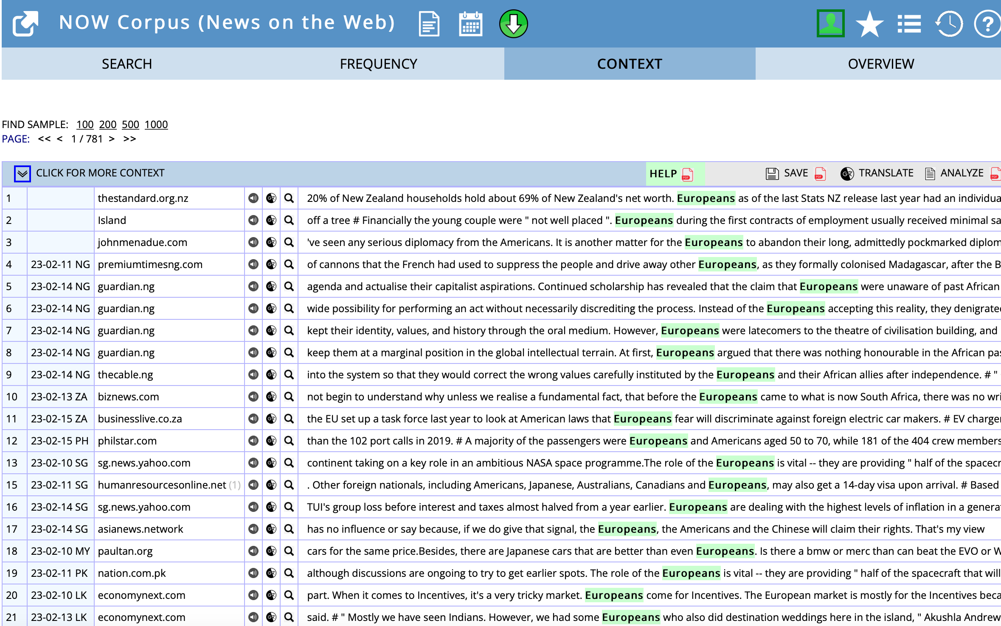

Slide 17
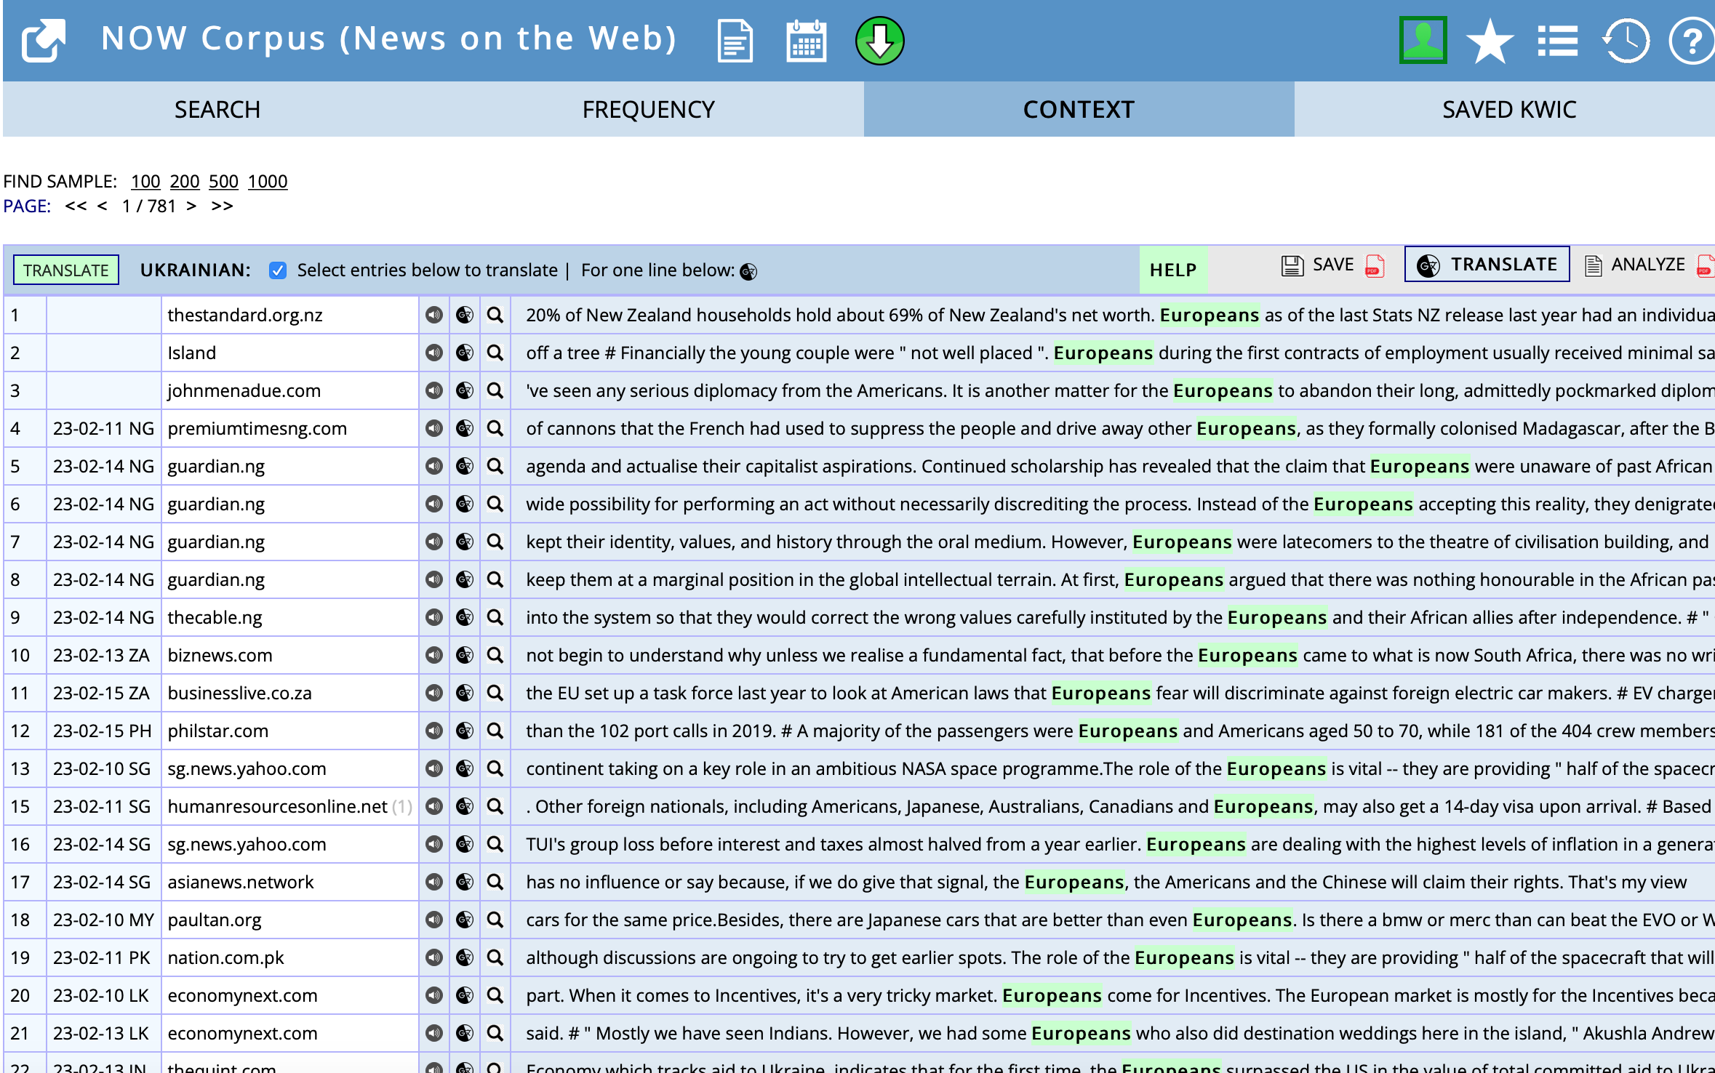

Slide 18
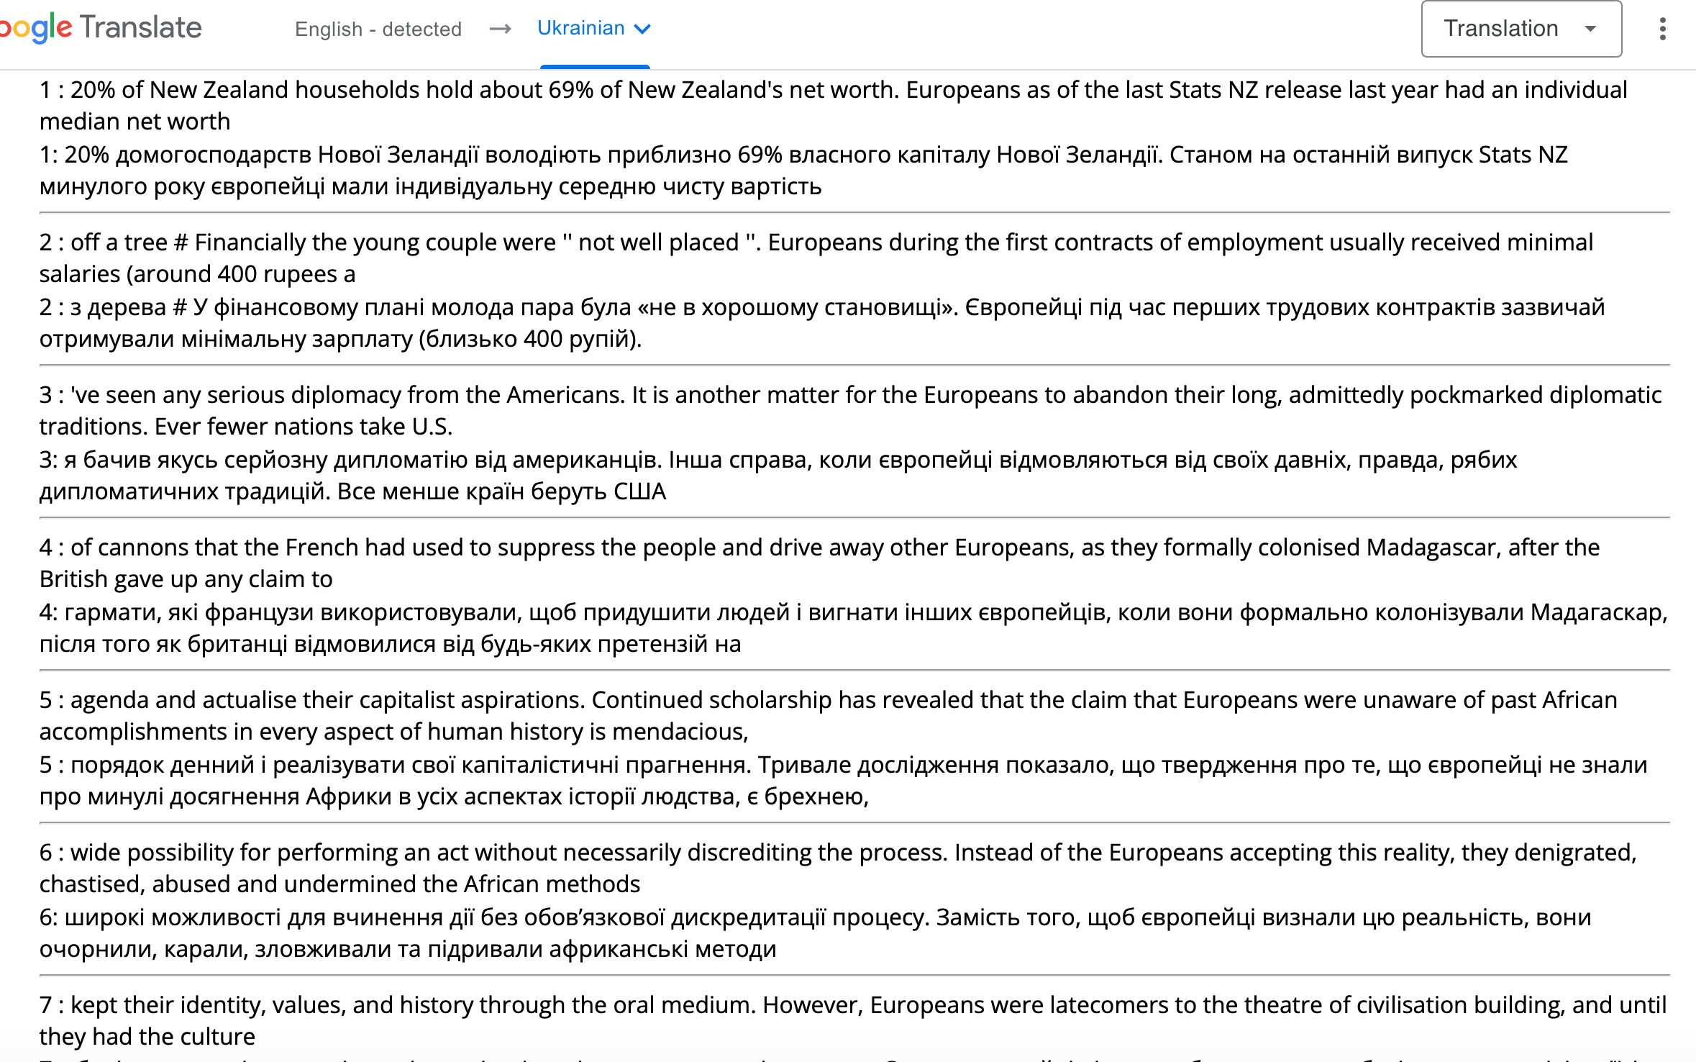

Slide 19
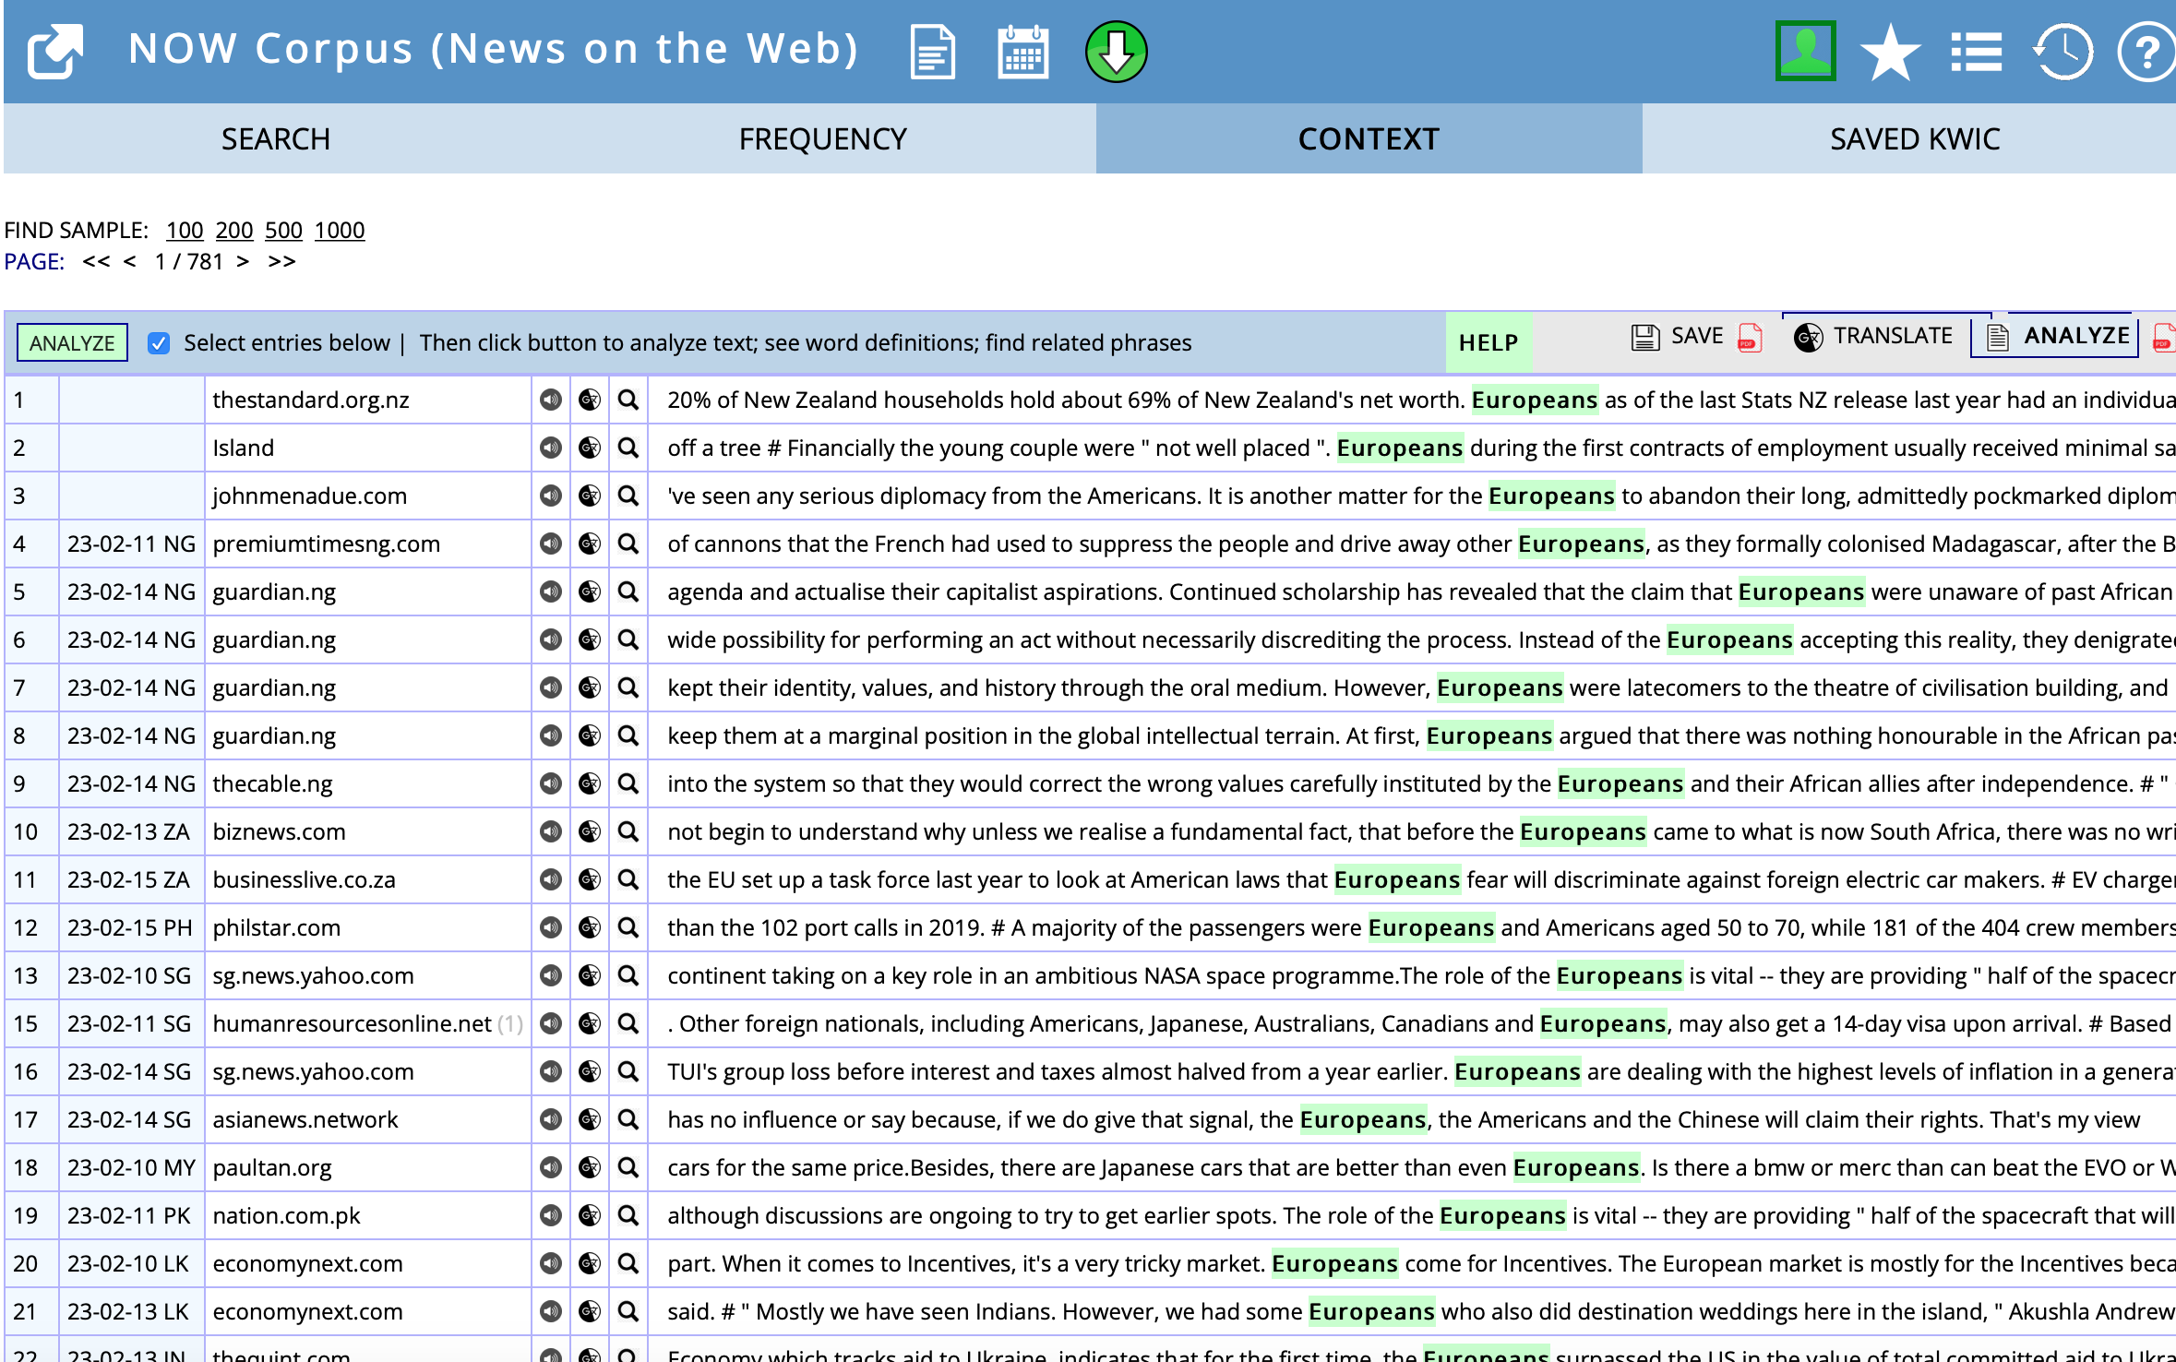

Slide 20
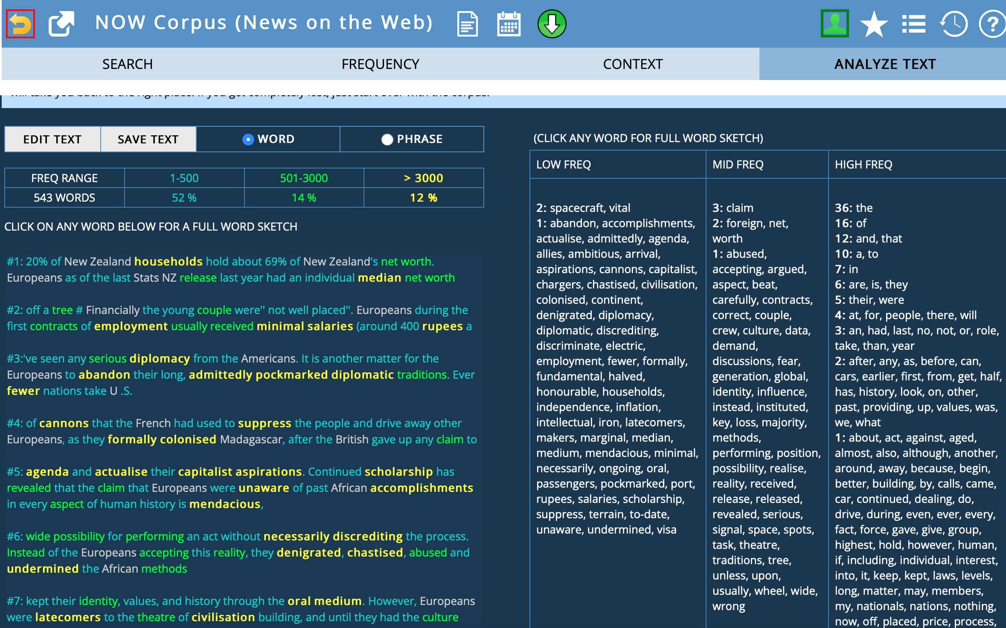

Slide 21
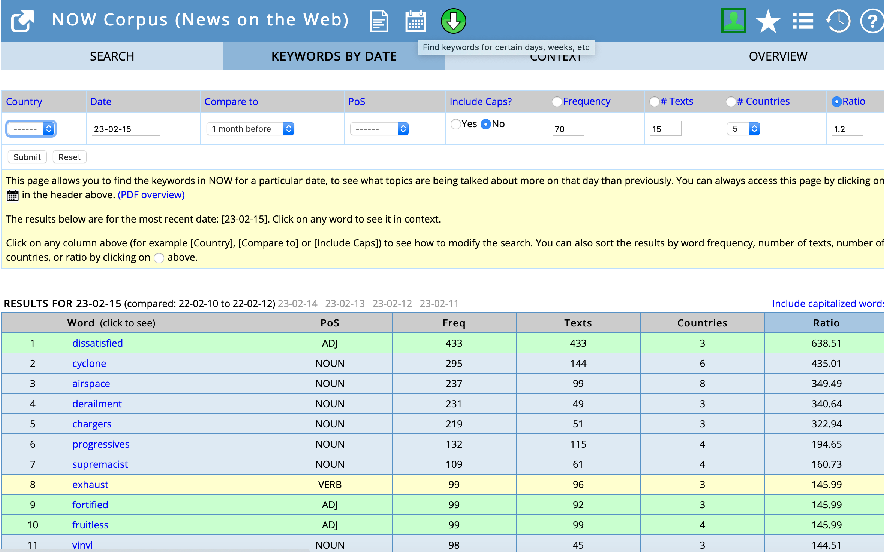

Slide 22
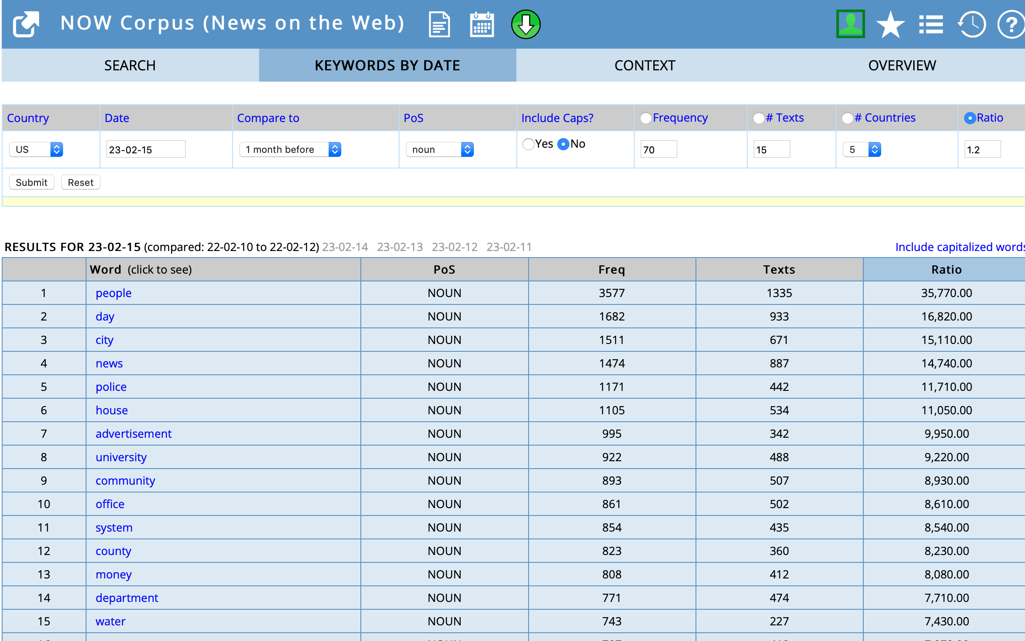

Slide 23
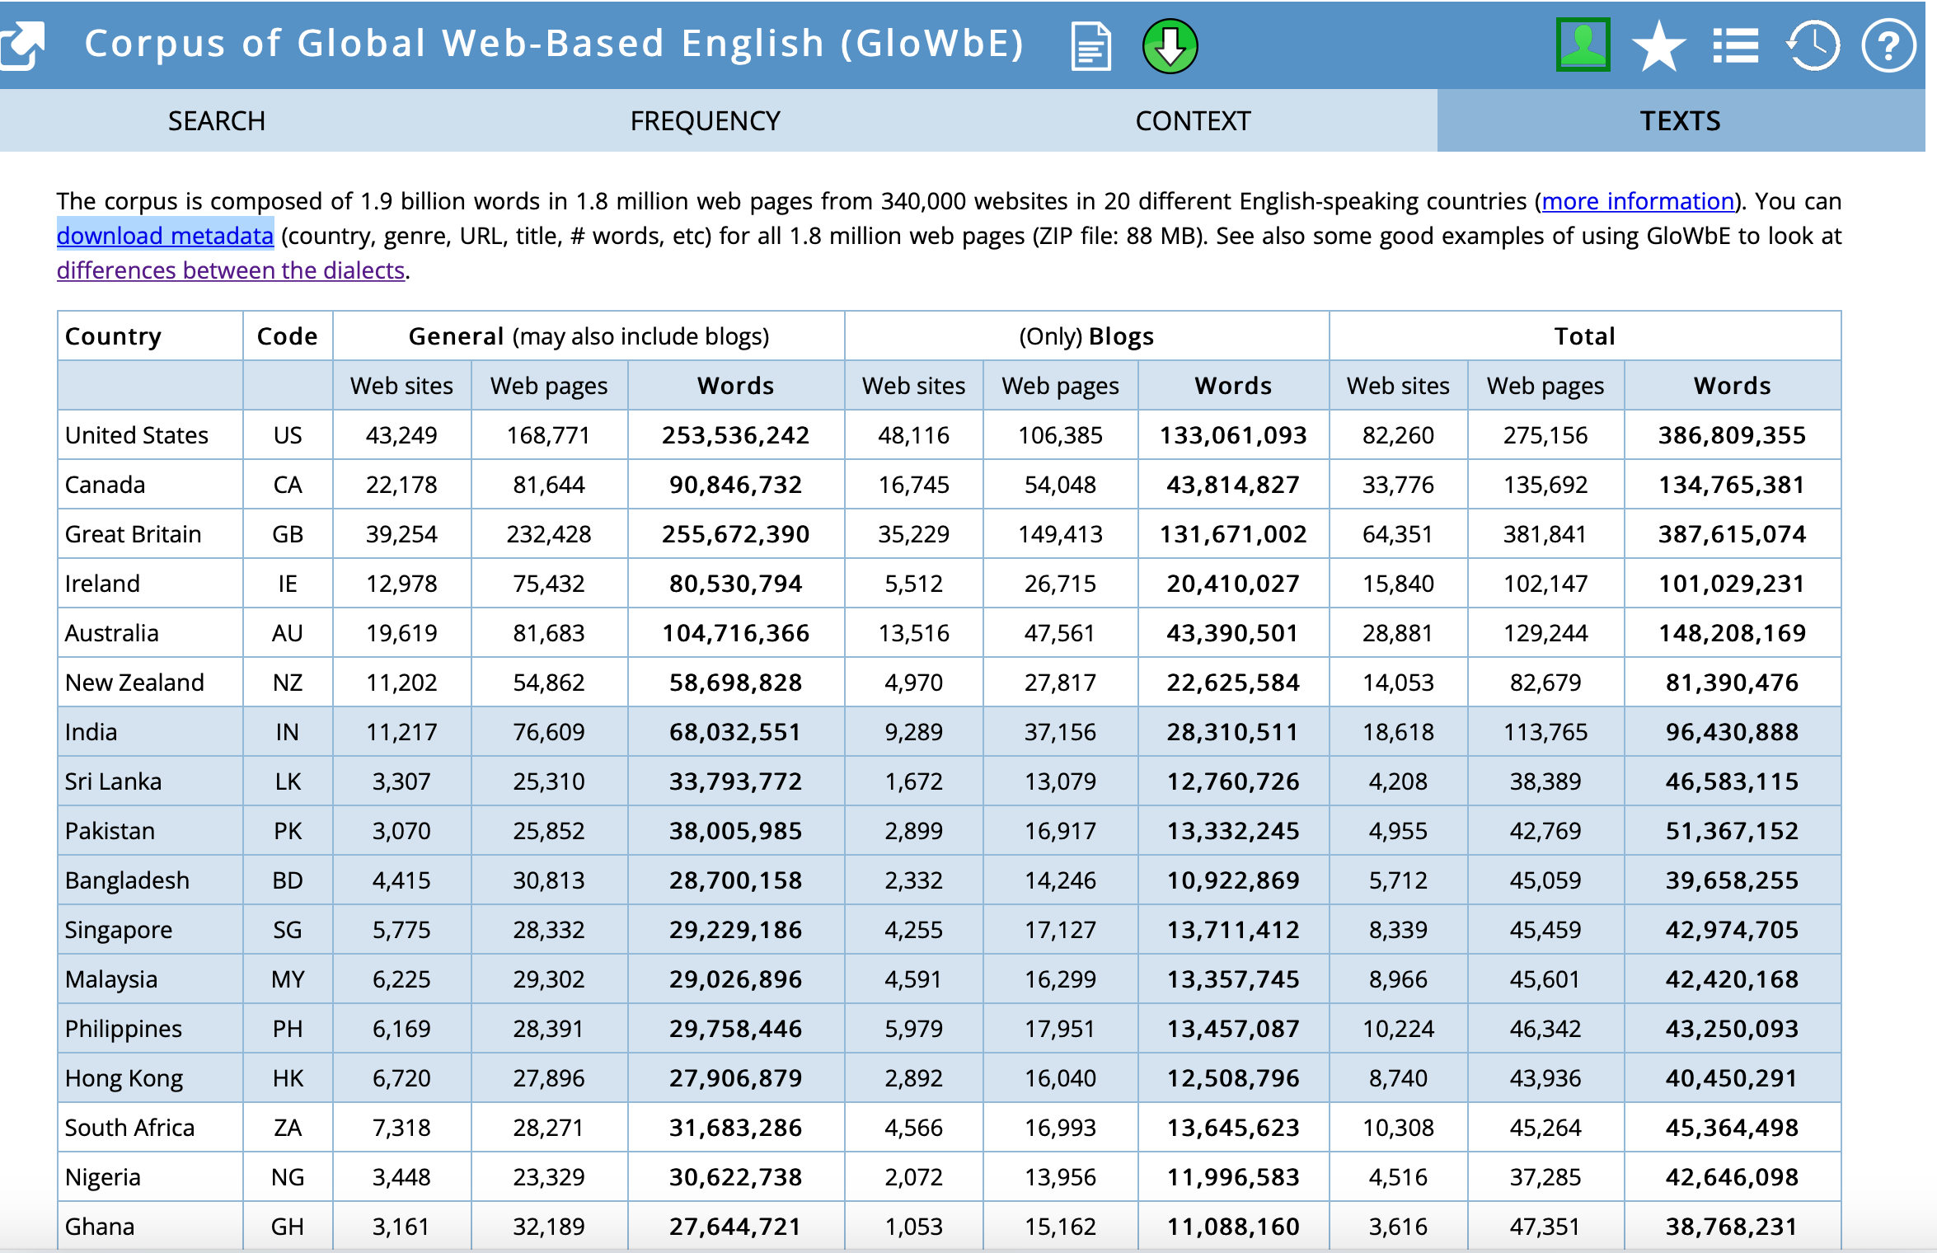

Slide 24
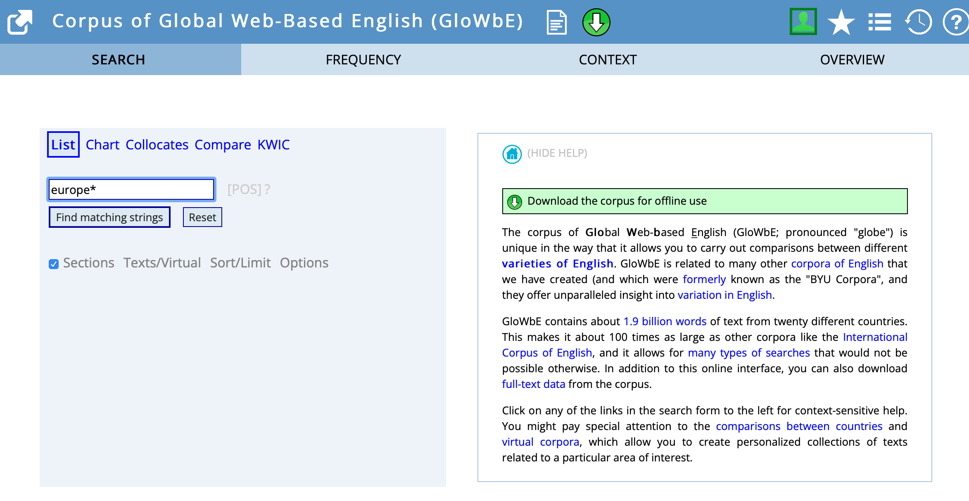
https://en.wikipedia.org/wiki/List_of_dialects_of_English

Slide 25
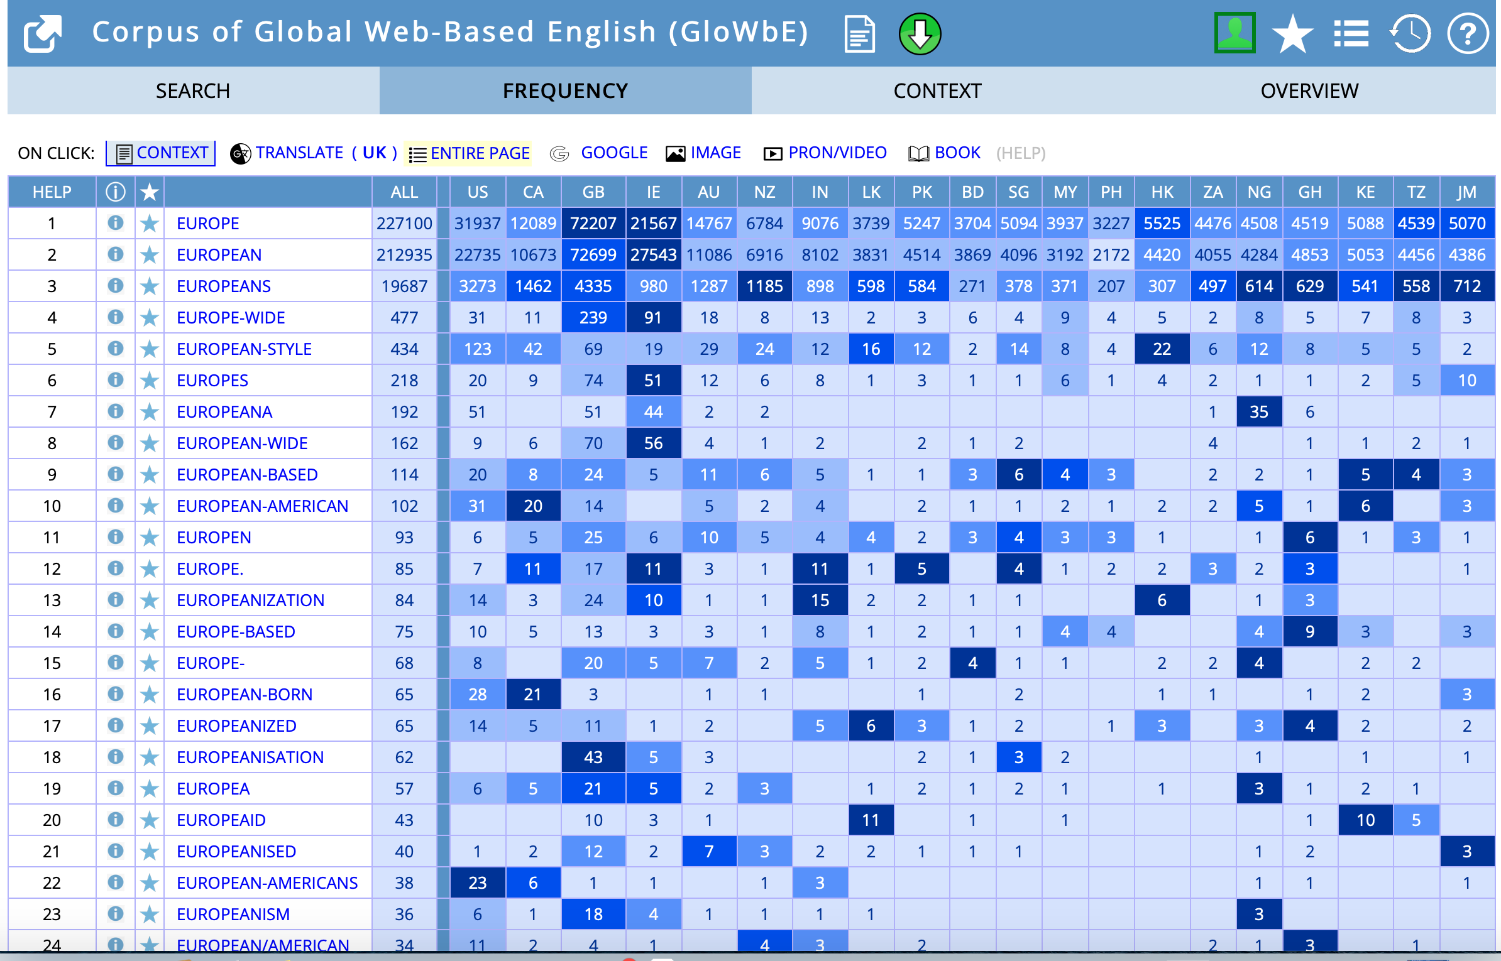

Slide 26
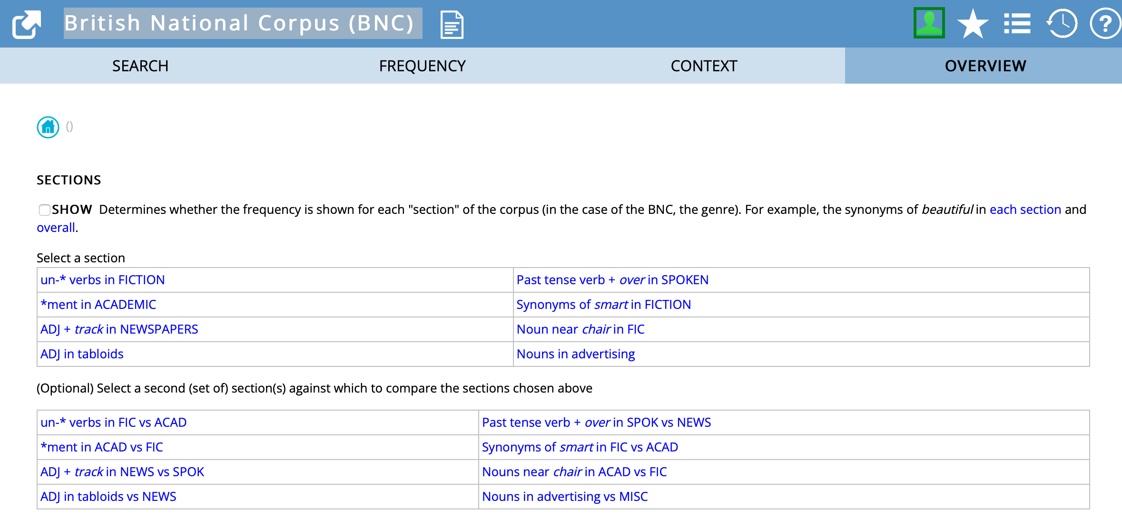
British National Corpus (BNC)

Slide 27
British National Corpus (BNC)

Slide 28
British National Corpus (BNC)

Slide 29
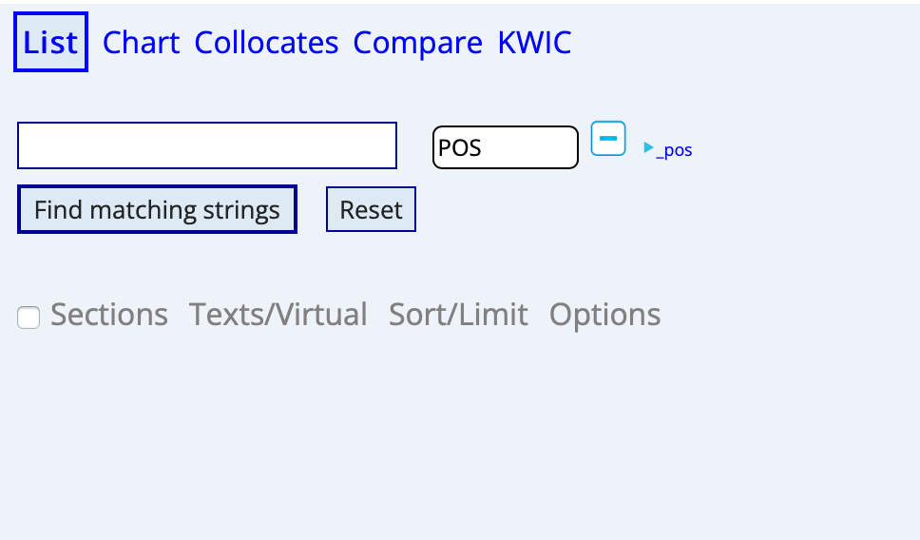
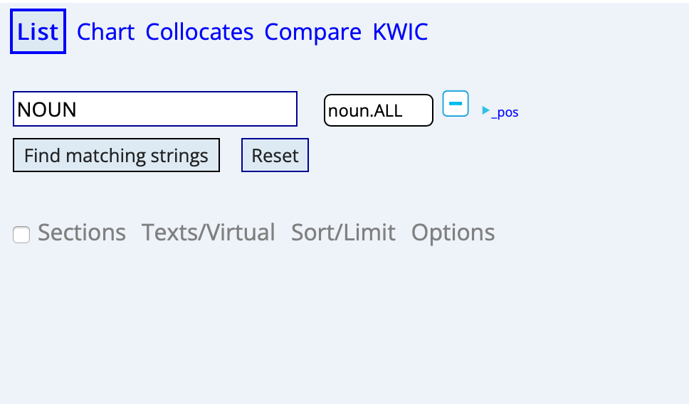
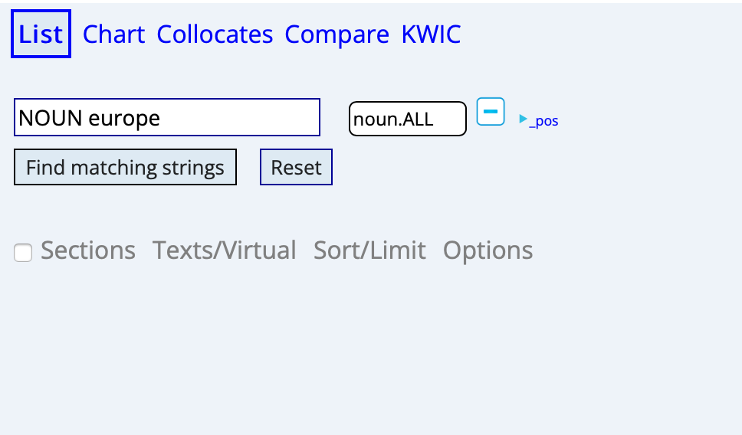
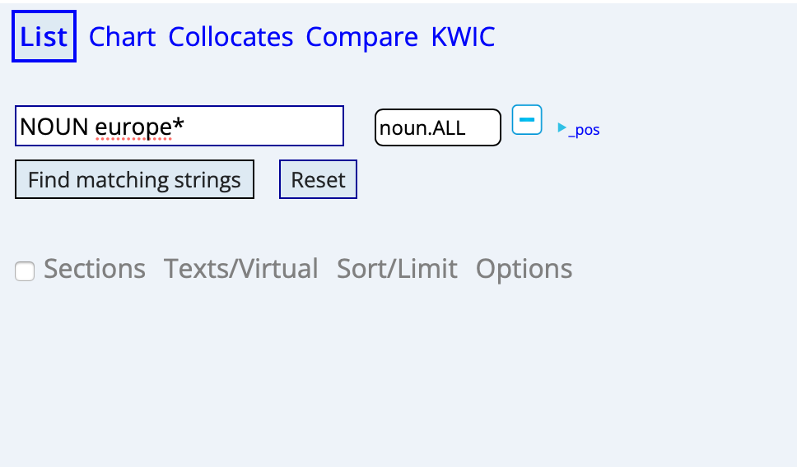
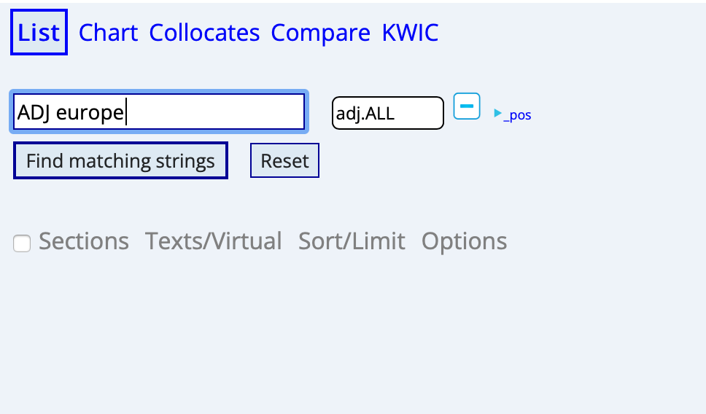
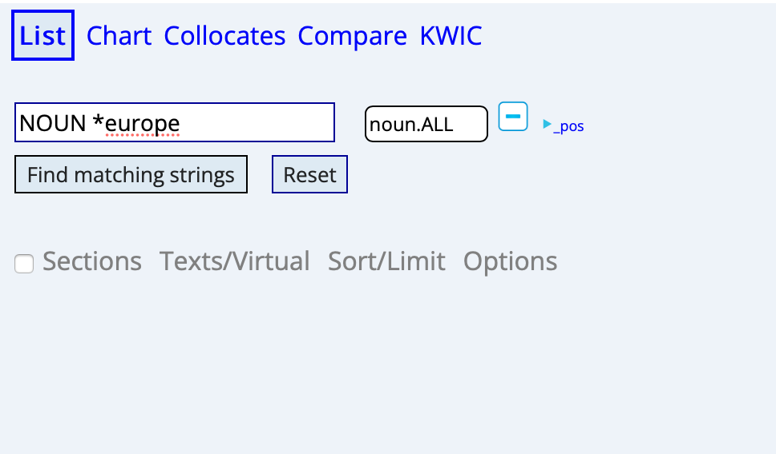
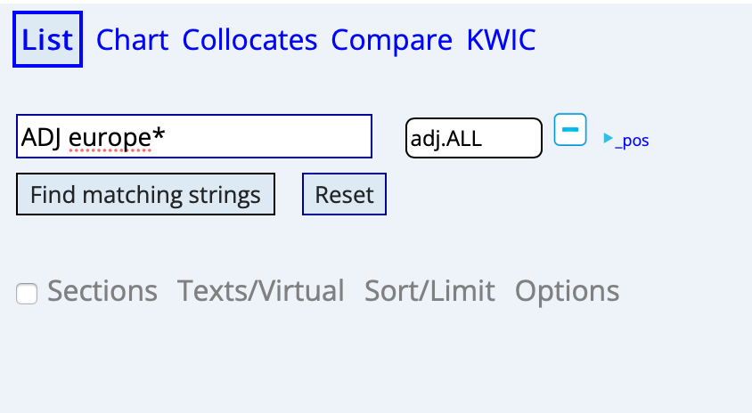
lIst

Slide 30
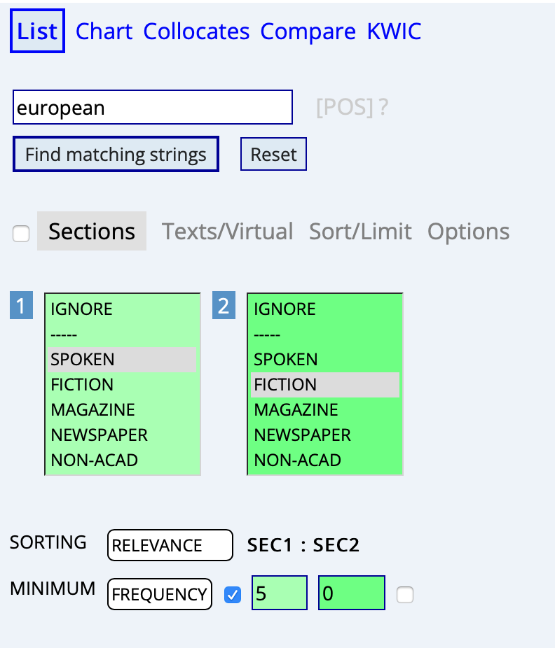
Sections

Slide 31
Розмовний vs художня література

Slide 32
Журнали vs Газети

Slide 33
Журнали vs Газети

Slide 34
Журнали vs Газети

Slide 35
Журнали vs Газети

Slide 36
Журнали vs Газети

Slide 37
Журнали vs Газети

Slide 38
european

Slide 40
CHArt

Slide 41
CHArT

Slide 42
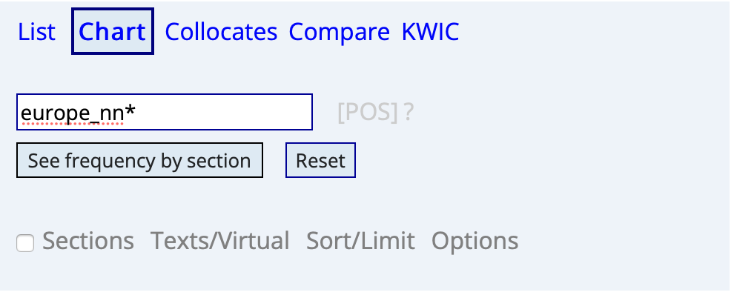

Slide 43
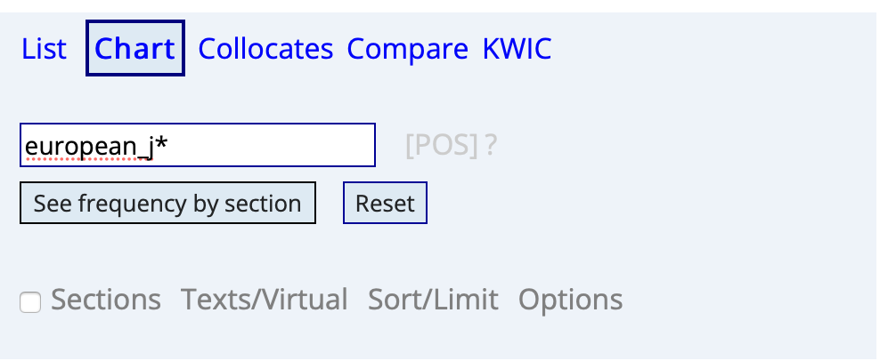

Slide 44
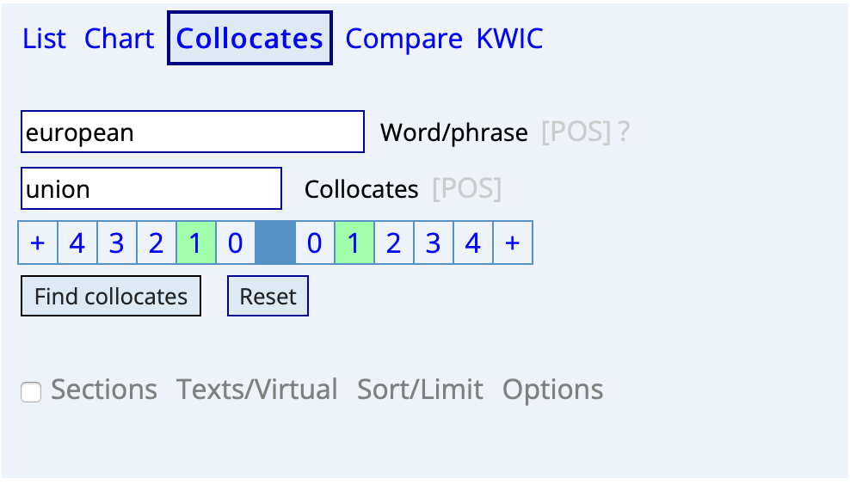
COLLocates

Slide 45
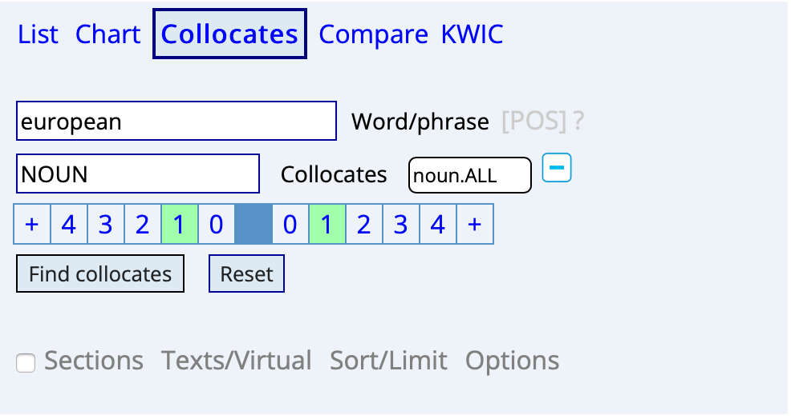
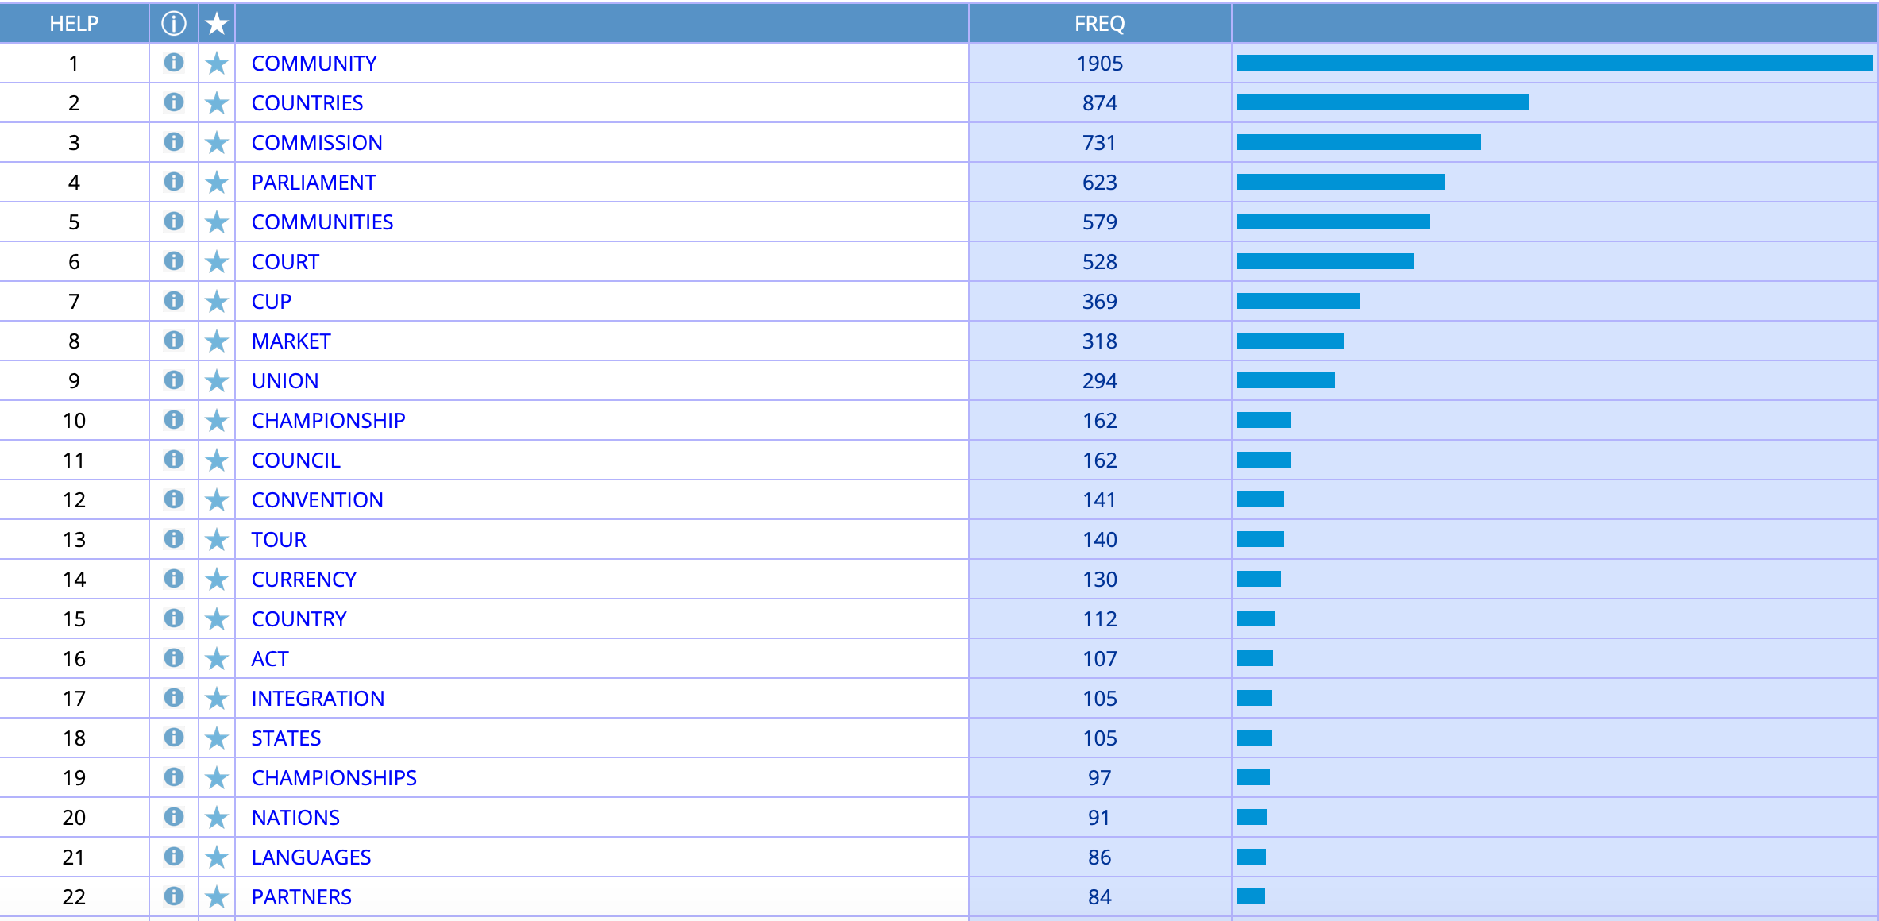

Slide 46
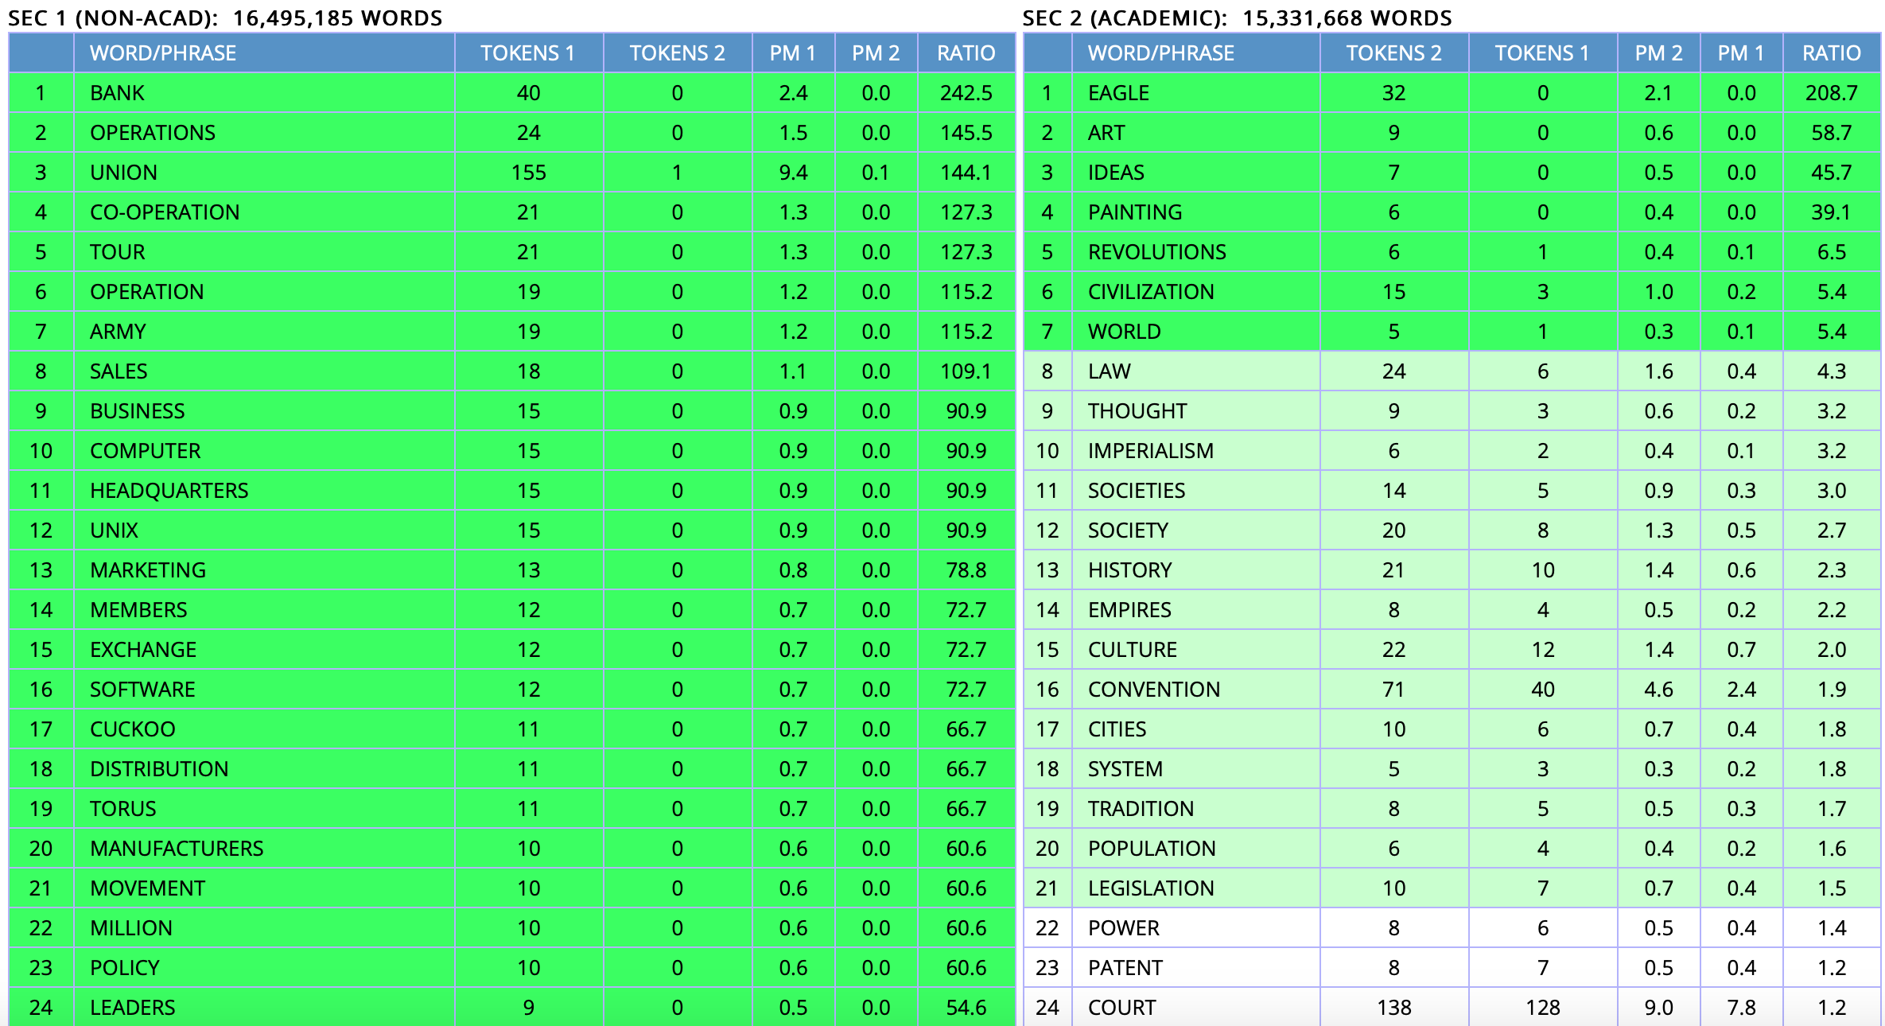

Slide 47
Compare

Slide 48
Compare

Slide 49
Kwic

Slide 50
Kwic

