Slide 1
Corpus Linguistics. Intro

Slide 2
Outline
Corpus linguistics
History of Corpus linguistics
Definitions of corpus
Corpus metadata
First Corpora
Types of Corpora
The corpus based approach
Corpus driven approach
Collecting and Computerizing Data

Slide 3
Corpus Linguistics
“[c]orpus linguistics is the term used for compiling collections of texts and using them to probe language use” (Finegan (2008)
corpus linguistics deals with collecting language samples in a principled way and using the data to explore whether we can validate a linguistic theory or hypothesis or not.
Corpus linguistics might also be the source of the hypotheses about language.

Slide 4
History of Corpus Linguistics
Pre-Chomskyan period – Boas (1940) – shoeboxes
1950s – critisized
Developments in technology – massive corpora
The Brown Corpus (1960) - https://www.sketchengine.eu/brown-corpus/

Slide 5
What is a Corpus?

Slide 6
Sinclair (2004)
“[...] a collection of pieces of language text in electronic form, selected according to external criteria to represent, as far as possible, a language or language variety as a source of data for linguistic research” (p. 19).

Slide 7
should represent the whole with a limited number of texts
should be created by considering a specific idea
needs to be in electronic format
should serve as a linguistic study

Slide 8
CHILDES (https://childes.talkbank.org )
the corpus itself, without the metadata, will be useless since the researcher will not be able to know the background information of the corpus

Slide 9
metadata
the data about data (McEnery et al.), which means the information given about the texts in a corpus
interlocutors’ demographic information in a spoken corpus,
author’s information,
date of publication,
title of a writing
information about the definition of the symbols used while tagging the text, types of files

Slide 10
a corpus is thought to be representative of the language variety it is supposed to represent if the findings based on its contents can be generalized to the said language variety (Leech 1991)
Burnard (2005): metadata should be accepted as an umbrella term, including four main categories:
Analytic metadata
Descriptive metadata.
Administrative metadata
Editorial metadata

Slide 11
Brown Corpus, was created by W. Nelson Francis and Henry Kucera in the early 60s
was not capable of explaining the theories of language
Corpus linguists were seen as descriptivists who aimed to count and categorize constrictions observed in a corpus

Slide 12
Chomsky - three types of adequacies in describing grammar and evaluating language theories
Observational Adequacy
He studied for the exam
*studied for the exam
Descriptive Adequacy
Explanatory Adequacy

Slide 13
MEYER
corpora are much better suited to functional analyses of language: analyses that are focused not simply on providing a formal description of language but on describing the use of language as a communicative tool

Slide 14
Grammatical Studies
https://www.lancaster.ac.uk/fass/projects/corpus/cbls/corpora.asp#_Toc92298908
http://korpus.uib.no/icame/manuals/LONDLUND/INDEX.HTM
Reference Grammars
Longman Grammar of Spoken and Written English (1999) by Biber et al.
https://www.lancaster.ac.uk/fass/projects/corpus/cbls/corpora.asp#_Toc92298892
Lexicography
https://www.birmingham.ac.uk/research/activity/corpus/index.aspx
https://www.collinsdictionary.com/dictionary/english

Slide 15
Language Variation
http://korpus.uib.no/icame/clarin/
Historical Linguistics
https://www.english-corpora.org/eebo/
Contrastive Analysis and Translation Theory
https://www.hf.uio.no/ilos/english/services/knowledge-resources/omc/enpc/

Slide 16
Language Acquisition
https://childes.talkbank.org
Learner Corpora
https://www.jstor.org/stable/3588404?seq=2
Language Pedagogy

Slide 17
A specialized corpus is a corpus type represented by a collection of texts compiled from a particular genre (newspaper articles, agreement letters, academic articles, lectures, essays, etc.).
Specialized corpora should serve the needs of a researcher who plans to study a specific genre in their study.
In addition to the genre-based specification, a researcher may restrict the corpus to a time frame, a social setting, or a given topic.

Slide 18
Types of Corpora
A specialized corpus: The Air Traffic Control Speech Corpus and the Corpus of Early Modern English
A general corpus: The Corpus of American Contemporary English
Comparable corpora: International Corpus of English: https://www.ice-corpora.uzh.ch/en.html
Parallel corpora: investigate differences between languages. For instance, English
A learner corpus
A historical or diachronic corpus
A monitor corpus
Balanced or representative corpus

Slide 19
Collecting and Computerizing Data
The researcher needs to plan exactly what will be included in the corpus carefully.
Researchers should choose the kinds and amounts of texts and from whom they will collect data according to the criteria set before compiling corpora.
The researcher should also be ready for changes during the course of data collection since the process of text compilation may not be as smooth as expected.
The data collection process changes must be accepted as natural and inevitable.
The researcher needs to be flexible in terms of restructuring the corpus creation process.

Slide 20
The corpus based approach
Assuming that what we see in a corpus is largely grammatical and/or acceptable, the corpus provides evidence of what speakers believe to be acceptable utterances in their language free of the over judjement of others.
Draws upon authentic or real texts.
Corpus can find differences that intuition alone cannot perceive
Corpus can yield reliable quantitative data.

Slide 21
Corpus linguistics
A methodology or a theory?
Corpus linguistics should be considered as a methodology with a eide range of applications across many areas and theories of linguistics.

Slide 22
Corpus-based VS Corpus-Driven approach
Tognini-Benelli (2001):
corpus-based approach (CBA) and
corpus-driven approach (CDA)
In some cases, the concepts of corpus-based and corpus-driven approaches are often
misused (Kang & Luo, 2020; Liu, 2020) or being mixed (Wang & Wei, 2020).
Since the emergence of controversial issues stemmed from the binary division between
corpus-based and corpus-driven approaches, linguists began to make efforts to contribute to
clarifying the two opposite viewpoints in corpus linguistics.

Slide 23
‘Corpus-based’ refers to “a methodology that avails itself of the corpus mainly to expound, test or exemplify theories and descriptions that were formulated before large corpora became available to inform language study” (Tognini-Bonelli, 2001, p. 65).
In a corpus-driven approach, “the commitment of the linguist is to the integrity of the data as a whole, and descriptions aim to be comprehensive with respect to corpus evidence” (Tognini-Bonelli, 2001, p. 84).

Slide 24
The similarity between CBA and CDA
the use of corpus as the primary tool to collect and analyse data
They “make extensive use of computers for analysis”
For CBA and CDA cases, a significant amount of data in real situations, effective searching tools, and accurate statistics by analysing engines assist a research work on a more solid foundation and eliminate bias as much as possible.

Slide 25
Corpus-based linguistics is a top-down approach, which involves the use of data in corpus to refute, exemplify, or validate a theory.
Corpus-driven linguistics is a bottom-up approach that “allows us to capture patterns in language from a neutral and unbiased perspective”. Through this approach, researchers form and present the hypotheses by observing data from the corpus.
Corpus-based approach assumes the validity of linguistic forms and structures derived from linguistic theory, conducts studies based on an existing theory or hypothesis and proves the theory or hypothesis correct or incorrect by extracting and analysing data from a corpus.
Corpus-driven approach rejects the use of any theory or paradigm from corpus linguistics. Those who are in favour of CDA argued that the data should be “approached with no prior assumptions”

Slide 26
In the case of CBA, researchers believe that the corpus should be representative and balanced.
CDA places high importance on the size of the corpus and believes that the corpus should be large and become balanced when the largeness is adequate.
KWIC – key word in context

Slide 29
Computerizing Data
While computerizing data, researchers should bear some criteria in mind.
They should keep the speech transcriptions and the written data in ASCII (text) format as it is the standard format used in corpus linguistics.
Researchers can use ASCII files in parsers, concordance programs, and taggers.
Similar to ASCII files, researchers have been using Text Encoding Initiative (TEI) as this system developed a formalism used for identifying the specific character set used in a given electronic format.

Slide 30
ASCII stands for the "American Standard Code for Information Interchange"

Slide 31
ASCII files in parsers

Slide 32
TEI

Slide 33
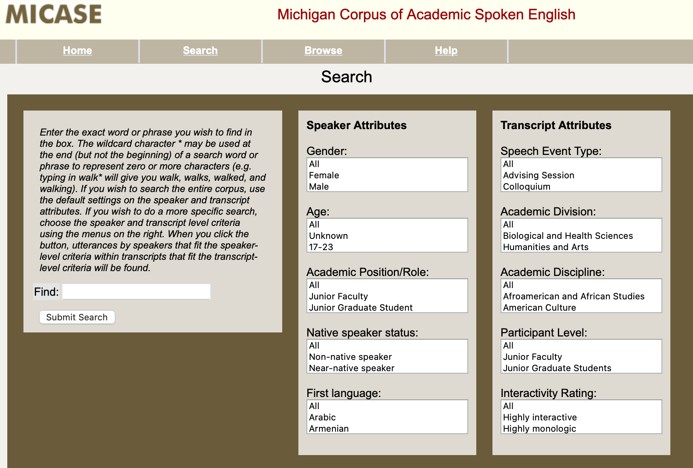
transcriptors
Sound Scriber, https://public.websites.umich.edu/~ebreck/code/sscriber/
VoiceWalker 2.0,
Backbone Transcriptor
https://www.um.es/backbone/tutorials/transcriptor/transcription.html

Slide 34
Backbone Transcriptor
<unclear/> indicates that the researcher could not recognize what had been uttered.
<unclear>word</unclear> indicates that the researcher could not ex- actly recognize the recording but has a guess about it.
<trunc>word</trunc> indicates that a word has been truncated. <foreign>word</foreign> indicates that the speaker uses a foreign word.
# shows the section boundaries.
<break/> indicates that the speaker stops syntactic structure and starts a new utterance.

Slide 35
Annotating Corpora
Most corpora use Standard Generalized Markup Language (SGML),
Text Encoding Initiative (TEI),
Extensible Markup Language (XML)
to have a unified structural markup system.

