Slide 1
№3 Теми та стилі новітньої літератури.
Тема свободи вибору й відповідальності особистості на тлі абсурдності життя. Франц Кафка. Екзістенціалізм. Експресіонізм. Альбер Камю як письменник і філософ. "Не камінь, що падає, а закон тяжіння". Життя на межі, усвідомлення межі. Айріс Мердок. Автори "єдиного твору". Дж. Селінджер. Гарпер Лі. Інтелектуальна проза. Антонія Байєтт.

Slide 2
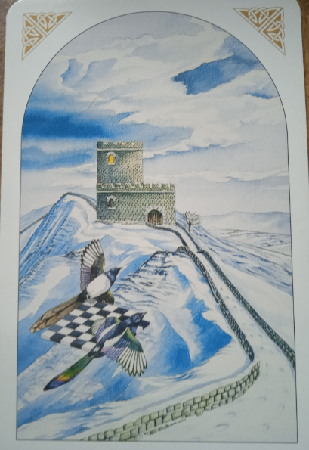
Terry Pratchett
Carpe Jugulum(1998)

Slide 3
'Well, there are two sides to every question. . .'
'What do you do when one of 'em's wrong?'
The reply came back like an arrow.
'I meant that we are enjoined to see things from the other person's point of view,' said Oats patiently.
'You mean that from the point of view of a torturer, torture is all right?'

Slide 4
'Not usually. There is a very interesting debate raging at the moment about the nature of sin, for example.'
'And what do they think? Against it, are they?'
'It's not as simple as that. It's not a black and white issue. There are so many shades of grey.'

Slide 5
'Nope.'
'Pardon?'
'There's no greys, only white that's got grubby. I'm surprised you don't know that. And sin, young man, is when you treat people as things. Including yourself. That's what sin is.'
'It's a lot more complicated than that-'
'No. It ain't. When people say things are a lot more complicated than that, they means they're getting worried that they won't like the truth. People as things, that's where it starts.'
'Oh, I'm sure there are worse crimes-'
'But they starts with thinking about people as things. . .'

Slide 6
'Nope.'
'Pardon?'
'There's no greys, only white that's got grubby. I'm surprised you don't know that. And sin, young man, is when you treat people as things. Including yourself. That's what sin is.'
'It's a lot more complicated than that-'
'No. It ain't. When people say things are a lot more complicated than that, they means they're getting worried that they won't like the truth. People as things, that's where it starts.'
'Oh, I'm sure there are worse crimes-'
'But they starts with thinking about people as things. . .'

Slide 8
Експресіонізм Кафки
Людина живе у ворожому світі. Її сутнісні сили відчужені у створених нею інститутах, які протистоять їй.
Прагнення щастя нездійсненне.
Водночас прагнення знайти дещо стале та незмінне: “незруйноване”, “світло”
Доля особистості належить не їй, а тому, абстрагувалося від людини, відділилося від неї. Суспільна організація буття стоїть над людиною та спотворює її сутність.
Хаос світу сильніший за людину, проте, навіть коли гине у хаосі, людина “світить”.

Slide 9
1914-16
1925
(постмортем – розрізнені епізоди – реконструкція Макса Брода)
Йозеф К.
Звинувачення як даність
Таємні знаки
Ритуальність бюрократії та процедур
«начебто виправдання» — нескінченне починання процесу заново
повсюдність і всемогутність системи
Людина не особистість, а елемент підтримки життєдіяльності системи.
Контакт з людиною як самостійне рішення, опанування власним життям.
Австрія-Чехія-Німецька мова-Єврейство

Slide 10
Експресіонізм
Зосереджена увага на реальному житті, але не на його реалістичному чи натуралістичному розумінні, а його філософських основах. “Не камінь, що падає, а закон тяжіння”
Вчення Фрейда. Примат підсвідомого, значення пам’яті та інтуїції.
Природа – творчій процес та прорив.
Особистість переповнена емоціями, розірвана, розщеплена, нездатна внести гармонію у світ, встановити зв’язок з ворожим світом.

Slide 11
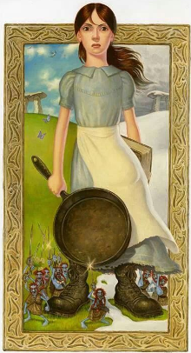
Terry Pratchett
The Wee Free Men (2003)

Slide 12
. . . and then, like someone rising from the clouds of a sleep, she felt the deep, deep Time below her. She sensed the breath of the downs and the distant roar of ancient, ancient seas trapped in millions of tiny shells. She thought of Granny Aching, under the turf, becoming part of the chalk again, part of the land under wave. She felt as if huge wheels, of time and stars, were turning slowly around her.
She opened her eyes and then, somewhere inside, opened her eyes again.

Slide 13
She heard the grass growing, and the sound of worms below the turf. She could feel the thousands of little lives around her, smell all the scents on the breeze, and see all the shades of the night. . .
The wheels of stars and years, of space and time, locked into place. She knew exactly where she was, and who she was, and what she was.

Slide 14
She leaned down, and centuries bent with her.
The secret is not to dream,’ she whispered. ‘The secret is to wake up. Waking up is harder. I have woken up and I am real. I know where I come from and I know where I’m going. You cannot fool me any more. Or touch me. Or anything that is mine.’
I’ll never be like this again, she thought, as she saw the terror in the Queen’s face. I’ll never again feel as tall as the sky and as old as the hills and as strong as the sea. I’ve been given something for a while, and the price of it is that I have to give it back.

Slide 15
And the reward is giving it back, too. No human could live like this. You could spend a day looking at a flower to see how wonderful it is, and that wouldn’t get the milking done. No wonder we dream our way through our lives. To be awake, and see it all as it really is . . . no one could stand that for long.

Slide 16
Принципи екзистенціалізму
Щодо людини існування передує сутності. Людина отримує сутність в процесі існування. Людина робить себе сама. Вона набуває сутності протягом всього життя.
Існування людини – вільне існування. Свобода – не свобода духа, а свобода вибору, яку неможна забрати в людини.
Існування людини передбачає відповідальність не лише за себе, але й за оточення.
Існування тимчасове та обмежене. Існування людини – буття, обернене у смерть.
Екзистенційний страх – як вогонь, він спалює все тимчасове та відволікає людини від всього світського. Лише тоді оприявнюється істинне існування.

Slide 17
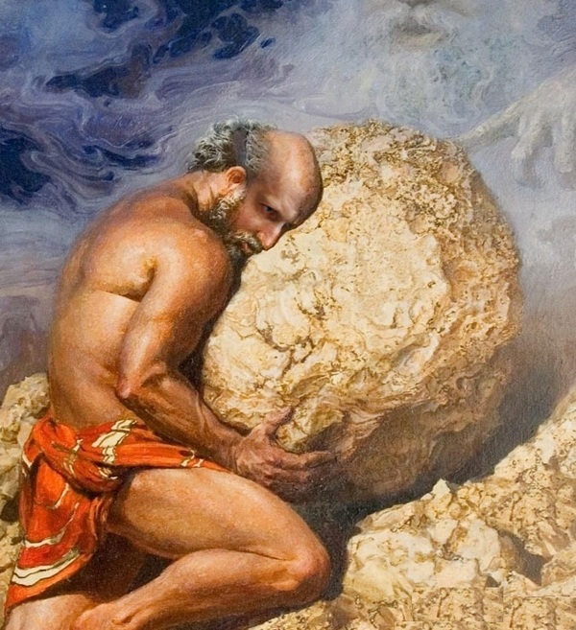
Альбер Камю
«Абсурд є метафізичним станом людини у світі»
Усвідомлена протидія абсурдності буття.
Чи варте життя того, щоб прожити його?
Сутність бунту як солідарності і філософії міри, що визначає згоду та незгоду з існуючими реаліями.
Філософія існування

Slide 18
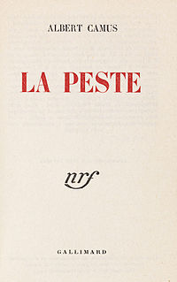
1944
Зло невіддільне від буття.
Оран. Д-р Ріє. Факти. Розум і логіка, невизнання хаосу.
Хронікальність. Підкреслена об’єктивність.
Всі фази епідемії: початок, наростання, загострення та спад
Полілог.
Алегорічність.
Образи «маленьких» людей, які своєю солідарністю долають велике лихо.

Slide 19
Екзистенціалізм
Єдність суб'єкта та об’єкта,
Усвідомлення себе як екзистенції, перебування у межовій ситуації,
Розуміння світу через межову ситуацію. Розуміння як сутність.
Проблема свободи як вибору.
Відповідальність за вибір та кожну дію

Slide 20
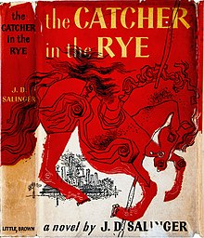
1951
It wasn't as cold as it was the day before, but the sun still wasn't out, and it wasn't too nice for walking. But there was one nice thing. This family that you could tell just came out of some church were walking right in front of me--a father, a mother, and a little kid about six years old. They looked sort of poor. The father had on one of those pearl-gray hats that poor guys wear a lot when they want to look sharp. He and his wife were just walking along, talking, not paying any attention to their kid. The kid was swell. He was walking in the street, instead of on the sidewalk, but right next to the curb. He was making out like he was walking a very straight line, the way kids do, and the whole time he kept singing and humming. I got up closer so I could hear what he was singing. He was singing that song, "If a body catch a body coming through the rye." He had a pretty little voice, too. He was just singing for the hell of it, you could tell. The cars zoomed by, brakes screeched all over the place, his parents paid no attention to him, and he kept on walking next to the curb and singing "If a body catch a body coming through the rye." It made me feel better. It made me feel not so depressed any more.
Holden Caulfield

Slide 21
"You know that song 'If a body catch a body comin' through the rye'? I'd like--"
"It's 'If a body meet a body coming through the rye'!" old Phoebe said. "It's a poem. By Robert Burns."
"I know it's a poem by Robert Burns."
She was right, though. It is "If a body meet a body coming through the rye." I didn't know it then, though.
"I thought it was 'If a body catch a body,'" I said. "Anyway,
I keep picturing all these little kids playing some game in this big field of rye and all. Thousands of little kids, and nobody's around--nobody big, I mean--except me. And I'm standing on the edge of some crazy cliff. What I have to do, I have to catch everybody if they start to go over the cliff--I mean if they're running and they don't look where they're going I have to come out from somewhere and catch them. That's all I'd do all day. I'd just be the catcher in the rye and all. I know it's crazy, but that's the only thing I'd really like to be. I know it's crazy."

Slide 22
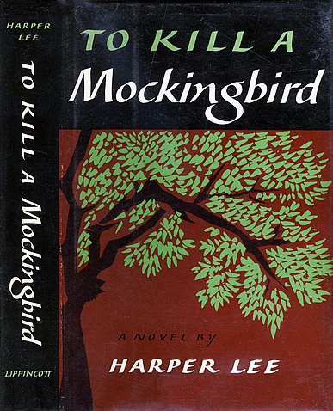
1960
Atticus was right. One time he said you never really know a man until you stand in his shoes and walk around in them. Just standing on the Radley porch was enough.
“An‘ they chased him ’n‘ never could catch him ’cause they didn’t know what he looked like, an‘ Atticus, when they finally saw him, why he hadn’t done any of those things… Atticus, he was real nice…”
His hands were under my chin, pulling up the cover, tucking it around me.
“Most people are, Scout, when you finally see them.”

Slide 23
1958
Under the Net (1954),
The Sea, the Sea (1978)
The Bell (1958),
A Severed Head (1961),
The Red and the Green (1965),
The Nice and the Good (1968), The Black Prince (1973),
Henry and Cato (1976),
The Philosopher's Pupil (1983), The Good Apprentice (1985), The Book and the Brotherhood (1987),
The Message to the Planet (1989),
The Green Knight (1993).
philosopher,
The Sovereignty of Good (1970).
The yearning for a spiritual life
in a materialistic age
The nature of virtue
existentialism
analytic philosophy
moral philosophy
Peter Conradi notes that The Bell is "her first novel to be fuelled by Platonism, in which Good substitutes for God, and any authentic spiritual tradition, including appreciation of the visual arts ... provides a means of ascent".

Slide 24
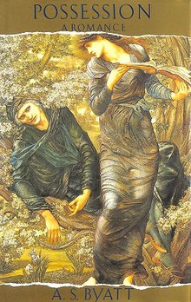
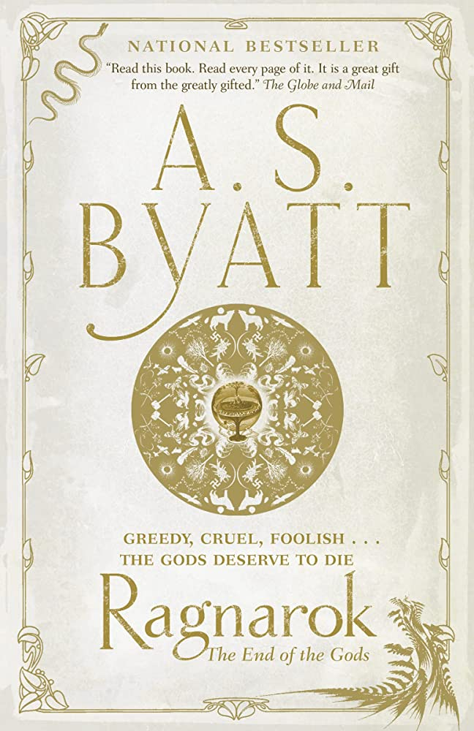
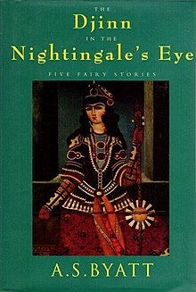
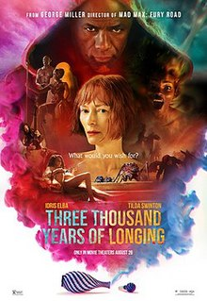
1990
2011
2009
1994
I started with the idea that writing children's books isn't good for the writers' own children. There are some dreadful stories. Christopher Robin at least lived. Kenneth Grahame's son put himself across a railway line and waited for the train. Then there's J. M. Barrie. One of the boys that Barrie adopted almost certainly drowned himself. This struck me as something that needed investigating. And the second thing was, I was interested in the structure of E. Nesbit's family—how they all seemed to be Fabians and fairy-story writers.

