Slide 1
Structural Linguistics
Lecture 1

Slide 2
Linguistics is
“the science of language, such as its structure, acquisition, relationship to other forms of communication” (Hornby, 1980: 494).
“the study of human speech including units, nature, structure and modification of language” (Webster, 1981: 664)
“the scientific study of language” (Ronald Wardhaugh, 1972: 213).

Slide 3
The Nature of Language (by Paul S. Anderson (1972: 35-36) )
Language is a system
Language is speech sound
Language is composed of symbols (arbitrary symbols)
Each language is unique and typical
Language is built from habit
Language is a communication tool
Language is closely linked to the culture it is located
Language is always changing

Slide 4
The Function of Language Halliday “Exploration in the Development of Language” (1975)
The Instrumental Function
serves the process of environment, caused specific events happen.
The Regulatory Function
acts to supervise and control every event that is happened.
The Representational Function
It is the use of language to make statements, to tell the facts and knowledge, to explain or to report, to represent the reality fact.

Slide 5
The Function of Language Halliday “Exploration in the Development of Language” (1975)
The Interactional Function
The success of interactional communication is caused by enough knowledge of “slang”, “jargon”, “funny story”, “folklore”, “common etique”, and “culture”.
The Personal Function
Ones personality usually signed by its personal of language function in communication.
The Heuristic Function
includes the use of language to get science, to learn all about the environment.
The Imaginative Function
It serves the creation of systems or ideas that have imaginative characteristics.

Slide 6
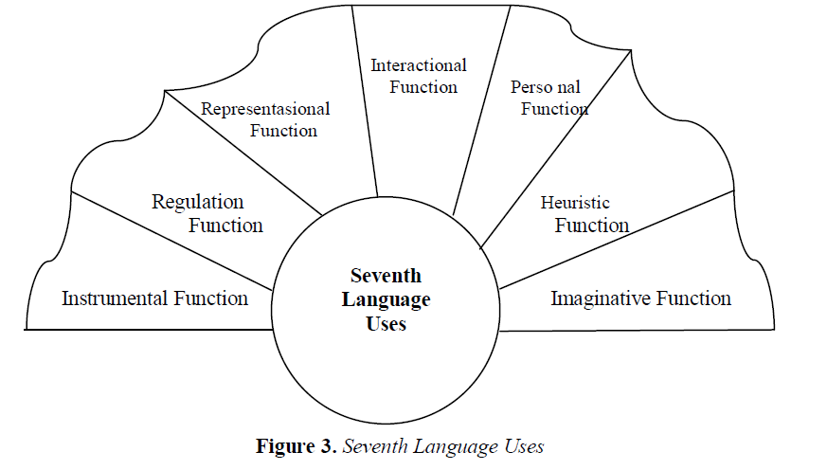

Slide 7
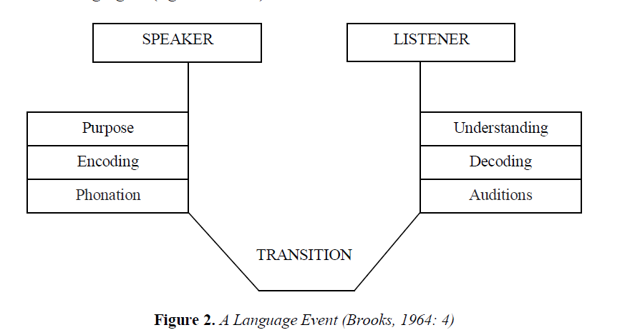

Slide 8
Structural Linguistics
1916
“Course de Linguistique Generale” by F. de Saussure
"Father of Structuralism“, the "Father of Modern Linguistics"

Slide 9
Ferdinand de Saussure:
“A language is a system in which all the elements fit together, and which the value of any one element depends on the simultaneous coexistence of all the others”

Slide 10
Language Characteristics by De Saussure
Language is a well-defined object in the heterogeneous mass of speech facts. It can be localized in the limited segment of the speaking-circuit where an auditory image becomes associated with a concept, it also the social side of speech, outside the individual who can never create nor modify it by himself.
Language is something that can be studied separately. Even dead languages are no longer spoken; its linguistic organism can be easily assimilated.

Slide 11
Language Characteristics by De Saussure
Whereas speech is heterogeneous, language is homogeneous. It is a system of signs in which the only essential thing is the union of meanings and sound-images.
Language is concrete, no less so than speaking; and this is a help in our study to of it.

Slide 12
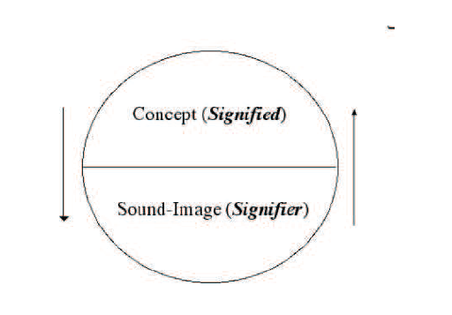

Slide 13
Characteristics of Structural Linguistics (by Soeparno (2002: 48-51) )
Behavioristic approach
Language processes as is a stimulus-response process.
Stimulus sometimes is in the form of speech, sometimes is in the form of sign with body movement (gesture), and sometimes is in the form of situation.
Language is in the Form of Speech
This characteristic indicates that only thing in the form of speech can be called language.
Language is in the form of Sign System (Signifie and Signifiant)
Substantially language is a sign system. The marking system is arbitrary and conventional. Sign system in language is in the form of two sides, the first side is signifie, while the other side is signifiant. Arbitrary is the characteristic of its sign which is free

Slide 14
Characteristics of Structural Linguistics (by Soeparno (2002: 48-51) )
Language is Habitual Factor
In acquiring language drill and practice methods are used.
Based on Generality
The form and structure of the language that has been used or that are already commonly used alone is considered as a grammatical form.
Grammatical Levels are Enforced Neatly
Grammatical levels are enforced in the range from the lowest level (phoneme) to the highest level (sentence).
The range of grammatical levels is morphemes, words, phrases, clauses, and sentences.

Slide 15
Characteristics of Structural Linguistics (by Soeparno (2002: 48-51) )
Analysis Pressure is in the Field of Morphology
Word pattern analysis is used as a structural analysis model (Eugine Nida, 1982).
Language is a Row of Syntagmatic and Paradigmatic relations
The usefulness of this paradigmatic row is to find or define the elements of language.
Language Analysis Based on Descriptive Paradigm
The language data that are analyzed is only the data at the time the research is done.
Language Structure Analysis Based on Direct Element
Direct element is the element that is one step lowerfrom its structure. This direct element is referred to as immediate constituents (IcS).

Slide 16
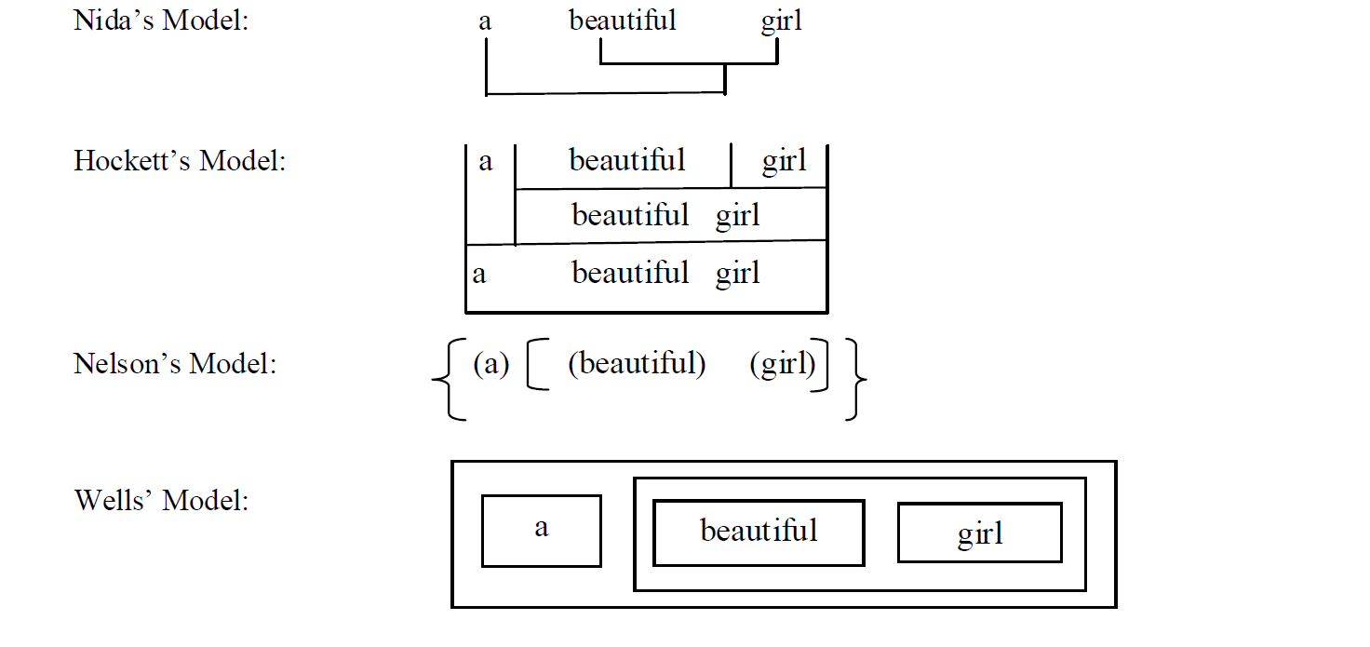

Slide 17
References:
Carol Sanders, Saussure Today: The Cambridge Companion to Saussure Cambridge Companions, Cambridge University Press, England, 2006
Carol Sanders, The Cambridge Companion to Saussure, (Cambridge Companions Online, Cambridge University Press, Massachuse!s, Boston, 2006)
D. Terrence Langendoen, Bloomfield, (Department of Linguistics,
Uni ver sity of Arizona, MIT Press, 1998)
David Crystal, The First Dictionary of Linguistics and Phonetics,
(Westview Press, Boulder Colorado, 1980)
Ferdinand de Saussure, Course on General Linguistics, (The
Philosophical Library, Inc, New York City, 1959)
Heddy Shri Ahimsa Putra, Strukturalisme Levi-Strauss; Mitos dan
Karya
Peter Mathews, A Short History of Structural Linguistics
(University of Cambridge, Cambridge, 2003)

