Slide 1
Тема 1. Переклад в інформаційному суспільстві.
Переклад як індустрія.
Сфери застосування та види перекладу, вимоги до якості, умови праці перекладача.
Етичний кодекс перекладача.
Технологічні застосунки в роботі перекладача.
Машинний та автоматизований переклад.

Slide 2
Постачальники мовних послуг LSPs (Language Service Providers)
$47.3 billion
18,500
2000
640,000
Africa
250
3/1000
30
Europe

Slide 3
https://translationschool.pro/
http://catforgrad.com/
https://www.uttu.info/

Slide 4
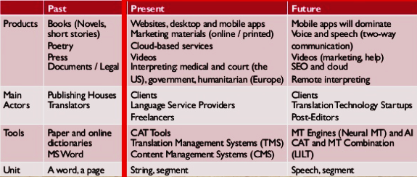
search engine optimization
https://www.nimdzi.com/book/UTIC/

Slide 5
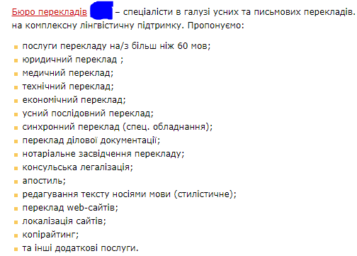

Slide 6
Етапи роботи з проєктом
Клієнт:
Мовна пара
Дедлайн
Бюджет проєкта
Підготовчій етап:
Вивчення індустрії
Пошук довідкових матеріалів
Оцінка якості / створення глосарія
Аналіз якості пам’яті перекладі
Статистичний аналіз тексту
Перекладач:
Переклад начорно
Переклад начисто
Саморедагування (+МО)
Перерва
(позбутися наслідків інтерференції)
Саморедактура (МП)
Автоматична перевірка якості

Slide 7
LISA QA Metric Localization Industry Standards Association Language quality inspection (LQI)
Types of errors
Severity levels
Accuracy
language
Terminology
Style
Functional
Regional
compliance
Critical
Major
minor

Slide 8
Multi-Languages Translators Code of Ethics
Roles, Responsibilities and Standards of Practice for Translators
“Every translation shall be faithful and render exactly the idea and form of the original – this fidelity constitutes both a moral and legal obligation for the translator.”
– International Federation of Translators (FIT). The Translator’s Charter (approved by the Congress at Dubrovnik in 1963, and amended in Oslo on July 9, 1994).

Slide 9
Translator’s Code of Ethics Professional Practice
Accuracy
preserves the meaning, style and register of the source document.
Confidentiality
All information submitted shall be confidential and may not be reproduced, disclosed or divulged.
Impartiality and Conflict of Interest
remain impartial and declare any potential conflict of interest (including personal or ethical values and opinions)

Slide 10
Limitation of practice
The translator must know his/her linguistic limitations and decline assignments that go beyond his/her skills and competence.
The translator must only accept assignments that he/she can complete and deliver in a timely manner (by the due date).
The translator must accept documents that he/she can translate. No work should be subcontracted to colleagues without prior written permission.
The translator should possess sound knowledge of the source language and be an expert in the target language.
The translator should accept translations only for fields or subject matters where he/she has knowledge and experience.

Slide 11
Accountability
The translator is accountable for his/her work and must recognize and acknowledge translation mistakes and try to rectify them even when the translation has been completed, in order to avoid potential liability and risk issues.
Professional Development:
The Translator
Must seek professional development courses to maintain, improve and expand translation skills and general knowledge through self-teaching, formal and informal continuing education.
Must acquire the proper terminology and enhance his/her knowledge by creating and updating terminology files.
Must seek evaluative feedback and practice self-evaluation concerning performance.

Slide 12
Respect for all parties
The translator must show respect for all parties involved in the translation assignment, including respect for self, the agency and to its clients.
The translator must respect copy rights and intellectual property.
Translated documents remain the client’s exclusive property.
https://multi-languages.com/translations-shtml/translators_ethics-shtml/

Slide 13
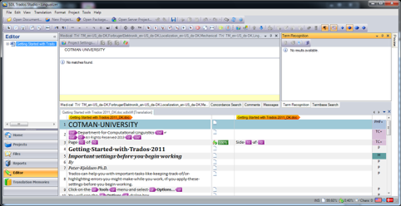
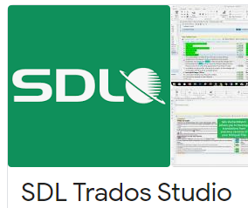

Slide 14
CAT, or Computer-Assisted Translation tools
software packages
speed
accuracy
efficiency
consistency
reducing costs and improving quality in the long term
spellchecking
text alignment
creating glossaries
Translation Memory

Slide 15
What are the trends for the translation industry in 2020?
Artificial intelligence (AI).
MTPE (machine translation & post-editing).
Automated translation.
Tech-driven consistency.
Content strategy localisation.
Emerging industries.
The B-word.
https://www.translateplus.com/blog/7-key-trends-for-the-translation-industry-in-2020/

Slide 16
