Slide 1
Wireless LAN Operations
Notes:
Wireless LAN Operations
This is the second topic that I am going to present to you. This lesson is aimed at providing you with better understanding of the way wireless technology operates. The material covered comes from Cisco Academy program curriculum offered in Scaling Networks.

Slide 2
Wireless LAN Operations
1. Wireless 802.11 Frame
2. Wireless LAN Operations
CSMA/CA
Wireless Clients and Access Point Association
Association Parameters
Discovering Aps
Authentication
3. Channel Management
Frequency Channel Saturation
Selecting Channels
4. Planning WLAN Deployment
5. Summary
Notes:
This is one of the two topics about wireless technology that I am going to present to you. The material covered in these presentation comes from Cisco Academy Program delivered in “Scaling Networks” curriculum.
I hope that after completing the first topic you will have a clear picture of wireless concepts and the wireless infrastructure components that make up wireless networks. In the next topic, I will discuss wireless operations to bring you to a better understanding of how wireless communication works.

Slide 3
Objectives
Describe wireless Frame types.
Describe the content method used in a wireless environment.
Describe association process.
Describe channel management
Describe WLAN deployment plan
Notes:
Objectives
After the lesson, you will be able to describe:
wireless frames.
How wireless clients connect to wireless access points.
How to manage wireless channels.
How to plan the deployment of WLAN

Slide 4
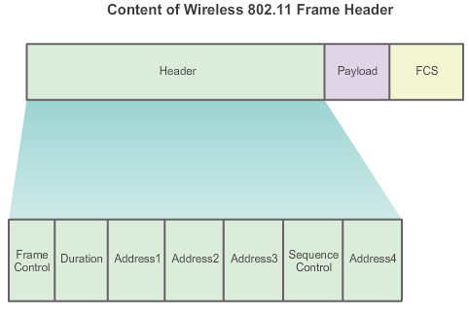
802.11 Frame Structure Wireless 802.11 Frame
Notes:
Wireless 802.11 Frame
All Layer 2 frames consist of a header, payload, and FCS section as shown in Figure 1. The 802.11 frame format is similar to the Ethernet frame format, with the exception that it contains more fields.
As shown in Figure 2, all 802.11 wireless frames contain the following fields:
Frame Control - Identifies the type of wireless frame and contains subfields for protocol version, frame type, address type, power management, and security settings.
Duration - Typically used to indicate the remaining duration needed to receive the next frame transmission.
Address1 - Usually contains the MAC address of the receiving wireless device or AP.
Address2 - Usually contains the MAC address of the transmitting wireless device or AP.
Address3 - Sometimes contains the MAC address of the destination, such as the router interface (default gateway) to which the AP is attached.
Sequence Control - Contains the Sequence Number and the Fragment Number subfields. The Sequence Number indicates the sequence number of each frame. The Fragment Number indicates the number of each frame sent of a fragmented frame.
Address4 - Usually missing because it is used only in ad hoc mode.
Payload - Contains the data for transmission.
FCS - Frame Check Sequence; used for Layer 2 error control.
Figure 3 displays a Wireshark capture of a WLAN beacon frame. Notice how the Frame Control field has also been expanded to display its subfields.
Note: The content of the Address fields vary depending on settings in the Frame Control field.

Slide 5
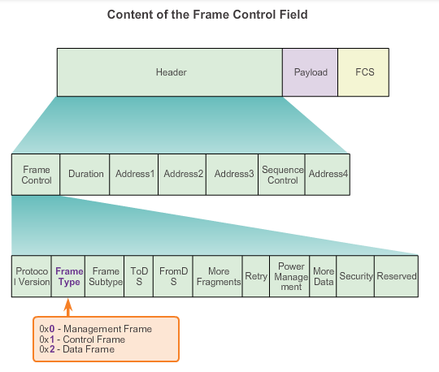
802.11 Frame Structure Wireless Frame Type
Notes:
Wireless Frame Type
Note: The Frame Type and Frame Subtype fields are used to identify the type of wireless transmission. As shown in the figure, a wireless frame can be one of three frame types:
Management Frame - Used in the maintenance of communication, such as finding, authenticating, and associating with an AP.
Control Frame - Used to facilitate in the exchange of data frames between wireless clients.
Data Frame - Used to carry the payload information such as web pages and files.

Slide 6
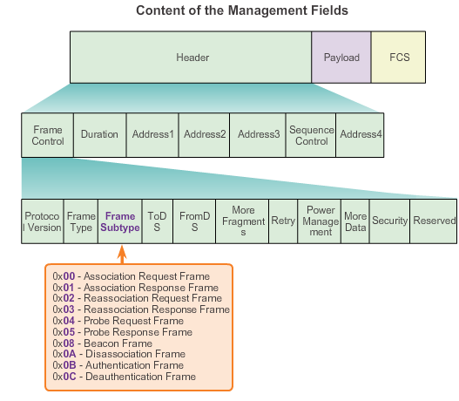
802.11 Frame Structure Management Frames
Notes:
Management Frames
Management frames are used exclusively to find, authenticate, and associate with an AP.
Figure 1 displays the field value of common management frames including:
Association request frame - (0x00) Sent from a wireless client, it enables the AP to allocate resources and synchronize. The frame carries information about the wireless connection including supported data rates and SSID of the network to the wireless client that wants to associate. If the request is accepted, the AP reserves memory and establishes an association ID for the device.
Association response frame - (0x01) Sent from an AP to a wireless client containing the acceptance or rejection to an association request. If it is an acceptance, the frame contains information, such as an association ID and supported data rates.
Reassociation request frame - (0x02) A device sends a reassociation request when it drops from range of the currently associated AP and finds another AP with a stronger signal. The new AP coordinates the forwarding of any information that may still be contained in the buffer of the previous AP.
Reassociation response frame - (0x03) Sent from an AP containing the acceptance or rejection to a device reassociation request frame. The frame includes information required for association, such as the association ID and supported data rates.
Probe request frame - (0x04) Sent from a wireless client when it requires information from another wireless client.
Probe response frame - (0x05) Sent from an AP containing capability information, such as the supported data rates, after receiving a probe request frame.
Beacon frame - (0x08) Sent periodically from an AP to announce its presence and provide the SSID and other preconfigured parameters.
Disassociation frame - (0x0A) Sent from a device wanting to terminate a connection. Allows the AP to relinquish memory allocation and remove the device from the association table.
Authentication frame - (0x0B) The sending device sends an authentication frame to the AP containing its identity.
Deauthentication frame - (0x0C) Sent from a wireless client wanting to terminate connection from another wireless client.
Beacons are the only management frame that may regularly be broadcast by an AP. All other probing, authentication, and association frames are used only during the association (or reassociation) process.
Figure 2 displays a sample Wireshark screen capture of a management frame. The field values change to reflect the purpose of the frame.
Note: The example provided was captured using Wireshark. However, Wireshark must be specifically configured to capture WLAN traffic. The ability to capture traffic varies between operating systems and may require a special wireless NIC.

Slide 7
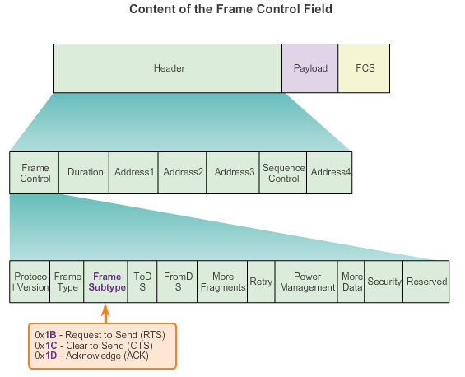
802.11 Frame Structure Control Frames
Notes:
Control Frames
Control frames are used to manage the information exchange between a wireless client and an AP. They help prevent collisions from occurring on the wireless medium.
The figure displays the field value of common control frames including:
Request to Send (RTS) frame - The RTS and CTS frames provide an optional collision reduction scheme for APs with hidden wireless clients. A wireless client sends an RTS frame as the first step in the two-way handshake, which is required before sending data frames.
Clear to Send (CTS) frame - A wireless AP responds to an RTS frame with a CTS frame. It provides clearance for the requesting wireless client to send a data frame. The CTS contributes to collision control management by including a time value. This time delay minimizes the chance that other wireless clients will transmit while the requesting client transmits.
Acknowledgment (ACK) frame - After receiving a data frame, the receiving wireless client sends an ACK frame to the sending client if no errors are found. If the sending client does not receive an ACK frame within a predetermined period of time, the sending client resends the frame.
Control frames are integral to wireless transmission and play a significant role in the media contention method used by wireless, known as Carrier Sense Multiple Access with Collision Avoidance (CSMA/CA).

Slide 8
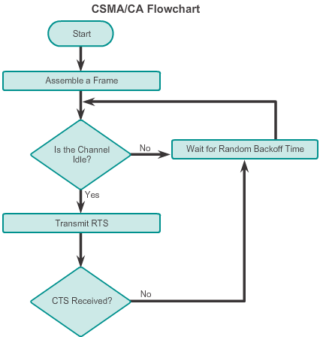
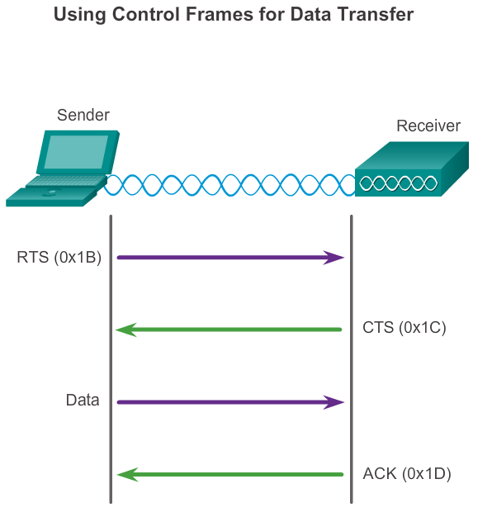
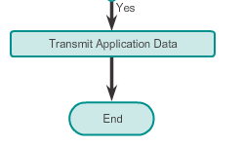
Wireless Operation CSMA/CA
CSMA/CA Flowchart
Notes:
CSMA/CA
Wi-Fi systems are half-duplex, shared media configurations; therefore, wireless clients can transmit and receive on the same radio channel. This creates a problem because a wireless client cannot hear while it is sending; thus, making it impossible to detect a collision. To address this problem, the IEEE developed an additional collision avoidance mechanism called the Distributed Coordination Function (DCF). Using DCF, a wireless client transmits only if the channel is clear. All transmissions are acknowledged; therefore, if a wireless client does not receive an acknowledgment, it assumes a collision occurred and retries after a random waiting interval.
Wireless clients and APs use the RTS and CTS control frames to facilitate the actual data transfer.
The Figure displays a flowchart detailing the CSMA/CA process.

Slide 9
Wireless Operation Wireless Clients and Access Point Association
Figure 1
Notes:
Wireless Clients and Access Point Association
Recall that the media contention method is the method in which devices determine how and when to access the media when traffic must be forwarded across the network. The IEEE 802.11 WLANs use the MAC protocol CSMA/CA. While the name is similar to the Ethernet CSMA/CD, the operating concept is completely different.
As shown in Figure 1, when a wireless client sends data, it first senses the media to determine if other devices are transmitting. If not, it then sends an RTS frame to the AP. This frame is used to request dedicated access to the RF medium for a specified duration. The AP receives the frame and, if available, grants the wireless client access to the RF medium by sending a CTS frame of the same time duration. All other wireless devices observing the CTS frame relinquish the media to the transmitting node for transmission.
The CTS control frame includes the time duration that the transmitting node is allowed to transmit. Other wireless clients withhold transmissions for, at least, the specified duration.
For wireless devices to communicate over a network, they must first associate with an AP or wireless router. An important part of the 802.11 process is discovering a WLAN and subsequently connecting to it.
Management frames are used by wireless devices to complete the following three-stage process:
Discover new wireless AP.
Authenticate with AP.
Associate with AP.
To associate, a wireless client and an AP must agree on specific parameters. Parameters must be configured on the AP and subsequently on the client to enable the negotiation of these processes.

Slide 10
Wireless Operation Association Parameters
SSID – Unique identifier that wireless clients use to distinguish between multiple wireless networks in the same vicinity.
Password – Required from the wireless client to authenticate to the AP. Sometimes called the security key.
Network mode – Refers to the 802.11a/b/g/n/ac/ad WLAN standards. APs and wireless routers can operate in a mixed mode; i.e., it can simultaneously use multiple standards.
Security mode – Refers to the security parameter settings, such as WEP, WPA, or WPA2.
Channel settings – Refers to the frequency bands used to transmit wireless data. Wireless routers and AP can choose the channel setting or it can be manually set.
Notes:
Association Parameters
Common configurable wireless parameters include:
SSID - An SSID is a unique identifier that wireless clients use to distinguish between multiple wireless networks in the same vicinity. The SSID name appears in the list of available wireless network on a client. Depending on the network configuration, several APs on a network can share an SSID. Names are usually 2 to 32 characters long.
Password - Required from the wireless client to authenticate to the AP. A password is sometimes called the security key. It prevents intruders and other unwanted users from accessing the wireless network.
Network mode - Refers to the 802.11a/b/g/n/ac/ad WLAN standards. APs and wireless routers can operate in a Mixed mode meaning that it can simultaneously use multiple standards.
Security mode - Refers to the security parameter settings, such as WEP, WPA, or WPA2. Always enable the highest security level supported.
Channel settings - Refers to the frequency bands being used to transmit wireless data. Wireless routers and AP can choose the channel setting or it can be set manually if there is interference with another AP or wireless device.
Notice that the Linksys EA6500 supports 2.4 GHz and 5 GHz radios.
In Network mode, it can support Mixed, Wireless-N Only, or Wireless-G Only. The Mixed setting provides more flexibility, but it can also slow down communication. For example, if all the wireless clients connecting to the router are using 802.11n, then they all enjoy the better data rates provided. If 802.11g wireless client associate with the AP, then all of the faster wireless client contending for the channel must wait on 802.11g clients to clear the channel before transmitting. However, if all wireless client support 802.11n, then select Wireless-N Only for best performance.

Slide 11
Wireless Operation Discovering APs
Passive mode
AP advertises its service by sending broadcast beacon frames containing the SSID, supported standards, and security settings.
The beacon’s primary purpose is to allow wireless clients to learn which networks and APs are available in a given area.
Active mode
Wireless clients must know the name of the SSID.
Wireless client initiates the process by broadcasting a probe request frame on multiple channels.
Probe request includes the SSID name and standards supported.
May be required if an AP or wireless router is configured to not broadcast beacon frames.
Notes:
Discovering APs
Wireless devices must discover and connect to an AP or wireless router. Wireless clients connect to the AP using a scanning (probing) process. This process can be:
Passive mode - The AP openly advertises its service by periodically sending broadcast beacon frames containing the SSID, supported standards, and security settings. The primary purpose of the beacon is to allow wireless clients to learn which networks and APs are available in a given area, thereby allowing them to choose which network and AP to use.
Active mode - Wireless clients must know the name of the SSID. The wireless client initiates the process by broadcasting a probe request frame on multiple channels. The probe request includes the SSID name and standards supported. Active mode may be required if an AP or wireless router is configured to not broadcast beacon frames.
A wireless client could also send a probe request without an SSID name to discover nearby WLAN networks. APs configured to broadcast beacon frames would respond to the wireless client with a probe response and provide the SSID name. APs with the broadcast SSID feature disabled do not respond.

Slide 12
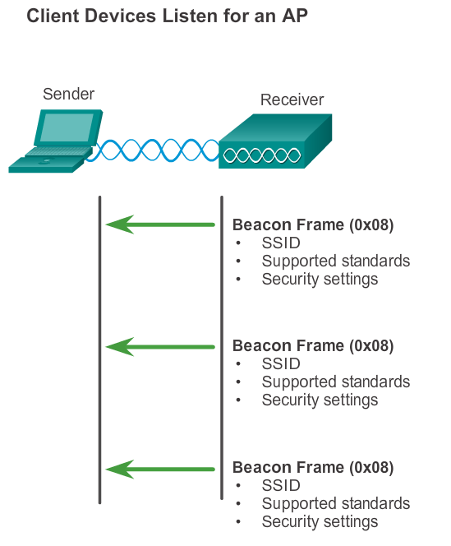
Wireless Operation Discovering APs
Figure 1
Notes:
Discovering Aps
Figure 1 illustrates how passive mode works with the AP broadcasting a beacon frame every so often.

Slide 13
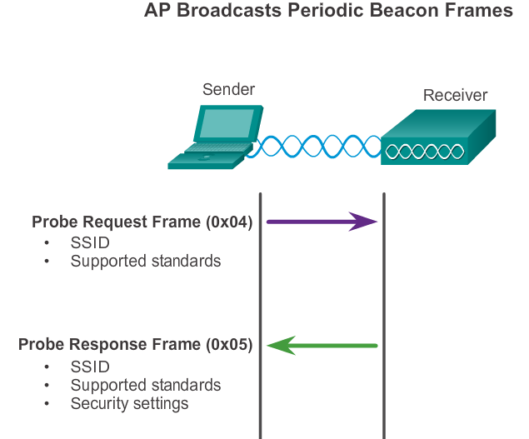
Wireless Operation Discovering APs
Figure 2
Notes:
Discovering APs
Figure 2 illustrates how active mode works with a wireless client broadcasting a probe request for a specific SSID. The AP with that SSID responds with a probe response frame.
A wireless client could also send a probe request without an SSID name to discover nearby WLAN networks. APs configured to broadcast beacon frames would respond to the wireless client with a probe response and provide the SSID name. APs with the broadcast SSID feature disabled do not respond.

Slide 14
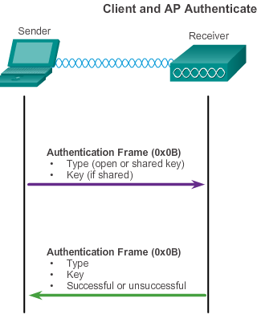
Wireless Operation Authentication
Open authentication – A NULL authentication where the wireless client says “authenticate me” and the AP responds with “yes.” Used where security is of no concern.
Shared key authentication – Technique is based on a key that is pre-shared between the client and the AP.
Notes:
Authentication
The 802.11 standard was originally developed with two authentication mechanisms:
Open authentication - Fundamentally a NULL authentication where the wireless client says “authenticate me” and the AP responds with “yes”. Open authentication provides wireless connectivity to any wireless device and should only be used in situations where security is of no concern.
Shared key authentication - Technique is based on a key that is pre-shared between the client and the AP.
Figure 1 provides a simple overview of the authentication process. However, in most shared key authentication installations, the exchange is as follows:
1. The wireless client sends an authentication frame to the AP.
2. The AP responds with a challenge text to the client.
3. The client encrypts the message using its shared key and returns the encrypted text back to the AP.
4. The AP then decrypts the encrypted text using its shared key.
5. If the decrypted text matches the challenge text, the AP authenticates the client. If the messages do not match, the wireless client is not authenticated and wireless access is denied.
After a wireless client has been authenticated, the AP proceeds to the association stage. As shown in Figure 2, the association stage finalizes settings and establishes the data link between the wireless client and the AP.
As part of this stage:
The wireless client forwards an Association Request frame that includes its MAC address.
The AP responds with an Associate Response that includes the AP BSSID, which is the AP MAC address.
The AP maps a logical port known as the association identifier (AID) to the wireless client. The AID is equivalent to a port on a switch and allows the infrastructure switch to keep track of frames destined for the wireless client to be forwarded.
After a wireless client has associated with an AP, traffic is now able to flow between the client and the AP.

Slide 15
Channel Management Frequency Channel Saturation
Direct-sequence spread spectrum (DSSS)
Uses spread-spectrum modulation technique; designed to spread a signal over a larger frequency band making it more resistant to interference.
Used by 802.11b.
Frequency-hopping spread spectrum (FHSS)
Relies on spread-spectrum methods to communicate.
Transmits radio signals by rapidly switching a carrier signal among many frequency channels.
This channel-hopping process allows for a more efficient usage of the channels, decreasing channel congestion.
Used by the original 802.11 standard.
Notes:
Frequency Channel Saturation
As previously explained, wireless LAN devices have transmitters and receivers tuned to specific frequencies of radio waves to communicate. A common practice is for frequencies to be allocated as ranges. Such ranges are then split into smaller ranges called channels.
If the demand for a specific channel is too high, that channel is likely to become oversaturated. The saturation of the wireless medium degrades the quality of the communication. Over the years, a number of techniques have been created to improve wireless communication and alleviate saturation. The techniques listed below mitigate channel saturation by using the channels in a more efficient way:
Direct-sequence spread spectrum (DSSS) - DSSS is a spread-spectrum modulation technique. Spread-spectrum is designed to spread a signal over a larger frequency band making it more resistant to interference. With DSSS the signal is multiplied by a “crafted noise” known as a spreading code. Because the receiver knows about the spreading code and when it was added, it can mathematically remove it and re-construct the original signal. In effect, this creates redundancy in the transmitted signal in an effort to counter quality loss in the wireless medium. DSSS is used by 802.11b. Also used by cordless phones operating in the 900 MHz, 2.4 GHz, 5.8 GHz bands, CDMA cellular, and GPS networks. (Figure 1)
Frequency-hopping spread spectrum (FHSS) - FHSS also relies on spread-spectrum methods to communicate. It is similar to DSSS but transmits radio signals by rapidly switching a carrier signal among many frequency channels. With the FHSS, sender and receiver must be synchronized to “know” which channel to jump. This channel hopping process allows for a more efficient usage of the channels, decreasing channel congestion. Walkie-talkies and 900 MHz cordless phones also use FHSS, and Bluetooth uses a variation of FHSS. FHSS is also used by the original 802.11 standard. (Figure 2)

Slide 16
Channel Management Frequency Channel Saturation (cont.)
Orthogonal Frequency-Division Multiplexing (OFDM)
Subset of frequency division multiplexing in which a single channel utilizes multiple subchannels on adjacent frequencies.
Because OFDM uses subchannels, channel usage is very efficient.
Used by a number of communication systems, including 802.11a/g/n/ac.
Notes:
Frequency Channel Saturation (continued)
Orthogonal frequency-division multiplexing (OFDM) - OFDM is a subset of frequency division multiplexing in which a single channel utilizes multiple sub-channels on adjacent frequencies. Sub-channels in an OFDM system are precisely orthogonal to one another which allow the sub-channels to overlap without interfering. As a result, OFDM systems are able to maximize spectral efficiency without causing adjacent channel interference. In effect, this makes it easier for a receiving station to “hear” the signal. Because OFDM uses sub-channels, channel usage is very efficient. OFDM is used by a number of communication systems including 802.11a/g/n/ac.

Slide 17
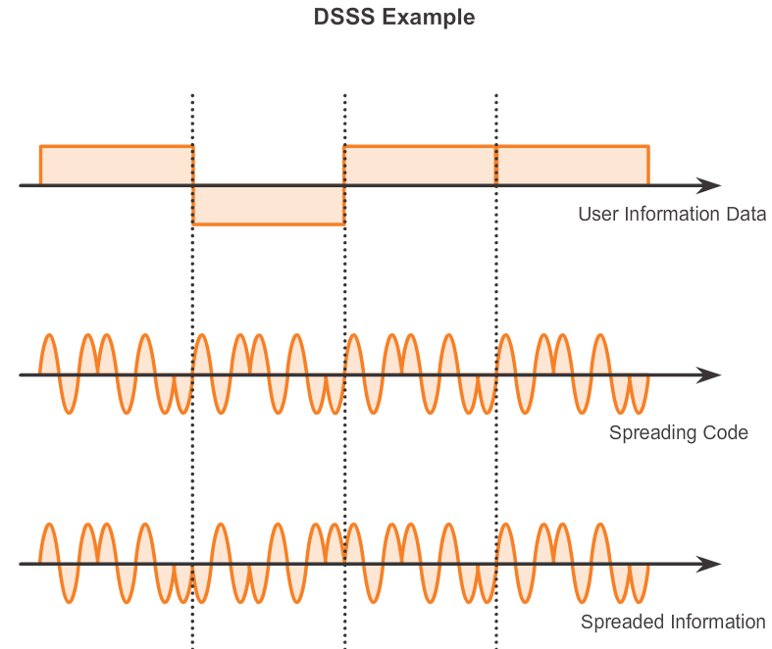

Slide 18
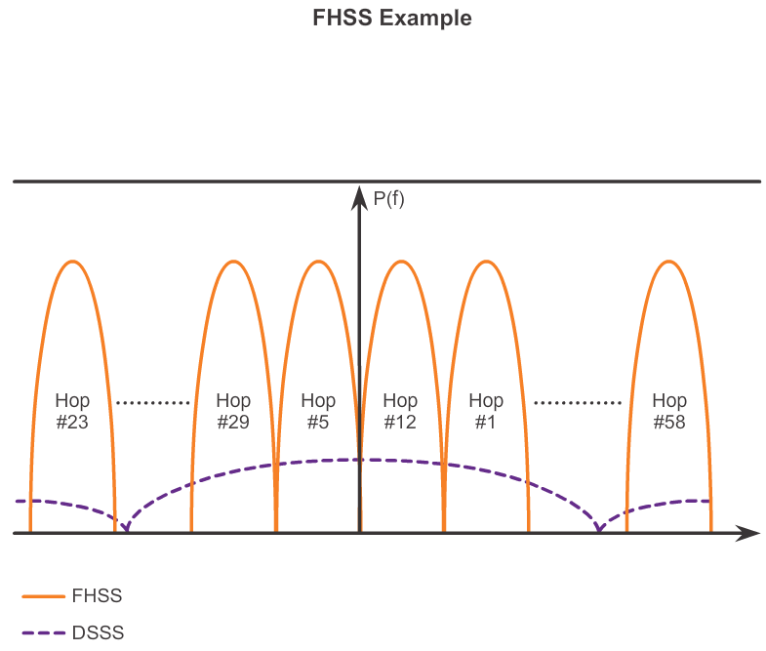

Slide 19
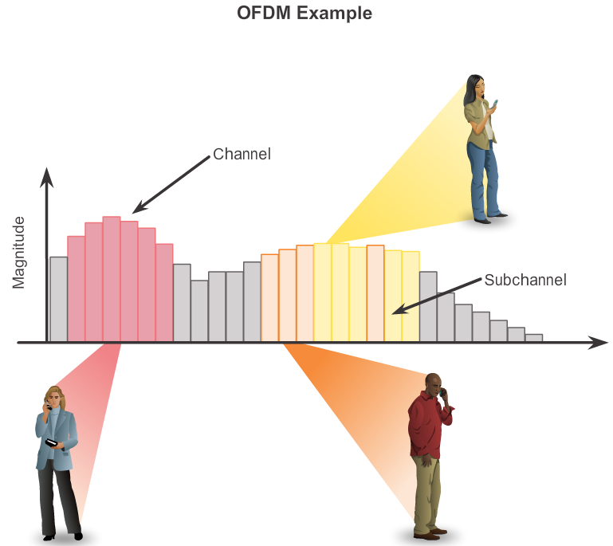

Slide 20
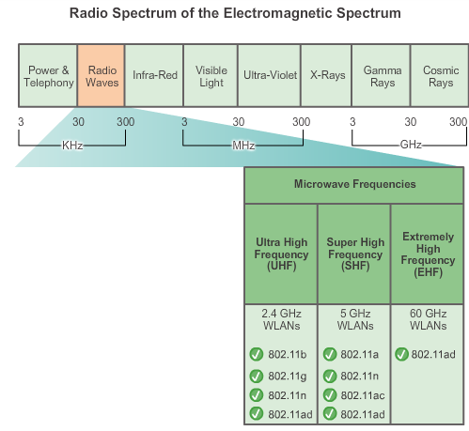
Channel Management Selecting Channels
Figure 1 highlights which 802.11 standard operates in the 2.4 GHz, 5 GHz, and 60 GHz bands. Each spectrum is subdivided into channels with a center frequency and bandwidth, analogous to the way radio bands are subdivided.
Figure 1
Notes:
Selecting Channels
The IEEE 802.11b/g/n all operate in the microwaves frequencies of the radio spectrum. The IEEE 802.11b/g/n standards operate in the 2.4 GHz to 2.5 GHz spectrum while 802.11a/n/ac standards operate in the more heavily regulated 5 GHz band. Figure 1 highlights which 802.11 standard operates in the 2.4 GHz, 5 GHz, and 60 GHz bands. Each spectrum is subdivided into channels with a center frequency and bandwidth, analogous to the way radio bands are subdivided.
The 2.4 GHz band is subdivided into multiple channels. The overall, combined channel bandwidth is 22 MHz with each channel separated by 5 MHz. The 802.11b standard identifies 11 channels for North America. The 22 MHz bandwidth, combined with the 5 MHz separation between frequencies, results in an overlap between successive channels, as shown in Figure 2.
Note: In Europe, there are 13 802.11b channels.
Interference occurs when an undesired signal overlaps a channel reserved for a desired signal, causing possible distortion. The solution to interference is to use non-overlapping channels. Specifically, channels 1, 6, and 11 are non-overlapping 802.11b channels, as shown in Figure 3.
A best practice for WLANs requiring multiple APs is to use non-overlapping channels. If there are three adjacent APs, use channels 1, 6, and 11. If there are just two, select any two that are five channels apart, such as channels 5 and 10. Most APs can automatically select a channel based on adjacent channels used. Some products continuously monitor the radio space to adjust the channel settings dynamically in response to environmental changes.
As enterprise WLANs migrate to 802.11n, they can use channels in the larger, less-crowded 5 GHz band, reducing “accidental denial of service (DoS)”. For instance, the 802.11n standard uses OFDM and can support three non-overlapping channels, as shown in Figure 4.
802.11n can also use channel bonding, which combines two 20 MHz channel into one 40 MHz channel, as shown in Figure 5. Channel bonding increase throughput by using two channels at one time to deliver data.
Most modern APs can auto-adjust channels to circumvent interference.
Note: IEEE 802.11ac uses OFDM with channels widths of 80, 160, and 80+80.

Slide 21
Channel Management Selecting Channels (cont.)
The solution to 802.11b interference is to use nonoverlapping channels 1, 6, and 11.
Notes:
4.2.3.2 Selecting Channels

Slide 22
Channel Management Selecting Channels (cont.)
Use channels in the larger, less-crowded 5 GHz band, reducing “accidental denial of service (DoS),” this band can support four non-overlapping channels.
Notes:
4.2.3.2 Selecting Channels

Slide 23
Channel Management Selecting Channels (cont.)
Channel bonding combines two 20-MHz channels into one 40-MHz channel.
Notes:
4.2.3.2 Selecting Channels

Slide 24
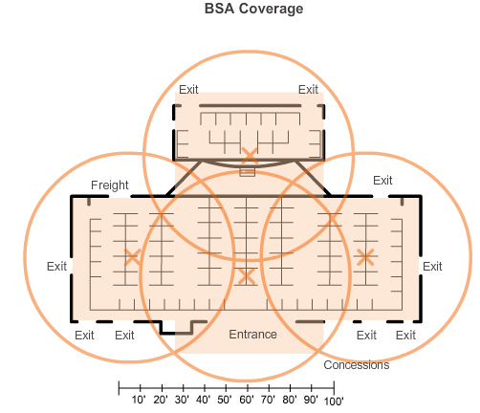
Channel Management Planning a WLAN Deployment
If APs are to use existing wiring, or if there are locations where APs cannot be placed, note these locations on the map.
Position APs above obstructions.
Position APs vertically near the ceiling in the center of each coverage area, if possible.
Position APs in locations where users are expected to be.
Figure 1
Notes:
Planning a WLAN Deployment
Implementing a WLAN that takes the best advantage of resources and delivers the best service can require careful planning. WLANs can range from relatively simple installations to very complex and intricate designs. There should be a well-documented plan before a wireless network can be implemented.
The number of users a WLAN can support is not a straightforward calculation. The number or users depends on the geographical layout of the facility, including the number of bodies and devices that can fit in a space, the data rates users expect, the use of non-overlapping channels by multiple APs in an ESS, and transmit power settings.
When planning the location of APs, the administrator cannot simply draw coverage area circles and drop them over a plan. The approximate circular coverage area is important, but there are some additional recommendations:
If APs are to use existing wiring or if there are locations where APs cannot be placed, note these locations on the map.
Position APs above obstructions.
Position APs vertically near the ceiling in the center of each coverage area, if possible.
Position APs in locations where users are expected to be. For example, conference rooms are typically a better location for APs than a hallway.
When these points have been addressed, estimate the expected coverage area of an AP. This value varies depending on the WLAN standard or mix of standards that are deployed, the nature of the facility, the transmit power that the AP is configured for, and so on. Always consult the specifications for the AP when planning for coverage areas.
BSAs represent the coverage area provided by a single channel. An ESS should have 10 to 15 percent overlap between BSAs in an ESS. With a 15 percent overlap between BSAs, an SSID, and non-overlapping channels (i.e., one cell on channel 1 and the other on channel 6), roaming capability can be created.
Figure 1 provides a sample of how the BSAs could overlap.
Other factors include site surveys, which is a detailed analysis of where to locate the various APs.

Slide 25
Summary
An STA first authenticates with an AP, and then associates with that AP.
The 802.11i/WPA2 authentication standard should be used. Use the AES encryption method with WPA2.
When planning a wireless network, nonoverlapping channels should be used when deploying multiple APs to cover a particular area. There should be a 10–15 percent overlap between BSAs in an ESS.
Cisco APs support PoE to simplify installation.
Notes:
Summary
A wireless client first authenticates with an AP, and then associates with that AP. The 802.11i/WPA2 authentication standard should be used. AES is the encryption method that should be used with WPA2.
When planning a wireless network, non-overlapping channels should be used when deploying multiple APs to cover a particular area. There should be a 10-15 percent overlap between BSAs in an ESS. Cisco APs support PoE to simplify installation.

