Slide 1
Restaurant with the Best Marketing Strategy

Slide 2
Keep in mind that the effectiveness of a marketing strategy can vary depending on the specific restaurant's target audience, location, and competition. It's essential to tailor your approach to your unique circumstances.

Slide 3
1. Digital Marketing and Online Presence: Website: Ensure your restaurant has a well-designed, user-friendly website that includes menus, contact information, and online reservation options. Social Media: Maintain active and engaging social media profiles on platforms like Instagram, Facebook, and Twitter to showcase your food, engage with customers, and run promotions.

Slide 4
2. Content Marketing: Create a blog on your website with articles about food, recipes, and restaurant news to engage with your audience and improve SEO.

Slide 5
3. Email Marketing: Collect customer email addresses and send regular newsletters with updates, special offers, and event announcements.

Slide 6
4. Online Reviews and Reputation Management: Encourage satisfied customers to leave positive reviews on platforms like Google, Yelp, and TripAdvisor, and actively manage and respond to both positive and negative feedback.

Slide 7
5. Loyalty Programs: Implement a loyalty program that rewards frequent customers with discounts, free items, or exclusive access to special events.

Slide 8
6. Influencer Marketing: Collaborate with local influencers or food bloggers to promote your restaurant through reviews and social media posts.

Slide 9
7. Local SEO: Optimize your website for local search terms to improve visibility in search engine results pages for users looking for nearby restaurants.

Slide 10
8. Online Ordering and Delivery Services: Partner with popular food delivery platforms like Uber Eats, Grubhub, or DoorDash to expand your reach and offer delivery services.

Slide 11
Product Ideas for the Restaurant Market: Custom Merchandise: Create branded merchandise such as T-shirts, mugs, or tote bags featuring your restaurant's logo and slogan.

Slide 12
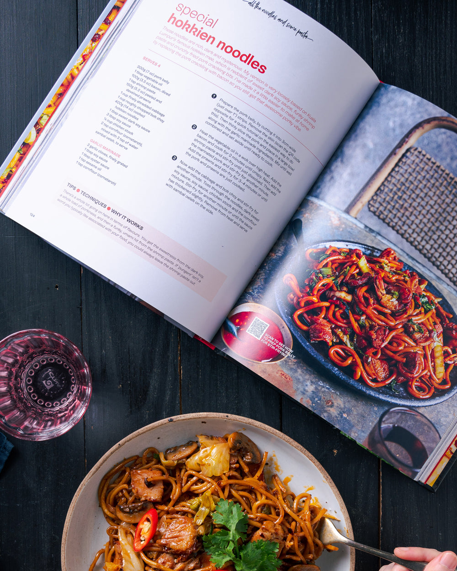
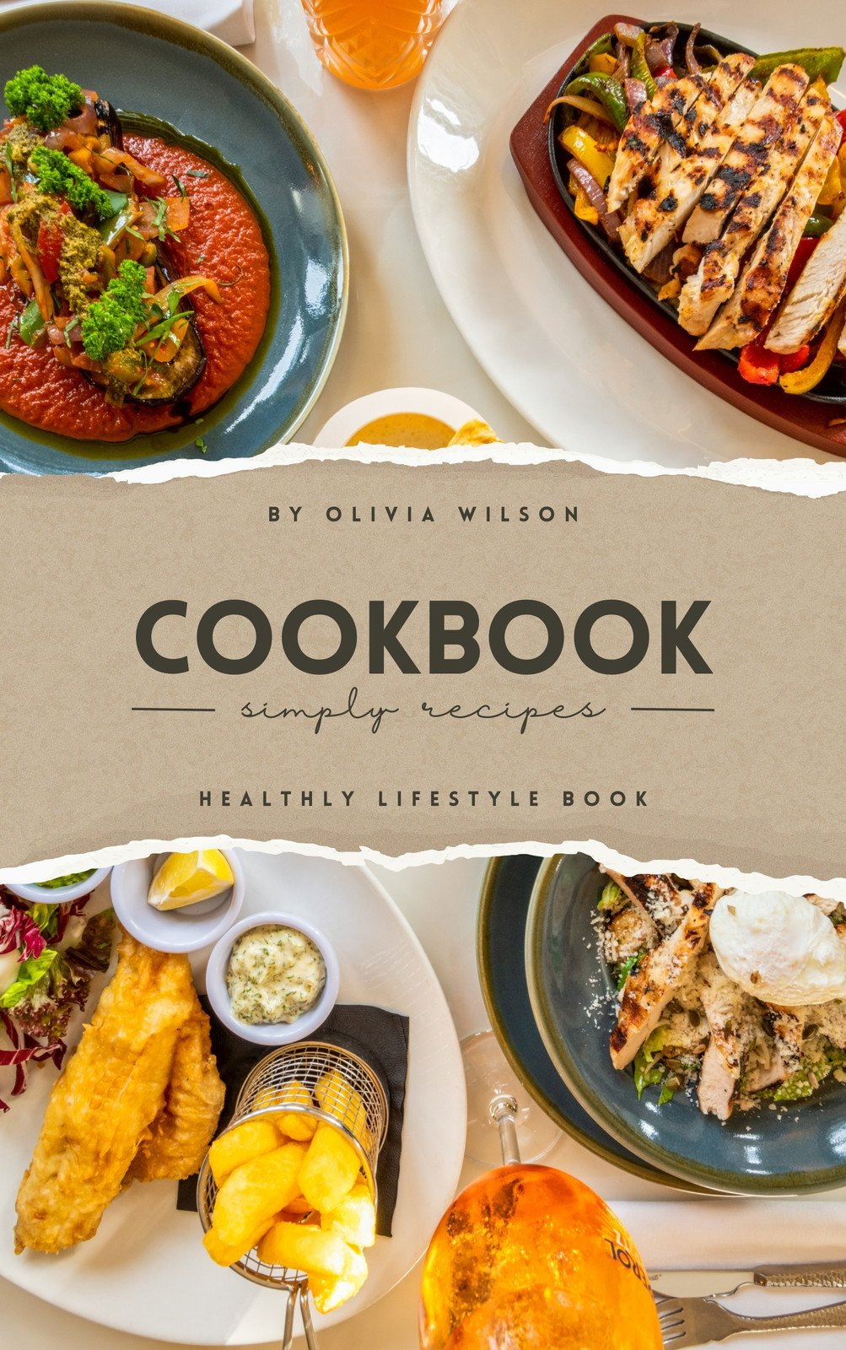
Cookbook: Publish a cookbook featuring some of your signature recipes, allowing customers to recreate their favorite dishes at home.

Slide 13
Meal Kits: Offer meal kits with pre-portioned ingredients and recipes for customers to enjoy your restaurant-quality dishes at home.

Slide 14
Online Cooking Classes: Host virtual cooking classes where your chef teaches customers how to prepare some of your restaurant's specialties.

Slide 15
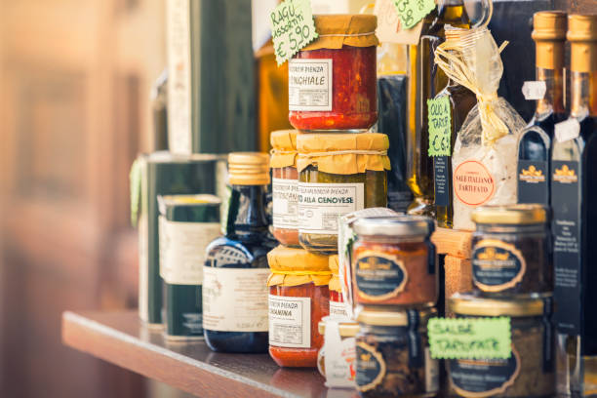
Gourmet Food Products: Package and sell some of your restaurant's popular sauces, dressings, or spice blends for customers to purchase and use at home.

Slide 16
Event Hosting Services: If you have space, offer event hosting services for private parties, meetings, or special occasions.

Slide 17
Remember to research your specific market and customer preferences to determine which strategy and product ideas align best with your restaurant's goals and audience. Regularly evaluate and adjust your marketing approach to stay relevant and competitive in the restaurant industry.

