Slide 1
Лекція 5 - Design & Architecture pt.3: Modern definition

Slide 2
План предмету.
Pt.1: Ввід у предмет. Що таке якість. Перспектива розробника
Pt. 2: Code quality & metrics
Design & Architecture Pt. 1: Технології проєктування
Design & Architecture Pt. 2: Визначення Архітектури
Design & Architecture Pt. 3: Modern definition & tools
Design & Architecture Pt. 4: Characteristics & components
Project lifecycle (PM/PO). Quality assurance (QA). Developer Operations (DevOps)
Standards - IEEE, ISO, Specs, RFC.

Slide 3
План лекції 6
Coupling
Architecture characteristics
Architecture components
Architecture patterns
Why data matters.

Slide 4
Coupling
Fortunately, we have better tools to analyze coupling in code bases, based in part on graph theory: because the method calls and returns form a call graph, analysis based on mathematics becomes possible. In 1979, Edward Yourdon and Larry Constantine published Structured Design: Fundamentals of a Discipline of Computer Program and Systems Design (Prentice-Hall), defining many core concepts, including the metrics afferent and efferent coupling. Afferent coupling measures the number of incoming connections to a code artifact (component, class, function, and so on). Efferent cou‐ pling measures the outgoing connections to other code artifacts. For virtually every platform tools exist that allow architects to analyze the coupling characteristics of code in order to assist in restructuring, migrating, or understanding a code base.

Slide 5
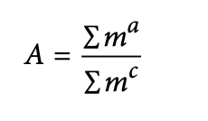
Abstractness, Instability, and Distance from the Main Sequence
These metrics were created by Robert Mar‐ tin for a C++ book, but are widely applicable to other object-oriented languages.
Abstractness is the ratio of abstract artifacts (abstract classes, interfaces, and so on) to concrete artifacts (implementation).

Slide 6
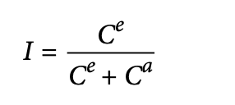
Another derived metric, instability, is defined as the ratio of efferent coupling to the sum of both efferent and afferent coupling
In the equation, ce represents efferent (or outgoing) coupling, and ca represents after‐
ent (or incoming) coupling.
The instability metric determines the volatility of a code base. A code base that exhibits high degrees of instability breaks more easily when changed because of high coupling. For example, if a class calls to many other classes to delegate work, the calling class shows high susceptibility to breakage if one or more of the called methods change.
Calculation Example:
Consider a module with 5 outgoing dependencies (Ce) and 3 incoming dependencies (Ca).
Instability I = Ce / (Ce + Ca) = 5 / (5 + 3) = 5 / 8 = 0.625.
This value indicates the module's tendency to be affected by changes in other parts of the system.

Slide 7
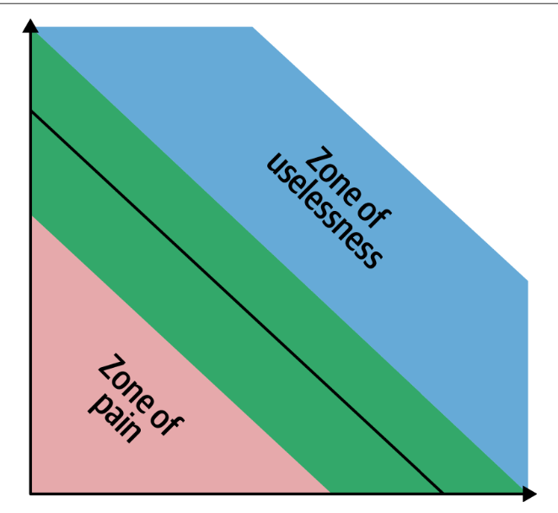
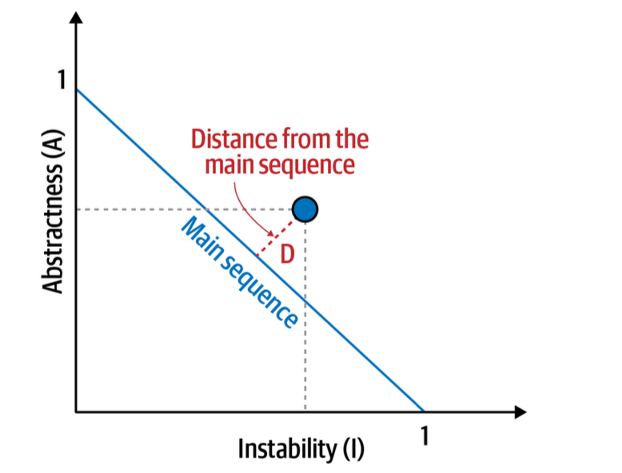
One of the few holistic metrics architects have for architectural structure is distance from the main sequence, a derived metric based on instability and abstractness

Slide 8
Architecture characteristics

Slide 9
Definition
An architecture characteristic meets three criteria:
• Specifies a nondomain design consideration
• Influences some structural aspect of the design
• Is critical or important to application success

Slide 10
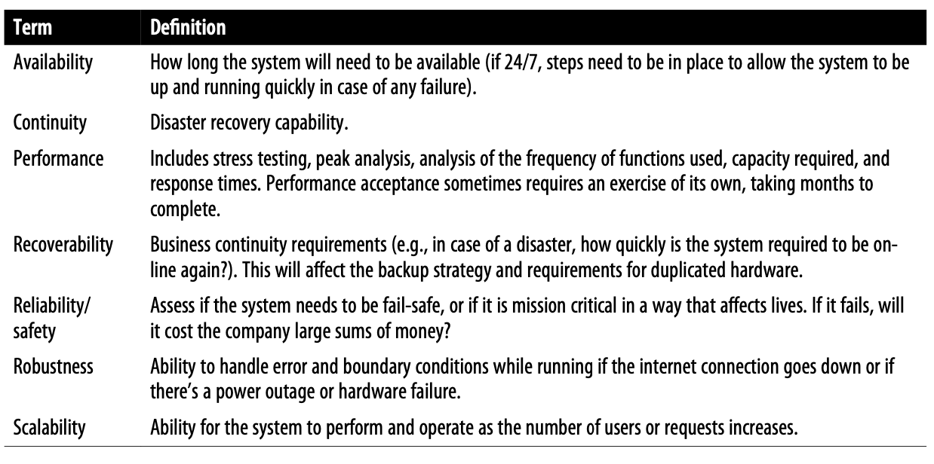
Operational

Slide 11
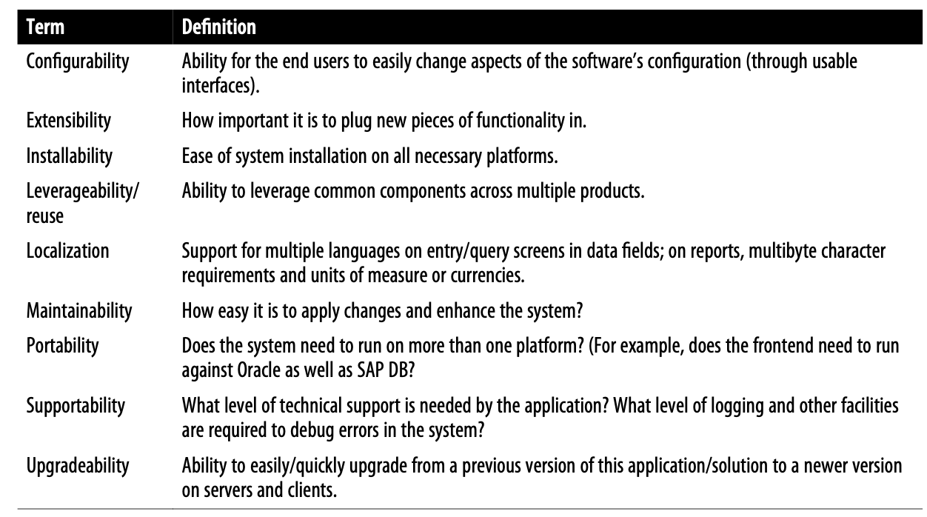
Structural

Slide 12
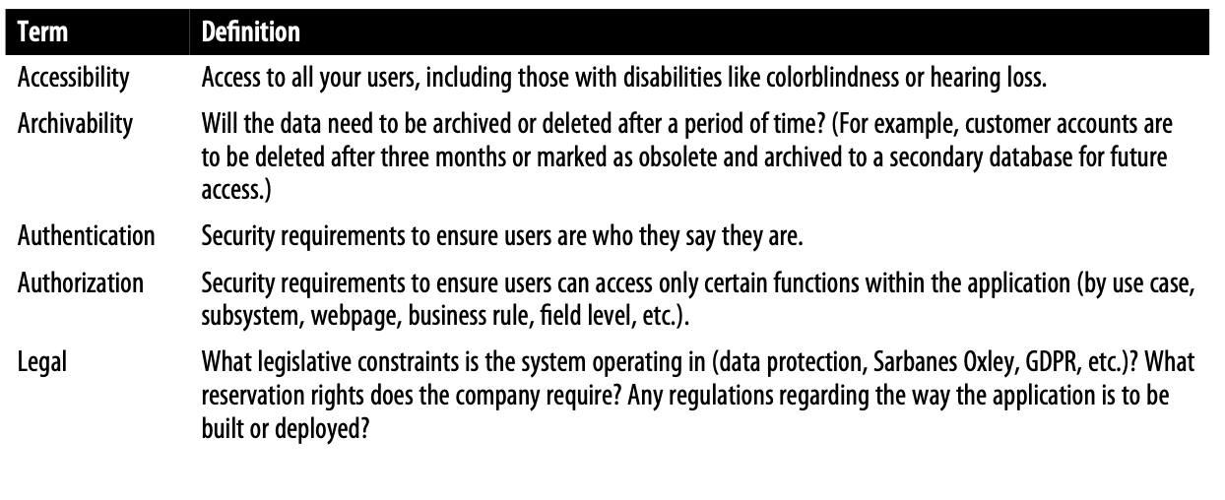
Cross-cutting

Slide 13
Architecture components

Slide 14
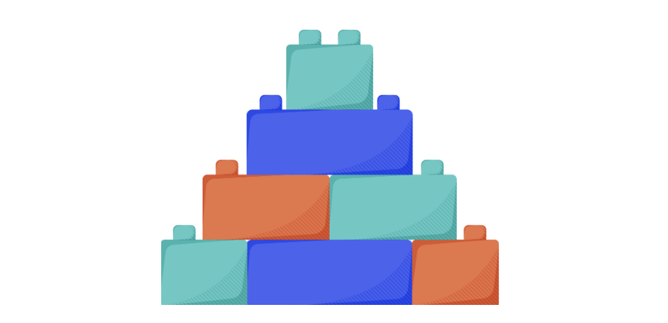
System design problems usually have some similarities, though specific details are often unique. We have extracted these similarities across design problems as the basic building blocks we’ll be covering. One example of a building block is a load-balancing component, which we’ll probably use in every design problem in one way or the other.
The purpose of separating the building blocks is to thoroughly discuss their design just once. This means that later we can use them anywhere without having to go over them in detail again. We can think about building blocks as bricks to construct more effective, capable systems.
Many of the building blocks we discuss are also available for actual use in the public clouds, such as Amazon Web Services (AWS), Azure, and Google Cloud Platform (GCP). We can use such constructs to build a system to further cement our understanding. (We won’t construct the system in this course, but we’ve left it as an exercise for interested learners.)

Slide 15
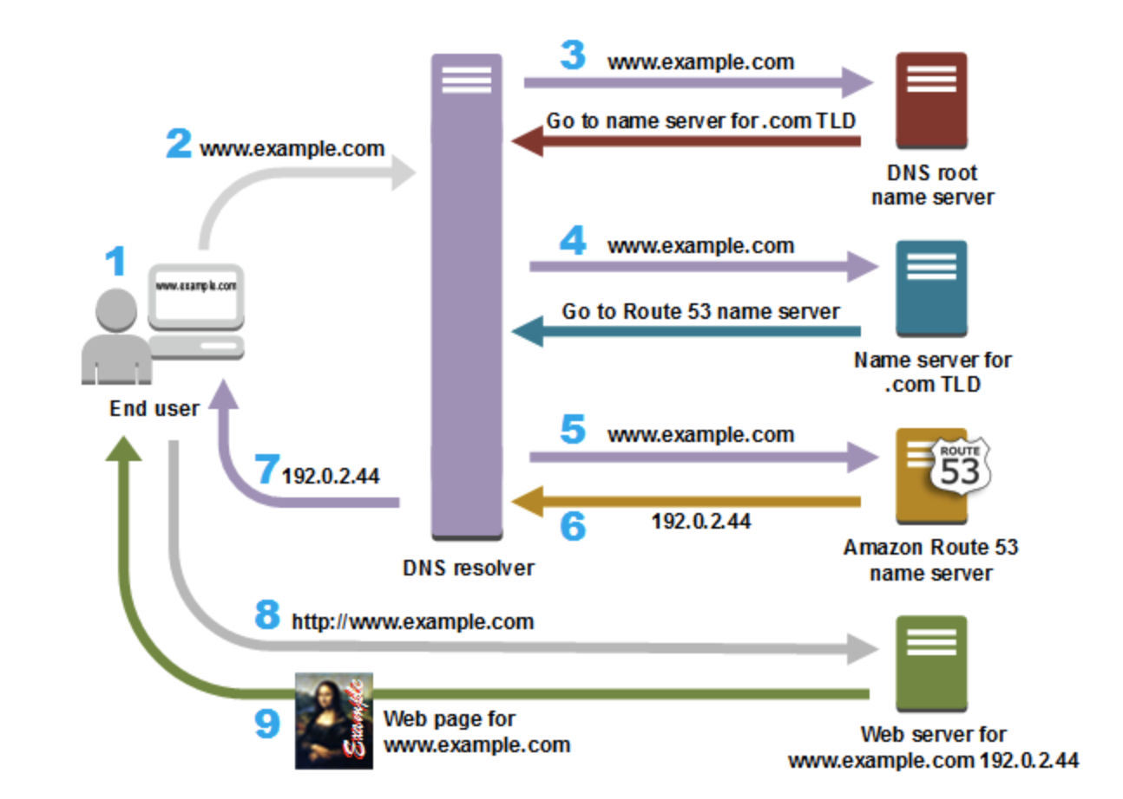
DNS (domain name system)
This building block focuses on how to design hierarchical and distributed naming systems for computers connected to the Internet via different Internet protocols.

Slide 16
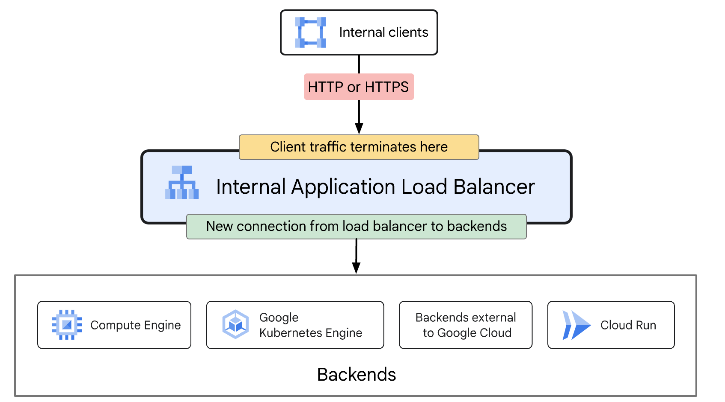
Load Balancers
A load balancer is a device that sits between the user and the server group and acts as an invisible facilitator, ensuring that all resource servers are used equally.

Slide 17
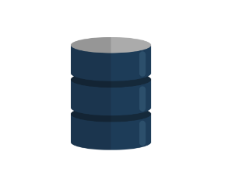
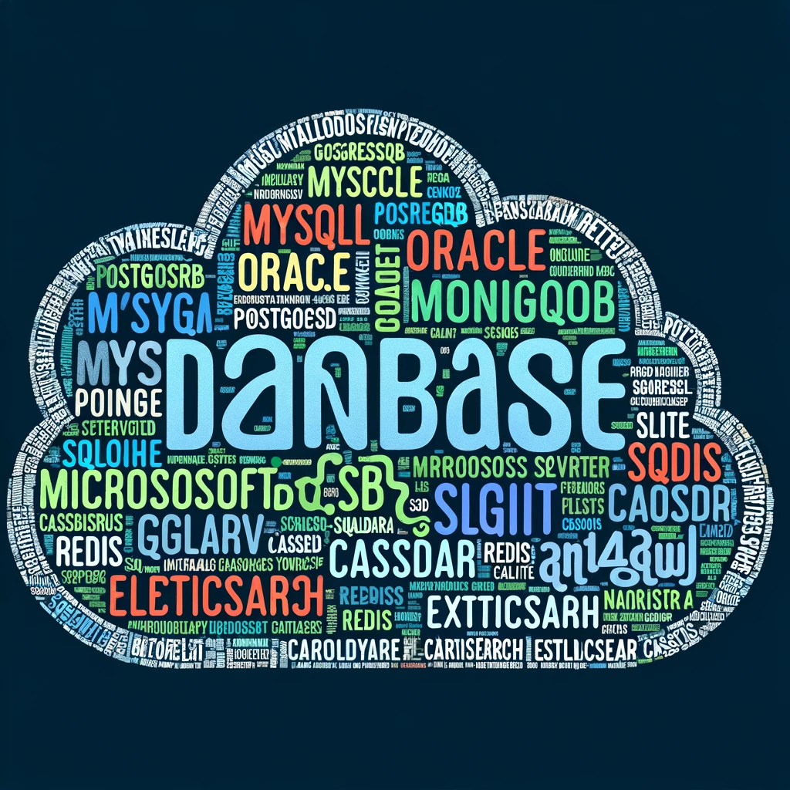
Databases
This building block enables us to store, retrieve, modify, and delete data in connection with different data-processing procedures. Here, we’ll discuss database types, replication, partitioning, and analysis of distributed databases.
Q: what types do you know?

Slide 18
CDN (content delivery network)
A content delivery network (CDN) is a network of interconnected servers that speeds up webpage loading for data-heavy applications. CDN can stand for content delivery network or content distribution network. When a user visits a website, data from that website's server has to travel across the internet to reach the user's computer. If the user is located far from that server, it will take a long time to load a large file, such as a video or website image. Instead, the website content is stored on CDN servers geographically closer to the users and reaches their computers much faster.

Slide 19
Caching
In computing, a cache is a high-speed data storage layer which stores a subset of data, typically transient in nature, so that future requests for that data are served up faster than is possible by accessing the data’s primary storage location. Caching allows you to efficiently reuse previously retrieved or computed data.

Slide 20
pub/sub
Pub/Sub is an asynchronous and scalable messaging service that decouples services producing messages from services processing those messages.

Slide 21
Distributed search
Distributed search is a search engine technique that uses many computers and networks to handle tasks related to indexing, query processing and Web crawling. This distributed model concept uses multiple computers and networks to provide computing and bandwidth resources.
Distributed search, which offers the most efficient search approach and solution, follows the open standards of many search engines, enabling remote querying and results distribution.

Slide 22
Architecture patterns

Slide 23
Layered

Slide 24
Components within the layered architecture style are organized into logical horizontal layers, with each layer performing a specific role within the application (such as presentation logic or business logic). Although there are no specific restrictions in terms of the number and types of layers that must exist, most layered architectures consist of four standard layers: presentation, business, persistence, and database, as illustrated. In some cases, the business layer and persistence layer are combined into a single business layer, particularly when the persistence logic (such as SQL or HSQL) is embedded within the business layer components. Thus, smaller applications may have only three layers, whereas larger and more complex business applications may contain five or more layers.

Slide 25
Pipeline
One of the fundamental styles in software architecture that appears again and again is the pipeline architecture (also known as the pipes and filters architecture). As soon as developers and architects decided to split functionality into discrete parts, this pattern followed. Most developers know this architecture as this underlying principle behind Unix terminal shell languages, such as Bash and Zsh.
Developers in many functional programming languages will see parallels between language constructs and elements of this architecture. In fact, many tools that utilize the MapReduce programming model follow this basic topology. While these examples show a low-level implementation of the pipeline architecture style, it can also be used for higher-level business applications.

Slide 26
Example
tr -cs A-Za-z '\n' |
tr A-Z a-z |
sort |
uniq -c |
sort -rn |
sed ${1}q
Others:
ETL
Orchestrators: Apache Camel
Streaming pipelines

Slide 27
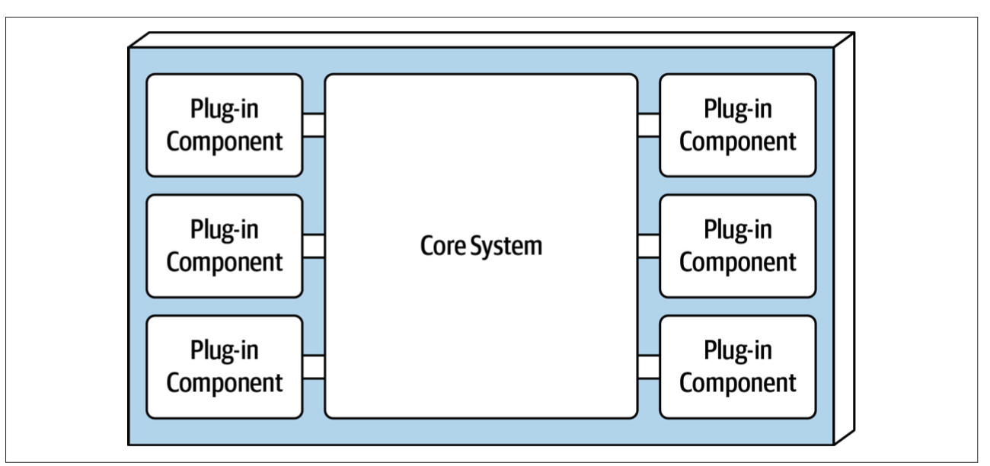
Microkernel
The microkernel architecture style (also referred to as the plug-in architecture) was coined several decades ago and is still widely used today. This architecture style is a natural fit for product-based applications (packaged and made available for download and installation as a single, monolithic deployment, typically installed on the custom‐ er’s site as a third-party product) but is widely used in many nonproduct custom business applications as well.

Slide 28
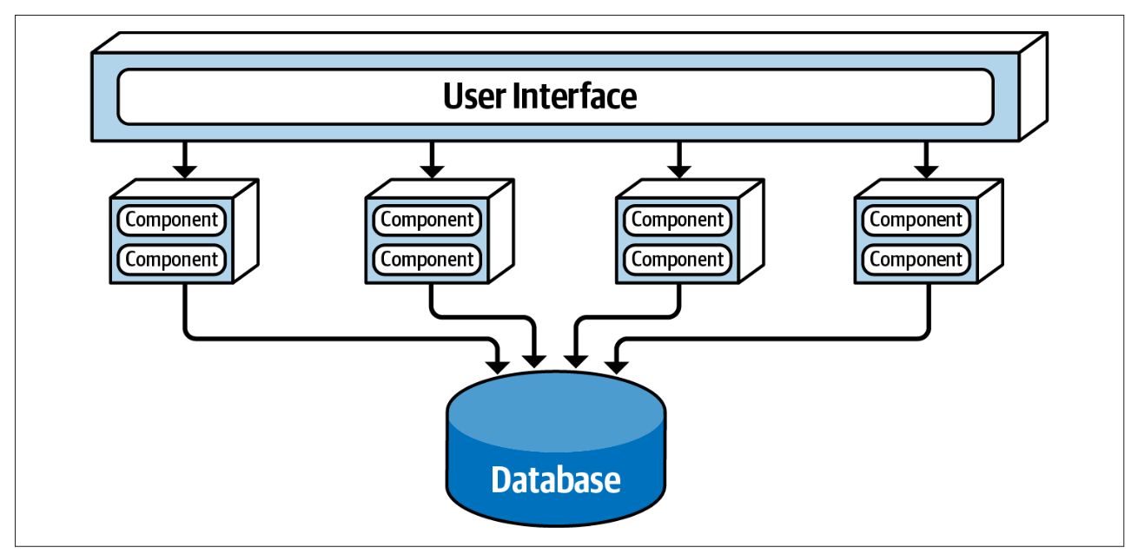
Service-based
Service-based architecture is a hybrid of the microservices architecture style and is considered one of the most pragmatic architecture styles, mostly due to its architectural flexibility. Although service-based architecture is a distributed architecture, it doesn’t have the same level of complexity and cost as other distributed architectures, such as microservices or event-driven architecture, making it a very popular choice for many business-related applications.

Slide 29
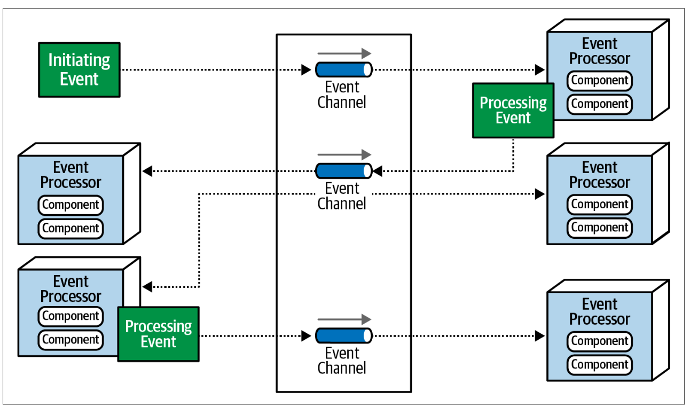
Event driven
The event-driven architecture style is a popular distributed asynchronous architecture style used to produce highly scalable and high-performance applications. It is also highly adaptable and can be used for small applications and as well as large, complex ones. Event-driven architecture is made up of decoupled event processing compo‐ nents that asynchronously receive and process events. It can be used as a standalone architecture style or embedded within other architecture styles (such as an event- driven microservices architecture).

Slide 30
Other types
Microservices
Space based
Orchestration-Driven Service oriented Architecture

Slide 31
Why data matters?

Slide 32
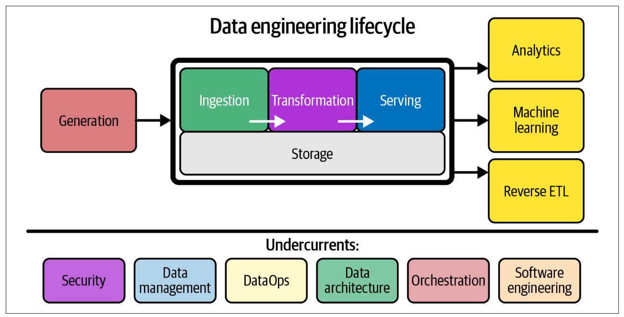
Data engineering
Data engineering is the development, implementation, and maintenance of systems and processes that take in raw data and produce high-quality, consistent information that supports downstream use cases, such as analysis and machine learning. Data engi‐ neering is the intersection of security, data management, DataOps, data architecture, orchestration, and software engineering. A data engineer manages the data engineering lifecycle, beginning with getting data from source systems and ending with serving data for use cases, such as analysis or machine learning.

Slide 33
Data architecture
TOGAF is The Open Group Architecture Framework, a standard of The Open Group. It’s touted as the most widely used architecture framework today. Here’s the TOGAF definition
The term “enterprise” in the context of “enterprise architecture” can denote an entire enterprise—encompassing all of its information and technology services, processes, and infrastructure—or a specific domain within the enterprise. In both cases, the architecture crosses multiple systems, and multiple functional groups within the enterprise.
TOGAF defines data architecture as follows: A description of the structure and interaction of the enterprise’s major types and sources of data, logical data assets, physical data assets, and data management resources.

Slide 34
The AWS Well-Architected Framework consists of six pillars:
• Operational excellence
• Security
• Reliability
• Performance efficiency
• Cost optimization
• Sustainability
Google Cloud’s Five Principles for Cloud-Native Architecture are as follows:
• Design for automation.
• Be smart with state.
• Favor managed services.
• Practice defense in depth.
• Always be architecting.
We advise you to carefully study both frameworks, identify valuable ideas, and determine points of disagreement. We’d like to expand or elaborate on these pillars with these principles of data engineering architecture:
1. Choose common components wisely.
2. Plan for failure.
3. Architect for scalability.
4. Architecture is leadership.
5. Always be architecting.
6. Build loosely coupled systems.
7. Make reversible decisions.
8. Prioritize security.
9. Embrace FinOps.

Slide 35
Data warehouse
A data warehouse is a central data hub used for reporting and analysis. Data in a data warehouse is typically highly formatted and structured for analytics use cases. It’s among the oldest and most well-established data architectures.

Slide 36
Data Lake
Among the most popular architectures that appeared during the big data era is the data lake. Instead of imposing tight structural limitations on data, why not simply dump all of your data—structured and unstructured—into a central location? The data lake promised to be a democratizing force, liberating the business to drink from a fountain of limitless data. The first-generation data lake, “data lake 1.0,” made solid contributions but generally failed to deliver on its promise.

Slide 37
Others
data lakehouse
data platforms
Lambda architecture
Kappa architecture
Batch/Stream/Real Time analytics
IoT architecture
Data mesh
Data fabric
Data hub
Scaled architecture
metadata-first architecture
live data stacks

Slide 38
END

