Slide 1
Wireless Router and Clients Configuration
Subhrendu Guha Neogi
Instructor Trainer, Sir Padampat Singhania University, Udaipur, Rajasthan, India
Subhrendu.neogi@spsu.ac.in

Slide 2
Agenda
Configuring Wireless Access Point / Wireless Router
Configuring Wireless Clients – PC, Smartphones, Tablets
Setting up a Home Network to Access Internet

Slide 3
Configuring Wireless Access Point / Wireless Router

Slide 4
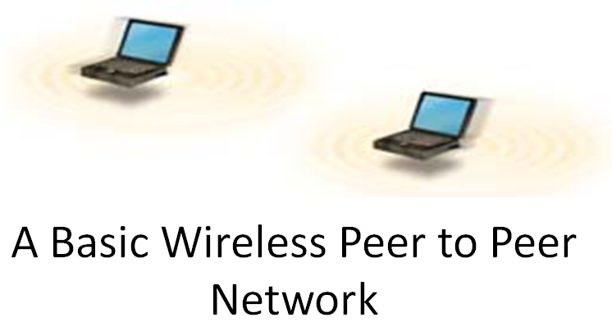
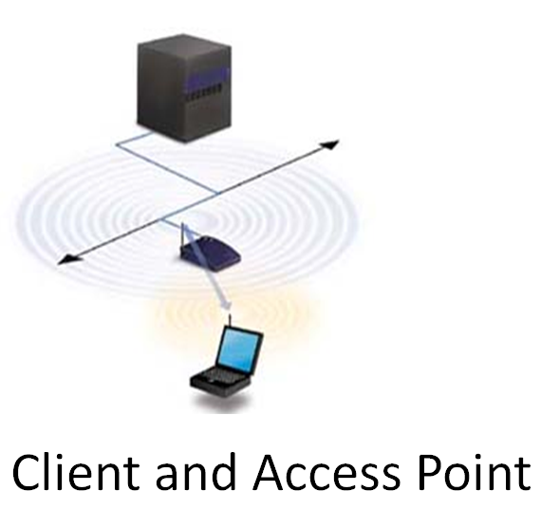
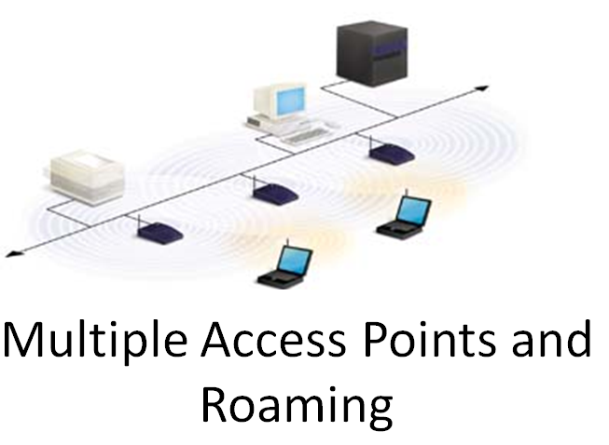
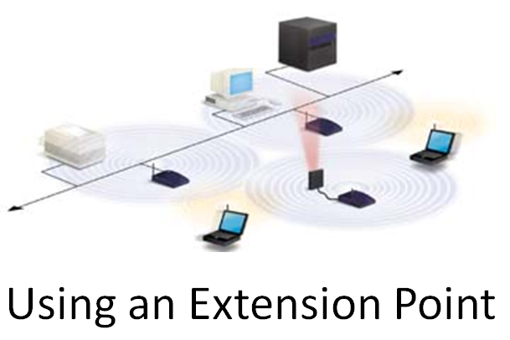
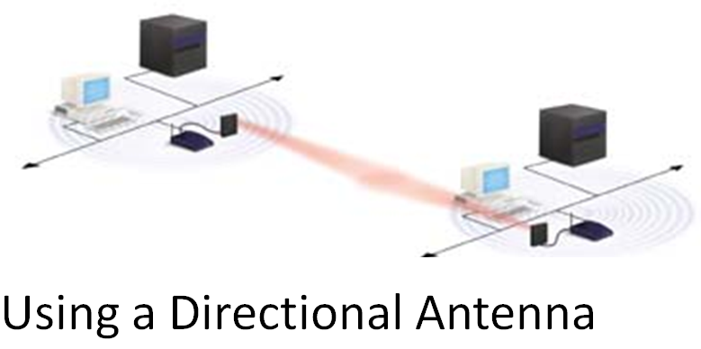
How to Configure Wireless LANs
Five ways to configure a wireless LAN
Peer-to-peer network
Client and access point
Multiple access points and roaming
Using an extension point
Using a directional antenna
Wireless Setup
SSID
Channel
Security
MAC Filter

Slide 5
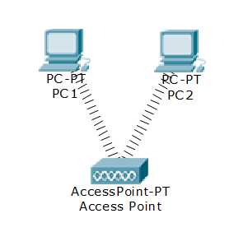
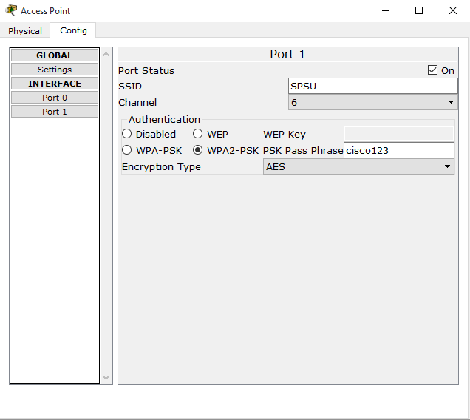
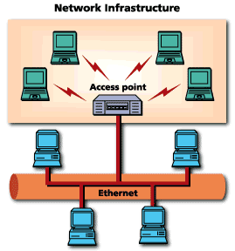
Configuring Wireless Access Point
Connecting PC for configuration
Configuring Wireless Port
Configuring SSID
Configuring Authentication
Selecting Encryption Type
MAC authentication
Advanced Wireless Settings

Slide 6
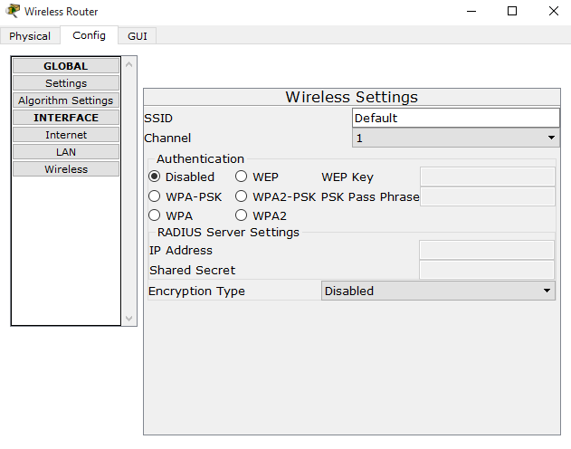
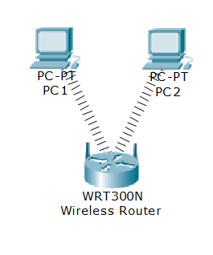
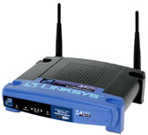
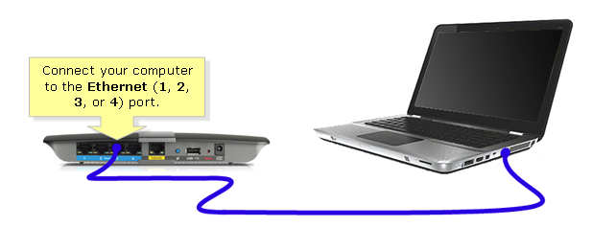
Configuring Wireless Router
Connecting PC for configuration
Configuring Internet Port
Configuring SSID
Configuring DHCP
Configuring Authentication
Selecting Encryption Type
MAC authentication
Advanced Wireless Settings

Slide 7
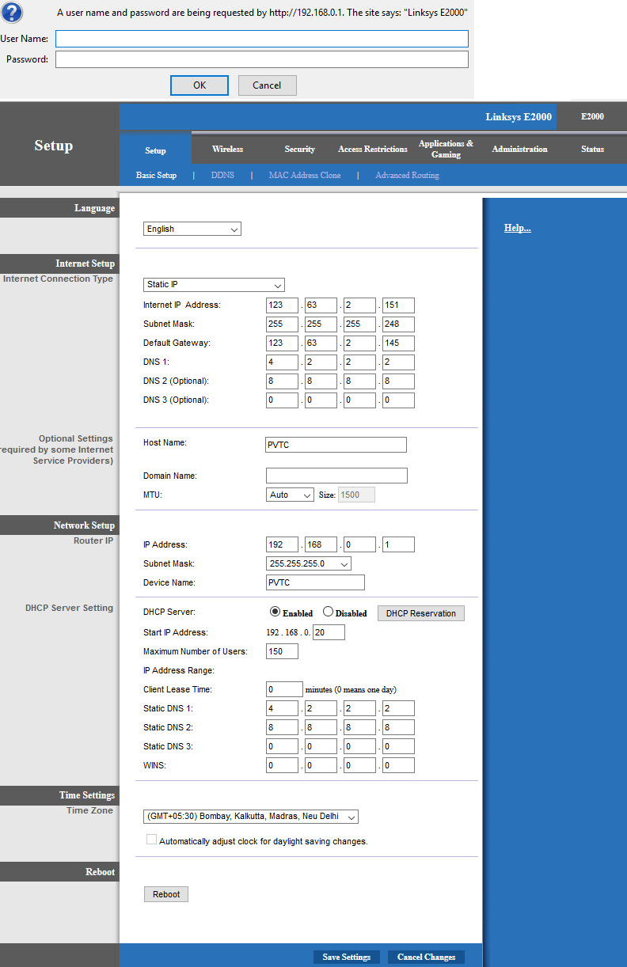
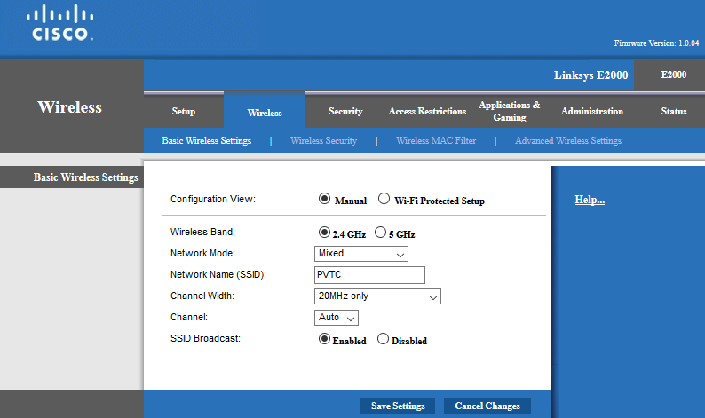

Slide 8
Main Menus and Sub Menus
A Main Menu Item
Firmware Version
Sub-Menu Items for the “Setup” menu
Wireless Router Model #

Slide 9
“Basic Setup” Sub-Menu
Router to Modem setup
Router’s IP Address
Help
Take a note of the DNS Server Addresses
Disable DHCP, It is safer to use Static IPs
Save

Slide 10
Changing the Password

Slide 11
Configuring the Radio Interface
Enable the radio interface, configure the SSID and disable SSID Broadcasting

Slide 12
Configure WEP Key
Make sure that you right down the automatically generated 26 hex digits key. The hex key will be used later to configure the wireless clients

Slide 13
Stronger Encryption

Slide 14
MAC Authentication
To get the MAC address of your Wireless card, Go to DOS and type “ipconfig /all

Slide 15
Advanced Wireless Settings

Slide 16
Configuring Port Forwarding

Slide 17
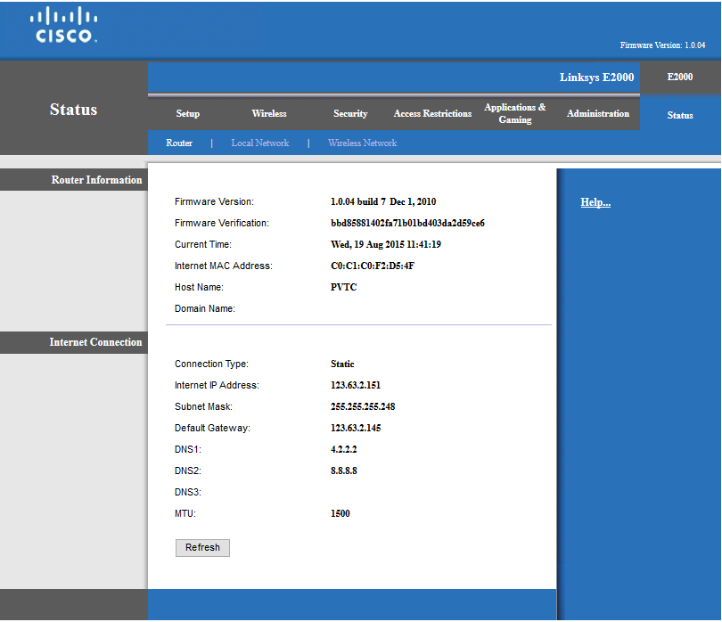
Status of Wireless Settings

Slide 18
Configuring Wireless Clients – PC, Smartphones, Tablets

Slide 19
Configuring Wireless Clients
Client configuration – Select SSID for the Wireless Device
Provide Key as per Security mode of Wireless Device WPA/WPA2
Configure IP Address
Test the connectivity

Slide 20
Setting up a Home Network to Access Internet

Slide 21
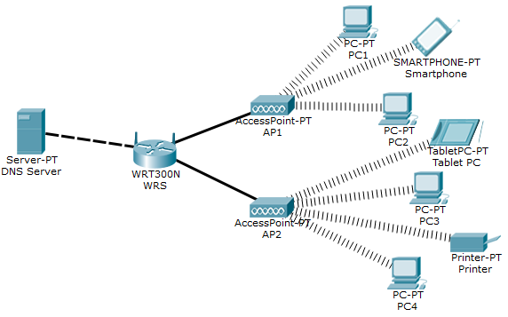
Setting up a Home Network to Access Internet
Devices used in Topology
Wireless Router
Wireless Access Point
PC/Laptop
Wireless Printer
Smartphone
Tablet PC
Configuring Wireless Router for Internet Access
Configuring Wireless Access Point
Test the connectivity

Slide 22
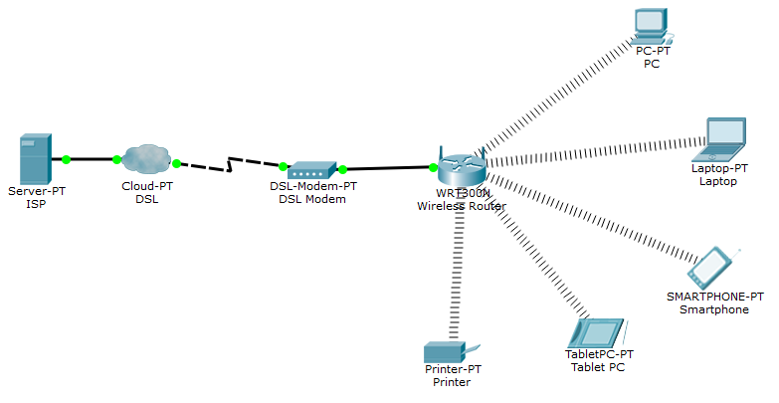

Slide 23
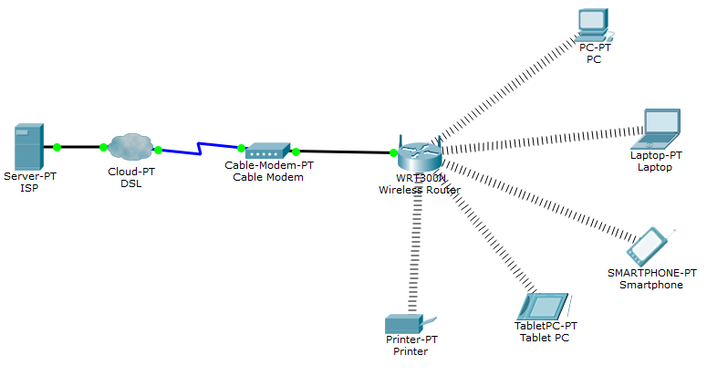

Slide 24
Learning Outcome
How to configure a Wireless AP
How to configure Wireless Clients
How to set up a Home Network to Access Internet

