Slide 1
Event Management – Poetry Evening

Slide 2
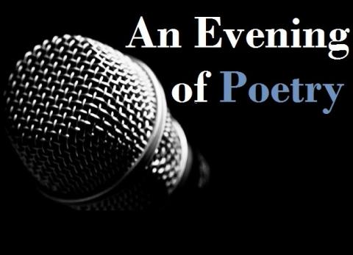
Organizing a poetry evening at a restaurant can add a unique and intimate touch to your event. Here's a step-by-step guide on how to plan and manage a successful poetry evening in a restaurant setting:
Define Your Objectives: Determine the purpose of the event. Are you hosting it to showcase local poets, celebrate a special occasion, or simply to provide a creative and enjoyable evening for guests?
Set a Date and Time: Select a date and time that works for both your target audience and the restaurant. Evening or weekend slots often work well for poetry events.

Slide 3
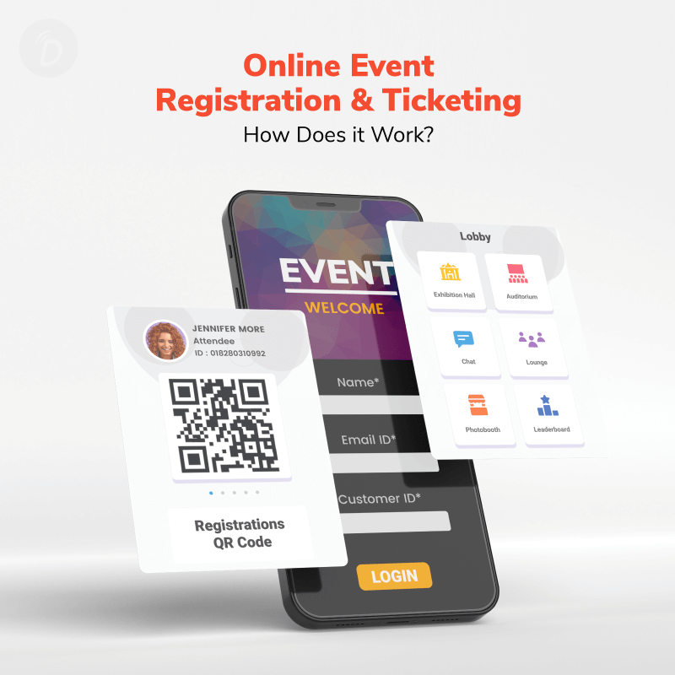
Budgeting: Create a budget that includes food and beverage costs, marketing expenses, and any fees for performers or hosts. Consider whether the event will be free or ticketed to cover expenses.
Invitations and RSVPs: Send out invitations or create an event page online. Encourage attendees to RSVP so you can provide an accurate count to the restaurant for seating and catering purposes.
Ticketing and Registration: Decide on the ticketing system, whether it's through an online platform or at the restaurant. Ensure that guests can easily purchase tickets in advance.

Slide 4
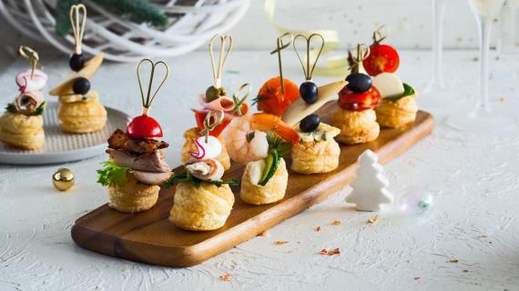
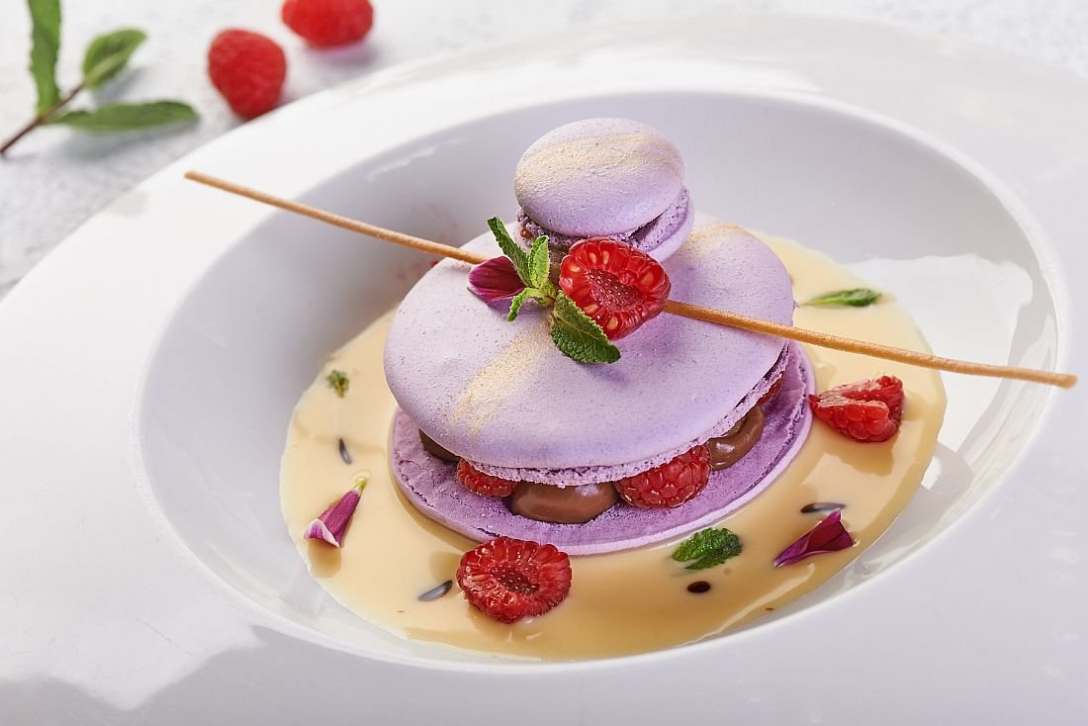
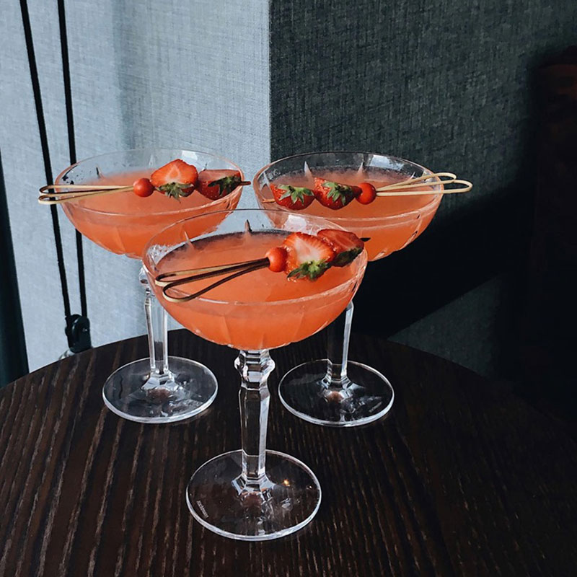
Event Theme and Decor: Choose a theme or aesthetic for the evening and decorate the restaurant accordingly. Consider table centerpieces, candles, or artistic displays that complement the poetry theme.
Menu Selection: Create a special menu or select dishes and beverages that complement the evening's theme. Consider offering appetizers, drinks, and desserts for guests to enjoy.

Slide 5
Program Structure: Plan the structure of the evening, including the order of performers, breaks, and any interactive activities or audience engagement. Designate an emcee or host to guide the event.
Promotion and Marketing: Promote the event through social media, email invitations, and local event listings. Use visually appealing posters and flyers to grab attention and generate interest.
Follow-Up: After the event, send thank-you notes or emails to performers, sponsors, and attendees. Gather feedback to improve future events.

Slide 6
Here is an example of a successful evening of poetry in a restaurant: Normal Art Restaurant in Kyiv Poetry evenings in this restaurant take place with the participation of Eugene Soya.
Eugene Soya is a poet and traveler, one of the first and one of the brightest representatives of the new poetic wave. The author of nine poetry collections and the unforgettable hit "Echo of a Thousand Stations". Eugene will tell you about what he searched for in hundreds of cities, everything is intimate - as it should be when poetry is involved. Such evenings make city lights brighter, cars run faster, and love be sweeter, put the hearts of poetry and be happy.

Slide 7
An on-line marketing campagne to promote this event
Campaign Elements:
- Event Landing Page;
Social Media Teasers;
Email Marketing;
Content Marketing;
- Online Tickets and Reservations;
- Social Media Contests;
Video Promotions;
Collaborations;
Email Reminders;
Feedback and Engagement.

