Slide 1
Introduction to Corpus Linguistics
Lecture 5

Slide 2
Corpus Linguistics is NOT
able to provide negative evidence
able to explain why
able to provide all possible language at one time
a branch of linguistics, but the route into linguistics
a distinct paradigm in linguistics but a methodology

Slide 3
Corpus Linguistics is NOT
a linguistic theory but rather a methodology
quite a revolt against an authoritarian ideology, it is nonetheless an argument for greater reliance on evidence
purely observational or descriptive in its goals, but also has theoretical implications

Slide 4
Corpus Linguistics IS
a practice, rather than a theory
the study of language based on evidence from large collections of computer-readable texts and aided by electronic tools
a vital and innovative area of research

Slide 5
Corpus Linguistics IS
a newly emerging empirical framework that combines a firm commitment to rigorous statistical methods with a linguistically soph-isticated perspective on language structure and use
a relatively modern term used to refer to a methodology, which is based on examples of “real life” language use

Slide 6
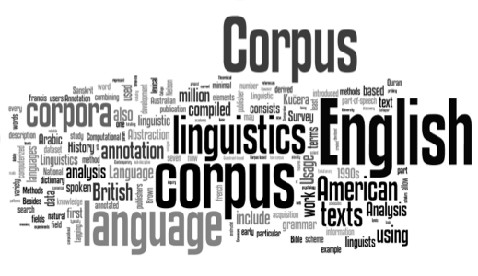
System and Corpus: Exploring Connections(Equinox, 2005):
Corpus Linguistics “is essentially a method for investigating language”, and is “almost perversely ‘theory-light’”.

Slide 7
Corpus Linguistics
Corpus linguistics is the study of language based on large collections of "real life" language use stored in corpora (or corpuses) – computerized databases created for linguistic research.
It is also known as corpus-based studies [Nordquist, 2019].

Slide 8
Corpus Linguistics finds out
What are the most frequent words and phrases?
What are the differences between written and spoken language?
What tenses do people use most frequently?
What prepositions follow particular verbs?
How often do people use idiomatic expressions?

Slide 9
Corpus Linguistics Peculiarities
Corpus linguistics is concerned with meaning, with symbolic content. People are not interested in grammatical constructions; they want to know the meaning of what has been said.
Corpus linguistics looks at language from a social, not a psychological perspective. Language is verbal communication between people, is the discourse of what is actually being said (written) and listened to (read).
Corpus linguistics is diachronic. Whatever is said is a reaction to things that have been said before. We can only fully understand utterances if we know what they refer to. The discourse has, of necessity, adiachronic dimension.

Slide 10
Corpus Linguistics Peculiarities
Corpus linguistics uses frequency to arrive at generalisations. The generalisations that corpus linguistics arrives at are not interpreted as laws or rules, but as plausible ways to group similar things together.
Corpus linguistics can also make specific claims concerning unique events of language phenomena by showing in which aspects this event differs from all other occurrences of the same type of phenomenon .

Slide 11
Corpus Linguistics
Chafe
corpus linguistics as proceeding from understanding lan-guage to understanding mind
Tognini-Bonelli
explores the corpus-driven approach in greater depth, calling it aqualitative revolution
De Beaugrande
asserts that corpora reveal not the disorder of language use, but its different modes of order

Slide 12
Corpus Linguistics
Sinclair
focuses on meaning, posits the lexical item as the principal unit of meaning, and asserts that it is monosemous.
Fillmore
concedes the benefits of corpus data to an armchair (theoretical) linguist.
Aarts
suggests that corpus linguistsshould focus more on “the qualitative data that corpora can furnish”

Slide 13
Corpus Approach (Biber, Conrad&Reppen, 1998)
It is empirical, analyzing the actual patterns of language use in natural texts.
It utilizes a large and principled collection of natural texts as the basis for analysis.
It makes extensive use of computers for analysis.
It depends on both quantitative and qualitative analytical techniques.

Slide 14
Corpus Linguistics Targets
Phraseology
Lexico
grammar
Register
ESP

Slide 15
Phraseology
Collocation
Lexical bundles
Preferred sequences

Slide 16
Lexico grammar
Sinclair (1991): “... there is no difference between lexis and grammar, or that lexis and grammar are so closely intertwined that they cannot be productively studied separately. Certain lexical items fall in certain patterns and certain patterns contain certain lexical items ...”

Slide 17
Register
Register is viewed as a situation of use.

Slide 18
English for Specific Purposes (ESP)
The Academic Word List (AWL): https://www.wgtn.ac.nz/lals/resources/academicwordlist
The Business Letters Corpus (BLC): http://www.someya-net.com/concordancer/

Slide 19
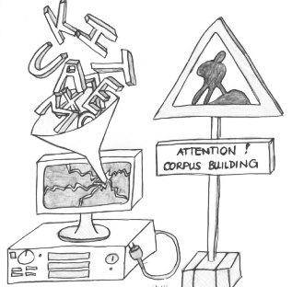
Corpus
A corpus is viewed as a principled collection of authentic texts stored electronically that can be used to discover information about language that may not have been noticed through intuition alone.

Slide 20
Types of Corpora
generalized corpora
specialized corpora
learner corpora
pedagogic corpora

Slide 21
References
An Introduction to Applied Linguistics : https://www.press.umich.edu/pdf/9780472033850-part1.pdf
Introduction to Corpus Linguistics: Critical Concepts in Linguistics (6 volumes). Available from: https://www.researchgate.net/publication/282649636_Introduction_to_Corpus_Linguistics_Critical_Concepts_in_Linguistics_6_volumes

