Slide 1
Methodological Preliminaries
Lecture 4

Slide 2
Structuralism Variants
Linguistics structuralism
The traditional meaning of language consists of symbols. The words are symbols to convey some meaning.
Anthropological structuralism
The underlying structure comparatively remains constant. There are varying relationships between the underlying elements.
Structural Marxism
Structuralism is the method or approach to study social reality.
Post-structuralism
Language cannot point outside of itself. Language produces meaning. Language does not express individuality.

Slide 3
Structuralism Key Features
Structuralism attempts to analyze world as a production of ideas.
Structuralism assumes that the language has a logical pattern.
Structuralism is against historicism and empiricism.
Language and speech are different: language is social, it develops overtimes, speech is individual.

Slide 4
Structuralism Key Features
Signs are the basic units of language. They have two aspects: signifier and signified, signifier is the ‘material’ aspect and signified is the conceptual aspect.
Structuralism is a method of identifying the underlying structure or logic of general meanings.
The meaning of a linguistic sign depends upon its relationship to other signs.
The meaning of a linguistic sign depends upon its relationship to other signs.

Slide 5
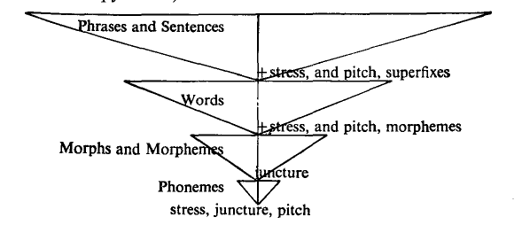
Prof. Hill’s Hierarchy

Slide 6
Sign Types by C.P. Peirce
icon sign
index sign
symbol sign

Slide 7
The Nature of Language by Paul S. Andersen, 1972
Language is a system.
Language is speech sound.
Language is composed of (arbitrary) symbols.
Each language is unique and typical.
Language is built from habit.
Language is a communication tool.
Language is closely linked to the culture.
Language is always changing.

Slide 8
The Nature of Language by H. Douglas Brown, 2001
Language is a systemic system.
Language is a set of symbols.
The symbols are primarily vocal, but may also be visual.
The symbols contain the conventional meaning.
Language is a communication tool.
Language operates in speech community or culture.
Language is essentially human but not limited to humans only.
Language is acquired by all people (nation).

Slide 9
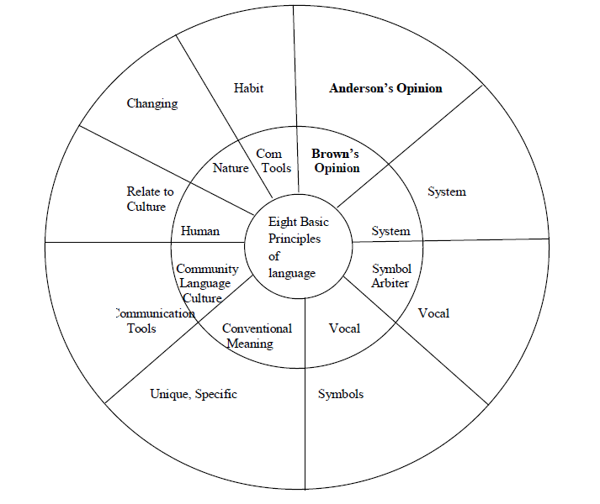
The Nature of Language by Anderson

Slide 10
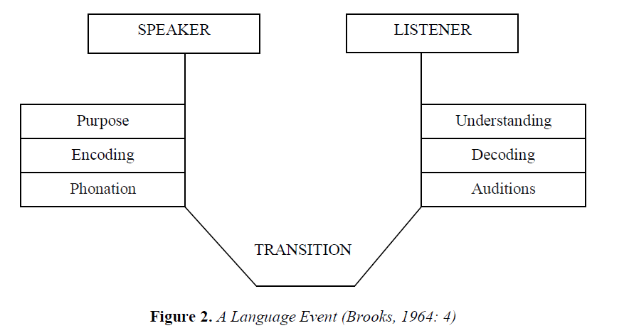
Language Event by Brook, 1964

Slide 11
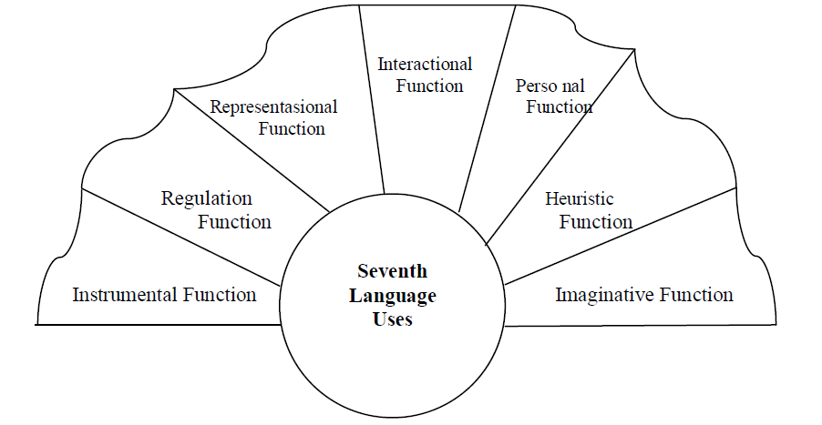
Language Functions by Halliday, 1975

Slide 12
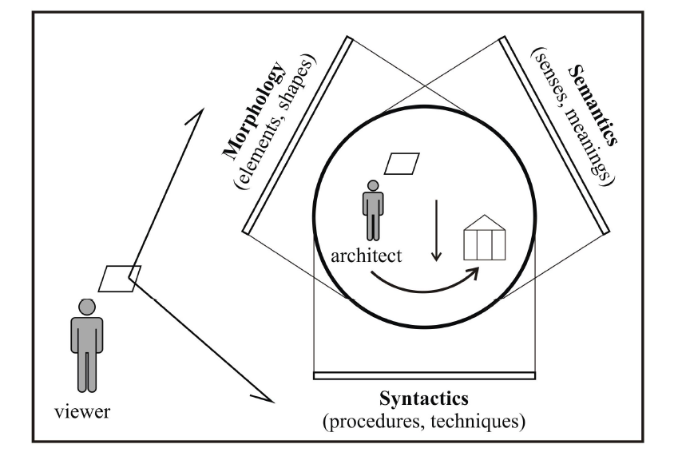
The Structure of the Language by O. Remizova, 2015

Slide 13
Structuralist meta-theory
D₁, ..., D_{n}, R₁, ..., R_{n}
D₁ are basic sets a
R₁ are relations constructed on these sets.

Slide 14
Moulines, 2008 : 163
Structuralism owes his name to the fundamental thought that the most adequate way of interpreting and understanding what a scientific theory is, does not consist in conceiving it as a set of statements, but rather in conceiving it as a form or collection of different types of complex structures, which themselves are built up of simpler structures.

