Slide 1
Structuralism in Linguistics
Lecture 2

Slide 2
Outline
The origin of Structuralism.
Schools of Structuralism.
Stages in Structuralism development.
Structuralism conceptual ideas.
Discovery procedure.

Slide 3
Structuralism
a mode of knowledge of nature and human life that is interested in relationships rather than individual objects or, alternatively, where objects are defined by the set of relationships of which they are part and not by the qualities possessed by them taken in isolation [Mauro W. Barbosa de Almeida, in International Encyclopedia of the Social & Behavioral Sciences (Second Edition), 2015];
a philosophy and method that developed from insights in the field of linguistics in the mid-20th Century to study the underlying patterns of social life [R.G. Smith, in International Encyclopedia of Human Geography (Second Edition), 2020].

Slide 4
Structuralism
an intellectual tendency that seeks to understand and explain social reality in terms of social structures. Structures are defined as the patterns and forms of social relations and combinations among a set of constituent social elements or component parts such as positions, units, levels, regions and locations, and social formations [W.V. Heydebrand, in International Encyclopedia of the Social & Behavioral Sciences, 2001].

Slide 5
Structuralism
is concerned with the analysis of an experience, event, or idea down to its smallest part. Once the smallest parts have been found, they are classified into groups [Peter Sturmey, ... Erica Doran, in Functional Analysis in Clinical Treatment (Second Edition), 2020].

Slide 6
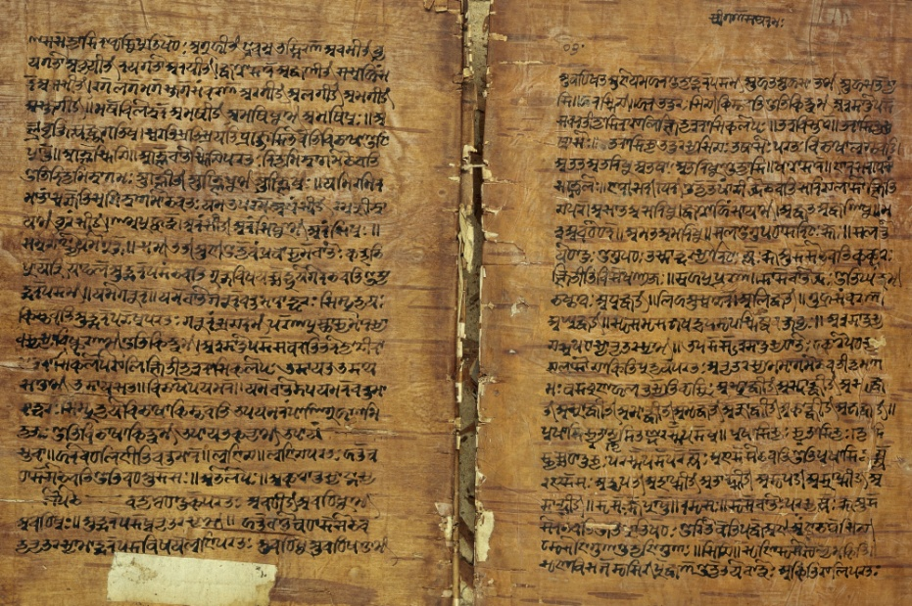
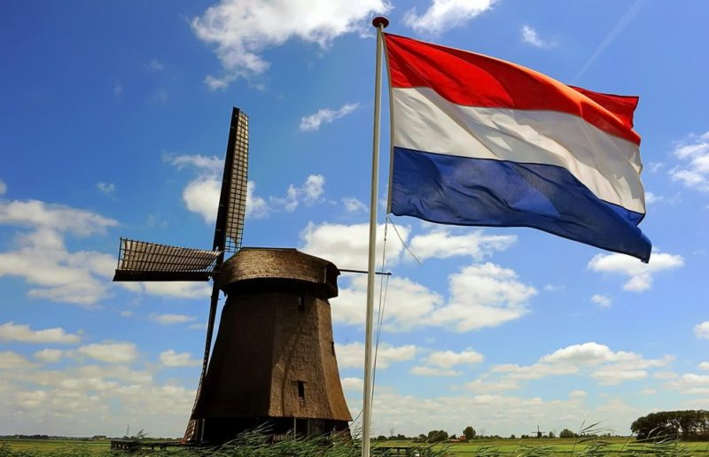
Structuralism
1939

Slide 7
Schools of Structuralism 20-40s of the XX century
The Prague School
Danish Structuralism (Glossematics) The Copenhagen School
Descriptive Linguistics (the USA)

Slide 8
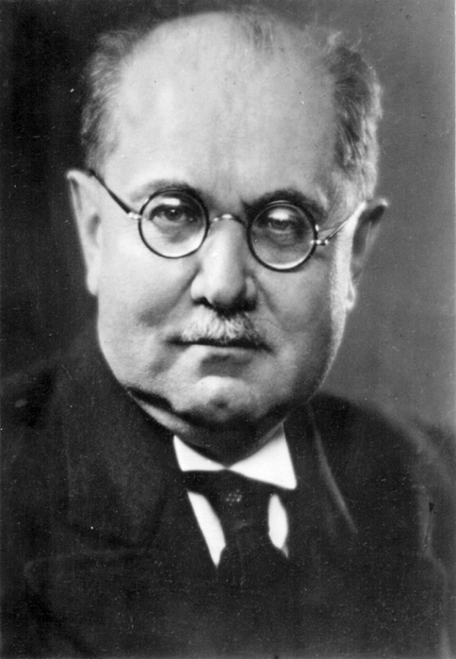
The Prague School Pražský lingvistický kroužek
established in Prague in the 1920s by Vilem Mathesius;
representatives: Russian linguist Nikolay Trubetskoy and the Russian-born American linguist Roman Jakobson, the famous Czech literary scholars René Wellek and Jan Mukařovský.

Slide 9
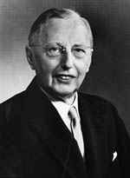
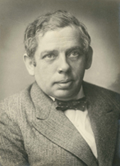
The Copenhagen School Cercle Linguistique de Copenhague
founded at 8 p.m. on the 24th September, 1931 by Louis Hjelmslev and Viggo Brodal;
theory of language – glossematics (“Prolegomena to a Theory of Language” (1943) and “Résumé of a Theory of Language”;
The principal ideas of the school are:
a language consists of content and expression;
a language consists of a succession and a system;
content and expression are interconnected by commutation;
there are certain relations in the succession and the system;
there are no one-to-one correspondents between content and expression, but the signs may be divided into smaller components.

Slide 10
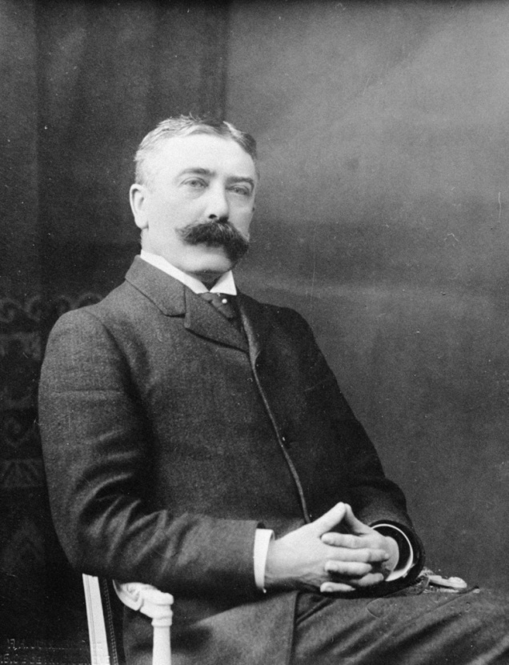
Descriptive Linguistics
founded in 1916 by Ferdinand de Saussure;
Descriptive linguistics emphasizes:
the primacy of speech;
the adoption of a synchronic approach;
the description of language and dialect systems as they are found to be spoken.

Slide 11
Stages in Structuralism Development
up to the 1950's
since the 1950's
since the 1970's

Slide 12
For structuralists a language is a self-contained and tightly organised system whose history is of changes from one state of the system to another.

Slide 13
Structuralism Conceptual Ideas
language is a system-structural formation in which all its units are connected among themselves by various relations;
language is a system of signs, correlated with other symbolic systems within their common discipline - semiotics;
there is a distinction between language and speech;
language is characterized by syntagmatic and paragmatic relations;

Slide 14
Structuralism Conceptual Ideas
language can be studied synchronically and diachronically, the priority belongs to synchrony;
due to statics, language as a system is balanced, dynamics provides the possibility of changes in language;
language is an independent phenomenon with its own internal laws, it must be studied primarily taking into account intralinguistic factors;
in the study of language it is necessary to use strict, precise methods that make Linguistics closer to the Nature Sciences.

Slide 15
Structuralism Key Concepts
The primacy of speech
Synchronic approach
Descriptivism versus prescriptivism

Slide 16
Discovery Procedure
Phonetics (speech sounds)
Phonemics (phonemes and allophones)
Morphemics (morphemes and allomorphs)
Syntax (sentence construction)
Discourse (use of speech)

