Slide 1
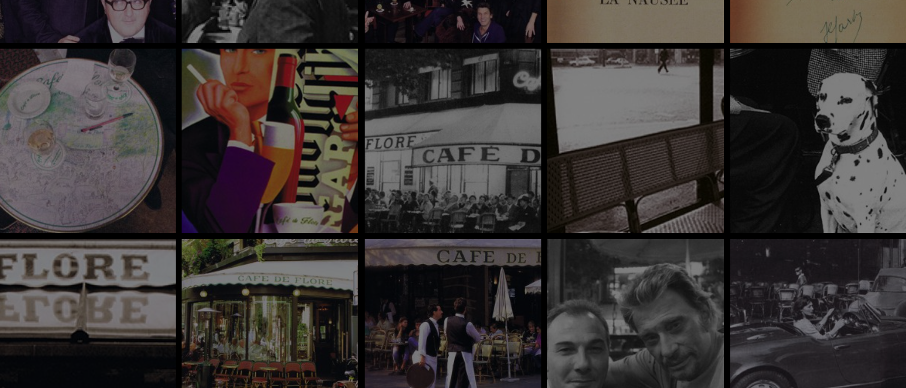
Marketing Strategies

Slide 2
Agenda
1. What is a marketing strategy
2. Starbucks Coffee Shop
3. Cafe de Flore Coffee Shop
4. Costa Coffee Shop
5. Analysis of coffee shop marketing strategies

Slide 3
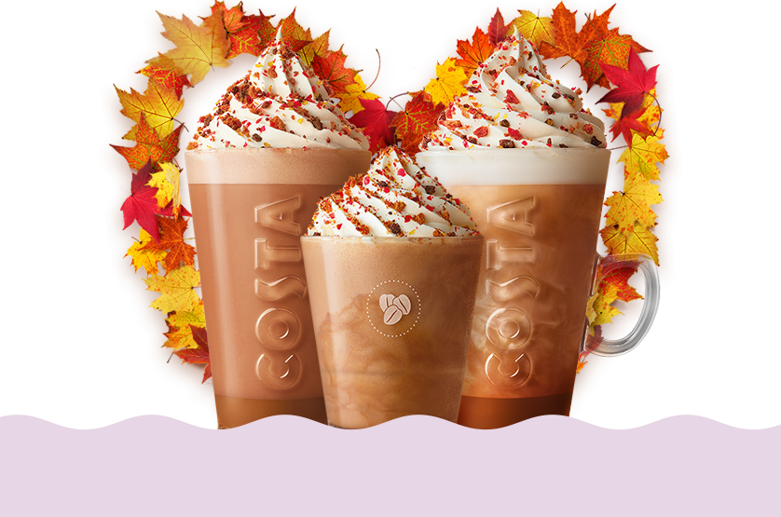
Today, we will discuss three globally popular coffee shops: Starbucks, Costa Coffee, and Cafe de Flore. We will analyze their marketing strategies in the market and make comparisons to determine the best approach for promotion.

Slide 4
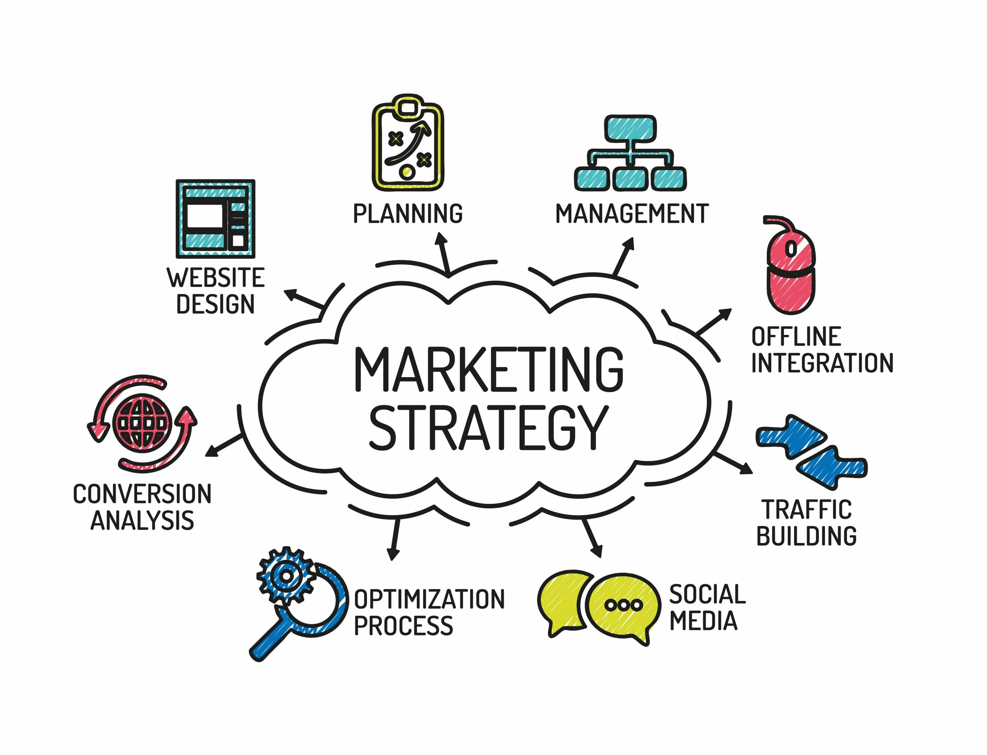
A marketing strategy is a carefully thought-out plan that explains how a business will reach its marketing goals and connect with its target customers. It involves figuring out who the customers are, what makes the product or service stand out, how to promote it, what to charge for it, and other details to attract and keep customers. Marketing strategies are essential for achieving success in the market.

Slide 5
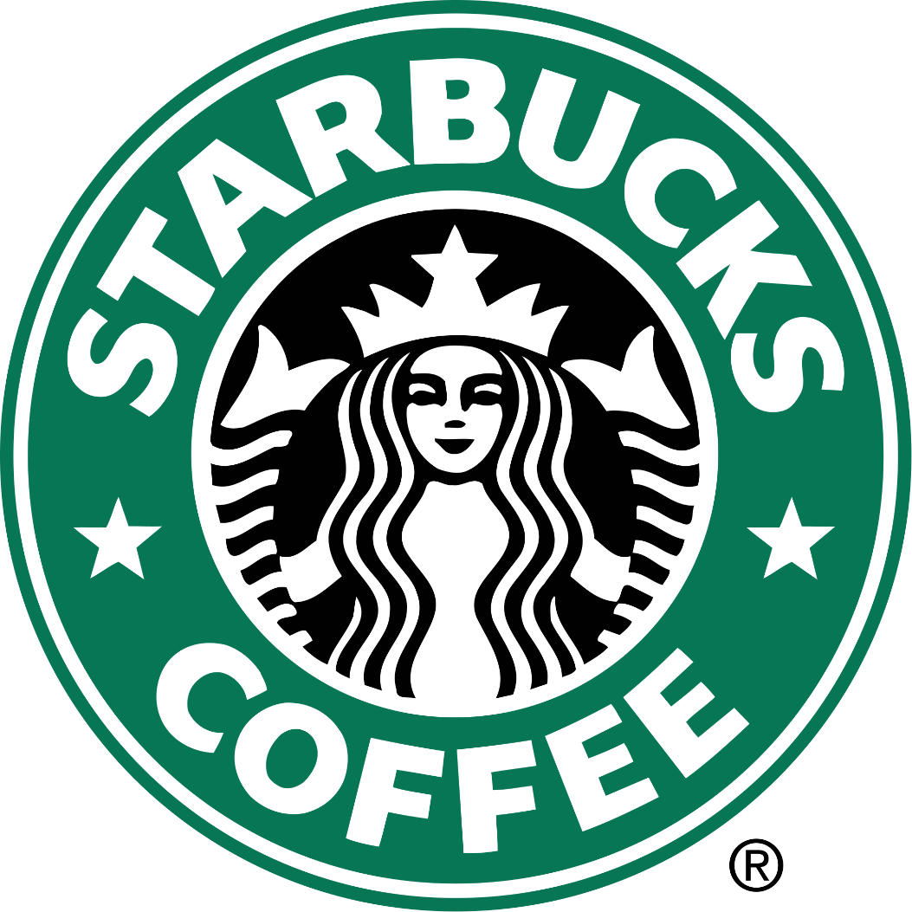
Starbucks is a multinational coffeehouse chain and coffee company. It is known for its extensive menu of coffee and other beverages, as well as its coffee shops that provide a comfortable and inviting environment for customers to enjoy their drinks. Starbucks has a global presence, with thousands of locations worldwide, and is recognized for its commitment to quality coffee and a unique café experience.
Web-page

Slide 6
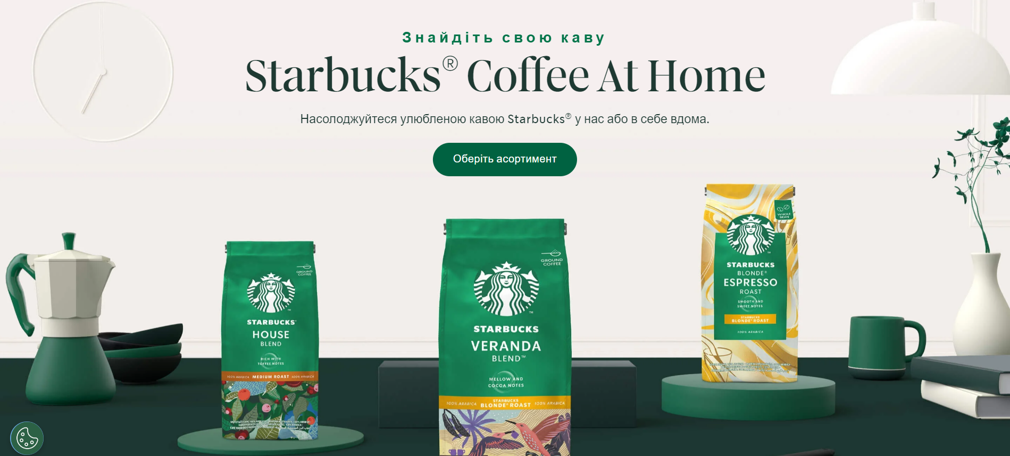

Slide 7
"Do you love coffee that's easy to drink and has a smooth, harmonious, and balanced taste? Enjoy Starbucks® Blonde Roast coffee, our lightest roast."
"Craving coffee with a rich, strong, and bold flavor? Try Starbucks® Dark Roast coffee, a dark roast blend."
"Try Starbucks® Medium Roast coffee with a medium level of roasting and savor its full, rich, and robust flavor."

Slide 8
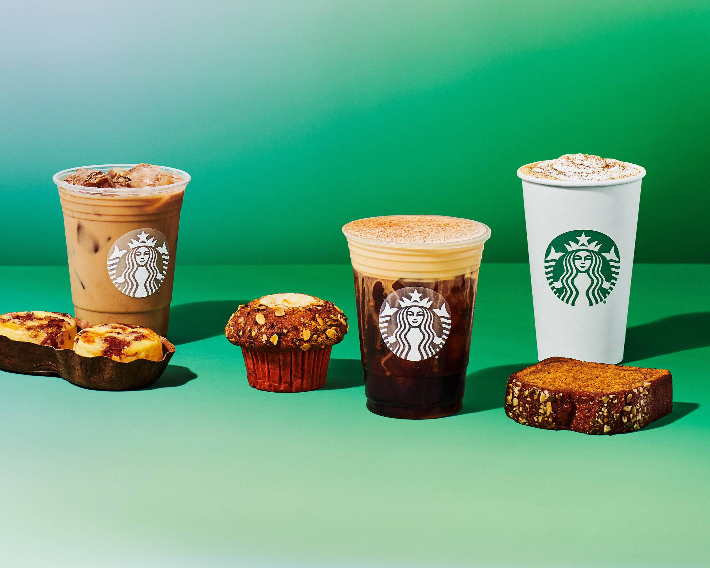
Starbucks' marketing strategy includes several key elements:
1. Expanding the network: Starbucks actively grows its chain of coffee shops both nationally and internationally, aiming to be closer to customers and capture significant market shares.
2. Maintaining coffee quality: Starbucks places a strong emphasis on the high quality of its coffee and coffee-based beverages. They work closely with coffee bean farmers and roast their beans to achieve the best taste.
3. Wide product variety: Starbucks offers a wide range of coffee drinks, teas, desserts, and other products to attract different customer segments.
4. Creating a comfortable atmosphere: Starbucks coffee shops are designed to provide a comfortable and pleasant environment for customers to relax and enjoy their beverages.

Slide 9
5. Selling branded goods: In addition to coffee, Starbucks also sells branded merchandise like coffee makers, mugs, coffee beans, and more.
6. Digital marketing: Starbucks actively uses digital channels to attract and retain customers, with features like their mobile app, loyalty program, and other innovations.
7. Regular promotions and offers: The company runs various promotions and discounts to entice customers.
Overall, Starbucks' marketing strategy is built on delivering a high-quality product, expanding its network, creating an inviting café atmosphere, and making effective use of digital resources to engage and keep customers.

Slide 10
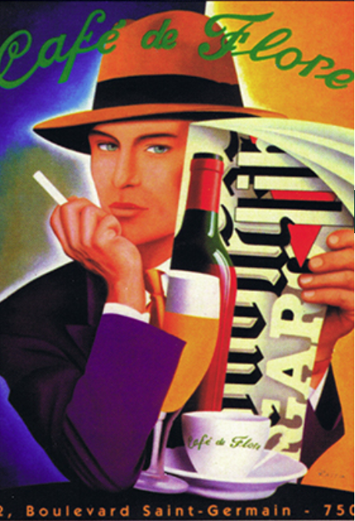
Cafe de Flore is a historic café located in the Saint-Germain-des-Prés neighborhood of Paris, France. This café has a rich cultural heritage and is renowned for its storied history. It served as an important hub for writers, artists, and intellectuals throughout the 20th century. Cafe de Flore is known for its "boulevard life" atmosphere and a rich coffee culture, making it a popular destination for those who appreciate French literature and art.
Web-page

Slide 11
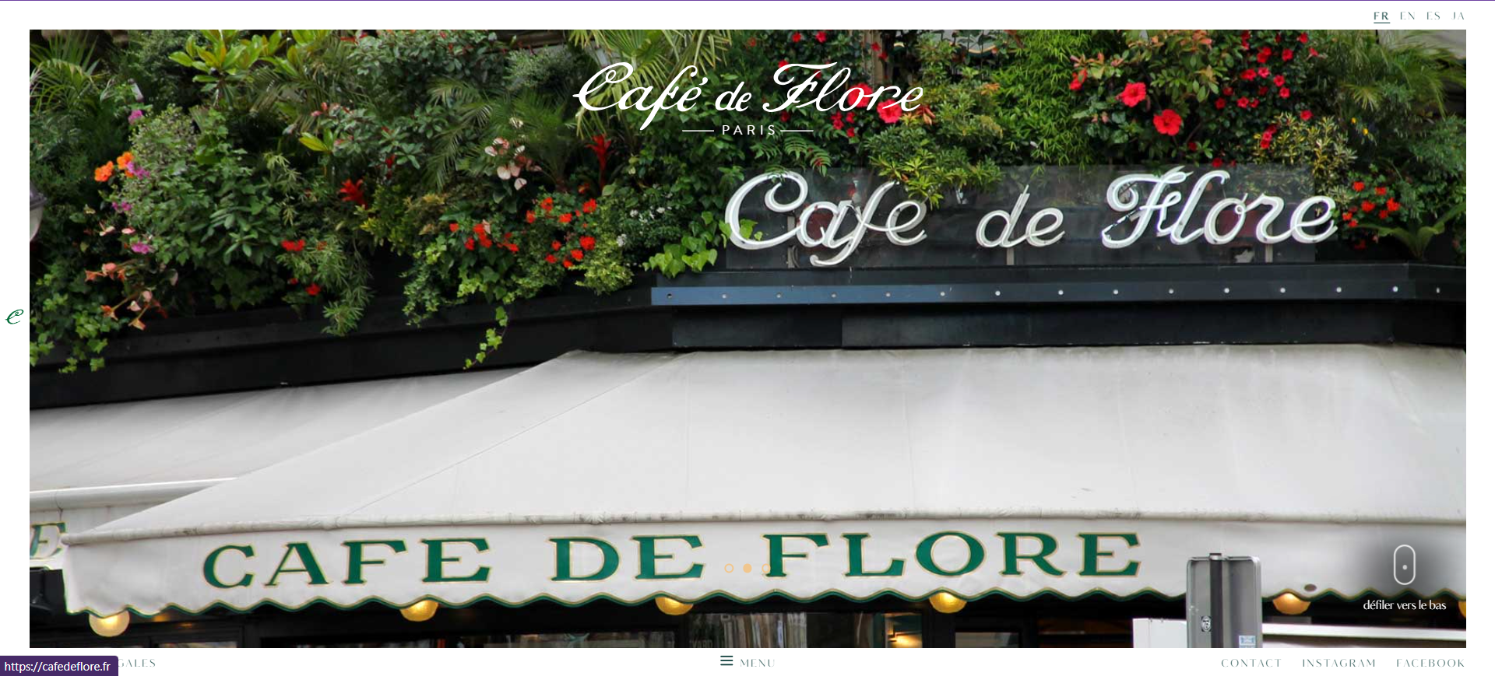

Slide 12
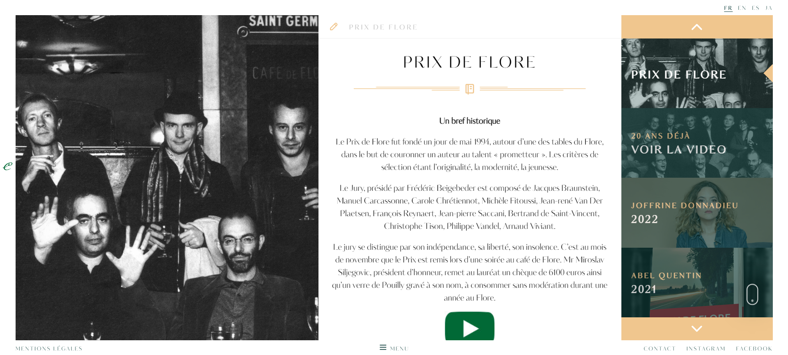

Slide 14
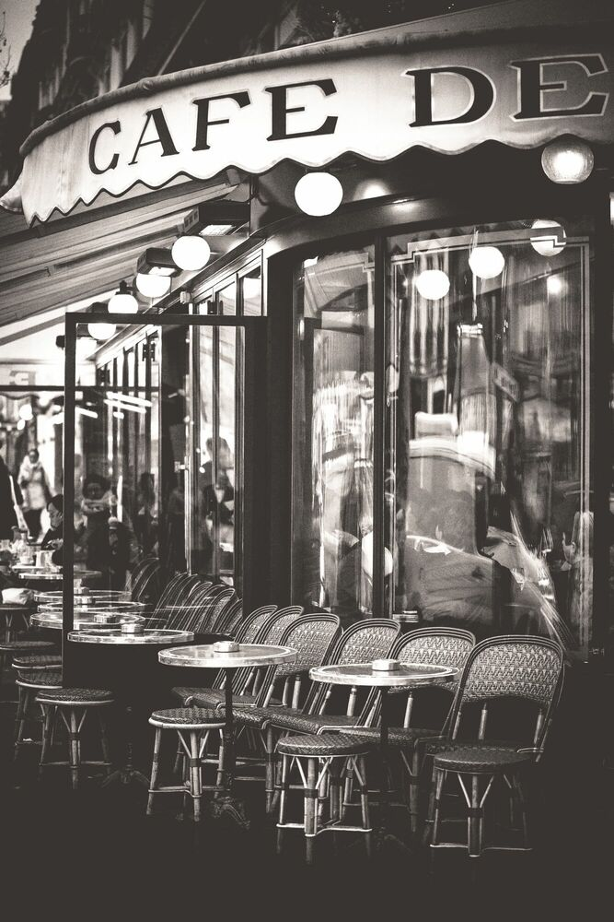
Cafe de Flore primarily relies on traditional marketing strategies that are aimed at maintaining its prestige and historical significance:
1. Heritage Marketing: The café actively uses its rich history and connections with famous personalities to attract attention. It shares photos and stories of past visits by renowned writers and artists.
2. Ambiance and Style: Cafe de Flore creates a unique atmosphere that encourages a pleasant experience. They aim to preserve the authentic interior and service.
3. Exclusivity: The café positions itself as an upscale place offering refined drinks and a cultural experience. This appeals to customers who appreciate elegance and history.

Slide 15
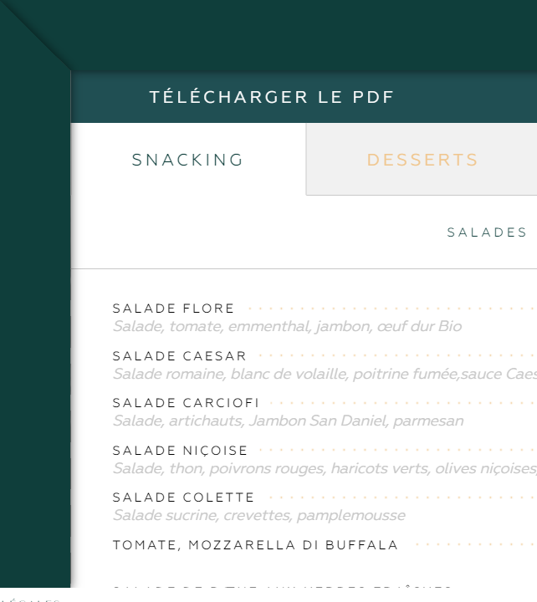
4. Art Event Partnerships: Cafe de Flore may support art events or exhibitions, enhancing its popularity within the artistic community.
5. Social Media and Online Presence: While maintaining its traditional reputation, the café can also use social media and a website to attract new customers and inform them about its services.
In summary, Cafe de Flore relies on its historical reputation and an atmosphere that attracts those who value cultural heritage and exclusivity.

Slide 16
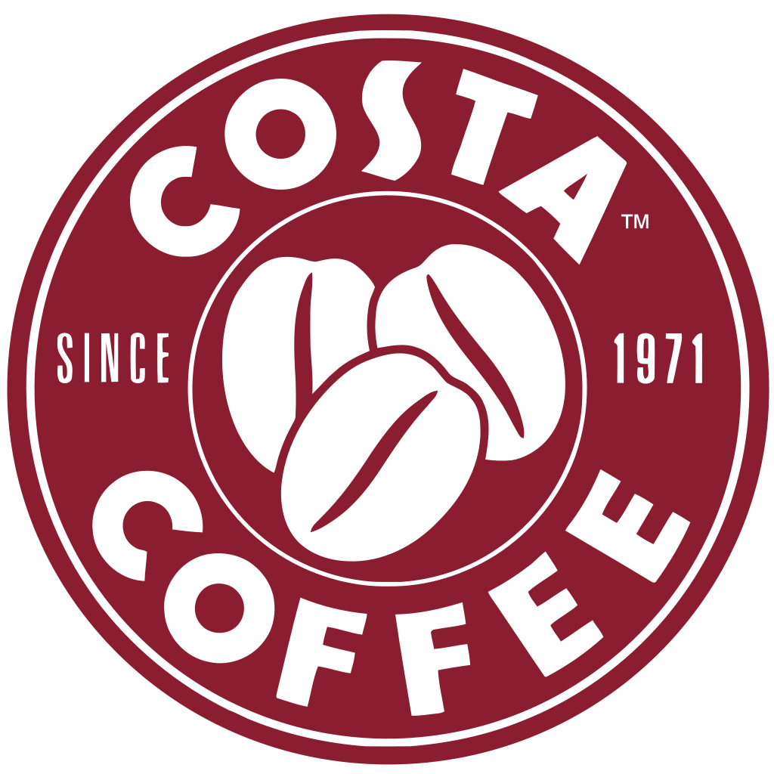
Costa Coffee is a British coffee shop chain, one of the largest in the world. It's known for its coffee, fresh pastries, and a variety of drinks. Costa Coffee shops have a friendly atmosphere and are often popular places for meetings and work. They are also active in the online space and have a loyalty program for customers.
Web-page

Slide 17
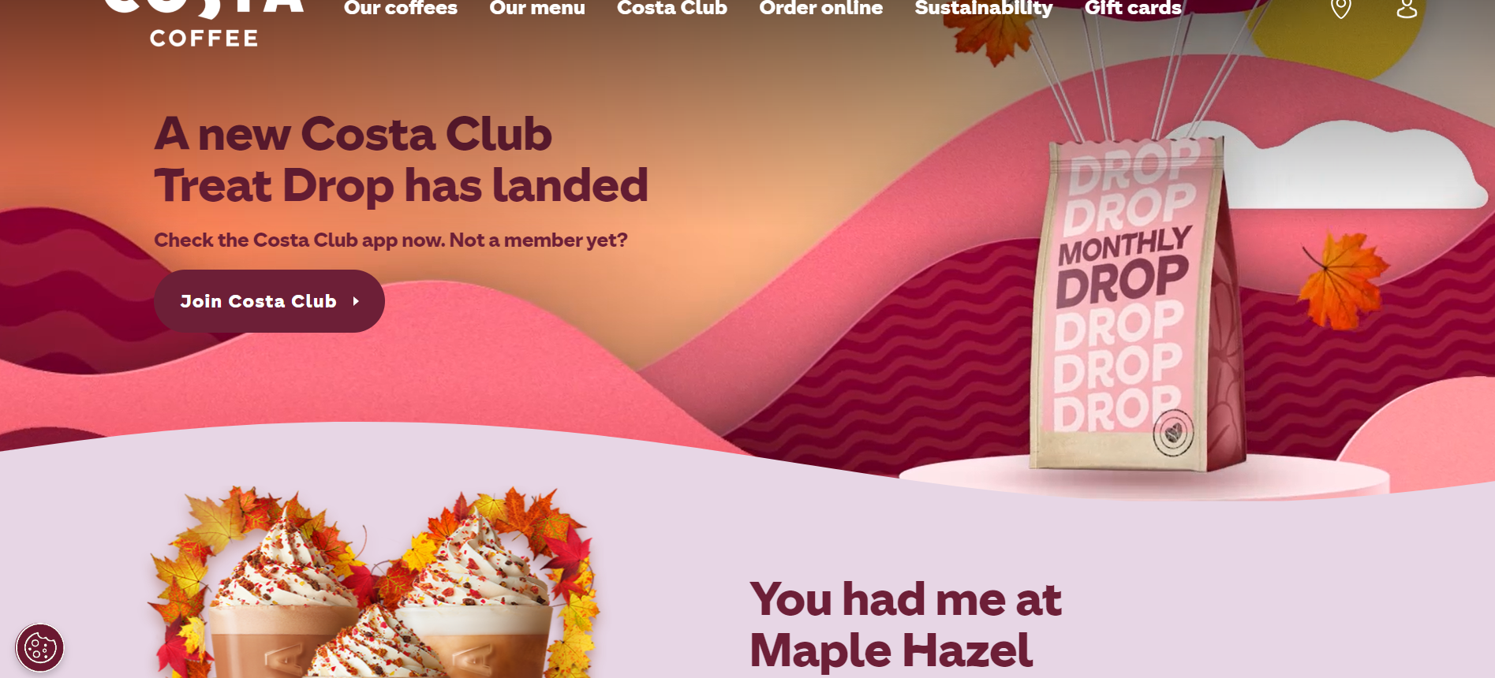

Slide 18
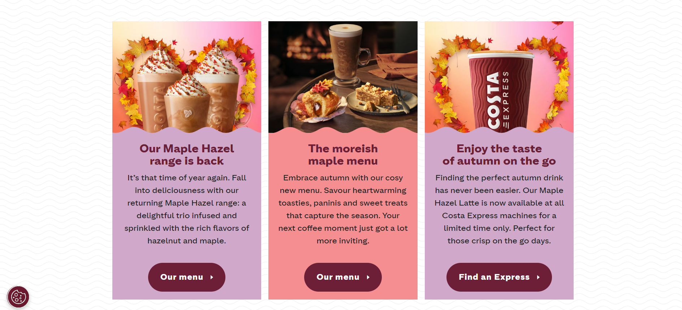

Slide 19
Costa Coffee uses various marketing strategies, including:
1. Network Expansion: The coffee shop actively opens new locations in different areas to be closer to customers.
2. Product Quality: Costa Coffee aims to provide high-quality coffee and other products that appeal to those who appreciate tasty drinks.
3. Customer Loyalty: The café offers a loyalty program that rewards regular customers with discounts and bonuses.

Slide 20
4. Promotions and Advertising: Costa Coffee conducts various promotions and advertising campaigns to attract the attention of new customers.
5. Online Presence: The café actively uses social media and a website to attract and retain customers, as well as for online ordering of food and drinks.
In essence, Costa Coffee combines product quality with expanding its network and digital marketing to attract and retain customers.

Slide 21
Analyzing the marketing strategies of three coffee shops - Starbucks, Cafe de Flore, and Costa Coffee - can be like this:
1. Starbucks:
- A large chain with a wide geographic presence.
- Strong emphasis on coffee quality and menu innovations.
- Digital strategy with a mobile app and loyalty program.
- Active engagement with customers and social media.
2. Cafe de Flore:
- Specializes in preserving its historical reputation and atmosphere.
- Utilizes its reputation and connections with celebrities to attract customers.
- Partnerships with artistic events.
- Focuses on ambiance and culture.
3. Costa Coffee:
- Actively expands and opens new stores.
- High product quality and a loyalty program.
- Promotions and advertising to attract customers.
- Digital presence and online ordering.

Slide 22
Determining which coffee shop has the best marketing strategy will depend on specific goals and the target audience. Starbucks is known for innovation and global coverage. Cafe de Flore appeals to those who value history and atmosphere. Costa Coffee combines quality with expanding its network and digital marketing. So, the choice of the "best" strategy will depend on specific factors such as the target audience and market conditions.

Slide 23
Have a delicious coffee)

