Slide 1
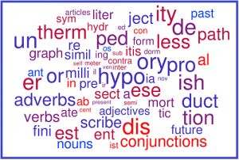
Morphology
Lecture 6

Slide 2
OUTLINE
MORPHOLOGY as a branch of Linguistics.
The WORD and its structure. PARTS OF SPEECH.
The MORPHEME and its classification.
The ALLOMORPH and its positioning.
WORD FORMATION.

Slide 3
Morphology
Morphology is a branch of Linguistics that studies the structure of words and types of their formation.
The term morphology is Greek and comes from morph- (shape, form), and -ology (study).
first recorded in writing in 1796 by Goethe.
first used in relation to linguistics in 1859 by August Schleicher.

Slide 4
Morphology
Morphology refers to the systematic form-meaning relationship between words and the study of the internal structure of words.
Morphology is intimately related to syntax. Morphology studies the structure of words only. Everything that is larger than a word is the domain of syntax.

Slide 5
Morphology
MORPHOLOGY
inflectional
derivational
studies inflections of a language
studies the types of word formation

Slide 6
Word
A word is a unit of language that carries meaning and consists of one or more morphemes which are linked more or less tightly together, and has a phonetic value.
A word is the best defined in terms of internal stability (further divisible) and external mobility (can take different positions in a sentence).
Words can be combined to create phrases, clauses, and sentences.

Slide 7
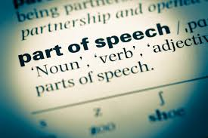
Word
Grammarians classify words according to their parts of speech and identify and list the forms that words can show up in.

Slide 8
Parts of Speech
The parts of speech are classes of words, all the members of these classes having certain characteristics in common which distinguish them from the members of other classes.
Approaches:
classical (by prescriptivists);
functional (by descriptivists);
distributional (by structuralists);
complex.

Slide 9
The Principles of Classification as Used by Prescriptive Grammarians
English in terms of Latin forms and Latin grammatical constraints.
Words in English were divided into declinables (nouns, adjectives, pronouns, verbs, participles) and indeclinables (adverbs, prepositions, conjunctions, interjections, articles).
The key principle of the classification was form.

Slide 10
The Principles of Classification as Used by Non-Structural Descriptive Grammarians
Henry Sweet (1892) speaks of three principles of classification: form, meaning, and function.
Declinables: noun-words (noun, noun-pronoun, noun-numeral, infinitive, gerund), adjective-words (adjective, adjective-pronoun, adjective numeral, participle), verb (finite verb), verbals (infinitive, gerund, participle).
Indeclinables (particles), adverb, preposition, conjunction, interjection.

Slide 11
The Principles of Classification as Used by Structural Descriptive Grammarians
The traditional classification of words into parts of speech was rejected and criticized from 2 points.
First, traditional grammar relies heavily on the most subjective element in language, meaning.
Second, it uses different criteria of classification: it distinguishes the noun, the verb and the interjection on the basis of meaning; the adjective, the adverb, the pronoun, and the conjunction, on the basis of function, and the preposition, partly on function and partly on form.

Slide 12
The Classification of Words in Post-Structural Traditional Grammar
Complex Approach Criteria
Semantic
Formal
Functional
grammatical meaning of the
whole class of words
(general grammatical meaning)
paradigmatic properties: relevant grammatical categories, the form of the words,
their specific inflectional and derivational features
concerns the syntactic function of words in the sentence and their combinability

Slide 13
Parts of Speech
When characterizing any part of speech we are to describe its:
semantics;
morphological features;
syntactic peculiarities.

Slide 14
Word
Words
Notional
Functional
present
open classes
present closed classes
noun, adjective, numeral, verb, and adverb
article, pronoun, preposition, conjunction,
particle, modal words, and interjection

Slide 15
Nouns
Meaning: thingness.
Form: the category of number (singular and plural) and the category of case (common and genitive).
Function: (a) Combining with words to form phrases: a good student, a nice teacher. (b) Function in the sentence: a subject, the predicative, an object, an attribute, an adverbial modifier.

Slide 16
Adjectives
Meaning: property.
Form: invariable. Some adjectives form degrees of comparison (long, longer, longest).
Function: (a) Adjectives combine with nouns both preceding and (occasionally) following them (large room, times immemorial). (b) Function in the sentence: an attribute (large room) or a predicative (is large), an objective predicative (painted the door green).

Slide 17
Pronouns
Meaning: pronouns point to the things and properties without naming them.
Form: some pronouns have the category of number (singular and plural), e. g. this; some pronouns have the category of case (he - him, somebody - somebody's), while others have none (something).
Function: (a) Some pronouns combine with verbs (he speaks, find him), while others can also combine with a following noun (this room). (b) In a sentence: subject, object, attribute.

Slide 18
Numerals
Meaning: denote either number or place in a series.
Form: invariable.
Function: (a) Both cardinal and ordinal numerals combine with a noun (three rooms, third room). (b) In a sentence, an attribute (three rooms, the third room), can also be a subject, a predicative, and an object: Three of them came in time.

Slide 19
Verbs
Meaning: expresses a process.
Form: tense, aspect, mood, voice, person, and number.
Function: (a) Verbs are connected with a preceding noun (children play) and with a following noun (play games). They are also connected with adverbs (write quickly). Occasionally a verb may combine with an adjective (married young). (b) In a sentence: the predicate or part of it (link verb).

Slide 20
Adverbs
Meaning: property of an action or of a property – some adverbs indicate time or place of an action (yesterday, here), while others indicate its property (quickly) and others again the degree of a property (very).
Form: invariable. Some of them, however, have degrees of comparison (fast, faster, fastest).
Function: (a) An adverb combines with a verb (run quickly), with an adjective (very long), occasionally with a noun (the then president) and with a phrase (so out of things). (b) In a sentence: an adverbial modifier, or part of it (from there), but it may occasionally be an attribute.

Slide 21
Prepositions
Meaning: relations between things and phenomena.
Form: invariable.
Function: (a) Prepositions enter into phrases in which they are preceded by a noun, adjective, numeral, stative, verb or adverb, and followed by a noun, adjective, numeral or pronoun. (b) In a sentence a preposition never is a separate part of it. It goes together with the following word to form an object, adverbial modifier, predicative or attribute, and in extremely rare cases a subject (There were about a hundred people in the hall).

Slide 22
Conjunctions
Meaning: express connections between things and phenomena.
Form: invariable.
Function: (a) They connect any two words, phrases or clauses. (b) In a sentence, conjunctions are never a special part of it. They either connect homogeneous parts of a sentence or homogeneous clauses (the so-called coordinating conjunctions), or they join a subordinate clause to its head clause (the so-called subordinating conjunctions).

Slide 23
Particles
Meaning: denote subjective shades of meaning introduced by the speaker or writer serving to emphasize or limit some point in what he says.
Form: invariable.
Function: (a) Particles may combine with practically every part of speech, more usually preceding it (only three), but occasionally following it (for advanced students only). (b) In a sentence: they enter the part of the sentence formed by the word (or phrase) to which they refer.

Slide 24
Interjections
Meaning: express feelings (ah, alas).
Form: invariable.
Function: (a) Interjections usually do not enter into phrases. Only in a few cases do they combine with a preposition and noun or pronoun, e.g. alas for him! (b) In a sentence: parenthesis. An interjection may also be a sentence in itself, e. g. Alas! as an answer to a question.

Slide 25
Word
Word
Simple
Complex
consists of 1 morpheme
consists of 2 or more morphemes

Slide 26
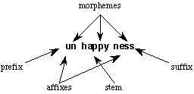
Word

Slide 27
Morpheme
Morpheme is the smallest meaningful unit in a language.
A morpheme is the smallest part of a word that has grammatical function or meaning.

Slide 28
Morpheme

Slide 29
Morpheme
Morpheme can occur on its own as a word; it does not have to be attached to another morpheme. It is a free morpheme. Such morphemes must be affixed to some other unit; each can only occur as a part of a word.
Morphemes that must be attached as word parts are called bound.

Slide 30
Morpheme
Derivational morphemes are added to forms to create separate words: [-er] is a derivational suffix whose addition turns a verb into a noun, usually meaning the person or thing that performs the action denoted by the verb. For example, [paint]+[-er] creates painter, one of whose meanings is “someone who paints.”

Slide 31
Morpheme
Inflectional morphemes do not create separate words. They merely modify the word in which they occur in order to indicate grammatical properties such as plurality, as the [-s] of magazines does, or past tense, as the [ed] of babecued does.

Slide 32
Allomorph
The variant forms of a given morpheme are its allomorphs. When we wish to refer to a minimal grammatical form merely as a form, we will use the term morph.
Allomorph is a non-distinctive realization of a morpheme.
Morpheme
Allomorph
Allomorph
Allomorph

Slide 33
Conditioning of Allomorphs
Conditioning happens when the presence of one allomorph predicts the occurrence of the other.
Conditioning
Phonological
Morphological

Slide 34
Phonological Conditioning
1. [-s] occurs with morphs ending with voiceless sounds except ‘sibilants’ and ‘affricates’.
For instance- cats, hats, books, caps etc. (-s sound)
2. [-z] occurs with morphs ending with voiced sounds except ‘sibilants’ and ‘affricates’
For instance- birds, dogs, beds, songs etc. (-z sound)
3. [-iz] occurs with morphs ending with sibilants (s, z) and affricates (ch , j).
For instance- roses, churches, judges etc.( -iz sound)

Slide 35
Morphological Conditioning
When the conditioning factor is not determined by any phonological feature but it is determined by the specific morph to which it is attached. In pairs such as ‘man-men’, ‘child-children’, which seem to contain the ‘plural morpheme’, we cannot state the variation in terms of phonetic environment. Instead we must refer to each morpheme separately.
This kind of variation among allomorphs is known as morphological conditioning.
Some other examples of morphological conditioning are:
ox – oxen
sheep – sheep
goose – geese

Slide 36
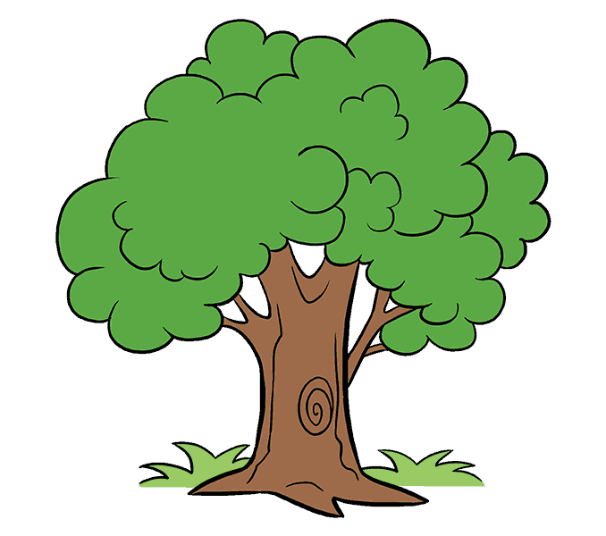
Word Formation (Derivation)
Derivation is the process of creating separate but morphologically related words.

Slide 37
Compounding
A compound is the combination of two or more free roots that are considered one word.
Compound
endocentric
exocentric
daylight, waterbed, bedroom, sunset, sunrise
egghead, birdbrain, paperback

Slide 38
Compounding
Compound nouns
a. Noun + noun: bath towel; boy-friend; death blow
b. Verb + noun: pickpocket; breakfast
c. Noun +verb: nosebleed; sunshine
d. Verb +verb: make-believe
e. Adjective + noun: deep structure; fast-food
f. Particle + noun: in-crowd; down-town
g. Adverb + noun: now generation
h. Verb + particle: cop-out; drop-out
i. Phrase compounds: son-in-law

Slide 39
Compounding
Compound verbs
a. Noun + verb: sky-dive
b. Adjective + verb: fine-tune
c. Particle + verb: overbook
d. Adjective + noun: brown-bag

Slide 40
Compounding
Compound adjectives
Noun + adjective: card-carrying; childproof
Verb + adjective: fail safe
Adjective + adjective: open-ended
Adverb + adjective: cross-modal
Particle + adjective: over-qualified
Noun + noun: coffee-table
Verb + noun: roll-neck
Adjective + noun: red-brick; blue-collar
Particle + noun: in-depth
Verb + verb: go-go; make-believe
Adjective/Adverb + verb: high-rise
Verb + particle: see-through; tow-away

Slide 41
Compounding
Compound adverbs
uptightly
cross-modally
Neo-classical compounds
astro-naut
hydro-electric
mechano-phobe

Slide 42
Coining
Coining is the creation of new words without reference to the existing morphological resources of the language, that is, solely out of the sounds of the language.
e.g. Googol meaning
1940, by a nine-year-old nephew of a mathematician

Slide 43
Abbreviation
Abbreviation involves the shortening of existing words to create other words, usually informal versions of the originals.
prof – professor
doc – doctor
uni – university
Alternatively, we may use the first letter of each word in a phrase to create a new expression, an acronym, as in UN, US.
UNICEF
(United Nations International Children’s Emergency Fund)
AIDS
(Acquired Immune Deficiency Syndrome)

Slide 44
Blending
Blending involves taking two or more words, removing parts of each, and joining the residues together to create a new word whose form and meaning are taken from the source words.
smoke + fog = smog
motor + hotel = motel
worldwide + seminar = webinar

Slide 45
Borrowing
Borrowing involves copying a word that originally belonged to one language into another language.
taco, burrito (Mexican food)
Over its 1500 year history English has borrowed from hundreds of languages, though the main ones are Latin (homicide), Greek (chorus), French (mutton), Italian (aria), Spanish (ranch), German (semester), and the Scandinavian languages (law).

Slide 46
Back Formation
Back formation happens when the speakers derive a morphologically simple word from a form which they analyze, on the basis of derivational and inflectional patterns in English, as a morphologically complex word.
typewriter – typewrite

Slide 47
References
Atkinson, M., D. Kilby and I. Roca 1982. Foundations of General Linguistics. London: George Allen & Unwin.
Bloomfield, L. 1933. Language. New York: Holt, Rinehart and Winston.
Carrol. J. B. 1953. The Study of Language. Cambridge, Mass.: MIT Press.
Chomsky, Noam. 2000. New Horizons in the Study of Language and Mind. Cambridge, CUP.
Chomsky, Noam. The Architecture of Language, (ed). Nirmalangshu Mukherji et.al., Oxford University Press, New Delhi, 2000.
Dinneen, F.P. 1967. An Introduction to General Linguistics. New York etc: Holt, Rinehart and Winston.
Diringer, D. 1962. Writing: Its Origin and Early History. New York: Praeger.
Diringer, D. 1968.The Alphabet. (2 Volumes). (3rd edition). London etc: Hutchinson.
Fromkin, V. and R. Rodman 1983. An Introduction to Language. 3rd edition. New York: Holt, Rinehart and Winston.
Gelb, I.J.1952. A Study of Writing. Chicago: University of Chicago Press.
Gleason, H.A. 1970. An Introduction to Descriptive Linguistics. Rev edn. New York: Holt, Rinehart & Winston.
Greenberg, J. 1966. Universals of Language. Cambridge, Mass.: MIT Press.
Hockett, C.F. 1958. A Course in Modern Linguistics. New York: Macmillan. (Indian edition New Delhi, Calcutta: Oxford and IBH).
Hudson, G.2000. Essential Introductory Linguistics. Oxford: Blackwell.
Hughes, J.P.1962. The Science of Language. New York: Random House-Alfred A. Knopf.
Jespersen, O. 1921. Language. London: George Allen & Unwin.
Joos, M. (ed.) 1958. Readings in Linguistics: Development of Descriptive Linguistics in America since 1925. 3rd edn. New York: American Council of Learned Societies.
Kurath, H.1972. Studies in Areal linguistics. Bloomington: Indiana University Press.
Lyons, J.1968. Introduction to Theoretical Linguistics. Cambridge: Cambridge University Press.
Martinet, A. 1964. Elements of General Linguistics. London: Faber & Faber.
Palmer, F.R.1971. Grammar. Harmondsworth: Penguin.
Pinker, Steven. 1994. The Language Instinct. London: Penguin
Robins, R.H. 1969. General Linguistics: An Introductory Survey. London: Longman.
Sapir, E. 1921. Language: An Introduction to the Study of Speech. New York: Harcourt Brace & World.
Saussure, Ferdinand de. Course in General Linguistics, (tr). Wade Baskin, McGraw-Hill, New York, 1959.

