Slide 1
Social media influencers for restaurants or food

Slide 2
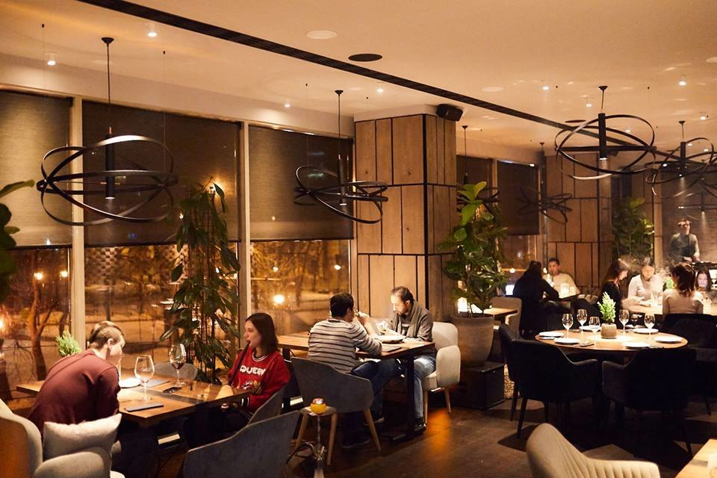
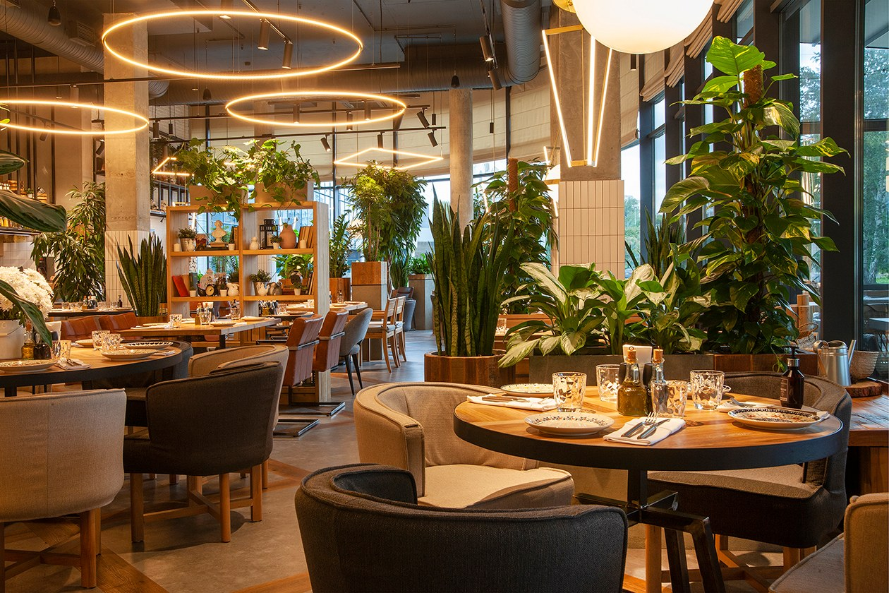
Why use social media for restaurants or food?
Attracting customers | Raising consciousness | Competitive advantage
Social media is a powerful tool for attracting new customers based on feedback and recommendations. | A restaurant or food featured on social media attracts the attention of a wide audience and increases their awareness of you. | The use of social networks allows you to strengthen your promotional plan, getting ahead of the competition.

Slide 3
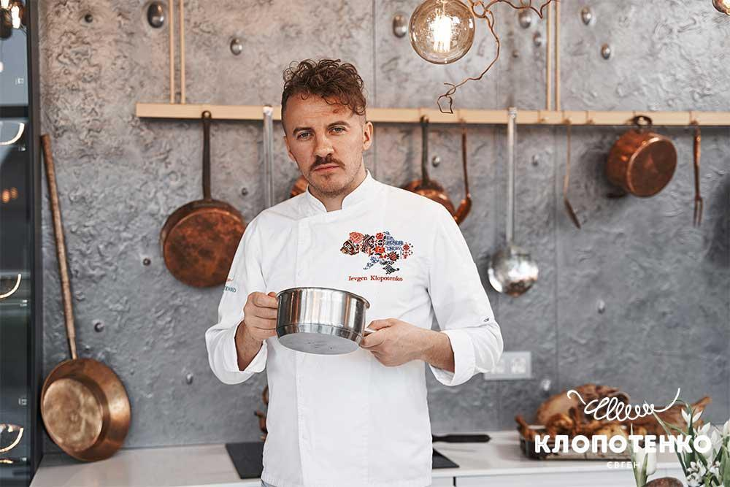
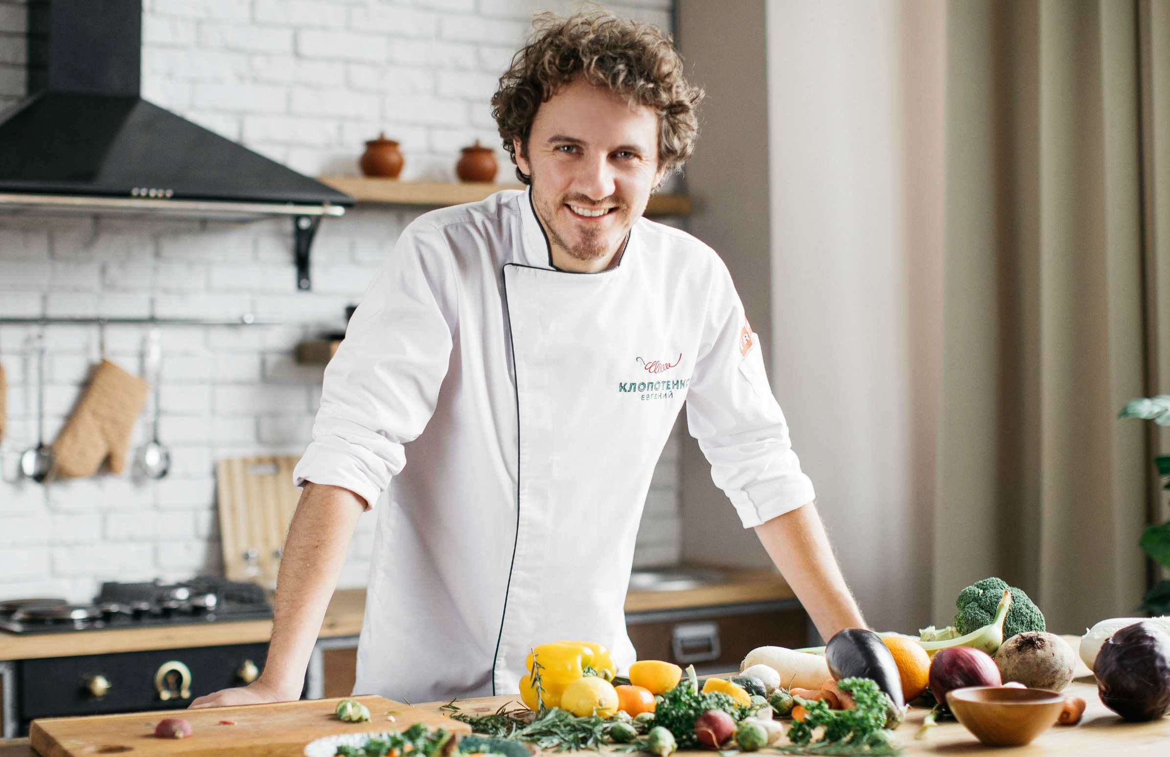
Who is Yevhen Klopotenko
Expert | A talented strategist | Accompanying
Yevhen Klopotenko is a well-known expert in the field of social networks and digital marketing. He provides restaurants and food with his expert assistance for their successful promotion. | He has a magical combination of strategic thinking and creative ideas, which makes him the perfect restaurant and food promoter. | Yevhen Klopotenko provides constant accompaniment and support to clients in social networks and helps them achieve the desired results.

Slide 4
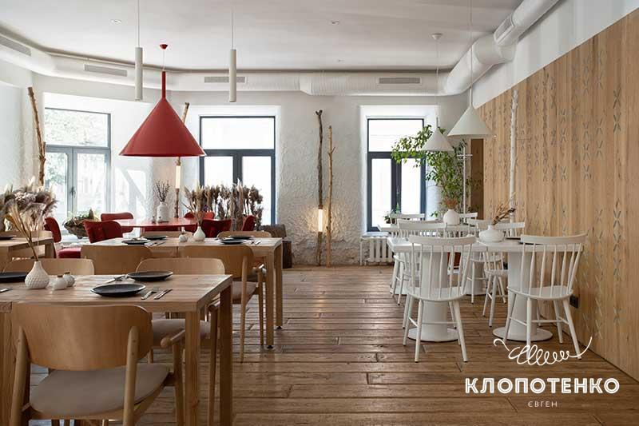
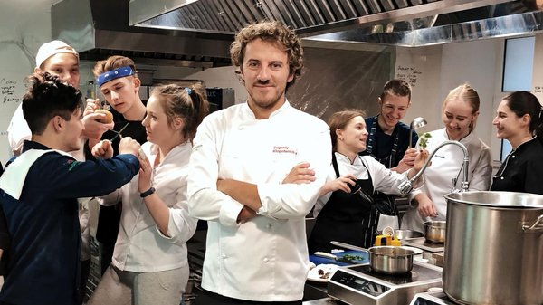
Yevgeny Klopotenko's influence on social networks
Growing popularity | A stronger presence | Stimulation of acquaintances
Increasing the number of followers, likes and comments on restaurant and food pages thanks to Yevhen Klopotenko's effective strategies. | Strengthening the presence of restaurants and food in social networks through active participation and involvement of a large audience. | Driving positive interactions between restaurants, food and customers through engaging content and interactive activities.

Slide 5
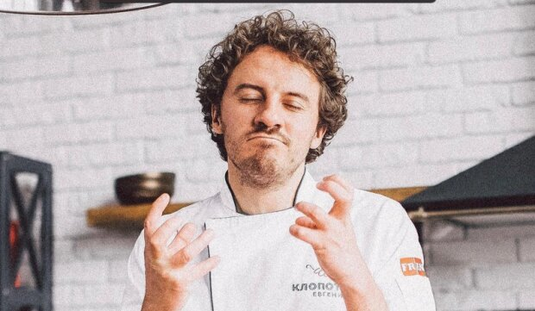
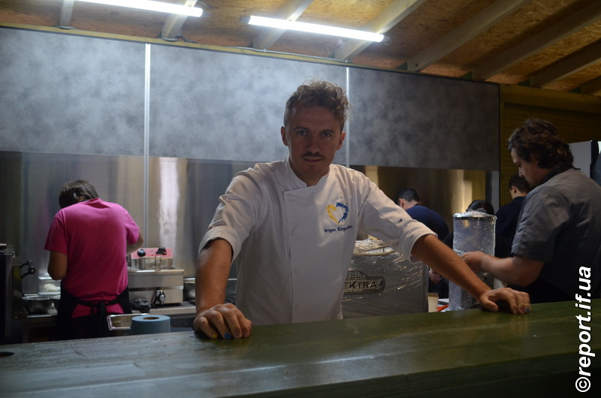
His role in the growing popularity of restaurants and food
Cooperation with bloggers | Attractive photo | Strategic campaigns
Yevhen Klopotenko effectively cooperates with well-known food bloggers who promote restaurants and dishes on social networks. | He provides valuable tips on photographing food and making your food look appetizing in your photos, which helps increase popularity. | His strategic social media campaigns help restaurants and food stand out and attract more customers.

Slide 6
Who is Hector Jimenez Bravo
Hector Jimenez Bravo-Canadian and Ukrainian chef of Colombian origin, businessman, TV presenter. Judge of the MasterChef Ukraine project, culinary arts teacher, founder of Bravo Restaurant Group consulting company. Winner of the prestigious culinary award "The World Master Chef"

Slide 7
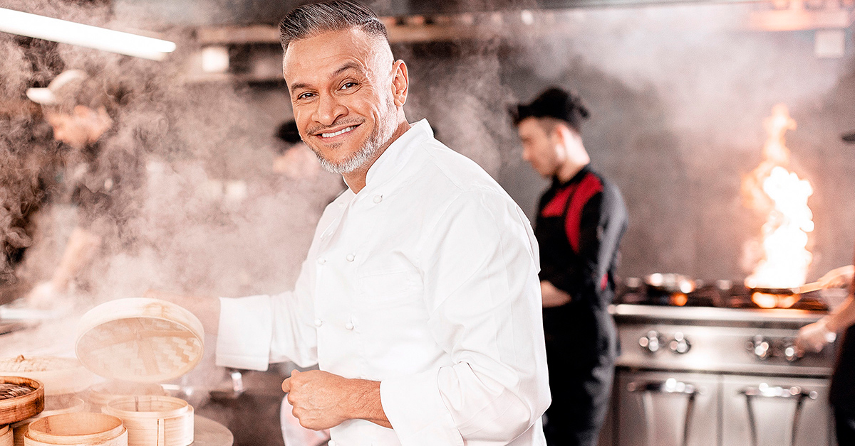
Actor successes in the restaurant business
Awards and recognition | Innovative menu | Cooperation with world chefs
Find out about the best restaurants founded by Hector and the awards they have won. | Learn about the creative dishes and signature recipes that have made Hektor so popular. | Hector does not hesitate to contact leading chefs to raise the bar of taste and quality.

Slide 8
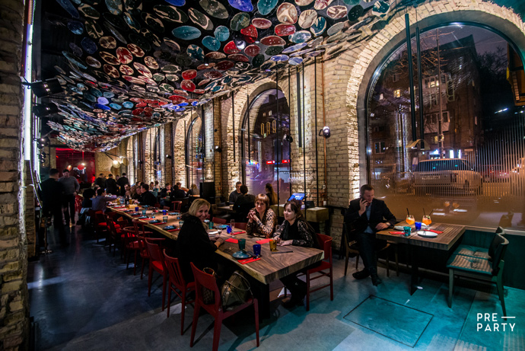
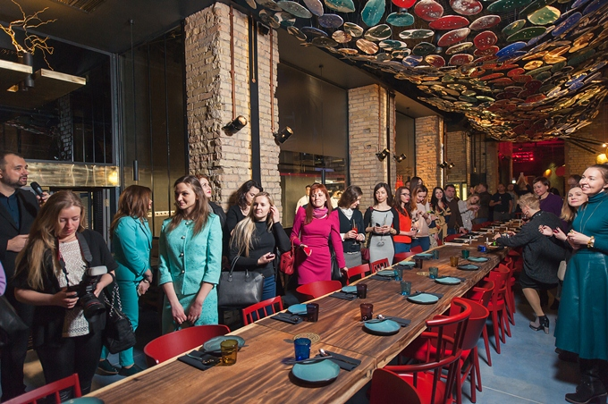
Its role in social media in restaurant and food advertising
Increased visibility | Intuitive marketing | Building loyalty
Learned how social media can help attract new customers and increase restaurant business turnover. | He told about the opportunities to address the target audience and the use of geolocation to attract customers. | He revealed to the audience the subtleties of creating a connection with customers through social networks and the use of loyalty programs.

Slide 9
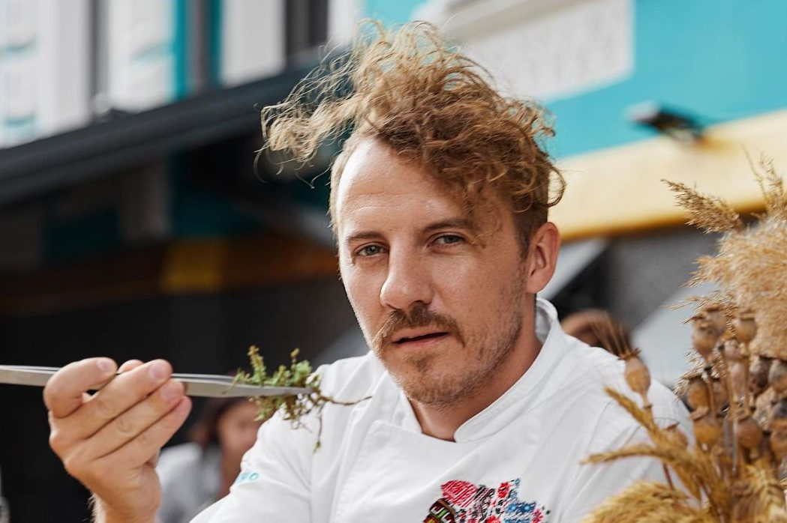
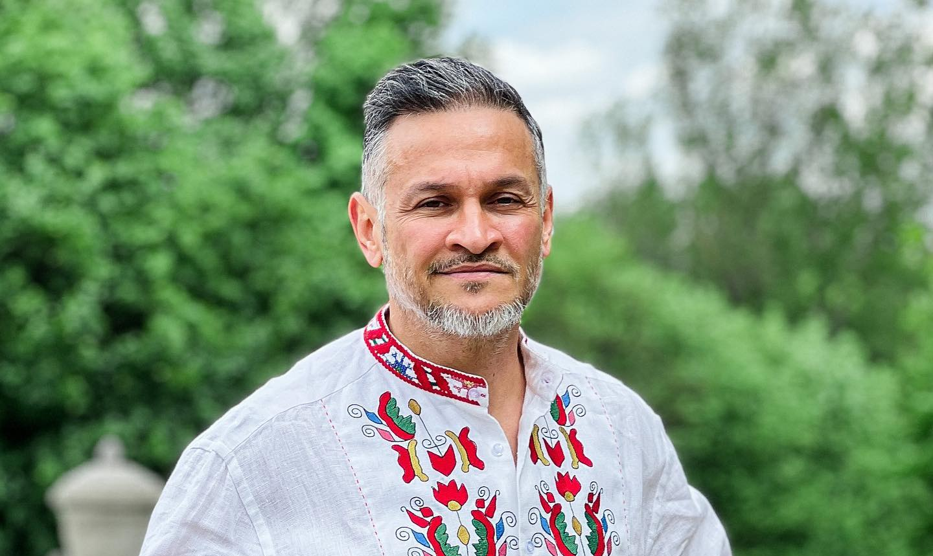
Conclusion
Positive consequences of using social networks
Increased volume of orders | Creating an image | Interaction with customers
Promoting restaurants and food on social networks leads to increased orders and popularity among customers. | Social networks help to create an attractive image of restaurants and food, to convince customers of their superiority and exclusivity. | The ability to interact with customers through social networks brings the restaurant and its audience closer, makes the business prosperous and successful.

