Slide 1
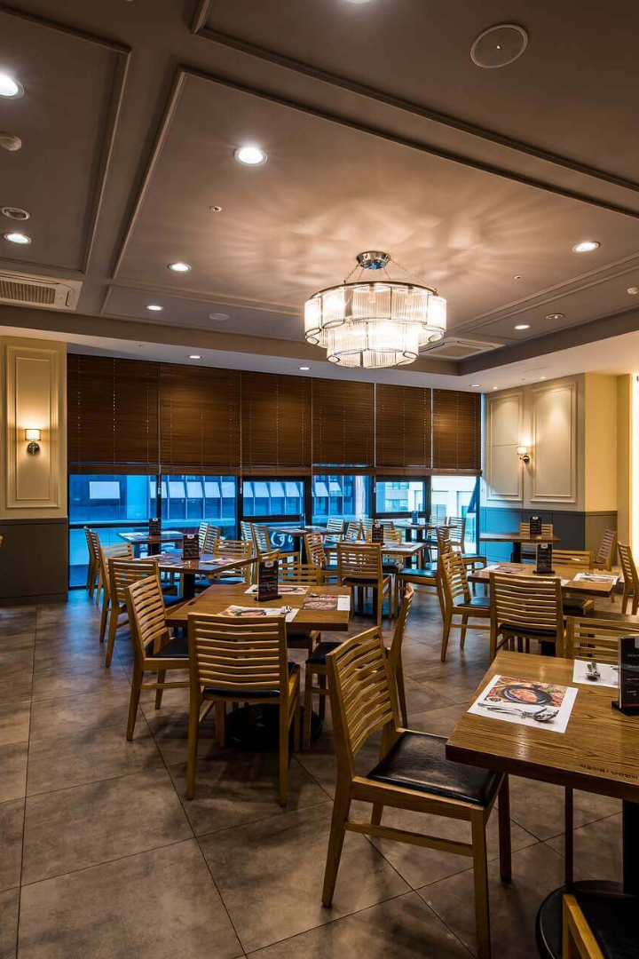
Introducing a New Quick-Service Restaurant Concept: Taste Valley
Welcome to Taste Valley, where the mountains meet your taste buds. Our restaurant concept offers a unique blend of local, organic, and international flavours, all in one place.

Slide 2
Our Target Markets and Market Segmentation
Millennials 💻
Families 👩‍👩‍👧‍👦
Aged 18-34, they are always on the go and looking for quick, delicious meals.
Parents looking for healthy options for their kids without sacrificing taste.
Tourists 🧳
Foodies 🍴
Travellers eager to explore local cuisine while taking a break from fast food chains.
People who appreciate quality food and enjoy discovering new flavours and culinary traditions.

Slide 3
Our Unique Selling Points
1
Local Ingredients 🍅
We use only fresh ingredients from local farms and suppliers to offer you the best quality meals with a low carbon footprint.
Customization 🍔
2
Our online menu allows you to personalize your meal to suit your dietary needs and preferences, whether you're a vegan or an omnivore.
3
Digital Ordering 📱
Order online through our website or app for a seamless experience and avoid long lines at the restaurant.

Slide 4
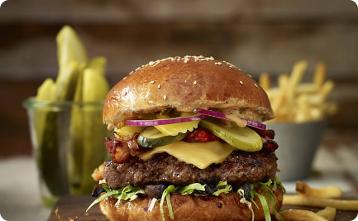
Our Digital Media Campaign
Influencer Program
Targeted Facebook Ads
Instagram Stories
We'll partner with local food bloggers and Instagram influencers to showcase our menu and spread the word about our restaurant, using the hashtag #TasteValley.
Using Facebook's targeted advertising, we will focus on specific demographics and custom audiences based on interests, behaviours, and location to promote our brand and attract more customers.
We'll post daily on Instagram Stories, sharing behind-the-scenes and daily specials to create a sense of community and encourage engagement.

Slide 5
Our Signature Dishes
1
The Valley Burger 🍔
2
Green Bowl 🥗
Our signature burger, featuring hormone-free Black Angus beef topped with bacon, cheddar, pickles, and a chipotle mayo sauce on a brioche bun.
A healthy and fresh bowl featuring a bed of quinoa, grilled veggies, avocado, and a house-made vinaigrette dressing.
3
Truffle Fries 🍟
4
Seasonal Fresh Squeezed Juice 🍹
Our golden and crispy fries topped with grated parmesan and truffle oil, a classic favourite with a touch of sophistication.
A refreshing drink, featuring a different local fruit each month - always fresh and never from concentrate.

Slide 6
The Taste Valley Experience
1
Soaring Views 🌅
Our restaurant features floor-to-ceiling windows with panoramic views of the mountains and valley, creating an unforgettable ambiance.
Family-Friendly 👪
2
We offer a play area for kids, and a calm and stress-free environment for parents.
3
Sustainability ♻️
We compost our food waste, recycle everything we can, and encourage our customers to use environmentally-friendly packaging for take-away orders.

Slide 7
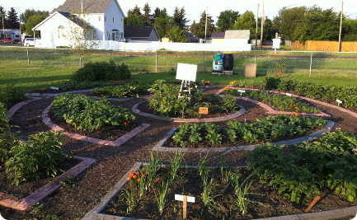
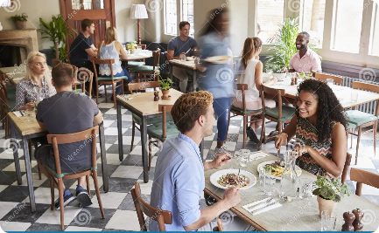
The Taste Valley Story
Local Roots
Chef-Driven 🍴
Customer-Centric 👥
Taste Valley started as a pop-up food stall in the farmers' market, and grew into a community-driven restaurant that works with local farmers and non-profits to promote healthy, sustainable, and ethical eating.
Our award-winning chef has over 20 years of experience, working in Michelin-starred restaurants around the world, and brings his creativity and passion for flavour to our menu.
We believe that happy customers make a successful business. We listen to your feedback and strive to offer the best service, pricing, and quality anywhere.

Slide 8
The Future of Quick-Service Restaurants
The Rise of Ghost Kitchens 👻
The Importance of Sustainability 🌱
Ghost kitchens, virtual kitchens, dark kitchens - whatever you call them, they represent a new era of food delivery. No storefront, no fuss, just food.
Chefs are increasingly mindful of the impact of their work on the planet. From using scraps to composting waste, sustainable thinking is at the heart of the industry. And for good reason - sustainable practices can improve your bottom line and preserve our planet for generations to come.

