Slide 1
BYOD and Beyond
Leong See Kay

Slide 2
Cisco BYOD Solution
Why BYOD? An introduction
BYOD Challenges
The Cisco BYOD Solution
BYOD Use Cases
Summary

Slide 3
Why BYOD? An introduction

Slide 4
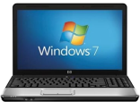
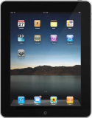
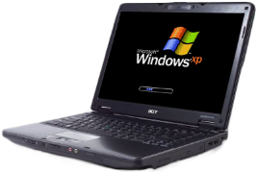
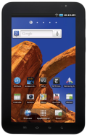
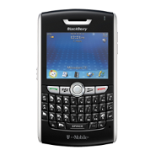
Device Diversity is here to stay
Benefits
Cost savings
Workers’ Satisfaction
Cutting-edge Technologies, latest features and capabilities
89%
26%
75%
10%
36%
22%
1%
23%

Slide 5
BYOD Challenges: User Wants
User Wants
Consistent experience on multiple devices
Seamless transitions between devices
Separation of work and personal data
Keep up with tech and social trends
89%
26%
75%
10%
36%
22%
1%
23%

Slide 6
BYOD Challenges: IT Wants
Providing Device Choice and Support
On-Boarding of New Devices
Maintaining Secure Access to the Corporate Networks
Enforcing Company Usage Policies
Visibility of Devices on the Network
Protecting Data and Loss Prevention
Revoking Access
Potential for New Attack Vectors
Ensuring Wireless LAN Performance and Reliability
Managing the Increase in Connected Devices
Work and Personal Overlap

Slide 7
BYOD Is Just the Tip of the Iceberg
BYOD
I need to allow iPads
on my network
End User
Tactical
Strategic
I need to help my company develop new mobile business models
I need to ensure workers can be more mobile and more productive
CEO
I need a BYOD strategy
that aligns with my VDI and workspace needs
I need to protect intellectual property
and confidential data
I need to quickly provide app services to new employees, partners and contractors
CIO
I need to support multiple device types without increasing cost or complexity
I need video and voice on virtual desktops
but I can’t compromise the experience
Legacy applications don’t run natively on new or mobile operating systems
IT
I Need a Workspace Strategy

Slide 8
What If You Could Solve It All?
CEO Aspirations, CIO Imperatives and End-User Requirements
What if I could speed innovation by opening my network and collaborating with customers and partners… While lowering IT cost and complexity?
What if I could let my employees have greater freedom and choice….
While protecting Intellectual Property?
What if I could let my team work their way…
Without compromising the way my business works?

Slide 9
OLD WAY
NEW WAY
Enterprise provided and managed user devices
Work is a place you go to—limited off campus access
IT visibility and control into user devices and applications
Security lived on the IT managed endpoint
Anywhere, anytime, any device usage
Work is a function—globally dispersed, mixed device ownership
Change in IT control and management paradigm — granularity beyond device
Security lives in the network to allow for BYOD
EXECUTIVE
EMPLOYEE
IT

Slide 10
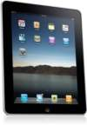
BYOD: A Company-Wide Project
Compliance Operations
Network
Team
Security Operations
Endpoint
Team
Application Team
Human Resources

Slide 11
Building Blocks of the Cisco BYOD Smart Solution

Slide 12
Cisco BYOD Smart Solution Building Blocks
Applications
Policy
Management
Unified Infrastructure
Security
Notes:
Building layers to support All the the Devices. Taking an architectural approach. Not building out Point solutions.

Slide 13
The Cisco BYOD Smart Solution
Device management integrated into unified policy
MDM
Workspace Management
Seamless mobility and anywhere access for secure mobility
AnyConnect, ASA
Secure Mobility
Unified policy for secure access, detailed visibility and simplified ops
Policy Management Infrastructure
ISE
Mission critical wireless - best workspace delivery & leading scalability
One network and one management for simplified operations and full visibility
BN—Unified Access Management—Prime
Core Infrastructure

Slide 14
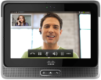
The BYOD Spectrum
LIMIT
BASIC
ENHANCED
ADVANCED
Environment Requires Tight Controls
Corp Only Device
Manufacturing Environment
Trading Floor
Classified Government Networks
Traditional Enterprise
Focus on Basic Services, Easy Access
Broader Device Types but Internet Only
Educational Environments
Public Institutions
Simple Guest
Enable Differentiated Services, On-Boarding with Security—Onsite/Offsite
Multiple Device Types + Access Methods
Early BYOD Enterprise Adopters
Corp Native Applications, New Services, Full Control
Any Device, Any Ownership
Innovative Enterprises
Retail on Demand
Mobile Sales Services (Video, Collaboration, etc.)

Slide 15
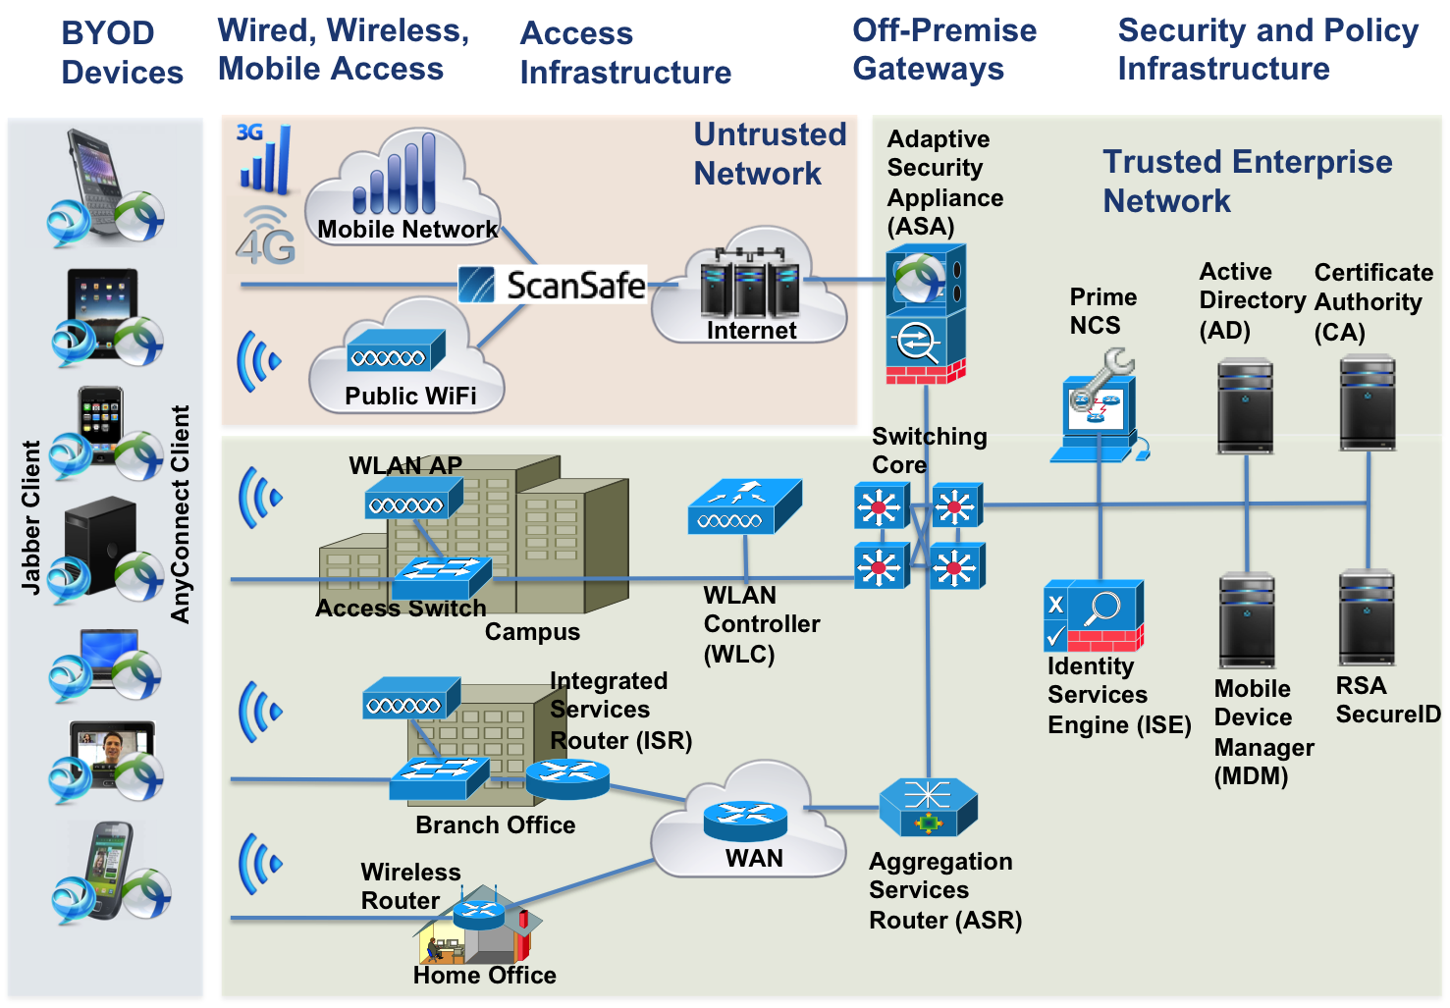
BYOD 2.1 Solution Components
* Note: ScanSafe validated in a future phase

Slide 16
Cisco BYOD Use Case

Slide 17
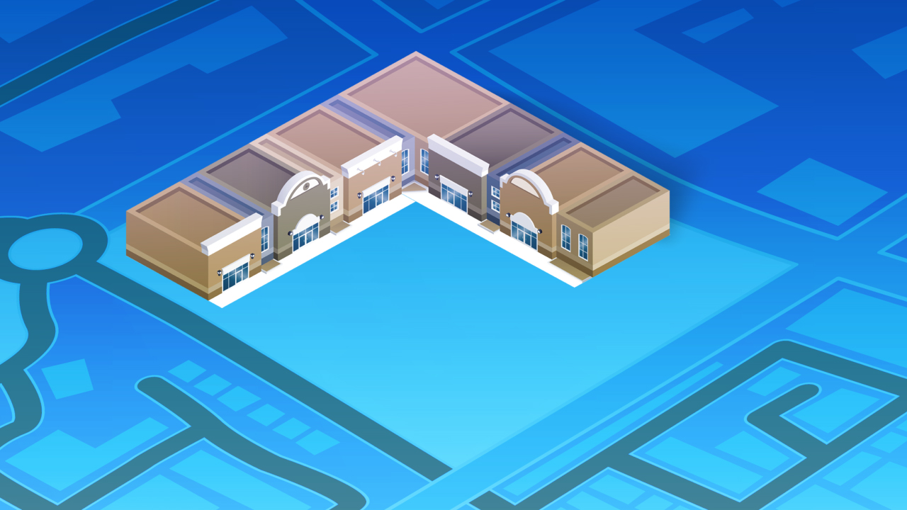
Notes:
Dr. X buys a 4G iPad during lunch, walks back to the hospital and hands his new iPad to IT and says I want to use this for my work. Now what?
[TRANSITION]

Slide 18
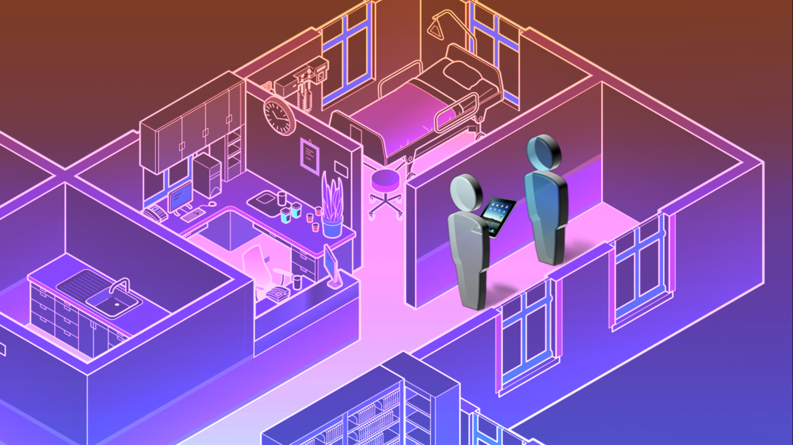
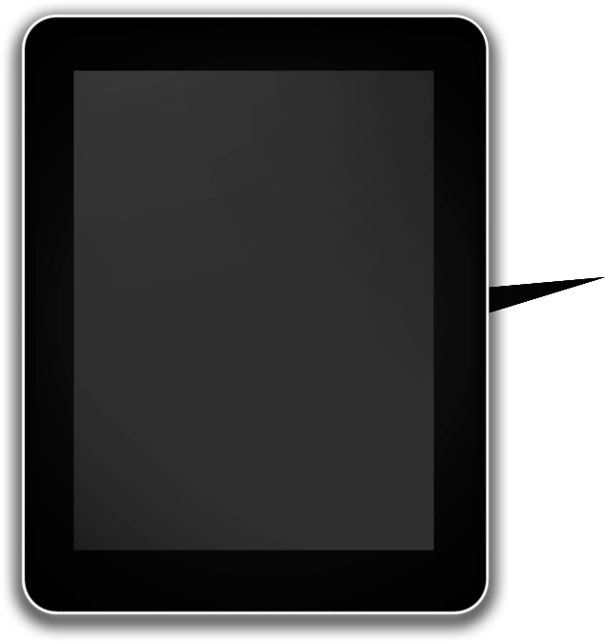
Trusted
WiFi
Authenticate User
Fingerprint Device
Apply Corporate Config
Enterprise Apps
Automatic Policies
Notes:
His IT manager tells him that using his username and password, he can “onboard” the device and the network will apply all the correct policies and approved apps automatically
The IT manager knows the importance of keeping the network secure, and complying with regulations to protect patient data. So things like remote wipe and data loss prevention are critical.
[TRANSITION]

Slide 19
802.11n Wi-Fi
Trusted
WiFi
Identity-Based Access Control
Apply defined policy profiles based on:
Device Type
User
Location
Application
Mobile Device Management
WAN Optimization Service Assurance
Notes:
Luckily, his system can help him apply contextual policies based on things like device type, user or location automatically, without user intervention. We’ve kept it simple for this example, but as you all know you can apply polices based on many more attributes.
That’s it, Dr. X has now on-boarded his new iPad. Keep in mind, to enable this seamless experience the network needs to support certain things: First, you need an 802.11n Wi-Fi network which can withstand the challenges of Mobility including complex RF interference. Second, you need identity-based network control for the contextual policy we just touched on. Mobile Device Management is required for functions such as installing enterprise applications or remote wipe if the device is lost. Last but not least, Make sure you have a management system for the infrastructure and a service assurance manager for visibility into what’s going on in the network, and what you need to do if things start going wrong. If you have branches in the Hospital, WAN optimization will help help keep network resources available.
[TRANSITION]

Slide 20
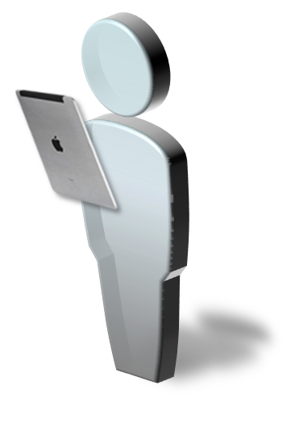
Trusted
WiFi
Access: FULL
No
Yes
Electronic Medical Records
Mobile TelePresence
Email
Instant Messenger
Notes:
Let’s get back to Dr. Thompson….
He is now attending to patients in the OR. His contextual policy has been defined from an application perspective such that when he is at work, he has full access electronic medical records, mobile telepresence, email and IM. Again, we are keeping it simple here in terms of applications used. It’s key to note that you can tailor this policy for unique job and regulatory requirements, with the doctor only allowed to access sensitive patient records while in the office due to HIPPA regulations.
It’s now 2 o’clock and Dr. Thompson needs his afternoon coffee, what happens when he leaves the Hospital? [TRANSITION]

Slide 21
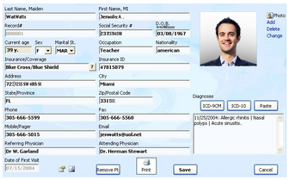
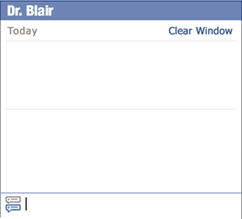
Trusted
802.11n Wi-Fi
Location
Video Optimization
Spectrum Intelligence
Client Acceleration
WiFi
Identity-Based Access Control
Is Mr. Allen’s lab work ready yet?
Not yet but i will let you know the moment it arrives
Mobile Device Management
Notes:
Doctor goes to OR, pulls up EMR and x-ray images
Communicates with staff via IM
We know that literally billions of devices are pouring onto networks – at hospitals that presents doctors, administrators, patients, and visitors. Each has unique needs, and along with tablets and smart phones, healthcare has specialized medical equipment, and wireless tracking tags, connecting in increasing numbers
A Wi-Fi network must be designed to meet these challenges, these changing device profiles, application profiles, and device density.
Capacity and performance to support the influx of clients
Performance to handle new applications, such as two-way TP with patients, and EMR data housed centrally for a medical group, and application data now residing in the cloud
Acceleration for all client types, even the medical asset tags, slower tablets and smart phones
PROACTIVE protection against wireless interference from things like blanket warmers and light controls
Location tracking for assets and people
Plus, patient data is protected by HIPPA regulations, so IT must carefully govern when and how this can be accessed

Slide 22
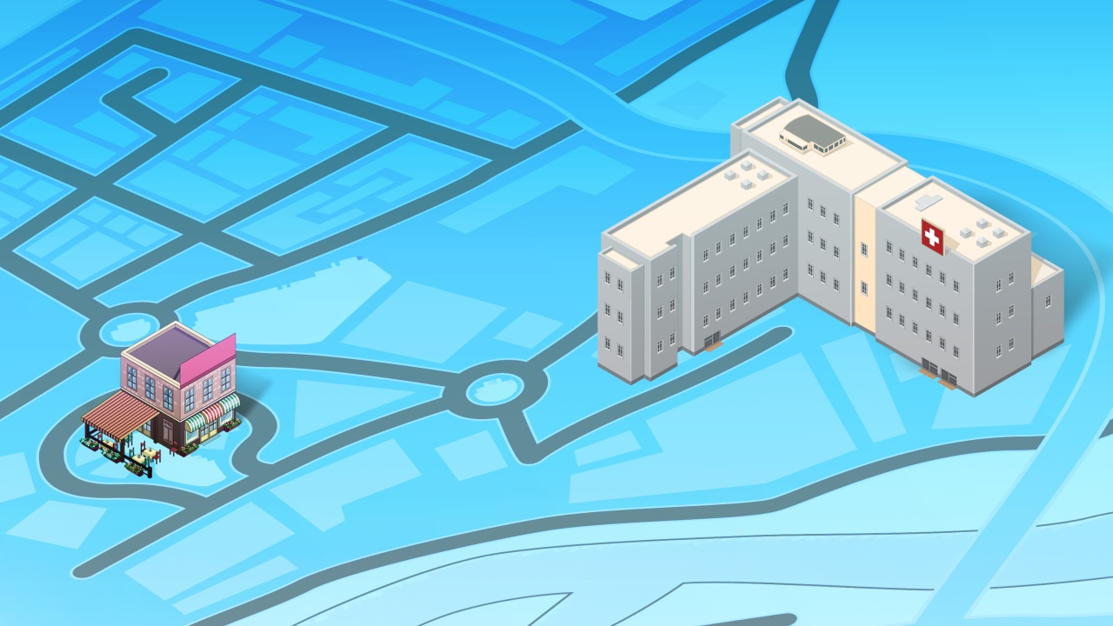
Untrusted WiFi
Access: Limited
WiFi Hotspot
Notes:
He decides to visit the coffee shop next door, which has a Wi-Fi hotspot. Now, his contextual policy becomes a roaming policy defined by the Hospital. The policy says that Dr. Thompson will not have access to EMR while at the coffee shop, but he will be able to use email, telepresence and IM
[TRANSITION] While there, he gets a paged from his nurse, and gets into a video chat session to have a two-way video chat about his patient.

Slide 23
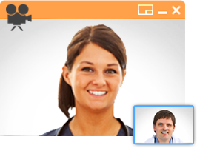
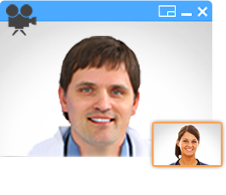
Hotspot
2.0
802.11n Wi-Fi
WiFi Hotspot
Web/Email Security
Identity- Based Access Control
VPN
Collaboration /UC
Notes:
Of course, behind that video call was infrastructure that made it possible.
[SP WI-FI] What really made this experience work was something called Hotspot 2.0. Let’s take a second, how many of you have heard about Hotspot 2.0? What about the standard 802.11u?
What’s important is this – let’s say the Coffee shop hotspot is being enabled by a Service Provider. Today, when you connect your device you need to enter your credentials and take multiple steps to ensure you can access the Wi-Fi network. With Hotspot 2.0, you have an agreement with the service provider and instantly, securely connect to that network with no user intervention. This really transforms Wi-Fi to the same ease of use as cellular. Once connected, his tablet automatically initiates VPN, to connect him to his trusted network.
Next, the hospital IT department can enforce web content security and email security to prevent malicious attacks on mobile devices. IT can set limits to what can be accessed in public areas, to ensure HIPPA compliance. Again, Identity based policy control is a hallmark of the solution.
[TRANSITION]

Slide 24
Notes:
Doctor goes to his child’s soccer game, still with iPad, on 3G
Again, his VPN has roamed from hotspot to 3G, preventing any interruption or intervention
He has full access to patient data, but his applications have been throttled to prevent overloading the 3G network and to prevent application performance issues
Our doctor pulls up his EMR application, checks for updates on patient status, all is well, watches game with ease

Slide 25
3G/4G
Access: Limited
No
Yes
Electronic Medical Records
Mobile TelePresence
Email
Instant Messenger
Notes:
Doctor goes to his child’s soccer game, still with iPad, on 3G
Again, his VPN has roamed from hotspot to 3G, preventing any interruption or intervention
He has full access to patient data, but his applications have been throttled to prevent overloading the 3G network and to prevent application performance issues
Our doctor pulls up his EMR application, checks for updates on patient status, all is well, watches game with ease

Slide 26
3G/4G
Identity-Based Access Control
VPN
Intelligent Packet Core
Notes:
Doctor goes to his child’s soccer game, still with iPad, on 3G
Again, his VPN has roamed from hotspot to 3G, preventing any interruption or intervention
He has full access to patient data, but his applications have been throttled to prevent overloading the 3G network and to prevent application performance issues
Our doctor pulls up his EMR application, checks for updates on patient status, all is well, watches game with ease

Slide 27
Trusted
WiFi
Trusted WiFi
Access: FULL
No
Yes
Electronic Medical Records
Mobile TelePresence
Email
Instant Messenger
Notes:
Doctor goes home – connects on home Wi-Fi,
He has partitioned access – tunnel back to hospital, and a personal SSID for family access
Doctor calls in on his IP softphone to talk with a colleague about tomorrow’s operations
[TRANSITION]

Slide 28
Bandwidth Priority
Trusted
WiFi
802.11n Wi-Fi
Full Service Home Router
Collaboration/UC
Notes:
Doctor goes home – connects on home Wi-Fi,
He has partitioned access – tunnel back to hospital, and a personal SSID for family access
Doctor calls in on his IP softphone to talk with a colleague about tomorrow’s operations
Son starts a Call of Duty “Modern Warfare 3” game – but his home router applies QoS and prioritizes this lower than his phone call
His call continues with perfect quality

Slide 29
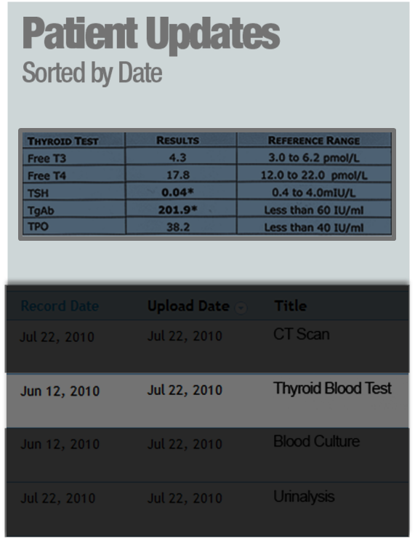
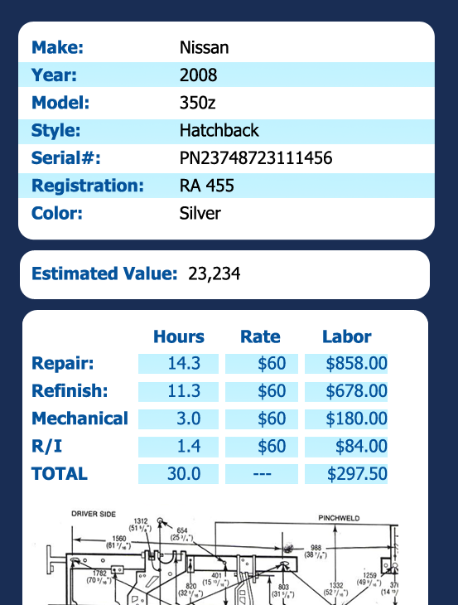
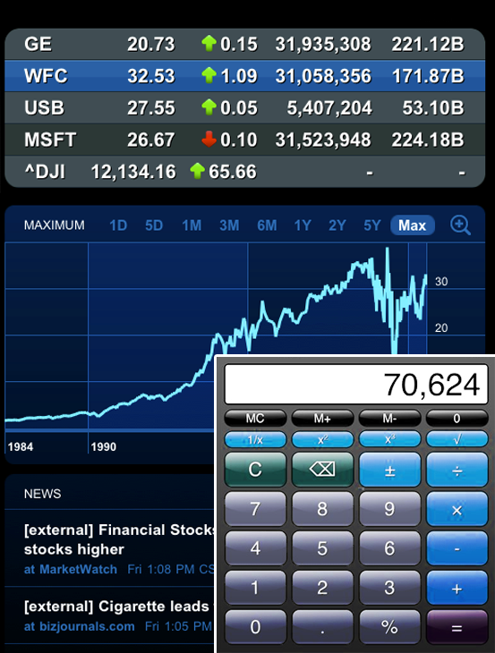
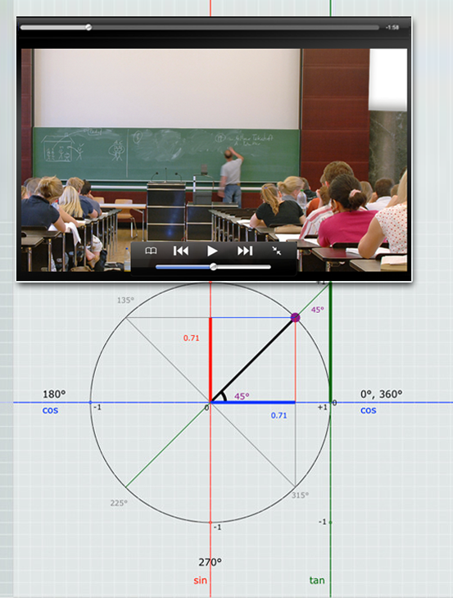
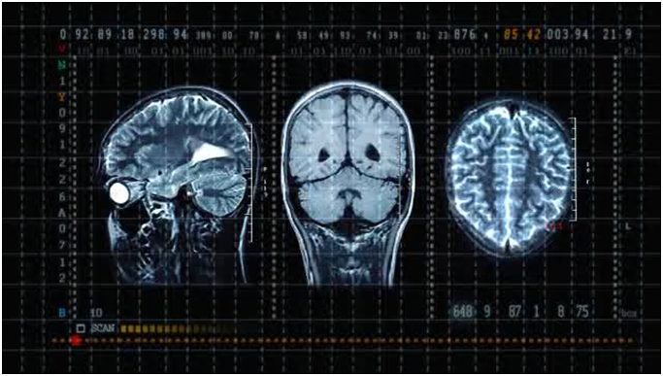
Notes:
Healthcare is especially mission-critical, and we can all relate.
But the parallels across industries are endless.
Retail: virtual dressing rooms, personalized shopping experience
Insurance: Agents and adjusters generating quotes on location with customers, with photos and data integrated
Financial services: portfolio management for client discussions, as well as a branded customer experience in retail branches (e.g., Wells Fargo)
Education: students in large lecture halls, watching multicast video of the lecture and supporting materials/photos
So what does all this data mean for you?
Businesses in every sector will need to keep up with these trends, and that means investing in a mobility architecture capable of turning this challenge into an opportunity.

Slide 30
Summary

Slide 31
Summary
BYOD impacts all areas of IT
Workspace delivery to any device can be native, virtual, or hybrid
BYOD implementation must address the entire “spectrum” of use cases in an organization
Cisco BYOD Solution
AnyConnect
ScanSafe
ASA
ESA/WSA
ISE
Wireless
Wired
Sec Group
Access
Cisco Prime

Slide 32
Reduced Burden on IT Staff
Device On-Boarding, Self Registration, Supplicant Provisioning
Reduced Burden on Help Desk Staff
Seamless Intuitive End-User Experience
Self Service Model
My Device Registration Portal, Guest Sponsorship Portal

