Slide 1
Business negotiations.
Making an appointment
(Ведення ділових переговорів. Ділова зустріч)

Slide 2
Types of negotiation
If people negotiate (with each other), they talk in order to reach an agreement which is to their mutual advantage – good for them both. Examples of these situations in business are:
a customer–supplier negotiations
b wage negotiations
c merger or takeover negotiations
d trade negotiations
e Negotiations also take place to settle disputes – decide arguments.
f contract disputes
g labour disputes
h trade disputes

Slide 3
Word combinations with ‘negotiations’
Intense Intensive | negotiations | are very difficult and tiring, with a lot being discussed.
Delicate Tense |  | are very difficult and could easily fail.
Eleventh-hour Last-minute |  | take place very late in relation to the time that an agreement is necessary.
Protracted |  | take a very long time.

Slide 4
Opening the negotiation
Linhas Transatlanticas (LT) is negotiating to buy a number of D740 planes from EPA. Frederica Ramos, LT’s chief executive, is talking to Tom Lang, EPA’s chief salesman. Here are some of the things she says:
a Mr Lang, good to see you again. How are you? Let me introduce my colleagues: Sandra Lopes, our head of finance, and this is Fernando dos Santos, head of operations here at LT.
b Would you like some coffee or tea, or would you prefer juice? How was the flight?
c Shall we go to the conference room and make a start?
d You told me you’re flying back on Friday evening, so that gives us three days. I think two days should be enough to cover all the points. On the third day, Friday, if we have an agreement, I’ll ask our lawyers to check it.
e As you all probably know, Mr Lang and I met at the Aerospace Trade Fair in Frankfurt last year and we had a very interesting discussion about the possibility of buying a number of D740s from EPA.
f Well, we’ve looked at the potential requirements for the new plane and it looks as if we may need 100 new planes over the next five years.

Slide 5
4 tips for successful negotiations

Slide 6
1. Do your research
Before entering into negotiation talks, evaluate all sides and consider their goals. It can also be helpful to research the person you are negotiating with. Understand the limitations of the negotiator. Do they have the ability to give you what you want? Understanding these limitations can help you strategize.
2. Know your priorities
Negotiations often require each side to compromise. Determine what is most important and what you are willing to settle for in its place. Setting your priorities ahead of time can help you evaluate what you refuse to give up and where you’re willing to budge. If you are the negotiator, be clear about what both sides offer and what they need from each other.

Slide 7
3. Consider the opposition
Consider the potential opposition to your negotiations. Do you think your manager will object to a pay increase because of declining sales? Will you be denied a higher starting salary for a position because your requested rate is above the average range? Write down all the potential oppositions and then gather the information you can use to argue your case.
4. Keep communications open
Be consistent about presenting your goals, objectives and expectations to reduce the risk of confusion. Use effective communication skills, including verbal responses and nonverbal cues. Strive for mutually beneficial solutions, but be prepared to compromise.
If you are the negotiator, ensure there are guidelines for the discussion and that both sides stick to them. Get agreements in writing.

Slide 8
Video All about Appointments - Making, Scheduling & Cancelling
https://www.youtube.com/watch?v=aifCzmFTcEA&ab_channel=LearnEnglish%7CLet%27sTalk-FreeEnglishLessons

Slide 9
Some expressions you can use
Asking for an appointment - I would like to arrange an appointment to discuss…. -Please would you indicate a suitable time and place to meet?
Suggesting a time -Would Tuesday suit you? -Would you be available on Tuesday?
Agreeing to an appointment -Thank you for your email. I would be available to discuss…. on (date) at (time and place).
Saying a time is not convenient Unfortunately, I will be away on business during the week of July 6 – 11, so I will be unable to meet you then. However, if you were available in the following week, I would be glad to arrange a meeting with you.
Cancelling an appointment -Unfortunately, due to some unforeseen business, I will be unable to keep our appointment for tomorrow afternoon.
-Would it be possible to arrange another time later in the week?
Apologising I apologise for any inconvenience.

Slide 10
Dialogues and tasks

Slide 11
READ THE DIALOGUE
A: I would like to make an appointment for a project meeting.
B: Of course, I have Monday or Tuesday available. What day would be best for you?
A: I would like to meet on Monday.
B: Very well then. Are mornings or afternoons best?
A: I want to come in the morning.
B: I will have my assistant check my calendar and get back to you with the exact time. Can you bring me an outline of the project when you come?
A: Yes, I can bring the outline when I come to the meeting.
B: Do you know how to get there?
A: No, I need directions, please.
B: Fine, we will make sure that we send you all of the information that you need. See you there!

Slide 12
Choose the correct word partnership to complete the sentences
A: I 1… to make an appointment for a project meeting.
B: Of course, I have Monday or Tuesday available. What day 2… best for you?
A: I would like 3… on Monday.
B: Very well then. Are mornings or afternoons 4…?
A: I want to come in the morning.
B: I will have my assistant 5… and get back to you with the exact time. Can you bring me an outline of the project when you come?
A: Yes, I can bring the outline when I come to the meeting.
B: Do you know how to get there?
A: No, I need directions, please.
B: Fine, we will 6… that we send you all of the information that you need. See you there!
a) to meet b) best c) would like d) would be e) make sure f) check my calendar

Slide 13
READ THE DIALOGUE
A: Could I meet with you to discuss the project?
B: Good idea. We could meet on Monday or Tuesday. Which day would you prefer?
A: Tuesday would be good for me.
B: OK. Do you think we should meet in the morning or in the afternoon?
A: I think the afternoon would be best.
B: That will work out. I will e-mail the exact time tomorrow. I need you to bring your plans with you.
A: Yes, I will bring my plans with me to the meeting.
B: Should we invite the whole committee or should we just have the sub-committee there?
A: I feel that the whole committee needs to be there.
B: Yes, I agree. We'll make sure that they get notified. Can you find the meeting place?
A: Yes, I know how to get there on my own.
B: Great! We will send you all the details later. Looking forward to meeting with you!

Slide 14
Insert replies B in the correct order
B: Great! We will send you all the details later. Looking forward to meeting with you! (1)
A: Could I meet with you to discuss the project?
-
A: Tuesday would be good for me.
-
A: I think the afternoon would be best.
-
A: Yes, I will bring my plans with me to the meeting.
-
A: I feel that the whole committee needs to be there.
-
A: Yes, I know how to get there on my own.
-
B: Good idea. We could meet on Monday or Tuesday. Which day would you prefer? (2)
B: Should we invite the whole committee or should we just have the sub-committee there? (3)
B: That will work out. I will e-mail the exact time tomorrow. I need you to bring your plans with you. (4)
B: OK. Do you think we should meet in the morning or in the afternoon? (5)
B: Yes, I agree. We'll make sure that they get notified. Can you find the meeting place? (6)

Slide 15
1. In your opinion, which of these items of advice for a successful conversation are useful and which are not?
1. Listen carefully.
2. Give only 'yes' or 'no' answers.
3. Interrupt a lot.
4. Be polite.
5. Ask questions.
6. Stay silent.
7. Keep eye contact.
8. Be friendly.
2. AUDIO 1.48
Listen to a conversation between two people who have recently met.
What is wrong? How can it be improved?
3. Match the expressions (1-5) to the functions (a-e).
1. I f you order more, we'll give you a discount. a) Refusing an offer
2. What exactly do you mean? b) Playing for time
3. I'd like to think about it. c) Making offers and concessions
4. I'm not sure about that. d) Closing the deal
5. Right, I think we've covered everything. e) Checking understanding

Slide 16
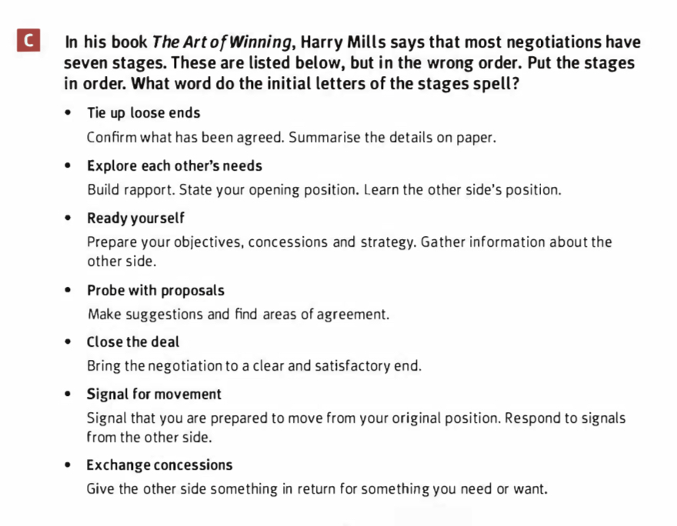
T
E
R
P
C
S
E

Slide 17
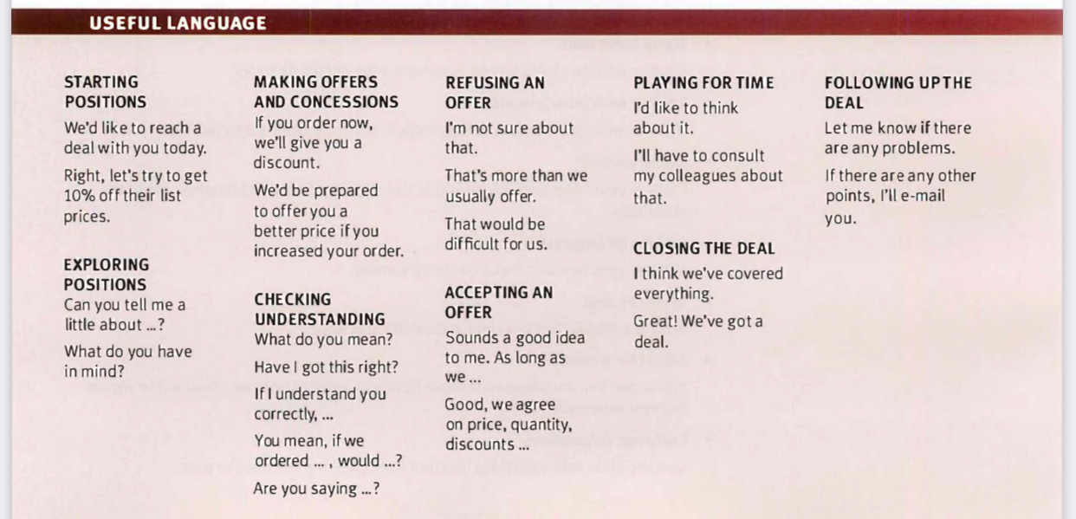

Slide 18
Thank you for your attention!

