Slide 1
The customer in an Omnichannel environment

Slide 3
Plan
1. The new customer path in a hybrid digital environment.
2. Mapping customer journey
3. Consumer behavior in the digital environment

Slide 4
1. The new customer path in a hybrid digital environment.
Customer connectivity & Peer-to-peer communication
Companies need to connect with customers in just a few critical touchpoints. Companies should map the customer path to purchase, understand customer touchpoints across the path, and intervene in select touchpoints that matter. They should focus their efforts - intensifying communications, strengthening channel presence, and improving customer interface - to improve those critical touchpoints as well as to introduce strong differentiation.
The best source of influence is the army of customers turned advocates. Thus, the ultimate goal is to delight customers and convert them into loyal advocates.

Slide 5
Understanding How People Buy: From Four A's to Five A's
AIDA: attention, interest, desire, and action. The advertising copy and sales pitch should grab attention, initiate interest, strengthen desire, and ultimately drive action.
4 A's - a modification of AIDA: aware, attitude, act, and act again. The interest and desire stages are simplified into attitude and a new stage, act again, is added. The modified framework aims to track post-purchase customer behavior and measure customer retention.
4 A's - the straightforward funnel. Customers learn about a brand (aware), like or dislike the brand (attitude), decide whether to purchase it (act), and decide whether the brand is worth a repeat purchase (act again). The number of customers going through the process continues to decline as they move into the next stage.

Slide 6
A new customer path must be defined to accommodate changes shaped by connectivity.
Shift 1. The initial appeal of a brand is influenced by the community surrounding the customer to determine the final attitude. Many seemingly personal decisions are essentially social decisions. The new customer path should reflect the rise of such social influence.
Shift 2. Loyalty is ultimately defined as the willingness to advocate a brand. If the customer is happy with the brand, they will be willing to recommend it even when currently not using it. The new customer path should be aligned with this new definition of loyalty.

Slide 7
Shift 3. When it comes to understanding brands, customers now actively connect with one another, building ask-and-advocate relationships. Customers who need more information will search for it and connect with other customers with better knowledge and more experience. Depending on the bias shown during the conversation, the connection either strengthens or weakens the brand's initial appeal. The new customer path should also recognize this connectivity among customers.

Slide 9
The aware stage (the gateway to the entire customer path). Customers are passively exposed to a long list of brands from past experience, marketing communications (Advertising), and/or the advocacy of others (word of mouth).
The appeal stage. Customers process all the messages they are exposed to and become attracted only to a short list of brands.
The ask stage. Customers usually follow up by actively researching the brands they are attracted to for more information from friends and family, from the media, and/or directly from the brands. Today, the ask is further complicated by the integration of the digital (online) and physical (offline) worlds. The customer path changes from individual to social. The brand appeal needs confirmation from others to allow the path to continue. Brands need to trigger the right amount of customer curiosity.

Slide 10
The act stage. The desired customer actions are not limited to purchase actions. After purchasing a particular brand, customers interact more deeply through consumption and usage as well as post-purchase services. Brands need to engage customers and make sure that their total ownership and usage experience is positive and memorable.
The advocate stage. Retention, repurchase, and ultimately advocacy to others.

Slide 12
Along the way from awareness to advocacy, there are catalysts that marketers can leverage to break up bottlenecks between the steps:
First Catalyst: Increasing Attraction.
Second Catalyst: Optimizing Curiosity.
Third Catalyst: Increasing Commitment.
Fourth Catalyst: Increasing Affinity. Firms need to engage with their customers beyond the typical touchpoints. This can mean building a rewards and loyalty program and interaction on social media or using gamification to get into closer contact.

Slide 16
A recent report by Arm Treasure Data and Forbes Insight in 2020 shows that 75 percent of consumers are somewhat or very likely to buy from a company based on their experience. This is regardless of price or product. In fact, 77% consider such experiences to be just as important as the quality of a company’s products or services.
https://www.moengage.com/learn/omnichannel-customer-journey/
Customer experience is the totality of cognitive, affective, sensory, and behavioral consumer responses during all stages of the consumption process including pre-purchase, consumption, and post-purchase stages

Slide 17
New-generation customer experience
As products have become commoditized, businesses now turn their innovation focus to every touchpoint surrounding the products. The new ways to interact with a product are now more compelling than the product itself. The key to winning the competition no longer rests on the product but on how the customers evaluate, purchase, use, and recommend it. CX has essentially become a new effective way for companies to create and deliver more customer value. In fact, CX is one of the primary drivers of business results. One-third of connected customers are willing to pay more for a great CX according to a Salesforce survey. A PwC study also found that almost three out of four customers say that a great CX will make them stay loyal. And customers would pay a price premium of up to 16% for a better CX.
Kotler et al, 2021
https://www.oracle.com/webfolder/assets/digibook/cx-research/index.html

Slide 18
2. Mapping customer journey
The customer journey is the series of interactions a customer has with a brand, product, or business as they become aware of a pain point and make a purchase decision.
https://blog.hubspot.com/service/customer-journey-map-vb
A customer journey map is a chart that includes certain actions customers take to achieve specific goals as well as the emotions and experiences they have while doing this. It helps companies understand consumers, predict their behavior, provide customers with a smooth user experience, and improve their marketing strategy based on customer demand, needs, and preferences.
https://sendpulse.com/support/glossary/customer-journey-map

Slide 19
The main goal: to create a seamless customer experience
Marketers need to map all possible touchpoints and channels across the 5 A's. The omnichannel marketing strategy should focus on the integration of the most popular channels.
Step 1: Map All Possible Touchpoints and Channels across the Customer Path
Step 2: Identify the Most Critical Touchpoints and Channels
Step 3: Improve and Integrate the Most Critical Touchpoints and Channels
Source: Kotler et al, 2017

Slide 20
Specific steps to creating CJM
https://sendpulse.com/support/glossary/customer-journey-map
1. Determine your goals. What you want to achieve: increase customer retention, find some information necessary for your future business decisions, or improve customer loyalty and customer experience. Afterward, specify the audience you target.
2. Get customer feedback through conducting research. Consider using surveys and questionnaires to receive comments from leads who are interested in purchasing from your brand and customers who already have experience interacting with your company.
3. Focus on one ideal buyer. You need to pay maximum attention to one persona that embodies your ideal customer and combines the most important characteristics. This step is essential in creating a map that describes customer experience in detail.

Slide 21
4. Specify the main touchpoints with consumers. Conduct research to unveil the stages at which prospects and clients interact with you and the channels they come from. Brand touchpoints include your site, blog, social media, online and offline events, online ads, and more. Getting insights into the performance of your website and social media content helps identify the most effective marketing channels.
5. Analyze customer interactions with the company. You can perform a website analysis, see how your leading competitors approach customers, leverage CRM to collect customer feedback, and use Net Promoter Score to let customers rate the likelihood of recommending your brand, etc.
6. Eliminate possible and existing drawbacks. You can improve your website, content, and the quality of customer support according to customers’ wishes.

Slide 22
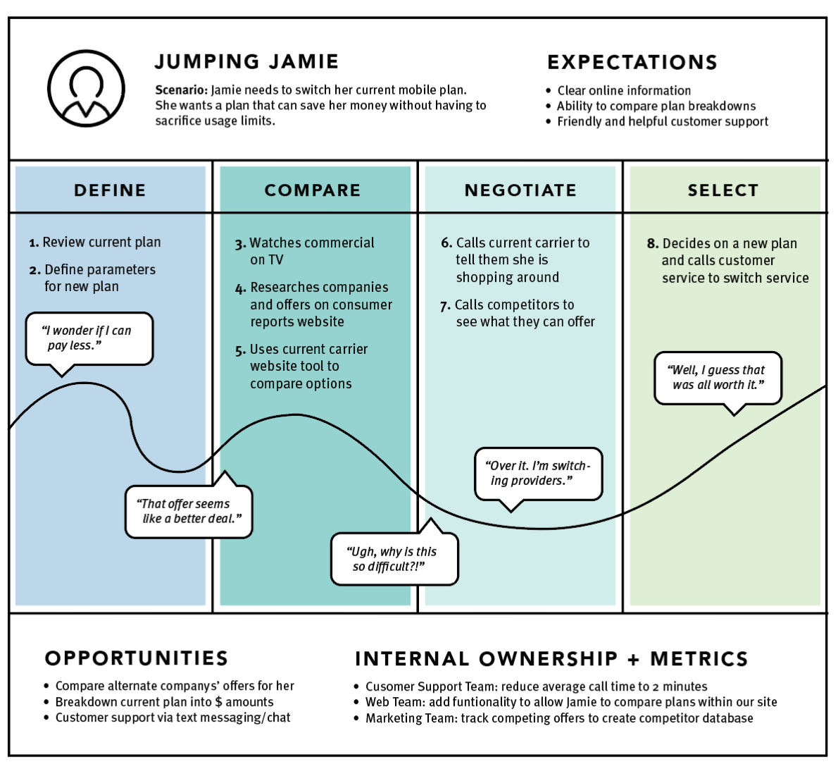
Example of Customer Journey Map

Slide 23
Customer Journey through main stages https://blog.hubspot.com/service/customer-journey-map-vb
Stages | Customer pain points | The main goal | Content | Customer touchpoints
Awareness | Customers have realized that they have a problem and a pain point to solve. A customer may not yet know that they need a product or service, but they will begin doing research | To help customers navigate their new pain points, not encourage a purchase | Educational content: How-to articles and guides General whitepapers General e-books Free courses | Company blog Social media Search engines

Slide 24
Stages | Customer pain points | The main goal | Content | Customer touchpoints
Consideration | Customers realize that they need a product or service. They begin to compare brands and their offerings | To help customers navigate a crowded solution marketplace and move them toward a purchase decision | Product marketing content: Product listicles Product comparison guides and charts Product-focused white papers Customer success stories or case studies | Company blog Company website Search engines Social media Conferences
Decision | Customers have chosen a solution and are ready to buy | To get customers to make a purchase. Brands deliver a seamless purchase process to make buying their products as easy and simple as possible | Free demos Free consultations Product sign-up pages Pricing pages Product promotions | Company website Search engines Email

Slide 25
Stages | Customer pain points | The main goal | Content | Customer touchpoints
Retention | Customers have purchased a solution and stay with the company as opposed to leaving for another provider. | Brands provide an excellent onboarding experience and ongoing customer service to ensure that customers don't churn | Retention-stage strategies: Providing a dedicated customer success manager Making your customer service team easily accessible Creating a knowledge base in case customers ever run into a roadblock | Company website Live chat Email Social media

Slide 26
Stages | Customer pain points | The main goal | Content | Customer touchpoints
Loyalty (Advocacy) | Customers not only choose to stay with a company – they actively promote it to their surroundings | Brands focus on providing a fantastic end-to-end CX. Customers become loyal when they've achieved success with your ?product? – if it works, they will likely recommend your brand to others. | Loyalty-stage strategies: Having an easy-to-navigate website Investing in your product team to ensure your product exceeds customer expectations Making it easy to share your brand with others via a loyalty program Providing perks to continued customers (e.g., discounts) | Company website Email Social media Company products

Slide 27
3. Consumer behavior in the digital environment
Consumer behavior is the study of how people make purchase decisions to satisfy their needs, wants, or desires and how their emotional, mental, and behavioral responses influence the buying decision. https://www.omniconvert.com/blog/consumer-behavior-in-marketing-patterns-types-segmentation/

Slide 29
Two main patterns of customer behavior in the digital environment
Webrooming pattern means those shoppers that search for information online and then confirm the information offline.
Showrooming pattern means gathering information and examining products in physical stores and then purchasing online.

Slide 31
THE INFLUENTIAL DIGITAL SUBCULTURES
Youth, Women, and Netizens (citizens of the internet) (YWN)
Youth: Acquiring the Mind Share
Early adopters. They try new products and experience new services that older segments deem too risky. Marketers with newly developed and launched products need them.
Trendsetters. This allows marketers to quickly pinpoint trends that will influence the market in the near future.
Game changers. They are concerned about what is happening around them. In fact, they are one of the primary drivers of change in the world

Slide 32
Women: Growing the Market Share
Information collectors. Women actually pay attention to all the information, and they will eventually summarize it for others.
Holistic shoppers. They are more likely to consider everything - functional benefits, emotional benefits, prices, and the like - before determining the true value of products and services.
Household managers. Women are also the influencers for other products such as investment and financial services.

Slide 33
Netizens: Expanding the Heart Share
Social connectors. Since it is a many-to-many network built on one-to-one relationships, an internet community usually grows exponentially and becomes one of the strongest forms of community
Expressive evangelists. Netizens, unlike internet users in general, are more likely to be brand evangelists.
Content contributors. Like good citizens contributing to their country, they contribute to the development of the Internet. The work of netizens makes life easier for other internet users.

Slide 34
Consumers can be classified into one of three segments:
Multichannel Enthusiasts who have positive attitudes towards all channels, high levels of innovativeness, and enjoy shopping;
Store-Focused consumers who prefer shopping in stores and have high levels of channel and brand loyalty; and
Uninvolved consumers who have little interest in any channel and a low degree of shopping involvement generally
Konuş et al. (2008)

Slide 35
Segmenting customers by their use of specific touchpoints in the customer journey
Herhausen et al, 2019
Store-focused segment. Shoppers have less online experience and spend less than customers from other segments.
Pragmatic online segment. Shoppers are older, more often female, have a shorter journey duration, more online and less offline experience, and spend more than store-focused customers.

Slide 36
Extensive online segment. Shoppers are more price-conscious and more often male, have a higher education, more online and less offline experience, and a shorter customer duration, and spend more than store-focused customers.
Multiple touchpoint segment. Shoppers are more involved, younger, and from a larger household, have a longer journey duration and more online experience, and spend more than store-focused customers.
Online-to-offline segment. Shoppers are more involved and more often male, have a longer journey duration and more online experience, and spend more than store-focused customers.

Slide 37
Thank you for your attention

