Slide 1
Лекція 7 - PM/PO, QA, DevOps

Slide 2
План предмету.
Pt.1: Ввід у предмет. Що таке якість. Перспектива розробника
Pt. 2: Code quality & metrics
Design & Architecture Pt. 1: Технології проєктування
Design & Architecture Pt. 2: Визначення Архітектури
Design & Architecture Pt. 3: Modern definition & tools
Design & Architecture Pt. 4: Characteristics & components
Project lifecycle (PM/PO). Quality assurance (QA). Developer Operations (DevOps)
Standards - IEEE, ISO, Specs, RFC.

Slide 3
План лекції 7
PM/PO
Визначення
Різниця
Типові підходи та практики PM
Типові підходи та практики PO
QA
Визначення
Види тестування
Типовий підхід
Типи тестів
DevOps
Визначення
Типові практики

Slide 4
PM

Slide 5
What Is a Project?
A project can be simply defined as an endeavor that involves completing tasks to achieve an objective with a limited set of resources and a finite timeline. Based on this definition, it’s clear that most businesses, nonprofits, governments and other types of organizations execute projects of some sort and therefore, need to implement a project management process.

Slide 6
What Is Project Management?
Project management is a process that allows project managers to plan, execute, track and complete projects with the help of a project team. To do so, they must use project management principles, skills, methodologies and tools to lead team members through each of the project management steps which are known as the project lifecycle.

Slide 7
Project Management and Program Management?
Program management uses the same principles and techniques as project management, but as its name suggests, it consists of managing programs instead of projects. Programs are a group of related projects that are executed simultaneously to make the most out of an organization’s available resources which presents unique challenges for project management professionals.

Slide 8
Brief PM History
Project management as we know it today began taking shape roughly in the 1950s when foundational tools and techniques of project management such as the critical path method (CPM), work breakdown structure (WBS) and the program evaluation and review technique (PERT) were created.
However, the origins of project management can be traced back to 1896 when Karol Adamiecki created the harmonogram, which was the inspiration for the Gantt chart, which was later created in 1910 by Henry Gantt and remains one of the most important project management tools today. The origins of project management are closely related to construction, engineering, scientific management and even military research.

Slide 9
Why?
PM is important because it helps organizations control all the moving parts of projects to bring them to successful completion. These moving parts are known as project management areas, which are key project aspects that must be overseen as projects progress.

Slide 10
Main areas
Here’s a quick definition of each of the 10 project management knowledge areas, first defined by the Project Management Institute (PMI) in its Project Management Body of Knowledge (PMBOK).
Scope management: Managing the scope of a project, which refers to the tasks, deliverables and milestones that should be delivered.
Schedule management: Creating a project schedule and setting guidelines for how it’ll be tracked and maintained.
Cost management: Estimating project costs to create a budget which is then tracked throughout the project.
Quality management: Ensuring project deliverables meet quality standards.
Resource management: Acquiring, allocating and tracking project resources like labor, materials and equipment.
Communication management: Defining communication guidelines for project teams and stakeholders.
Risk management: Identifying, evaluating and preventing or mitigating risks in your project.
Procurement Management: Acquiring project resources and maintaining relationships with vendors and suppliers.
Stakeholder management: Identifying project stakeholders, and managing them based on their expectations and influence over projects.
Integration management: Creating a framework that helps project teams work better together.
These project management knowledge areas need to be managed during each step of the project management process.

Slide 11
Project lifecycle - 1. Project Initiation
This is the starting phase where the project manager must prove that the project has value and is feasible through a series of project management documents. Here are the most important ones:
Business case: A business case justifies the need for the project, project objectives and return on investment.
Feasibility study: A feasibility study proves that the project can be executed within a reasonable time and cost.
Project charter: A project charter conveys what the project is going to deliver.
Once the project gets approved, the project manager must assemble a project team and set up a project management office. The project initiation phase ends with a kickoff meeting, which is when project goals and scope are defined.

Slide 12
Project lifecycle - 2. Project Planning
The goal of the project planning phase is the creation of the project plan, a comprehensive project document that explains in great detail how the project will be executed. Here’s a quick overview of the most important sections of a project plan.
Project schedule: The project schedule defines a timeline for the execution of tasks and resource allocation.
Project budget: A project budget is the sum of all the estimated project costs.
Scope management plan: Explains how your project scope will be tracked throughout the project.
Risk management plan: Explains the risks that might affect the project, along with strategies to mitigate them.
Resource management plan: Describes how your resources will be obtained, allocated and managed during the project.
Stakeholder management plan: Identifies all project stakeholders and the guidelines to manage them.
Project managers often lay out their project plan using Gantt chart software, which provides a visual representation of the entire project schedule and project scope. Some Gantt charts automatically identify critical path activities.

Slide 13
Project lifecycle - 3. Project Execution
The third project management phase is project execution, which is when the project plan is executed to meet the project goals and objectives.
The project execution phase is when project managers need to oversee the project management knowledge areas as their project progresses toward the monitoring and control phase.
Along the way, the project manager will reallocate resources or adjust time and scope as needed to keep the team working. In addition, they’ll identify and mitigate risks, deal with problems and incorporate any changes.

Slide 14
Project lifecycle - 4. Project Monitoring and Control
The fourth project management phase, project monitoring and control, takes place concurrently with the execution phase of the project. It involves monitoring the progress of the project execution activities to ensure the project team stays on schedule and within budget. Quality control procedures are applied to guarantee quality assurance.
Reporting is also a critical part of this project management phase. First, it allows project managers to track progress, and second, it provides data for stakeholders during presentations to keep them in the loop. There are many project management reports such as project status, timesheets, workload, allocation and expense reports.

Slide 15
Project lifecycle - 5. Project Closure
The fifth project management phase is project closure, in which the final project deliverables are presented to the stakeholders. Once approved, resources are released, documentation is completed and everything is signed off on.
Now that we’ve learned about the project management life cycle, let’s look at some project management approaches.

Slide 16
What Types of Project Management Exist?

Slide 17
Waterfall Project Management - A linear project management approach, in which stakeholder requirements are gathered at the beginning of the project, and then a sequential project plan is created.
Agile Project Management - An iterative project management approach that doesn’t follow a rigid project plan, but instead short sprints of work called agile sprints.
Scrum Project Management - An agile framework that’s very popular for product and software development.
Lean Project Management (or Lean Manufacturing) - This technique was invented to improve manufacturing processes and became a very important project management methodology through the years.
Kanban Method Kanban is a widely used project management approach that consists of managing work through visual boards and cards. Kanban boards are used by agile and scrum teams.
Six Sigma - Just like kanban or lean, six sigma is a set of tools and techniques that were developed to improve production processes and later became a project management approach.
Critical Path Method (CPM) The critical path method is a project scheduling technique that allows project managers to estimate the duration of a project, identify task dependencies, float and critical activities.
Critical Chain - Project Management A project management approach that’s based on the theory of constraints and uses resource management as the primary way to execute projects effectively.
PRINCE2 - PRINCE2 is the most popular project management methodology in the UK, Australia, and European countries. PRINCE2 is very similar to the Project Management Body of Knowledge from the PMI because it provides definitions and best practices for project managers.

Slide 18
Waterfall Methodology
This may be the most straightforward and linear of all the project management methods in this list, as well as the most traditional approach. The name is apt, as the waterfall methodology is a process in which the phases of the project flow downward. The waterfall model requires that you move from one project phase to another only once that phase has been successfully completed.
When to use it: The waterfall approach is great for manufacturing and construction projects, which are highly structured, and when it’s too expensive to pivot or change anything after the fact. The waterfall method makes use of Gantt charts for planning and scheduling.

Slide 19
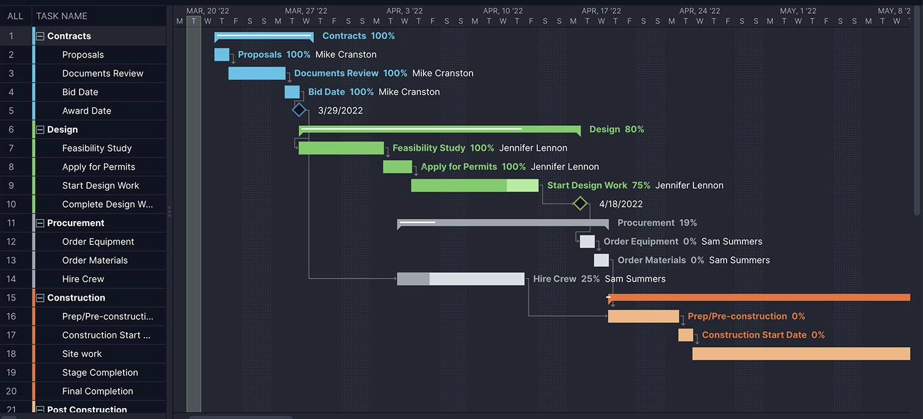

Slide 20
Agile Methodology
What it is: In a nutshell, Agile project management is an evolving and collaborative way to self-organize across teams. When implementing the agile methodology, project planning and work management are adaptive, evolutionary in development, seeking early delivery and are always open to change if that leads to process improvement. It’s fast and flexible, unlike waterfall project management.
The agile methodology offers project teams a very dynamic way to work and collaborate and that’s why it is a very popular project management methodology for product and software development. That’s because what we think of as agile really appeared in 2001 with the publication of the “Manifesto for Agile Software Development,” authored by 17 software developers.
When to use it: The practice originated in software development and works well in that culture. How do you know if agile is for you? It has been applied to non-software products that seek to drive forward with innovation and have a level of uncertainty, such as computers, motor vehicles, medical devices, food, clothing, music and more. It’s also being used in other types of projects that need a more responsive and fast-paced production schedule, such as marketing.

Slide 21
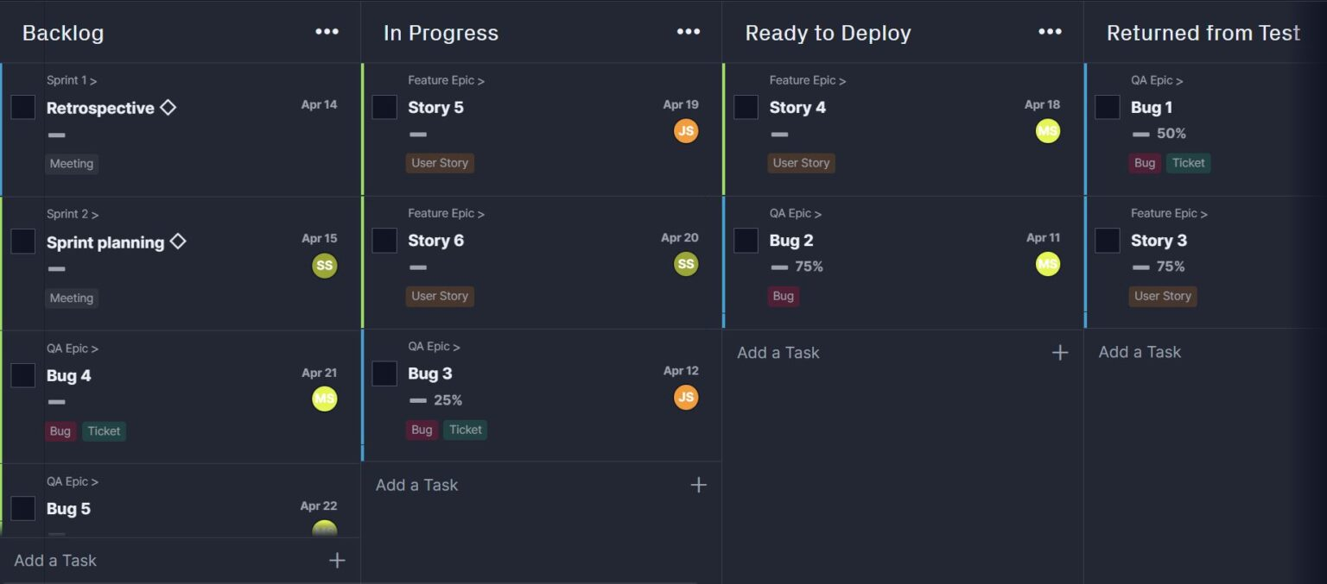

Slide 22
Scrum Methodology
What it is: Scrum is a short “sprint” approach to managing projects. The scrum methodology is It’s ideal for teams of no more than 10 people and often is wedded to two-week cycles with short daily meetings, known as daily scrum meetings. It’s led by what is called a scrum master. Scrum works within an agile project management framework, though there have been attempts to scale Scrum to fit larger organizations.
The term scrum was introduced in a “Harvard Business Review” article from 1986 by Hirotaka Takeuchi and Ikujiro Nonaka. It became a part of agile when Ken Schwaber and Mike Beedle wrote the book “Agile Software Development with Scrum” in 2001. Schwaber formed the Scrum Alliance in 2002, a certified scrum accreditation series. Schwaber left the Scrum Alliance in 2009 to start a parallel accreditation organization called Scrum.org.
When to use it: Like agile, the scrum methodology has been used predominantly in software development, but proponents note it is applicable across any industry or business, including retail logistics, event planning or any project that requires some flexibility. It does require strict scrum roles, however.

Slide 23
Critical Path Method (CPM)
What it is: In the critical path method (CPM), you build a model of the project, including all the activities listed in a work breakdown structure, the duration of those tasks, what if any task dependencies there are and marking off milestones to indicated larger phases of the project or points in which your project deliverables are due.
With this information, you can identify the longest sequence of tasks to finish the project, which is called the critical path. You’ll need to keep an eye on those tasks because if one of them is delayed, the whole project will be delayed.
The critical path method was developed in the late 1950s by Morgan R. Walker of DuPont and James E. Kelley, Jr., of Remington Rand. DuPont was already using a precursor of CPM as early as the 1940s, and it was applied to the Manhattan Project.

Slide 24
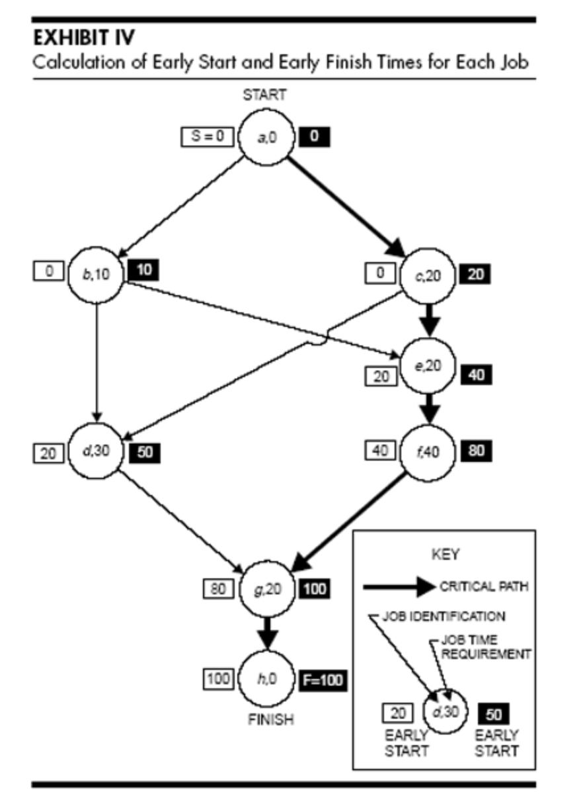
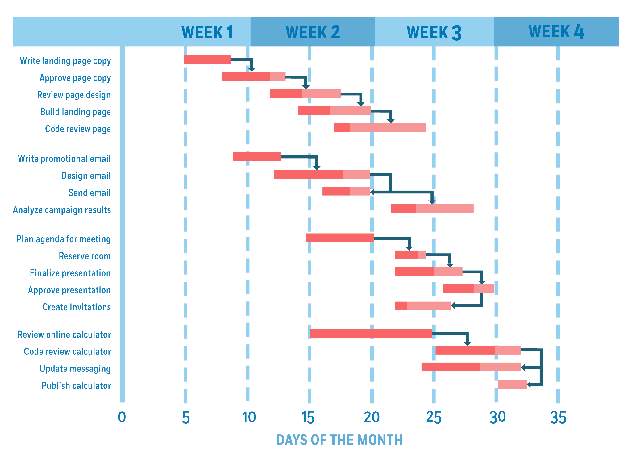

Slide 25
Kanban Methodology
What it is: The kanban methodology is a visual approach to project management. The name is literally billboard in Japanese. It helps manage workflow by placing tasks on a kanban board where workflow and progress are clear to all team members. The kanban methodology helps reduce inefficiencies and is a great project management tool for many purposes such as lean manufacturing or agile projects.
Kanban project management has been around since the late 1940s when it was studied by Toyota used the rate of demand to control the rate of production of its vehicles. The car company applied it to its lean manufacturing model, known as the Toyota production system.
With the dawn of visual planning boards in software in our era, like Trello, there are now new uses for kanban tools and kanban methods. Agile teams use kanban boards for story-boarding user stories and for backlog planning in software development.
When to use it: Another process developed initially for manufacturing and for software teams, the kanban method has since expanded and has been used in human resources, marketing, organizational strategy, executive process and accounts receivable and payable. Almost anyone can plan with Kanban boards, adding cards to represent project phases, task deadlines, people, ideas and more. Kanban software makes this methodology especially accessible.

Slide 26
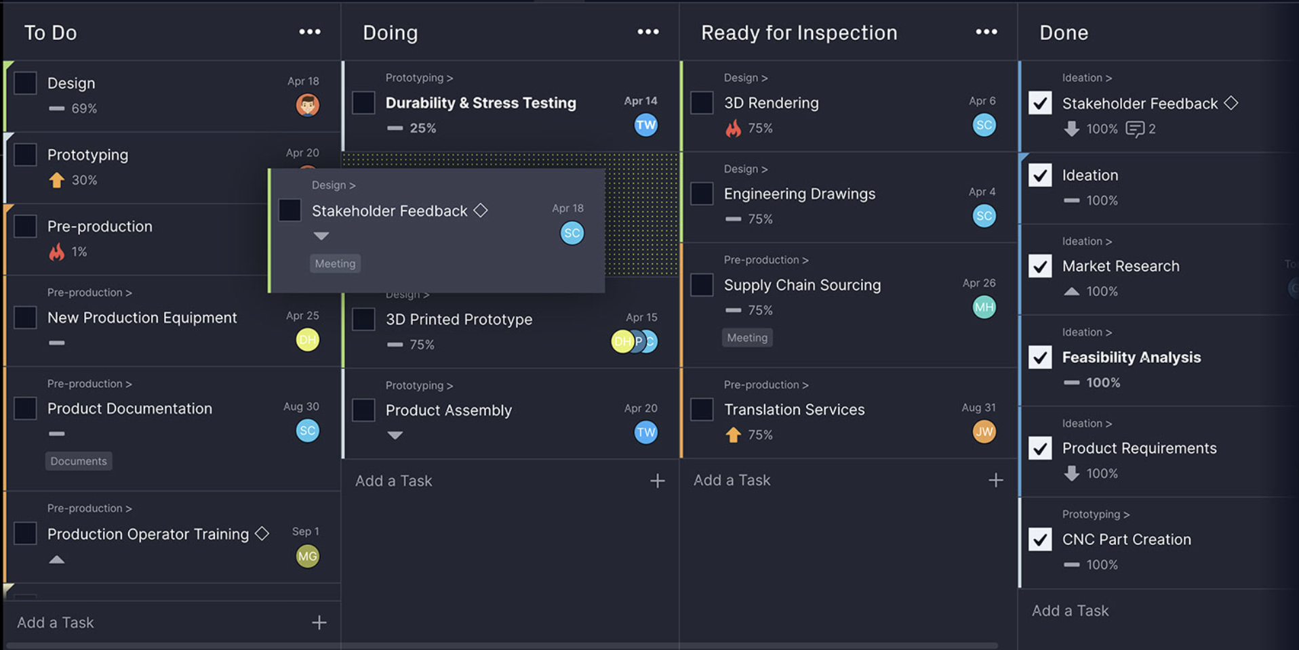

Slide 27
PO

Slide 28
What it is?
The Product Owner (PO) is the Agile team member primarily responsible for maximizing the value delivered by the team by ensuring that the team backlog is aligned with customer and stakeholder needs. As a member of the extended Product Management function, the PO is the team’s primary customer advocate and primary link to business and technology strategy. This enables the team to balance the needs of multiple stakeholders while continuously evolving the Solution.

Slide 29
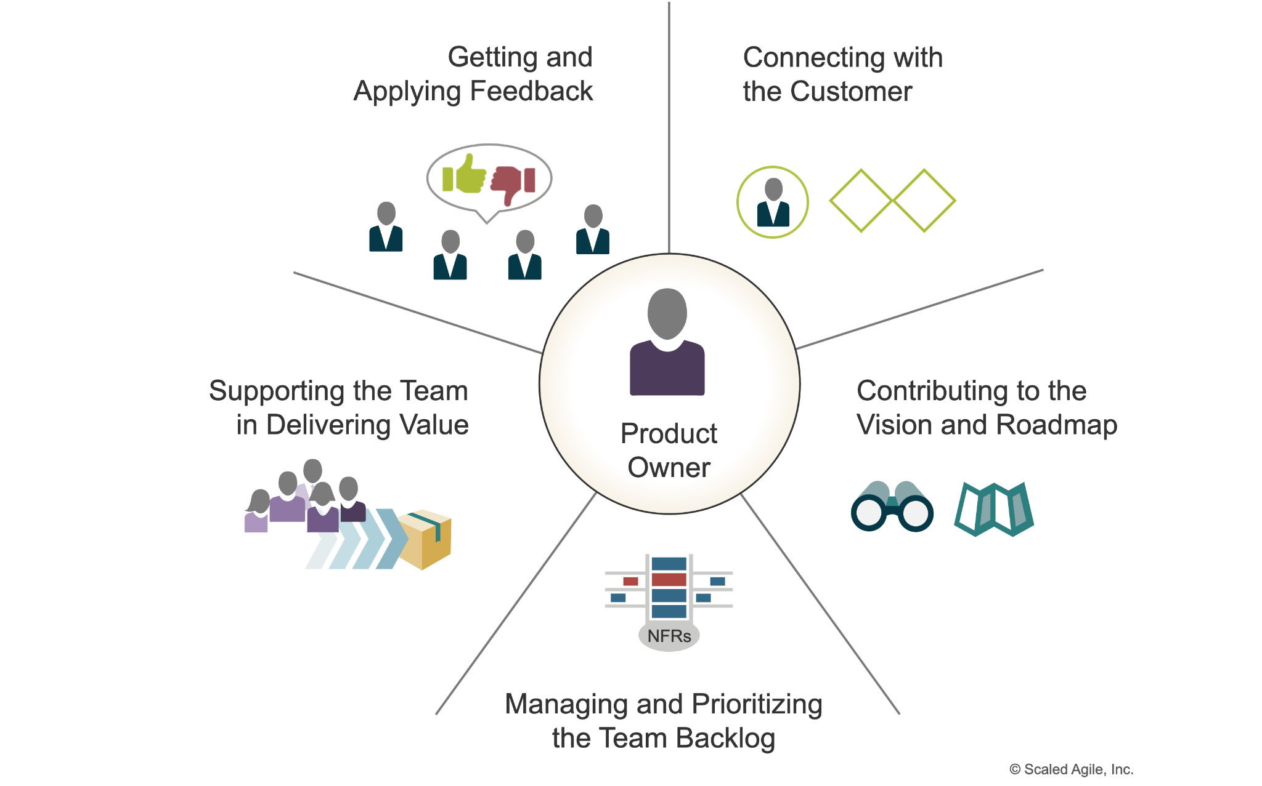
What does a Product Owner do?

Slide 30
QA

Slide 31
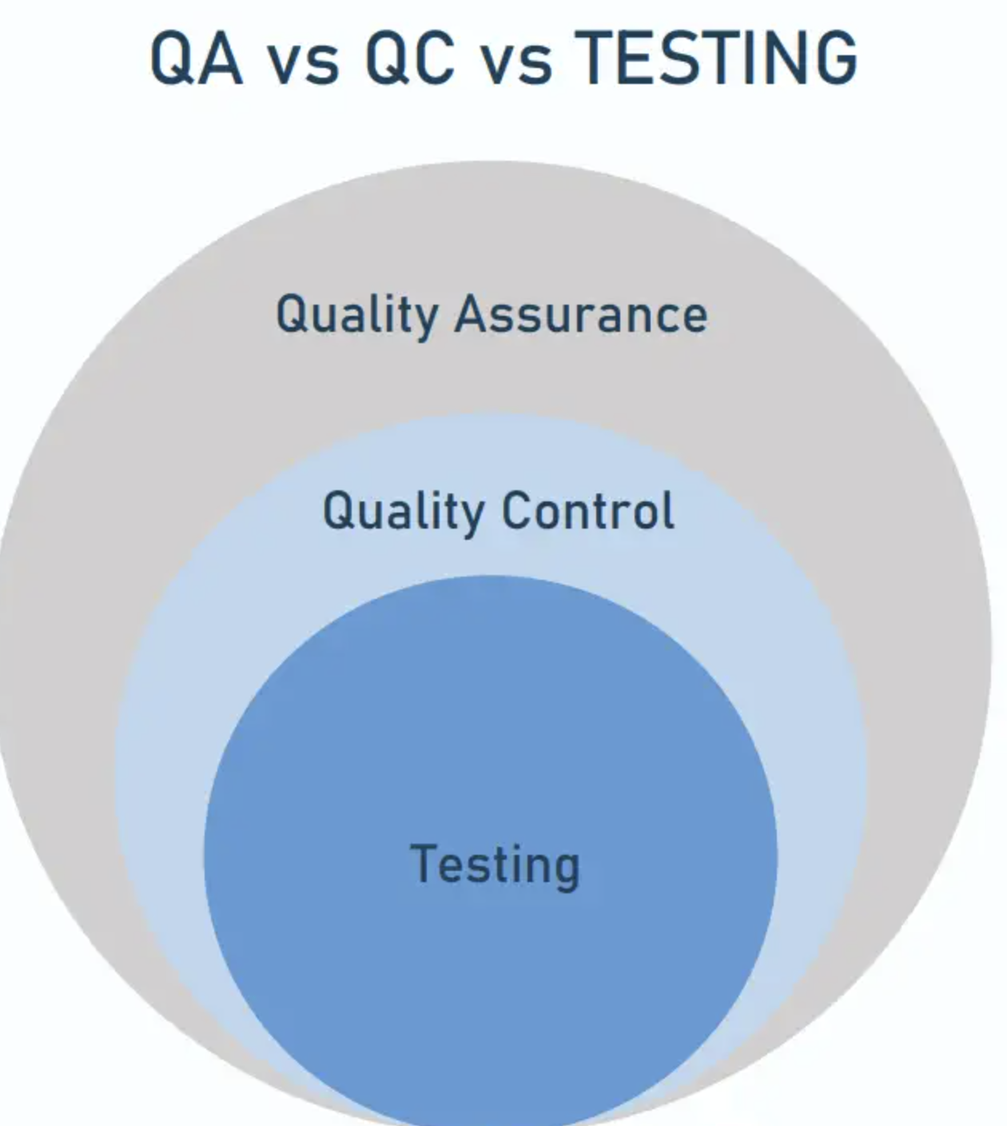
Terms
The concept of software quality is introduced to ensure the released program is safe and functions as expected. It can be defined as “the capability of a software product to satisfy stated and implied needs under specific conditions. Additionally, quality refers to the degree to which a product meets its stated requirements.”
Quality assurance (QA), quality control (QC), and QA software testing are three aspects of quality management to ensure that a program works as intended Often used interchangeably, the three terms cover different processes and vary in their scope, though they have the same goal — to deliver the best possible digital product or service.

Slide 32
Quality assurance (QA) refers to the systematic process of ensuring that product development meets customer expectations through continuous improvement and consistent maintenance of processes. It involves setting standards, creating guidelines, measuring performance, and enhancing workflows with the involvement of both internal and external stakeholders. The main goal is to establish a high-quality production environment and build customer trust.
Quality control (QC), on the other hand, is focused on verifying that the final product adheres to the quality standards established by QA. It involves practical activities like detecting bugs and ensuring the product meets pre-defined requirements through methods such as code reviews and testing by the engineering team.
Software testing is a specific activity within QC that focuses on identifying and resolving technical issues in the software code, and evaluating usability, performance, security, and compatibility. This is typically performed by test engineers either alongside the development process or at a separate testing stage, depending on the project management approach.
In essence, while QA is about process and standards setting across the development cycle to prevent defects, QC is about detecting defects in finished products, and testing specifically addresses finding and fixing bugs in the software before it reaches the end-user.

Slide 33
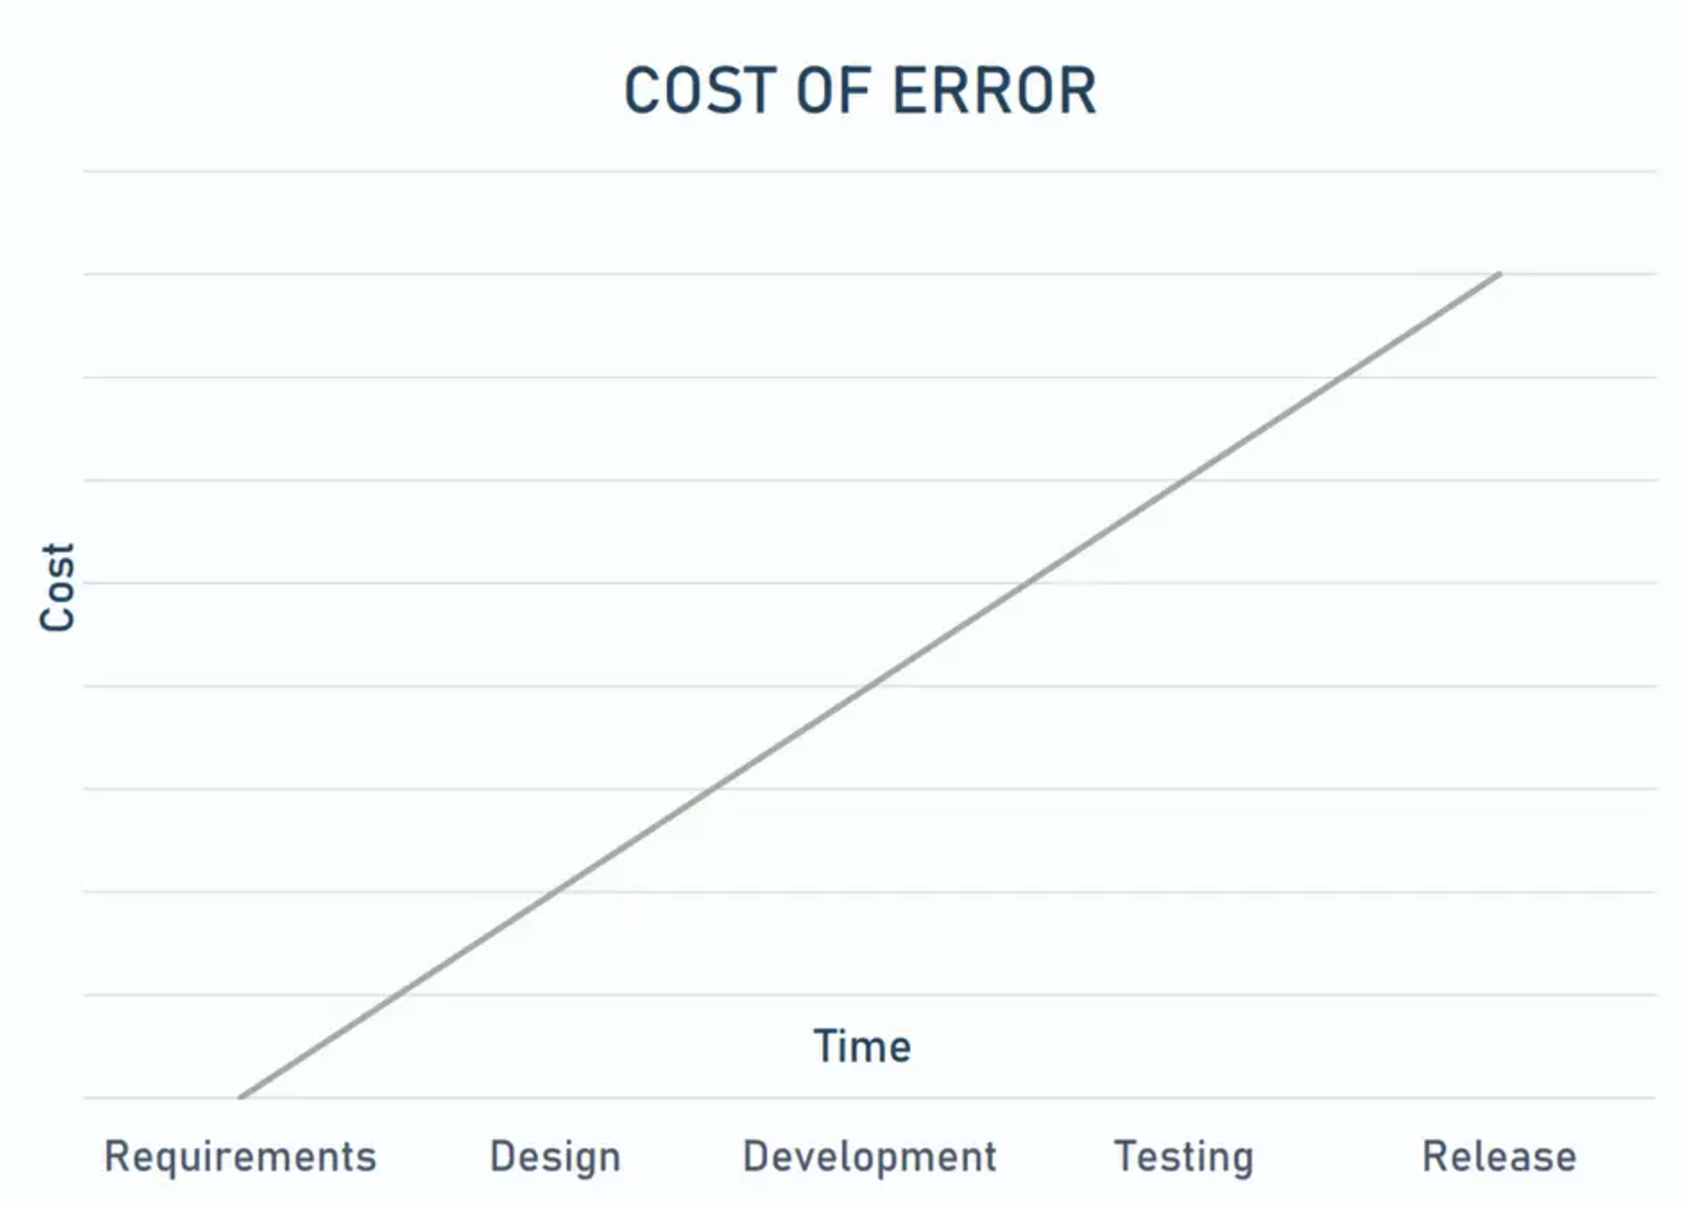
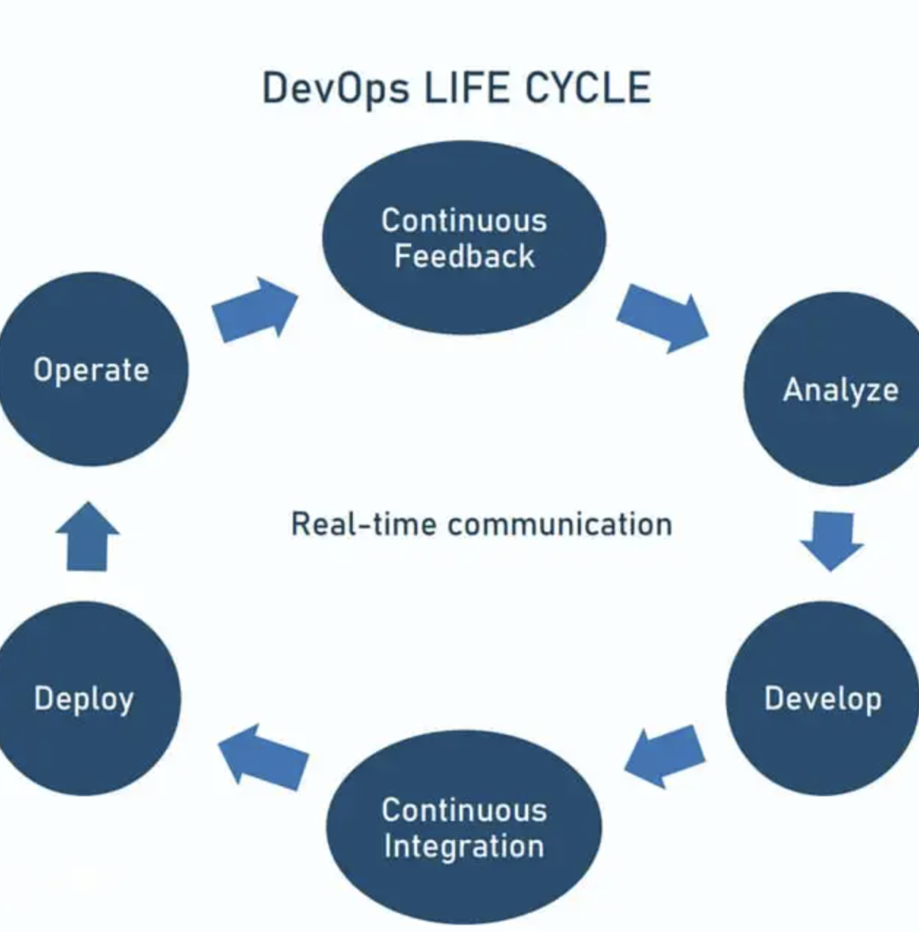
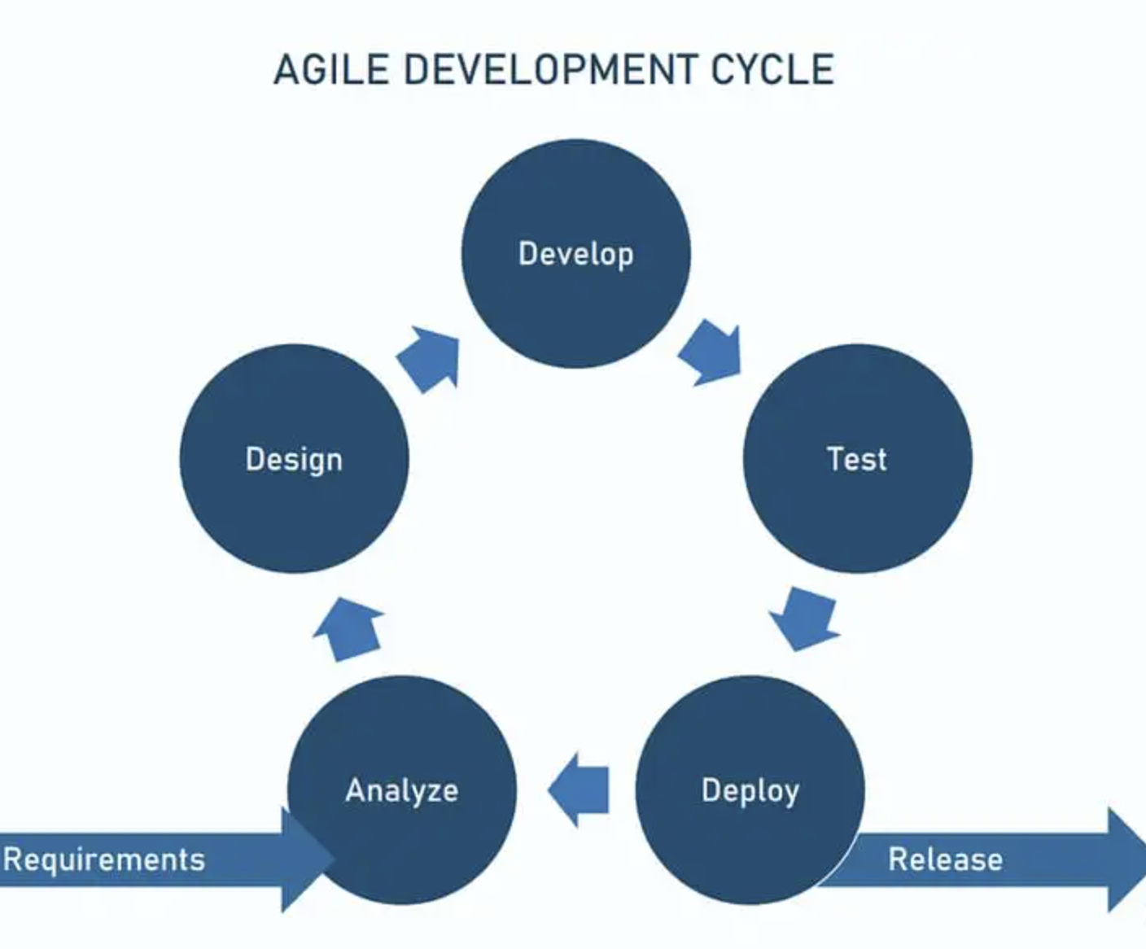
When it happens?

Slide 34
Testing LC

Slide 35
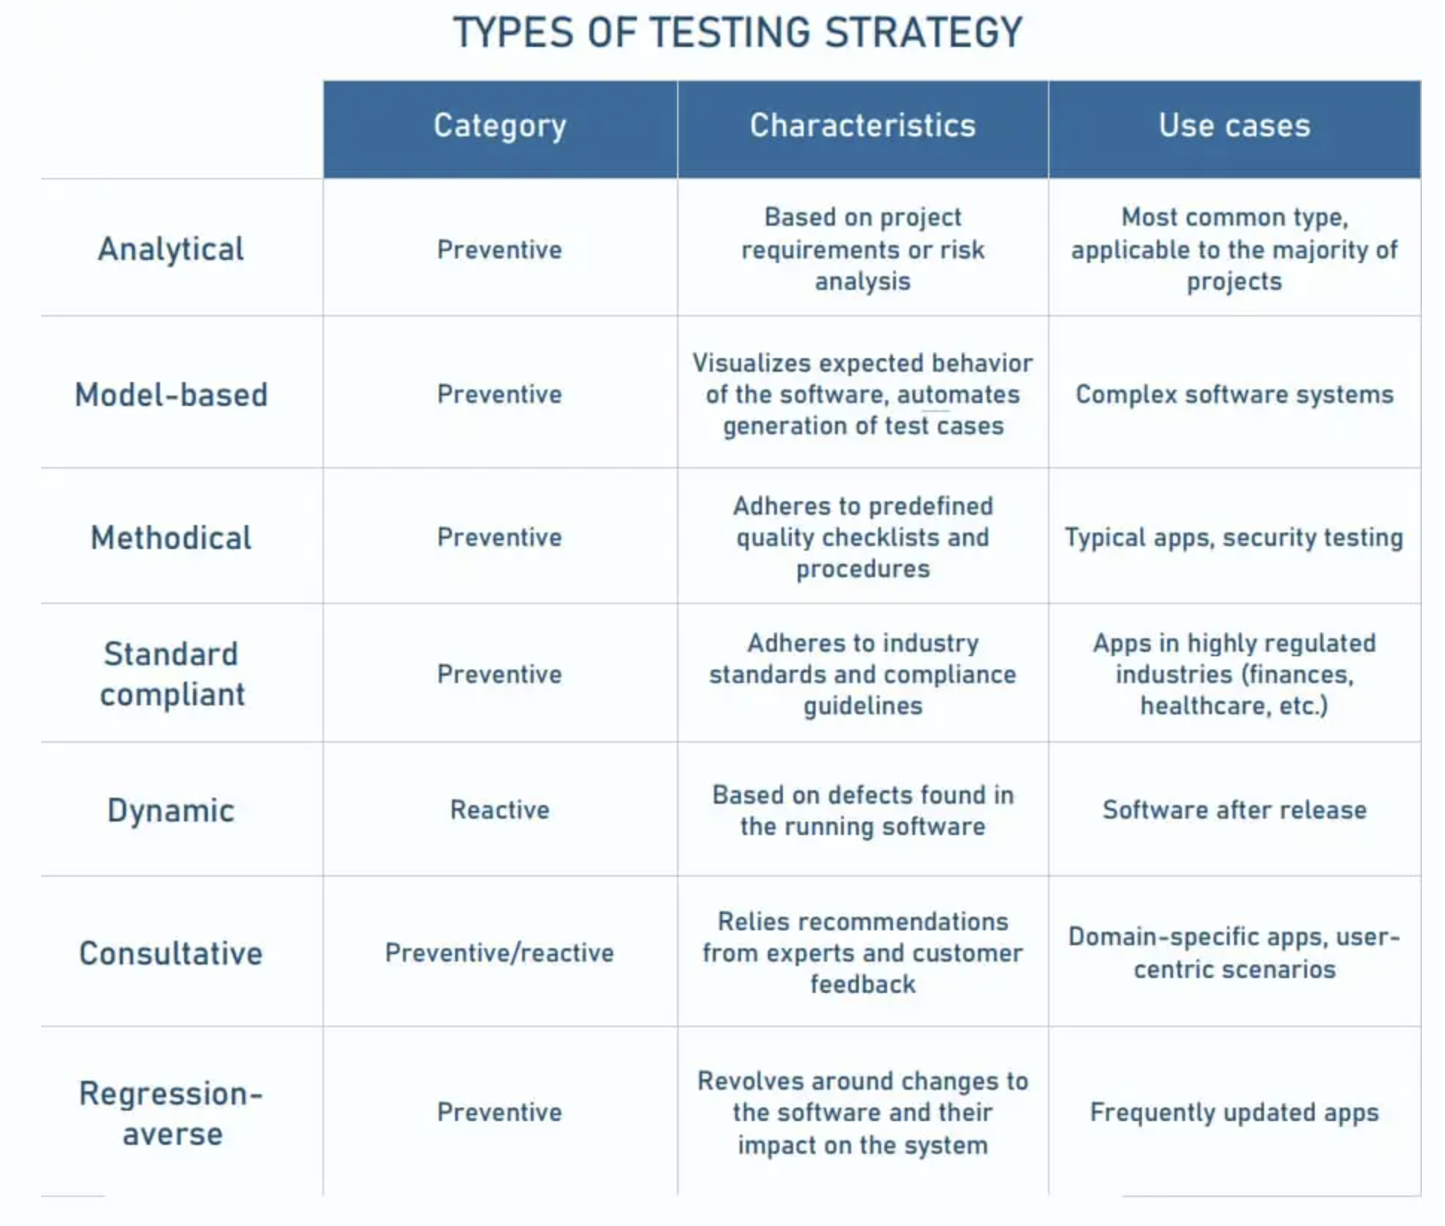
Test strategy

Slide 39
Methods & techniques
Black Box Testing: This technique focuses on the inputs and outputs of the software without knowledge of the internal workings. It's commonly used in system and user acceptance testing to verify software functionality and user demand satisfaction.
White Box Testing: This method requires a deep understanding of the application's code and is usually performed by developers. It focuses on the software's internal structures to enhance security, uncover hidden defects, and address them, particularly during unit and integration testing.
Gray Box Testing: Combining aspects of both black box and white box testing, this method involves some knowledge of the software's internal structures while also employing black box techniques to evaluate the user interface. It is primarily used at the integration level.
Smoke Testing: A subset of white box testing, smoke testing involves running a small number of tests to confirm the stability of a new build, ensuring it is ready for more extensive testing.
Ad Hoc Testing: An informal technique conducted without predefined plans or documentation, ad hoc testing involves random checks to find defects that structured testing may miss. It's typically used early in the development cycle and needs to be supplemented by more structured testing.
Exploratory Testing: Similar to ad hoc testing, this creative and freestyle approach involves learning about the system through testing, without predefined cases. It allows testers to provide rapid feedback and validate product quality from a user's perspective.

Slide 41
DevOps

Slide 42
What Is DevOps?
DevOps is a set of practices, tools, and a cultural philosophy that automate and integrate the processes between software development and IT teams. It emphasizes team empowerment, cross-team communication and collaboration, and technology automation.
The DevOps movement began around 2007 when the software development and IT operations communities raised concerns about the traditional software development model, where developers who wrote code worked apart from operations who deployed and supported the code. The term DevOps, a combination of the words development and operations, reflects the process of integrating these disciplines into one, continuous process.

Slide 43
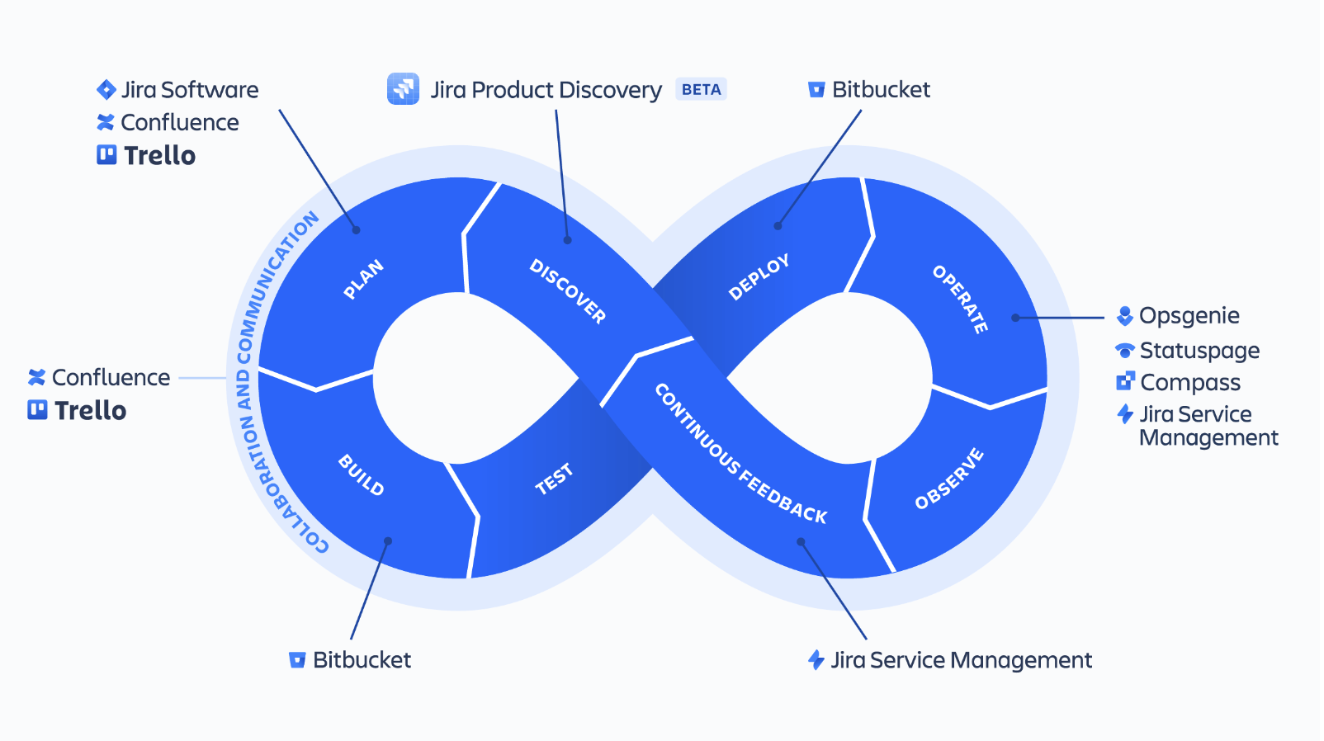
The DevOps lifecycle

Slide 44
Benefits
In Atlassian’s 2020 DevOps Trends survey, 99 percent of respondents said that DevOps had a positive impact on their organization. The benefits of DevOps include faster and easier releases, team efficiency, increased security, higher quality products, and consequently happier teams and customers.

Slide 45
Speed
Teams that practice DevOps release deliverables more frequently, with higher quality and stability. In fact, the DORA 2019 State of DevOps report found that elite teams deploy 208 times more frequently and 106 times faster than low-performing teams. Continuous delivery allows teams to build, test, and deliver software with automated tools.

Slide 46
Improved collaboration
The foundation of DevOps is a culture of collaboration between developers and operations teams, who share responsibilities and combine work. This makes teams more efficient and saves time related to work handoffs and creating code that is designed for the environment where it runs.

Slide 47
Rapid deployment
By increasing the frequency and velocity of releases, DevOps teams improve products rapidly. A competitive advantage can be gained by quickly releasing new features and repairing bugs.

Slide 48
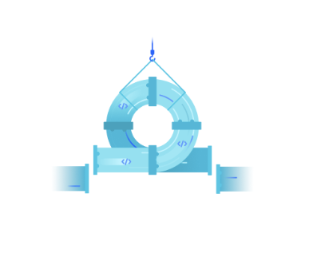
Quality and reliability
Practices like continuous integration and continuous delivery ensure changes are functional and safe, which improves the quality of a software product. Monitoring helps teams keep informed of performance in real-time.

Slide 49
Security
By integrating security into a continuous integration, continuous delivery, and continuous deployment pipeline, DevSecOps is an active, integrated part of the development process. Security is built into the product by integrating active security audits and security testing into agile development and DevOps workflows.

Slide 50
DevOps practises
Continuous integration
Continuous integration is the practice of automating the integration of code changes into a software project. It allows developers to frequently merge code changes into a central repository where builds and tests are executed. This helps DevOps teams address bugs quicker, improve software quality, and reduce the time it takes to validate and release new software updates.
Continuous delivery
Continuous delivery expands upon continuous integration by automatically deploying code changes to a testing/production environment. It follows a continuous delivery pipeline, where automated builds, tests, and deployments are orchestrated as one release workflow.

Slide 51
Situational awareness
It is vital for every member of the organization to have access to the data they need to do their job as effectively and quickly as possible. Team members need to be alerted of failures in the deployment pipeline — whether systemic or due to failed tests — and receive timely updates on the health and performance of applications running in production. Metrics, logs, traces, monitoring, and alerts are all essential sources of feedback teams need to inform their work.
Automation
Automation is one of the most important DevOps practices because it enables teams to move much more quickly through the process of developing and deploying high-quality software. With automation the simple act of pushing code changes to a source code repository can trigger a build, test, and deployment process that significantly reduces the time these steps take.
Infrastructure as Code
Whether your organization has an on-premise data center or is completely in the cloud, having the ability to quickly and consistently provision, configure, and manage infrastructure is key to successful DevOps adoption. Infrastructure as Code (IaC) goes beyond simply scripting infrastructure configuration to treating your infrastructure definitions as actual code: using source control, code reviews, tests, etc.

Slide 52
Microservices
Microservices is an architectural technique where an application is built as a collection of smaller services that can be deployed and operated independently from each other. Each service has its own processes and communicates with other services through an interface. This separation of concerns and decoupled independent function allows for DevOps practices like continuous delivery and continuous integration.
Monitoring
DevOps teams monitor the entire development lifecycle — from planning, development, integration and testing, deployment, and operations. This allows teams to respond to any degradation in the customer experience, quickly and automatically. More importantly, it allows teams to “shift left” to earlier stages in development and minimize broken production changes.

Slide 53
Useful links
PMbok
Agile manifesto
Critical path method - HBR
ScrumGuides
Scaled Agile Framework
QA vs QC vs Testing
Atlassian DevOps guide
DevOps com

Slide 54
END

