Slide 1
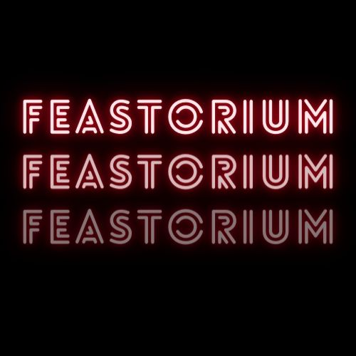
Where Culinary Meets Artistry.

Slide 2
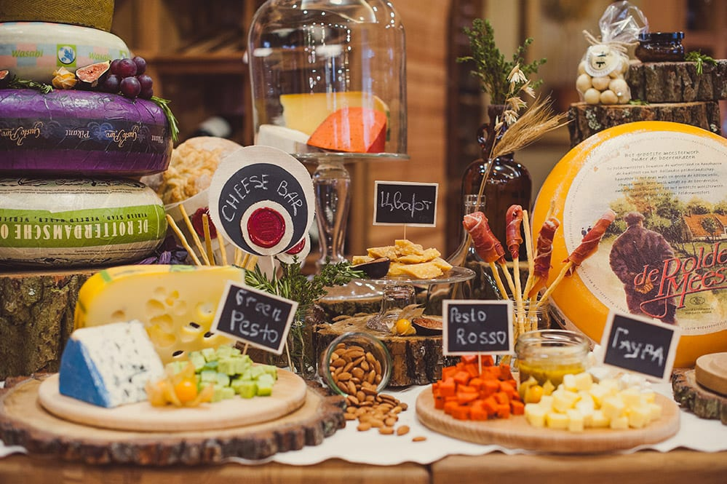
Problem: Average check is below industry standards.
Solution 1: Gastronomic Tastings
Plan:
Introduce gastronomic tastings that include exclusive dishes and wines.
Hold these tastings during lunch hours at an affordable price.
Launch an advertising campaign on social media and local platforms.
Possible Negatives:
Costs for preparing exclusive dishes may increase.
Staff training is required for servicing such tastings.

Slide 3
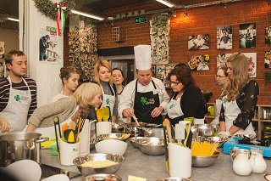
Solution 2: Culinary Workshops
Plan:
Organize culinary workshops for customers where they can learn to cook the restaurant's signature dishes.
Launch an advertising campaign emphasizing the opportunity to learn from the head chef.
Promote information about the workshops through ads in local newspapers and magazines.
Possible Negatives:
Preparation of the chefs for conducting the workshops.
Inventory costs for ingredients used in workshops.

Slide 4
Problem: Food costs are higher than industry standards..
Solution 1: Supplier Cooperation
Plan:
Establish contracts with local farmers and suppliers to source products directly from them.
Create a cooperative with neighboring restaurants to combine orders and obtain discounts on product purchases.
Run an advertising campaign highlighting the use of local ingredients.
Possible Negatives:
It takes time and effort to establish partnerships with suppliers.
Logistics costs for ensuring product delivery.

Slide 5
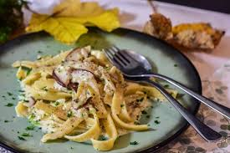
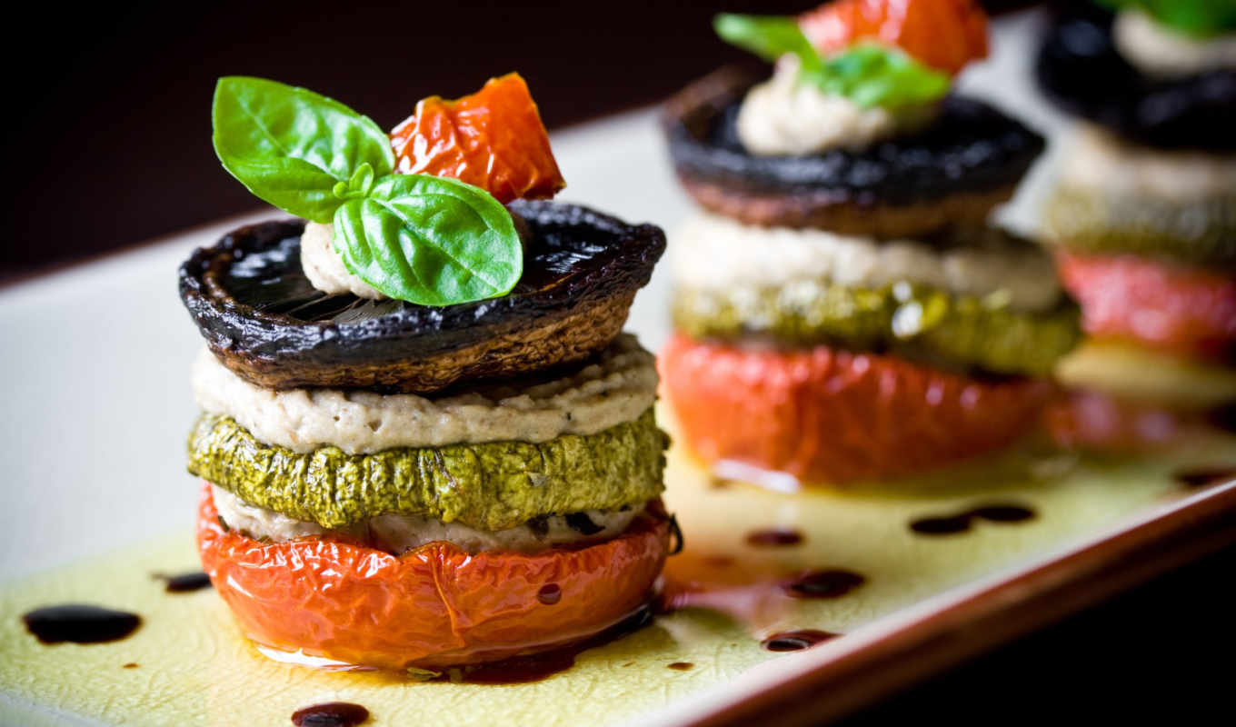
Solution 2: Menu Engineering
Plan:
Conduct a menu analysis to remove less profitable items and add dishes that can reduce costs.
Utilize ingredients that are more readily available in local markets and are seasonal.
Launch an advertising campaign emphasizing the updated, cost-effective menu.
Possible Negatives:
Menu changes may cause dissatisfaction among some regular customers.
Care must be taken to ensure that the quality of dishes does not decline.

Slide 6
Problem: Very low turnover.
Solution 1: Extended Operating Hours
Plan:
Offer breakfast, brunch, and late dinner to attract customers outside regular lunch and dinner hours.
Utilize advertising campaigns to highlight the extended operating hours.
Possible Negatives:
Additional labor costs for staff working during non-standard hours.
Ensuring that the quality of service remains high.

Slide 7
Solution 2: Themed Events
Plan:
Host various themed events, such as music nights, culinary festivals, and more.
Utilize advertising campaigns to promote these events and attract customers.
Make certain adjustments to the menu to match the theme of each event.
Possible Negatives:
Expenses for organizing themed events.
Staff training and preparation for serving guests during these events.

Slide 8
Overall Conclusion: These ideas are aimed at improving Feastorium's operations and achieving new performance indicators, including increasing the average check, reducing food costs, and boosting turnover. The addition of advertising campaigns will enhance the restaurant's appeal and help attract more guests.

