Slide 1
ETHICS
(Ділова етика)
1 практичне заняття

Slide 2
CONTENTS
Warming-up.
Business Ethics.
Discussion. The list of unethical/ethical activities, jobs, situations.
Listening. Considering options.
References.

Slide 3
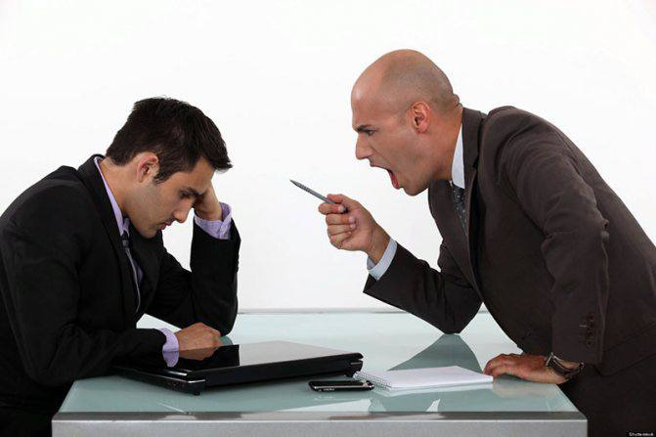
1. Warming-up
Work in pairs. Look at the photos. How do you think the people feel? What relationships do they have?
Useful expressions:
Oh! Let me think. Well, … It seems to me that ... On the one hand ..., on the other hand ...
For example, ... / For instance, ... Personally, I think that ... From my point of view, ... In my opinion, …

Slide 4
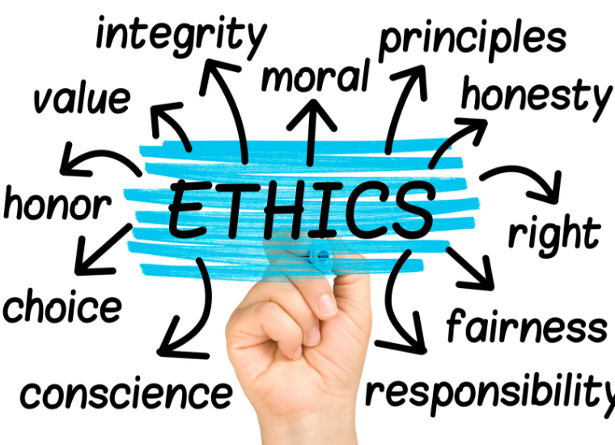

Slide 6
2. Business Ethics.
What is business ethics?
The term business ethics refers to the set of moral principles that guides a company's conduct. These principles govern every aspect of the company's operations, including its interaction with the government and other businesses, its treatment of its employees and its relationship with its customers. Whenever any ethical dilemmas or controversies arise, a business references these foundational principles to help resolve those situations.
Why is business ethics important?
Business ethics ensure that companies operate according to all applicable laws. This maintains the company's respect among its peers and customers and protects it from legal liability. A company's ethics also help it attract quality team members. Businesses that care for their teams according to the highest ethical standards are often attractive to job seekers. Ethical treatment can also increase employee retention and reduce hiring and training costs.
A business that treats its customers or clients ethically can build trust and create longstanding relationships. These customers are likely to return and may recommend the business to people within their sphere of influence. Also, a business known for its effective ethical principles can gain respect and elevate the quality of its brand.

Slide 7
7 types of business ethics:
There are various types of business ethics. Both the nature of the company's business and its location can affect its code of ethics. The following are some common business ethics:
1. Personal responsibility
Personal responsibility is a vital attribute for employees in both entry-level and senior positions. This could entail completing tasks your manager has assigned or simply fulfilling the duties of your job description. If you make a mistake, you acknowledge your fault and do whatever you need to do to fix it.
2. Corporate responsibility
Businesses have responsibilities to their employees, their clients or customers and their board of directors. Some of these may be contractual or legal obligations, others may be promises. For example, a commitment to conduct business fairly and to treat people with dignity and respect. Whatever those obligations are, the business has a responsibility to keep them.
3. Loyalty
Loyalty is a valuable quality for both corporate leaders and team members. It's important for team members to be loyal to their coworkers, managers and the company. This might involve speaking positively about the business in public and only addressing personnel or corporate issues in private. Customer or client loyalty is important to a company not only to maintain good business relations but also to attract business by cultivating a positive reputation.

Slide 8
4. Respect
Respect is an important business ethic, both in the way the business treats its clients, customers and employees and in the way its team members treat one another. When you show respect to someone, that person feels like a valued member of the team or an important customer. It indicates that you care about their opinions, you keep your promises to them and you work quickly to resolve any issues they may have.
5. Trustworthiness
A business cultivates trustworthiness with its clients, customers and employees through honesty, transparency and reliability. Team members should feel they can trust their companies to keep to the terms of their employment. Clients and customers should be able to trust the business with their money, data, contractual obligations and confidential information. Being trustworthy encourages people to conduct business with you and helps you maintain a positive reputation.

Slide 9
6. Fairness
When a business exercises fairness, it applies the same standards for all team members, regardless of rank. The same expectations of honesty, integrity and responsibility placed upon the entry-level employee also apply to the chief executive officer (CEO). Fairness means that a business strives to treat its customers with equal respect, offering the same goods and services to all based on the same terms.
7. Social and environmental responsibility
Corporate social and environmental responsibility means that a company recognizes its impact outside of the marketplace. Many companies look for ways to help their communities through volunteer work or financial investments. They may also adopt measures to reduce waste and promote a safe and healthy environment.

Slide 10
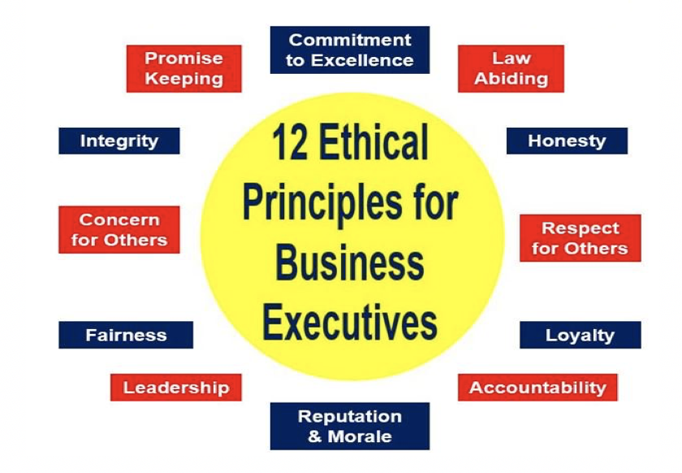

Slide 12
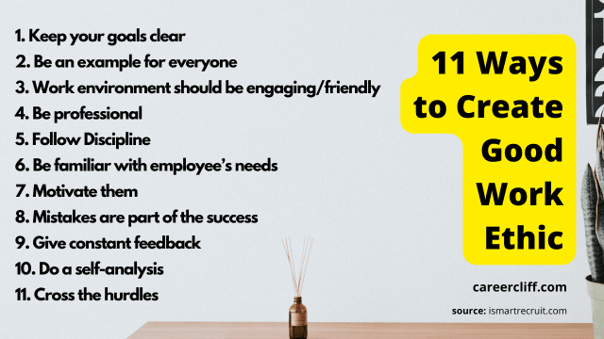

Slide 13
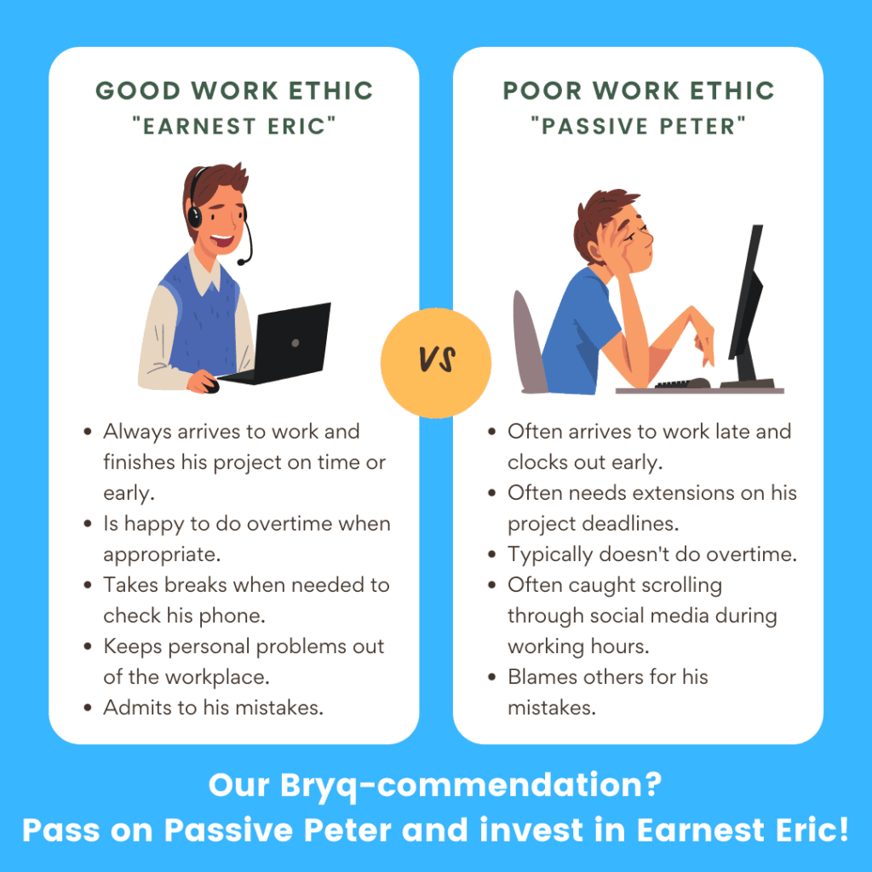

Slide 14
3. Discussion
1. Discuss this list of unethical activities. In your opinion, which are the worst? Are any common in your country?
﻿﻿Finding ways of paying as little tax as possible
﻿﻿Using your work computer or phone for private purposes (e.g. online shopping)
﻿﻿Accepting praise for someone else's ideas or work
﻿﻿Selling something as genuine when you know it is not
﻿﻿Using your influence to get jobs for friends or relatives (nepotism)
﻿﻿Phoning in sick at work when you are not ill
﻿﻿Not telling the truth about your age or experience on an application form
﻿﻿Not saying anything when you are charged too little for something by mistake
﻿﻿Paying people in cash for jobs done around the home in order to reduce the cost
﻿﻿﻿Claiming extra expenses (e.g. getting a taxi receipt for more than the actual fare)
2. Are some jobs/professions more ethical than others? How ethical do you think these professions are? Which are seen as more/less ethical in your country?
accountant civil servant lawyer police officer politician banker estate agent nurse university lecturer soldier car sales executive journalist doctor taxi driver

Slide 15
3. Look at the situations. Which do you think are the most serious?
1. A new contact suggests that a payment into his private bank account will enable a company to win a valuable supply contract.
2. An employee informs some friends about a company takeover before it is generally known so they can buy shares and make a profit.
3. A company is making copies of luxury branded products and selling them in street markets.
﻿﻿4. An upmarket private airline only employs attractive women under 25 years old as cabin crew and ground staff.
﻿﻿5. An industrial company is disposing of waste chemicals in the sea.
6. A car manufacturer is secretly taking photos of a rival's new model at a test track.
7. A cosmetics and pharmaceutical company tries out all its products on rats and mice.
8. Some criminals buy property and expensive cars with money they got from illegal activities. The goods are then sold and the now 'clean' money is used in other businesses and new bank accounts.
9. A group of rival mobile phone companies get together and agree to charge approximately the same amount for a range of services and packages.
10. A company tells the authorities that it is making a lot less profit than it actually is.

Slide 16
4. Match words from Box A and Box B to make word partnerships which describe the activities in Exercise 3.
EXAMPLE: 1. bribery and corruption
A.
B.
CD 2.25 Listen to the correct answers.
bribery | price | environmental | sex | insider
tax | counterfeit | money | animal | idustrial
and corruption | testing | discrimination | fraud | trading
fixing | laundering | goods | pollution | espionage

Slide 17
Choose the correct word partnership from Exercise 4 to complete the sentences. There are 5 expressions which you will not need.
1. A few years ago, British Airways and Korean Air were each fined $300m by the US Justice Department for their roles in separate . . . . . . . . . . . . conspiracies in both their cargo and passenger operations.
2. According to a survey, 91% of doctors believe . . . . . . . . . . . . Is important to medical progress.
3. An anti- . . . . . . . . . . . . directive was passed to prevent the proceeds of organised crime circulating through the financial system.
4. In 2008, it was estimated that $135 bn of . . . . . . . . . . . . were sold online.
5. Banks were recently accused of . . . . . . . . . . . . , as apparently female staff are often paid
40% less than their male counterparts.

Slide 18
4. Listening.
CD2.26 David Hillyard, Director of Programmes at EarthWatch, is describing his organisation. Listen to the first part of the interview and complete the gaps.
EarthWatch is an ............ research and ............ and ............ organisation, and
we have over ........... field research projects around the ............ . That involves, er, ............
looking at how animals and …............ are cooing in their natural …........ .
2. CD2.29 Listen to a conversation about a woman who was fired from her job and put these events in the order that they happened.
a) ﻿﻿﻿She lost her job.
﻿﻿﻿b) She felt desperate.
c) She lied on her CV.
d) There was an HR initiative.
e) The company found out she did not have a Master's degree.
﻿﻿﻿f) She got a really good job.
﻿﻿﻿g) She got strong performance reviews.

Slide 19
5. References.
David Cotton, David Falvey, Simon Kent, Market Leader 3rd Edition Intermediate Course Book. Page 96-99, 122, 163.
https://plienglish.net/wp-content/uploads/2020/04/Market-Leader-Intermediate-3rd-Edition.pdf
Аудіо 2.25
Аудіо 2.26
Аудіо 2.29

Slide 20
Thank you for your attention!
Дякуємо Вам за увагу!

