Slide 1
Corpus Linguistics Basic notions
Lecture 7

Slide 2
Corpus-Based vs Corpus-Driven Linguistics
Tognini-Bonelli 2001:
Corpus-based Linguistics
use corpus data in order to explore a theory or hypothesis, typically one established in the current literature, in order to validate it, refute it or refine it
Corpus-driven Linguistics
rejects the characterisation of corpus linguistics as a method and claims instead that the corpus itself should be the sole source of our hypotheses about language

Slide 3
Data Collection Regimes
Monitor corpora
seeks to develop a dataset which grows in size over time and which contains a variety of materials.
Balanced Corpus (Sample Corpus)
represents a particular type of language over a specific span of time.

Slide 4
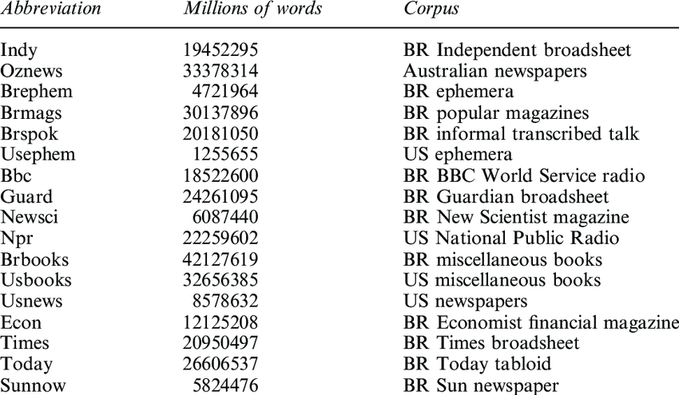
The Monitor Corpus Approach The Bank of English (BoE)
1980s 450 million words

Slide 5
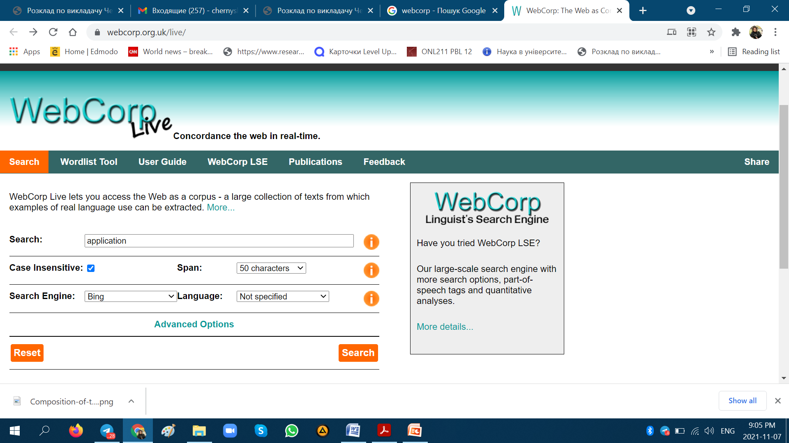
Web as Corpus Kilgarriff and Grefenstette 2003

Slide 6
Web as Corpus Kilgarriff and Grefenstette 2003
mixture of carefully prepared and edited texts, and what might charitably be termed ‘casually prepared’ material
the content of the web is not divided by genre
some texts on the web contain errors of all sorts

Slide 7
The Sample Corpus Approach
Corpora which seek balance and representativeness within a given sampling frame are snapshot corpora.
Lancaster-Oslo/Bergen (LOB) corpus
http://korpus.uib.no/icame/manuals/LOB/INDEX.HTM

Slide 8
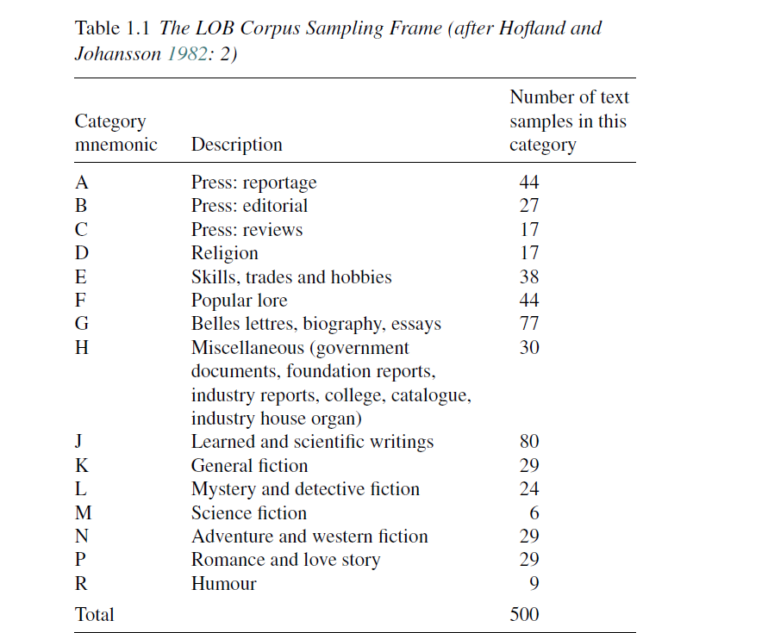
Lancaster-Oslo/Bergen (LOB) Corpus

Slide 9
Annotated vs Unannotated Corpora
https://varieng.helsinki.fi/CoRD/corpora/index.html
Metadata is information that tells you something about the text itself.
Textual markup encodes information within the text other than the actual words.
Linguistic information encoded within a corpus text in such a way that we can systematically and accurately recover that analysis later; when this is done, the corpus is said to be analytically or linguistically annotated.

Slide 10
Analytically or Linguistically Annotated

Slide 11
Linguistic Annotation Approaches
purely automatic annotation
automated annotation followed by manual correction
purely manual annotation

Slide 12
Annotation
constituency parsers such as Fidditch (Hindle 1983), used in the production of the Penn Treebank;
dependency parsers such as the Constraint Grammar system (Karlsson et al. 1995);
part-of-speech taggers such as CLAWS (Garside et al. 1987), used to annotate the BNC;
semantic taggers such as USAS (Rayson et al. 2004), which has been used to annotate a number of corpora (see, e.g.,Maclagan et al. 2008);
lemmatisers or morphological stemmers, which are often found as built-in subsystems of many parsers and taggers.

Slide 13
Key Advantages (Biber et al. 1998: 256)
you can do analyses that are not possible with concordancers;
you can do analyses ‘more quickly and more accurately’;
you can tailor the output to fit your own research needs;
you can analyse a corpus of any size.

Slide 14
Key Disadvantages (Biber et al. 1998: 256)
Not all linguists want to be computer programmers – secondgeneration concordancers promoted corpus linguistics by providing tools to the significant majority of linguists who may want to use corpora without becoming computer scientists manqu´es.
Small teams or individuals working alone can only go so far. By coordinating the work of teams towards a common goal we might reasonably expect greater progress in corpus tool development to be made.

Slide 15
Key Disadvantages (Biber et al. 1998: 256)
By working together on corpus and tools development, the process of the development of corpus encoding standards was accelerated. Without this impetus to develop standards, it is unlikely corpora would be as widely used as they are today, as they would be mired in conflicting formats with tools being developed and redeveloped to deal with those formats.
Locally developed tools need to be made available to other researchers so that findings based upon them may be replicated and verified. Where tools are made widely available by developers, the user of the tools is not faced with this demand.

