Slide 1
Лекція 5 - Design & Architecture pt.3: Modern definition

Slide 2
План предмету.
Pt.1: Ввід у предмет. Що таке якість. Перспектива розробника
Pt. 2: Code quality & metrics
Design & Architecture Pt. 1: Технології проєктування
Design & Architecture Pt. 2: Визначення Архітектури
Design & Architecture Pt. 3: Modern definition & tools
Design & Architecture Pt. 4: Characteristics & components
Project lifecycle (PM/PO). Quality assurance (QA). Developer Operations (DevOps)
Standards - IEEE, ISO, Specs, RFC.

Slide 3
План лекції 5
Architecture: modern definition
Design patterns
Why UML
Types
Comparison
Design vs Architecture - difference.
Cohesion

Slide 4
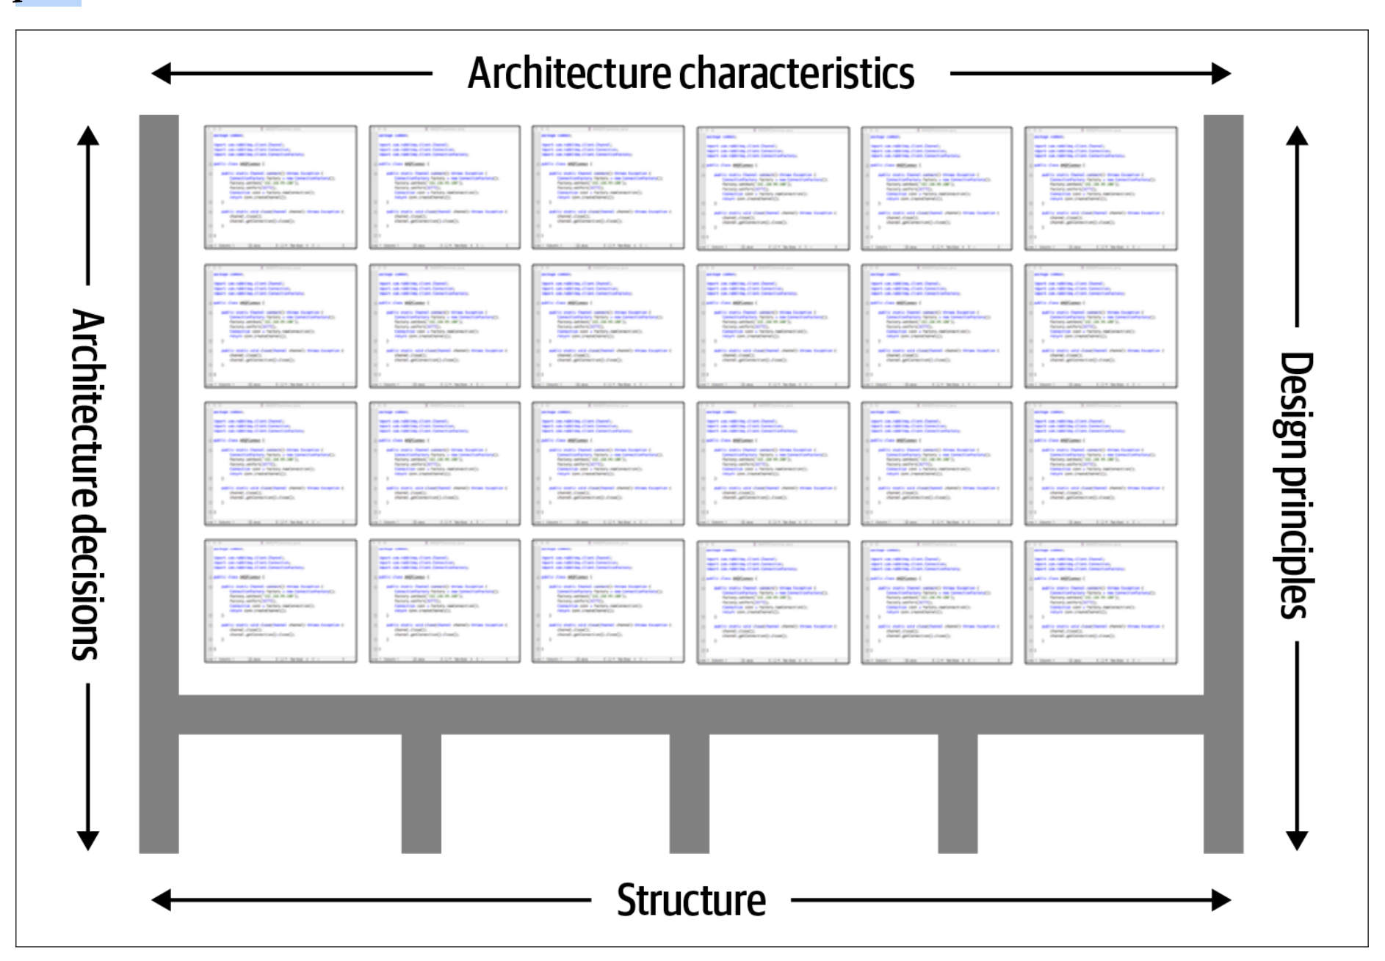
The industry as a whole has struggled to precisely define “software architecture.” Some architects refer to software architecture as the blueprint of the system, while others define it as the roadmap for developing a system. The issue with these common definitions is understanding what the blueprint or roadmap actually contains. For example, what is analyzed when an architect analyzes an architecture? Picture illustrates a way to think about software architecture. In this definition, software architecture consists of the structure of the system (denoted as the heavy black lines supporting the architecture), combined with architecture characteristics (“-ilities”) the system must support, architecture decisions, and finally design principles.

Slide 5
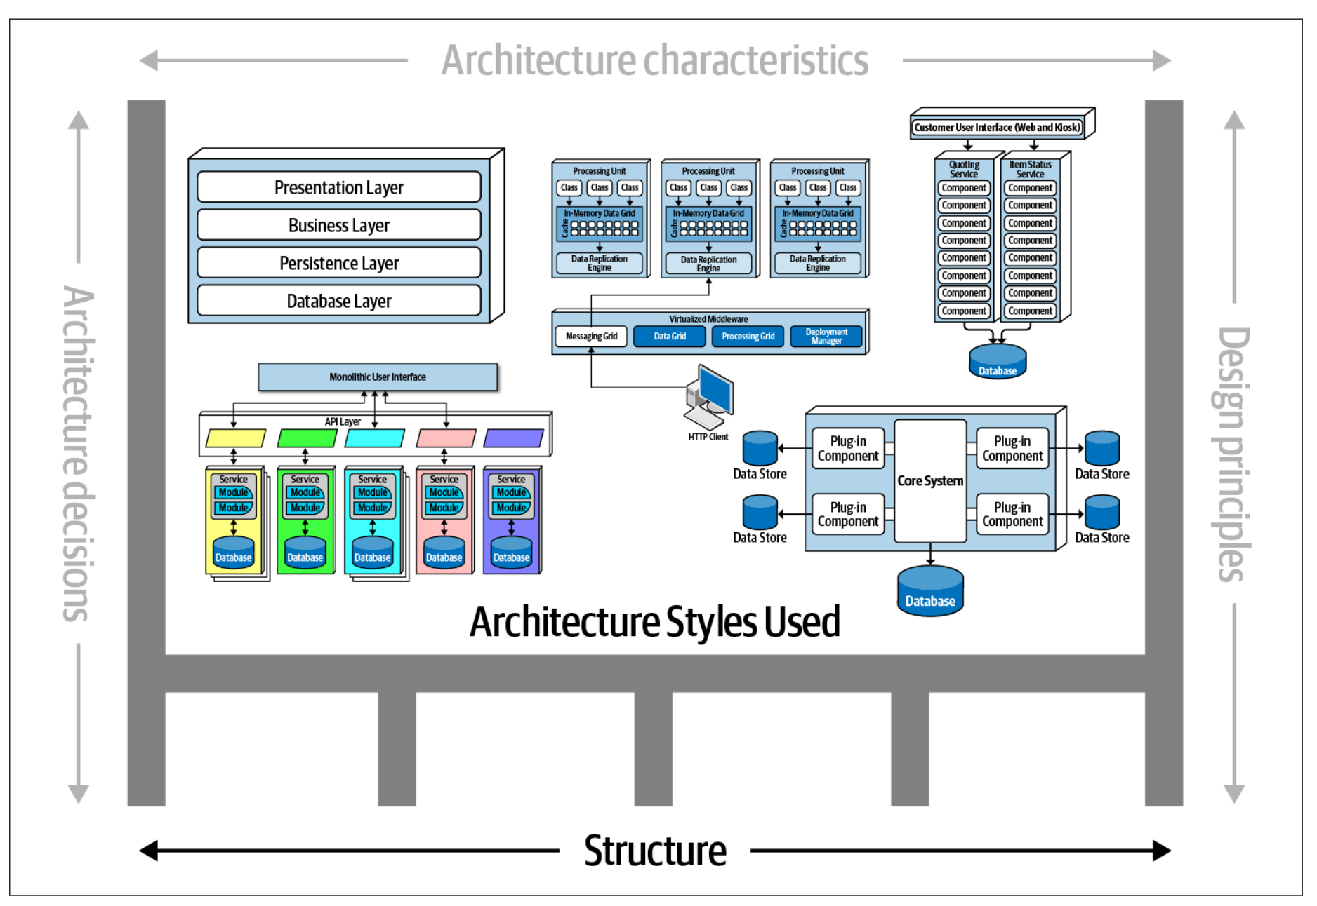
The structure of the system, as illustrated in, refers to the type of architec‐ ture style (or styles) the system is implemented in (such as microservices, layered, or microkernel). Describing an architecture solely by the structure does not wholly elu‐ cidate an architecture. For example, suppose an architect is asked to describe an architecture, and that architect responds “it’s a microservices architecture.” Here, the architect is only talking about the structure of the system, but not the architecture of the system. Knowledge of the architecture characteristics, architecture decisions, and design principles is also needed to fully understand the architecture of the system.

Slide 6
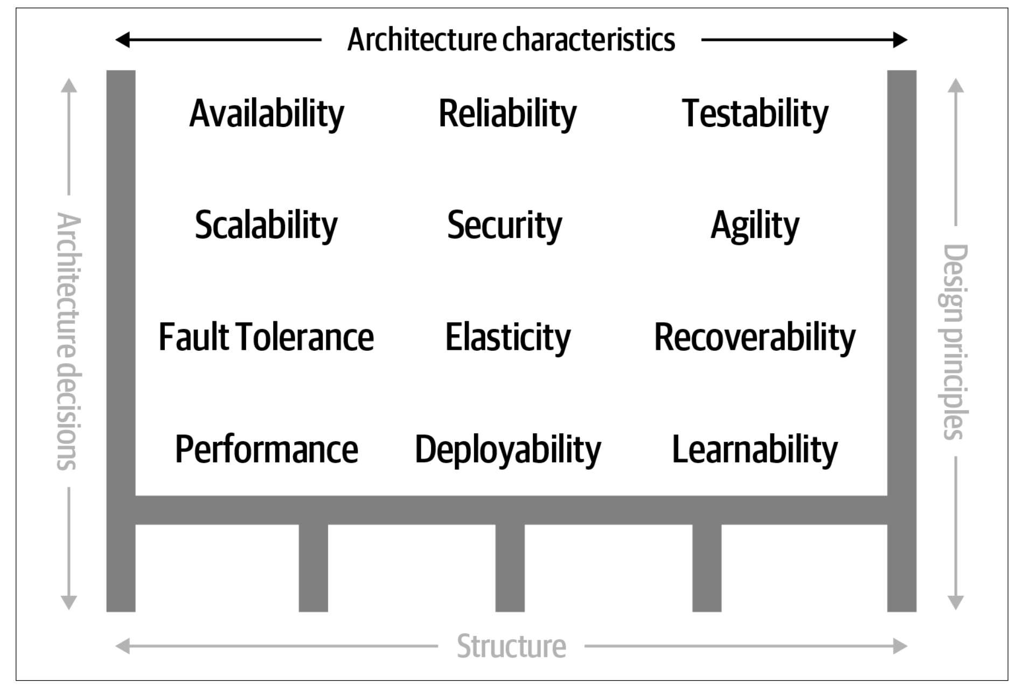
Architecture characteristics are another dimension of defining software architecture. The architecture characteristics define the success criteria of a system, which is generally orthogonal to the functionality of the system. Notice that all of the characteristics listed do not require knowledge of the functionality of the system, yet they are required in order for the system to function properly. Architecture characteristics are so important that we’ve devoted several chapters in this book to understanding and defining them.

Slide 7
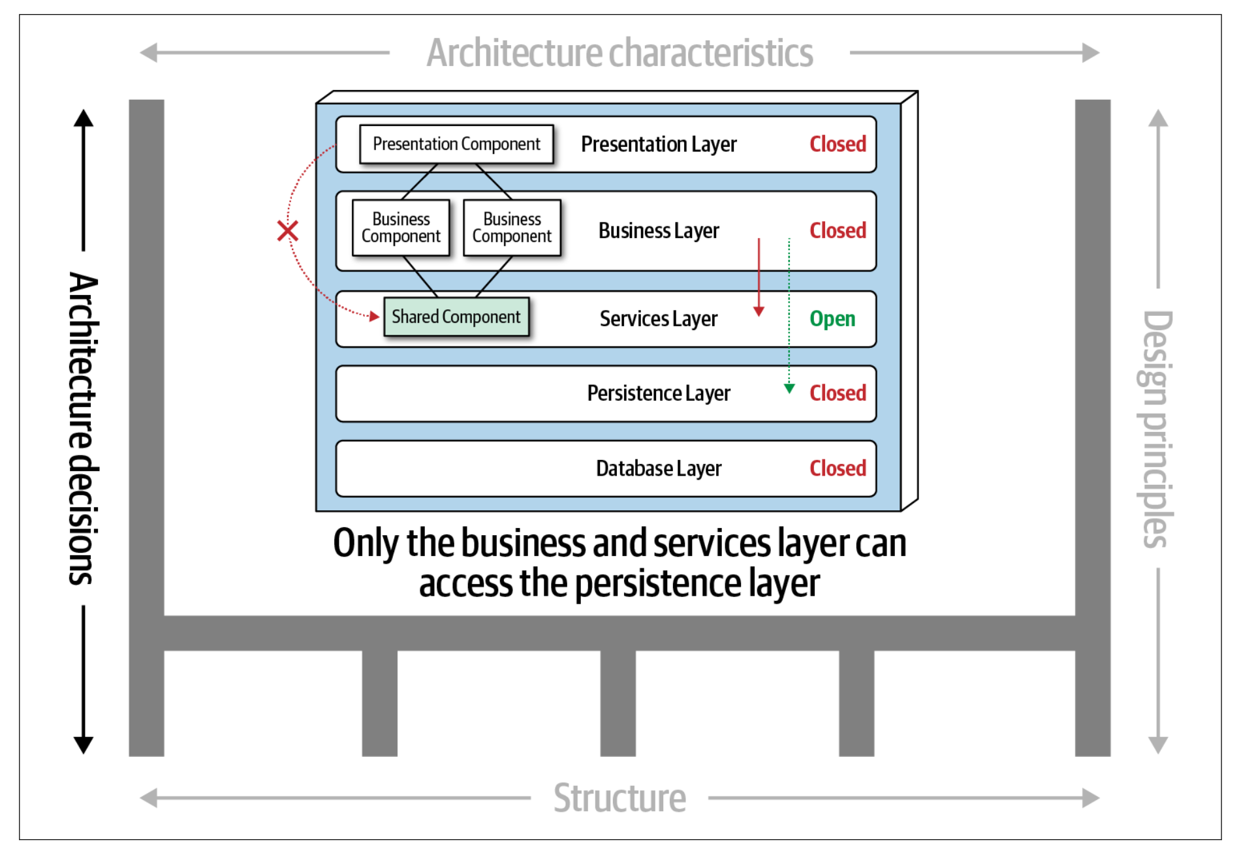
The next factor that defines software architecture is architecture decisions. Architecture decisions define the rules for how a system should be constructed. For example, an architect might make an architecture decision that only the business and services layers within a layered architecture can access the database, restricting the presentation layer from making direct database calls. Architecture decisions form the constraints of the system and direct the development teams on what is and what isn’t allowed.

Slide 8
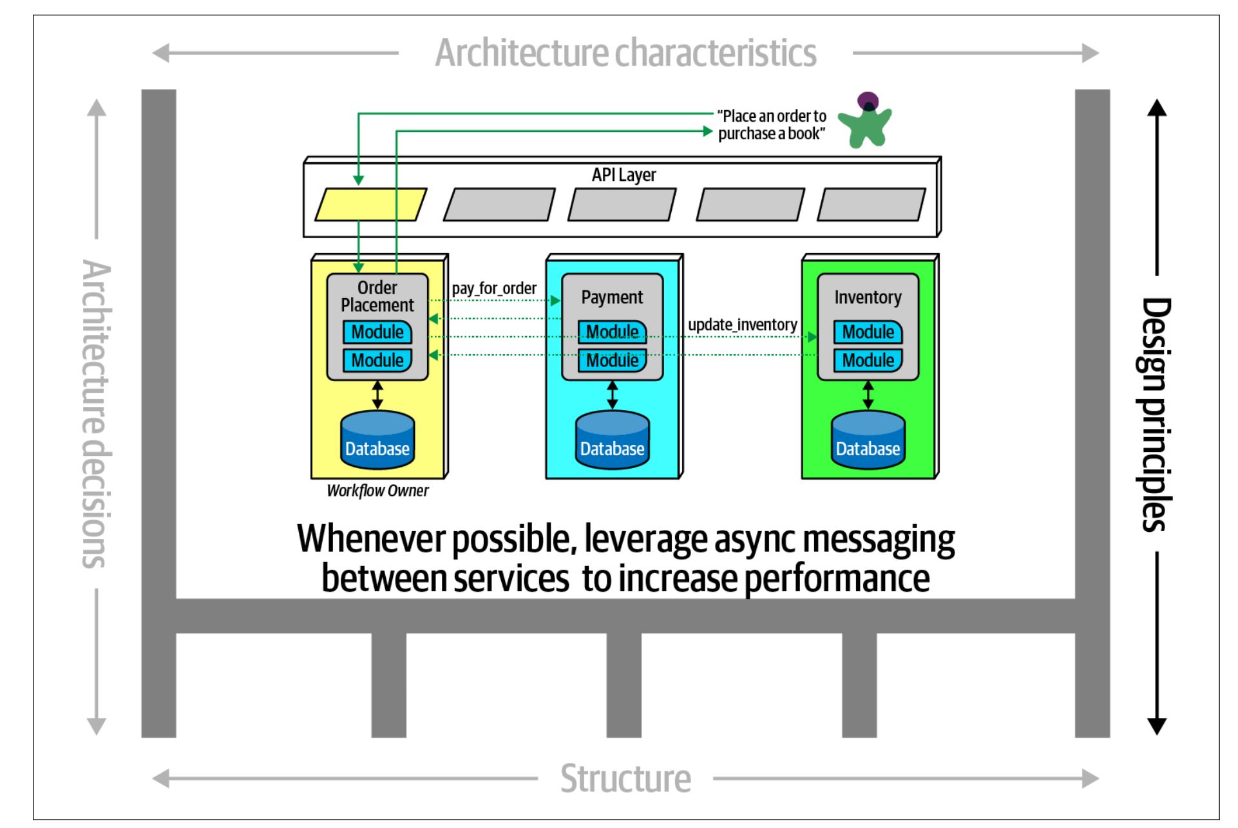
The last factor in the definition of architecture is design principles. A design principle differs from an architecture decision in that a design principle is a guideline rather than a hard-and-fast rule. For example, the design principle illustrated in states that the development teams should leverage asynchronous messaging between services within a microservices architecture to increase performance. An architecture decision (rule) could never cover every condition and option for communication between services, so a design principle can be used to provide guidance for the preferred method (in this case, asynchronous messaging) to allow the developer to choose a more appropriate communication protocol (such as REST or gRPC) given a specific circumstance.

Slide 9
Design patterns

Slide 10
https://refactoring.guru/design-patterns

Slide 11
Design vs Architecture

Slide 12
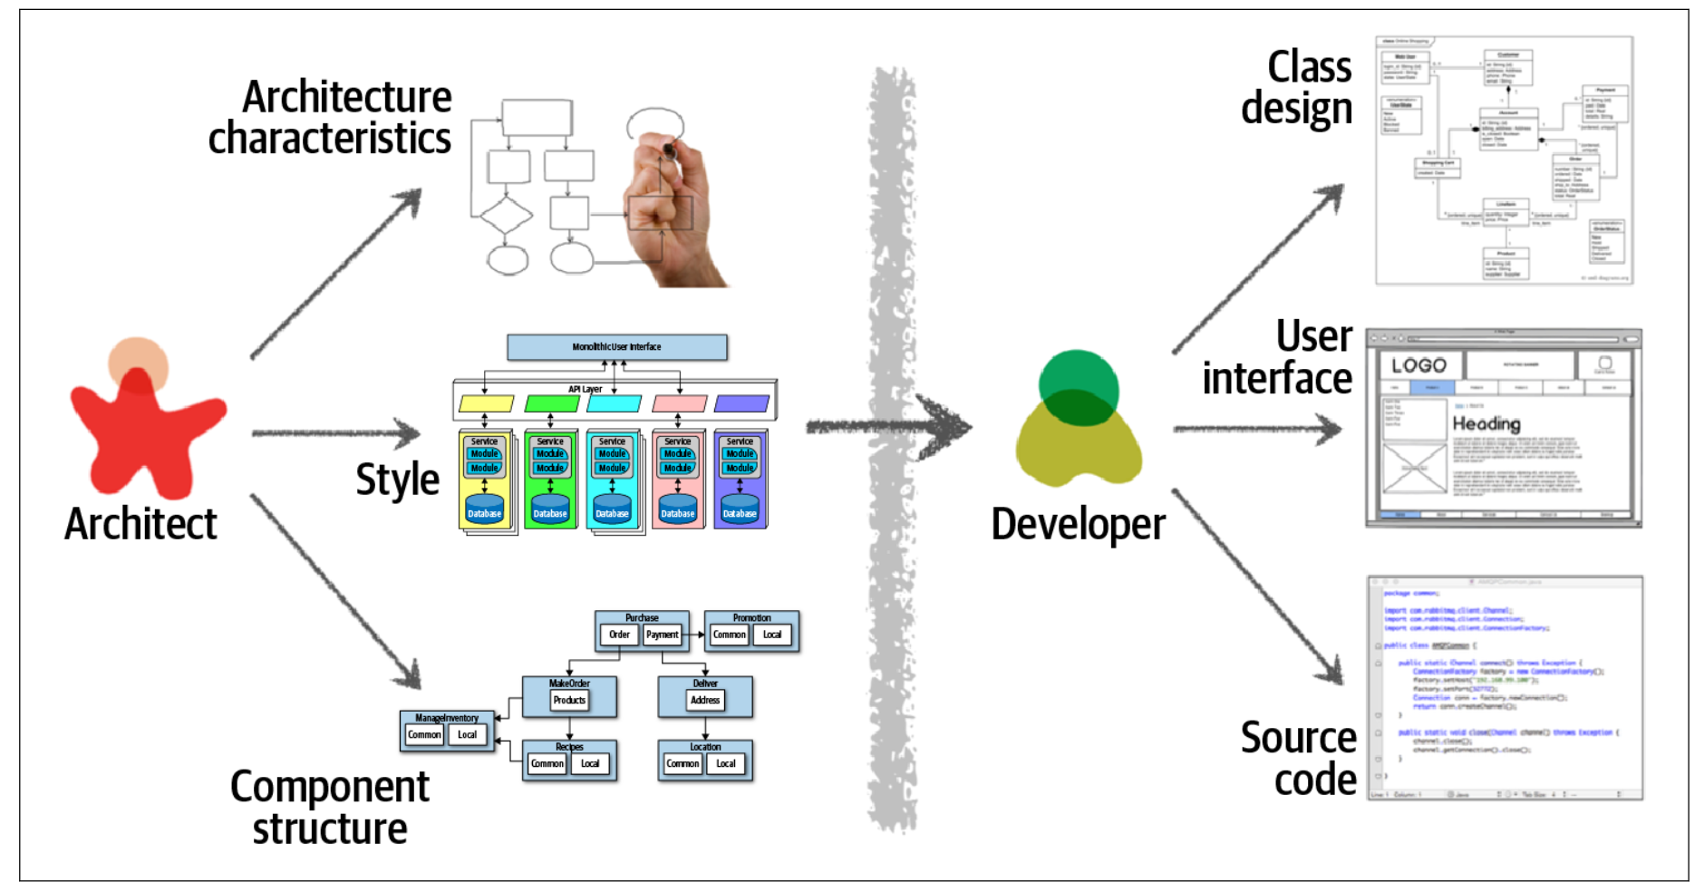
The difference between architecture and design is often a confusing one. Where does architecture end and design begin? What responsibilities does an architect have versus those of a developer? Thinking like an architect is knowing the difference between architecture and design and seeing how the two integrate closely to form solutions to business and technical problems.
Consider picture, which illustrates the traditional responsibilities an architect has, as compared to those of a developer. As shown in the diagram, an architect is responsible for things like analyzing business requirements to extract and define the architectural characteristics (“-ilities”), selecting which architecture patterns and styles would fit the problem domain, and creating components (the building blocks of the system). The artifacts created from these activities are then handed off to the development team, which is responsible for creating class diagrams for each component, creating user interface screens, and developing and testing source code.

Slide 13
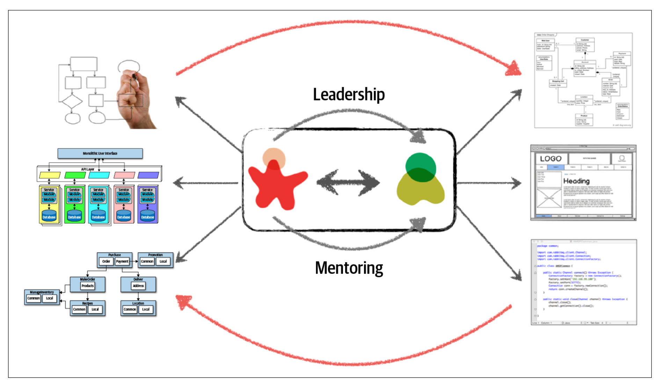
There are several issues with the traditional responsibility model illustrated in picture. As a matter of fact, this illustration shows exactly why architecture rarely works. Specifically, it is the unidirectional arrow passing though the virtual and physical barriers separating the architect from the developer that causes all of the prob‐ lems associated with architecture. Decisions an architect makes sometimes never make it to the development teams, and decisions development teams make that change the architecture rarely get back to the architect. In this model the architect is disconnected from the development teams, and as such the architecture rarely provides what it was originally set out to do.
To make architecture work, both the physical and virtual barriers that exist between architects and developers must be broken down, thus forming a strong bidirectional relationship between architects and development teams. The architect and developer must be on the same virtual team to make this work, as depicted in Figure 2-2. Not only does this model facilitate strong bidirectional communication between architecture and development, but it also allows the architect to provide mentoring and coaching to developers on the team.
Unlike the old-school waterfall approaches to static and rigid software architecture, the architecture of today’s systems changes and evolves every iteration or phase of a project. A tight collaboration between the architect and the development team is essential for the success of any software project. So where does architecture end and design begin? It doesn’t. They are both part of the circle of life within a software project and must always be kept in synchronization with each other in order to succeed.

Slide 14
Architecture is the stuff you can’t Google.

Slide 15
Coupling & cohesion. Modularity

Slide 16
Definition
The dictionary defines module as “each of a set of standardized parts or independent units that can be used to construct a more complex structure.” We use modularity to describe a logical grouping of related code, which could be a group of classes in an object-oriented language or functions in a structured or functional language. Most languages provide mechanisms for modularity (package in Java, namespace in .NET, and so on).

Slide 17
Cohesion (згуртованість)
Cohesion refers to what extent the parts of a module should be contained within the same module. In other words, it is a measure of how related the parts are to one another. Ideally, a cohesive module is one where all the parts should be packaged together, because breaking them into smaller pieces would require coupling the parts together via calls between modules to achieve useful results.
Functional cohesion - Every part of the module is related to the other, and the module contains every‐ thing essential to function.
Sequential cohesion - Two modules interact, where one outputs data that becomes the input for the other.
Communicational cohesion - Two modules form a communication chain, where each operates on information and/or contributes to some output. For example, add a record to the database and generate an email based on that information.
Procedural cohesion - Two modules must execute code in a particular order.
Temporal cohesion - Modules are related based on timing dependencies. For example, many systems have a list of seemingly unrelated things that must be initialized at system startup; these different tasks are temporally cohesive.
Logical cohesion - The data within modules is related logically but not functionally. For example, consider a module that converts information from text, serialized objects, or streams. Operations are related, but the functions are quite different. A common example of this type of cohesion exists in virtually every Java project in the form of the StringUtils package: a group of static methods that operate on String but are otherwise unrelated.
Coincidental cohesion - Elements in a module are not related other than being in the same source file; this represents the most negative form of cohesion.

Slide 18
Cohesion (згуртованість) - приклад
Customer Maintenance
add customer
update customer
get customer
notify customer
get customer orders
cancel customer orders
Can result in:
Customer Maintenance
add customer
update customer
get customer
notify customer
Order Maintenance
get customer orders
cancel customer orders
Which is the correct structure? As always, it depends:
Are those the only two operations for Order Maintenance? If so, it may make sense to collapse those operations back into Customer Maintenance
Is Customer Maintenance expected to grow much larger, encouraging developers to look for opportunities to extract behavior?
Does Order Maintenance require so much knowledge of Customer information that separating the two modules would require a high degree of coupling to make it functional?

Slide 19
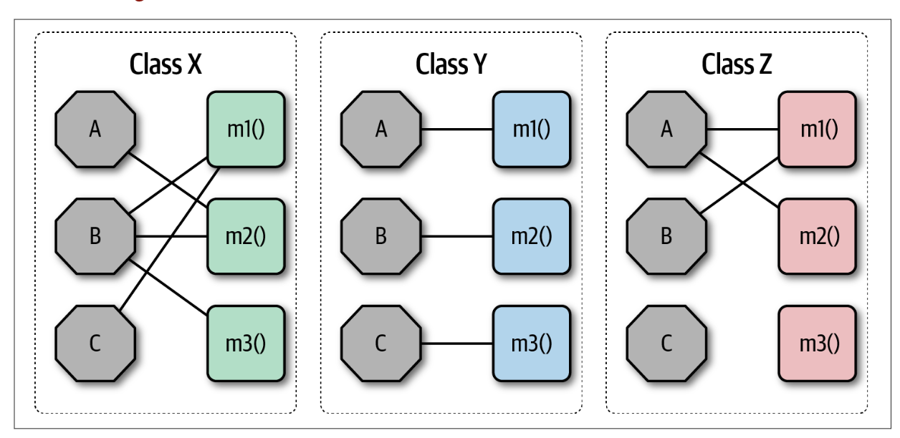
LCOM
The Chidamber and Kemerer Lack of Cohesion in Methods (LCOM) metric measures the structural cohesion of a module, typically a component. (as per this)
LCOM - The sum of sets of methods not shared via sharing fields
Many software metrics have serious deficiencies,
and LCOM is not immune.
All this metric can find is structural lack of cohesion;
it has no way to determine logically if particular pieces fit together.
This reflects back on our Second Law of Software Architecture:
prefer why over how.

Slide 20
END

