Slide 1
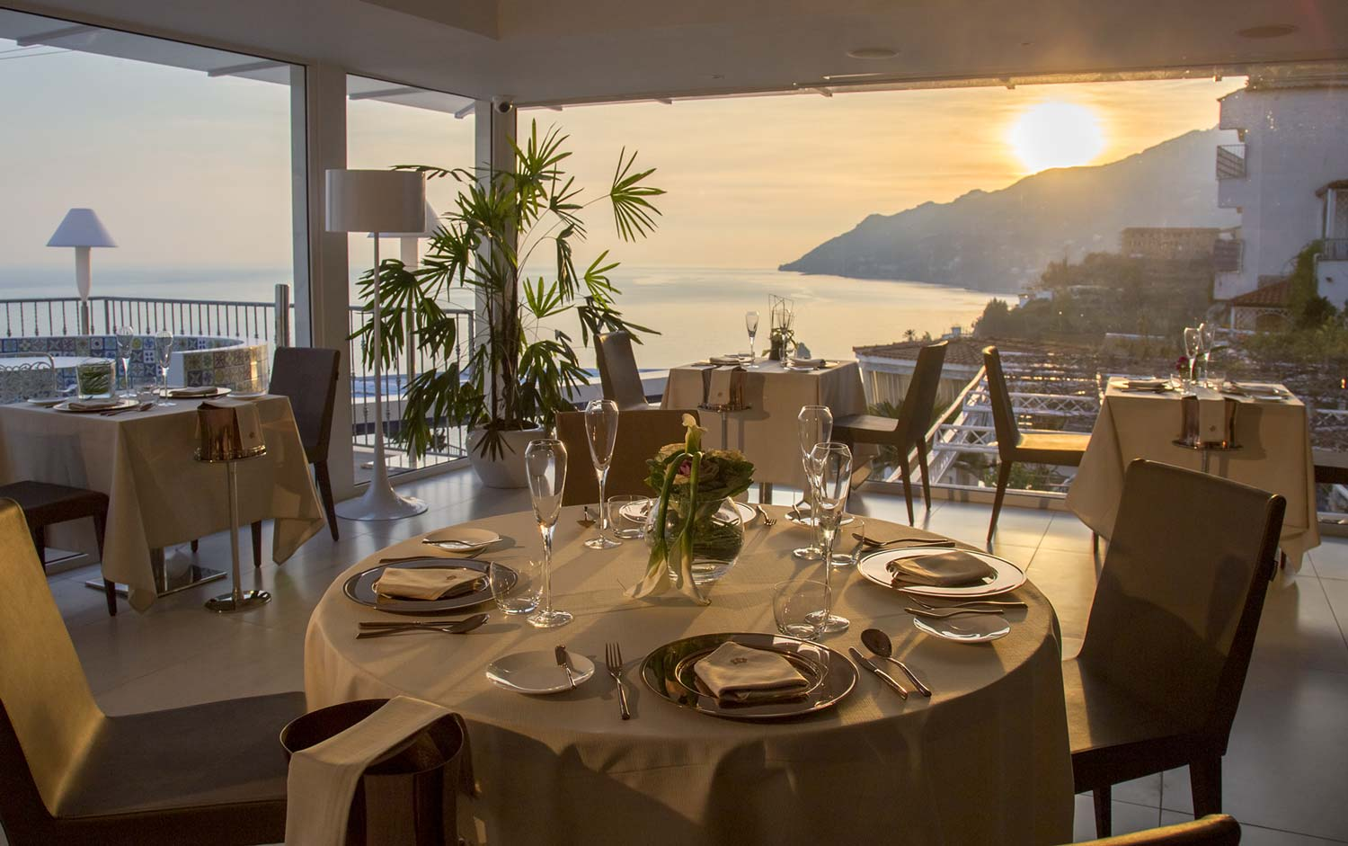
RestaurantP romoting Ideas restourant Salerno

Slide 2
Getting more people to the restaurant is an important goal for a successful gastronomic operation. A plan that can help you achieve this goal:
1. Analysis of the market and competitors:• Conduct market research to determine your competitive advantages.• Find out successful restaurants in the area and see what strategies work for them.
2. Practice with sleep:• Organize special occasions, such as special occasions, such as themed parties, master classes or culinary specialties.• Collaborate with local organizations to sponsor any event or event to raise awareness.
3. Improved service and menu:• Ensure a high level of customer service and provide them with unforgettable satisfaction.• Update the menu in line with current trends in gastronomy and meet the needs of guests.
4. Digital marketing campaign:• Create or update a website and ensure that it is optimized for search engines (SEO).• Develop an active presence in social media and consistently publish clear content, including photos of clients’ sites and videos.• Launch advertising campaigns on the Internet, directly targeting local residents.

Slide 3
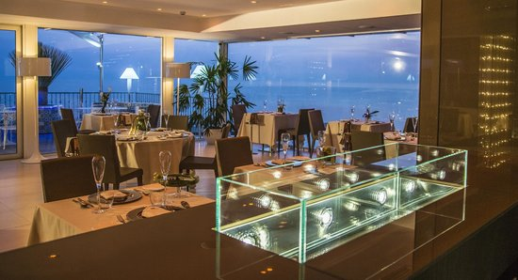
5. Loyalty program and promotions:
• Implement a payment system for regular clients, such as discount cards or special offers for repeat customers.
• Run special promotions and giveaways to encourage new customers to try your restaurant.
6. Optimization of working hours:
• Look at the possibility of expanded service hours, including service for snacks, lunches and evenings, and delivery.
• Analyze the popularity of hours and days of the week and ensure adequate staff strength.
7. Mirroring positive vibes:
• Actively follow social media and other online resources.
• Take criticism head-on and try to improve your work based on your findings.
8. Analysis of results:
• Constantly monitor the effectiveness of various marketing approaches and strategies, adjust them accordingly to the results.
Getting more people to the restaurant is a long-term process, and success relies on continued efforts and adaptation before changes to the market. It is important to listen to your clients and steadily grow your business

Slide 4
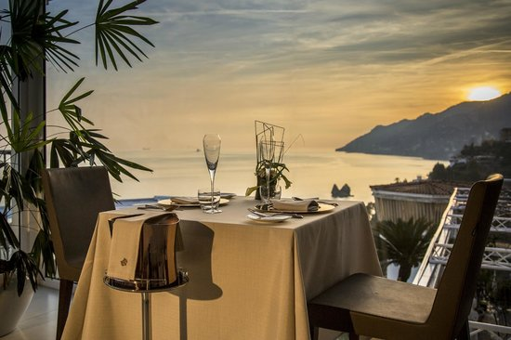
An advertising campaign for a restaurant must highlight its unique features and added excitement in order to gain the respect of potential customers. Some features of the restaurant that can be emphasized in advertising:
1. Culinary skill: Enhance the skills and talent of the cooks of your restaurant, especially if you have a powerful chef or a special gourmet dish.
2. Menu: Show the variety and taste of the herbs that you can taste in your restaurant. Incorporate seasonal or popular herbs.
3. Ingredients: If you choose high acidity, fresh and local ingredients, add this speciality.
4. Service: Tell us about the friendly and professional staff who will make your restaurant a memorable experience.
5. Atmosphere: Enhance the design and atmosphere of your restaurant, making it suitable for romantic evenings, family reunions or business meetings.

Slide 5
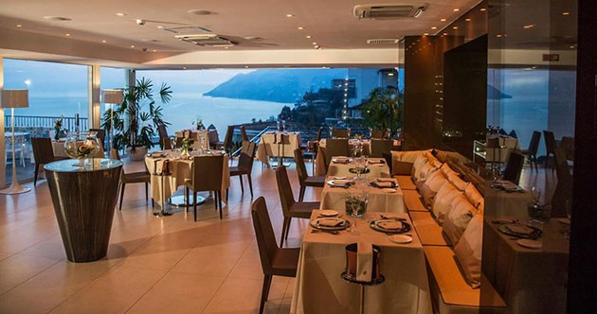
6. Entertainment: If you have live music, thematic approaches or other entertainment, voice it.
7. History and concept: Tell us about the history of your restaurant, its concept and values. Describe how your restaurant stands out from others.
8. News and ratings: Share positive reviews and ratings of clients from social networks or popular rating sites.
9. Promotions and promotions: Indicate on promotions, discounts and special offers for new and regular clients.
10. Location: If a restaurant is growing in a hand-made place, ask for the availability of parking and public transport.
Remember that an effective advertising campaign is all about capturing the spirit of your restaurant and winning the respect of your target audience.

Slide 6
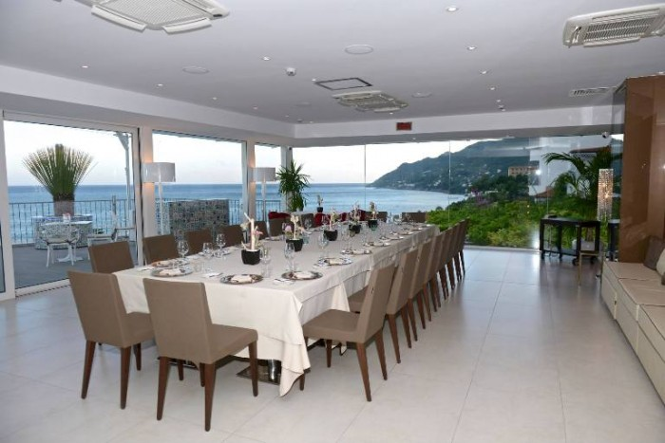
A social media marketing plan aimed at attracting both locals and tourists should be tailored and tailored to the needs of your area or business. Below is a general action plan that can be used as the basis for your strategy:
1. Defining the goal and audience:
• Determine what goal you want from social media (increase traffic, increase brand awareness, attract new customers, etc.).
• Consider what audience you want to attract (locals, tourists, or both).
2. Analysis of competitors:
• Research which social media platforms your competitors are holding back and how they're reacting with your audience.
• Find a niche or opportunity that will then set you apart from your competition.
3. Platform selection:
• Determine which social media platforms will find your target audience. For example, Facebook, Instagram, Twitter, TikTok, YouTube, etc.
• Consider creating your own website or blog to host content.

Slide 7
Creating content:
• Develop a content calendar to schedule and post regularly.
• Create a variety of content that will be interesting and useful for your audience: photos, videos, articles, news, etc.
• Include local attractions, events, promotions and information about local culture and traditions for locals and tourists alike.
5. Interaction with the audience:
• Respond to comments and messages from users, facilitate interaction and answer their questions.
• Invite users to join discussions and community groups.
6. Advertising and promotion:
• Use the platforms' promotional tools to increase reach.
• Consider working with influencers who can endorse your brand.
7. Analytics and tracking of results:
• Use analytics tools to track performance metrics (likes, comments, followers, conversion, etc.).
• Analyze the results and make changes to the strategy based on the collected data.
8. Continuous optimization:
• Constantly refine your strategy based on audience response and analytics.
• Consider changes in social media trends and adapt to them.

Slide 8
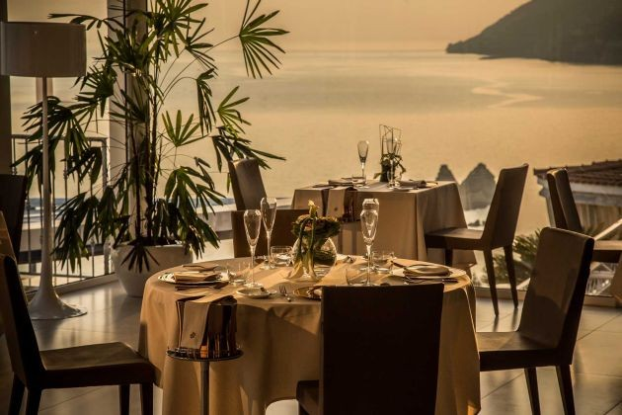
Creating the concept and graphics of a restaurant is an important part of the success of any gastronomic venture. It means style, atmosphere, menu, service and many other aspects that influence customer satisfaction
1. Target audience: My restaurant is for families and young people
2. Style and cuisine: Italian-style restaurant with a menu of Italian cuisine
3. Name of the restaurant: Salerno
4. Work schedule: The restaurant is open from 10:00 to 22:00
5. Personnel: qualified personnel, including cooks, waiters, bartenders and restaurant management.
6. Marketing and advertising: Advertising in social networks

Slide 9
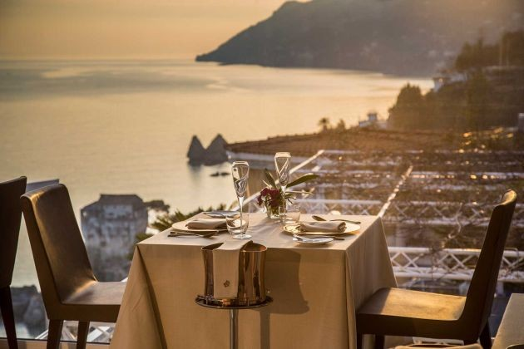
THANK YOU !

