Slide 1
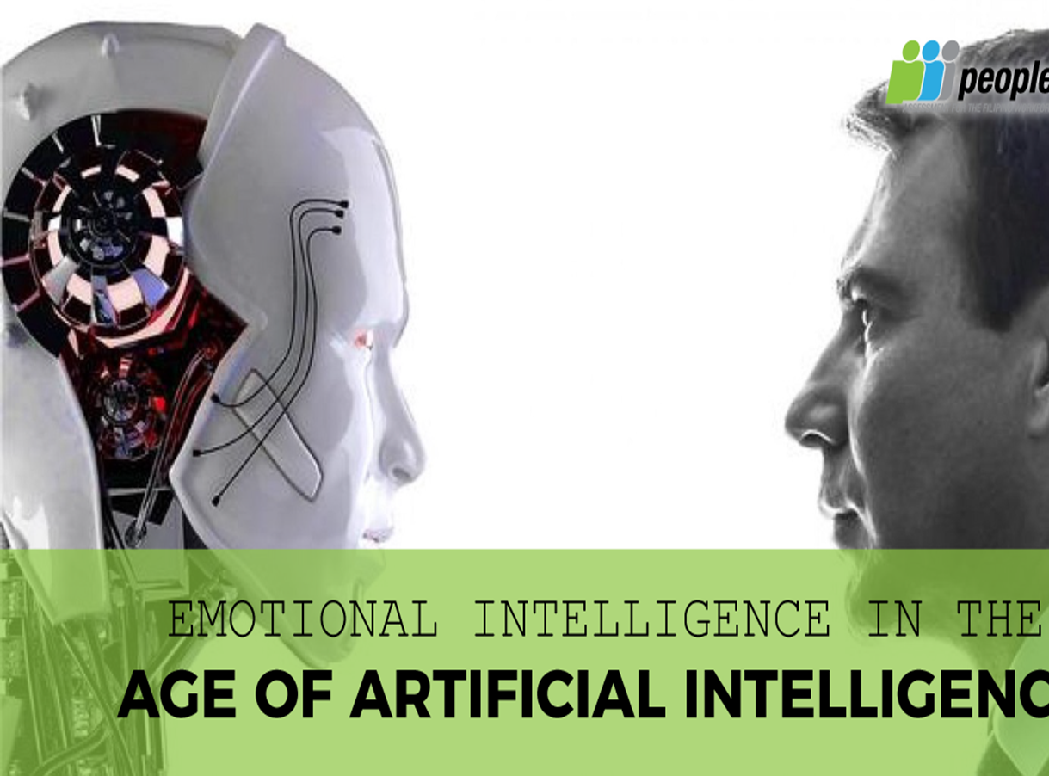
Emotional Intelligence vs Artificial Intelligence

Slide 2
What is Emotional Intelligence?
1
Defining Emotional Intelligence
2
Benefits for Restaurants
Emotional intelligence is the ability to recognize and manage your own emotions, as well as recognize and respond appropriately to the emotions of others.
3
Building Emotional Intelligence
Restaurants with emotionally intelligent staff are better equipped to provide quality service, foster positive customer relationships, and create a warm and welcoming atmosphere.
Emotional intelligence can be improved through training, self-reflection, and feedback from colleagues and customers.

Slide 3
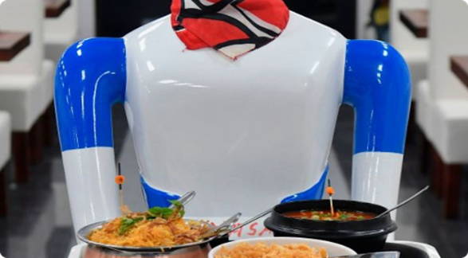
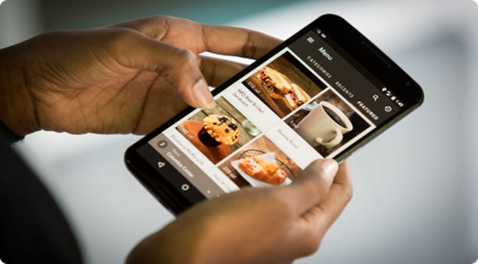
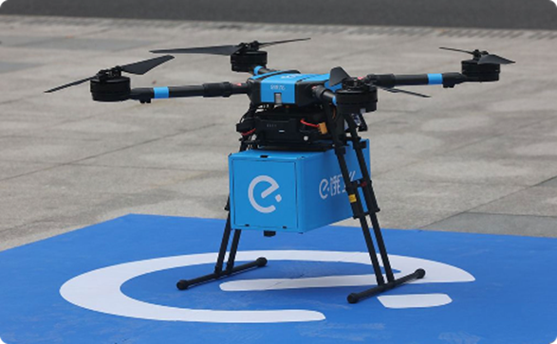
What is Artificial Intelligence?
Defining Artificial Intelligence
Benefits for Restaurants
Artificial intelligence refers to the simulation of human intelligence in machines, enabling them to perform tasks that typically require human-level intelligence or reasoning.
Restaurants can use artificial intelligence to improve efficiency, reduce errors, and personalize the customer experience through features like chatbots, recommendation engines, and predictive analytics.
Future of AI in Restaurants
The use of AI in restaurants is constantly expanding, from automated ordering systems to drone deliveries. It is also gaining popularity for its ability to manage inventory and reduce food waste.

Slide 4
Emotional Intelligence in Marketing
Stage 1: Research
Use customer feedback and emotional cues to develop marketing messages that resonate with your target audience.
Stage 2: Promotions
Engage with customers on a personal level through tailored promotions and marketing campaigns that address their specific needs and desires.
Stage 3: Follow-up
Use emotional intelligence to craft follow-up strategies that leave customers feeling valued and satisfied, encouraging them to return and refer others to your business.

Slide 5
Artificial Intelligence in Marketing
Customer Segmentation
Personalization
Chatbots
Utilize AI-powered algorithms to segment customer data and identify patterns, which allows for more targeted marketing campaigns.
Artificial intelligence can be used to analyze customer preferences and behaviors, resulting in personalized marketing messages and product recommendations.
Use AI-powered chatbots to respond to customer inquiries and address their needs in real-time, creating a more efficient and personalized customer experience.

Slide 6
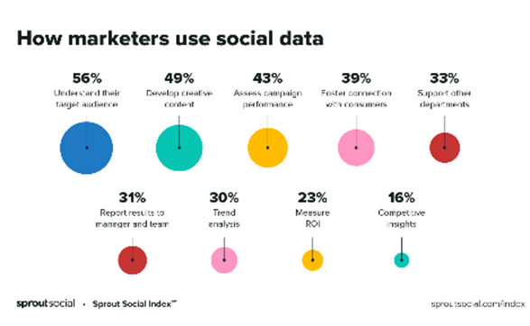
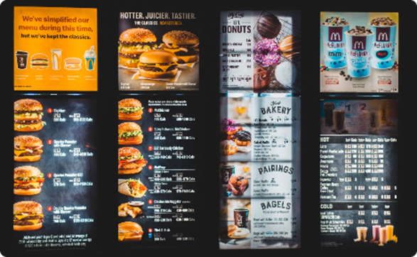
Combining Emotional and Artificial Intelligence
Staff Training
Social Media Marketing
Train staff on how to recognize and respond to the emotional needs of customers, while also leveraging AI-powered tools to personalize their experience.
Use AI-powered social media analytics to identify trending topics and customer sentiment, while also crafting emotionally intelligent messaging that resonates with your audience.
Menu Design
Use AI-powered tools to analyze customer preferences and create a menu that is personalized to their taste. Combine this with emotionally intelligent design and descriptions to create an unforgettable dining experience.

Slide 7
The Verdict
Emotional Intelligence
Artificial Intelligence
Emotional intelligence is critical for providing top-notch customer service, creating a positive customer experience, and fostering customer loyalty.
Artificial intelligence is key for streamlining operations, increasing efficiency, and providing personalized customer experiences.
A successful restaurant marketing campaign requires a balance of both emotional and artificial intelligence, with an emphasis on creating a warm and welcoming atmosphere while also leveraging the benefits of technology.

Slide 8
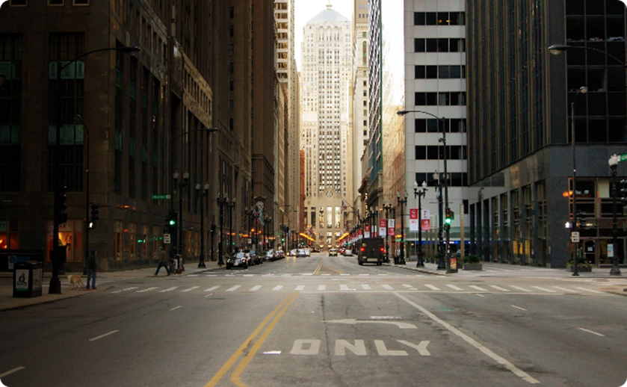
Conclusion
Key Takeaways
Looking Ahead
Emotional intelligence allows you to connect with customers on a personal level, building lasting relationships and fostering brand loyalty. Artificial intelligence can help you streamline operations, reduce costs, and stay ahead of the competition.
The future of the restaurant industry lies in a balance of emotional and artificial intelligence, with an emphasis on creating unforgettable dining experiences that keep customers coming back for more.

