Slide 1
Computational Linguistics
Introduction
Lecture 2

Slide 2
Outline

Slide 3
Topical Questions
Is it necessary to automatically process natural language texts, if we can just read them?
What do we need to know in order to develop a computer program that would do it?
What parts of linguistics are most important for this task?

Slide 4
Computer-Assisted Realia
create
proofread
store
manage
search

Slide 5
Alexander Gelbukh, 2014:
The great challenge of the problem of intelligent automatic text processing is to use unrestricted natural language to exchange information with a creature of a totally different nature: the computer.

Slide 6
mechanical assistance
intellectual assistance

Slide 7
Intellectual Assistance
read an unprepared text
test the text for correctness
execute the instructions contained in the text
comprehend the text well enough to produce a reasonable response based on its meaning

Slide 8
Automatic Text Processing Necessity Circumstance
lack of knowledge and education, time and wish to meet the modern standards of document processing
need to take into consideration a quantity of texts thousands times larger than one person is physically able to read in a lifetime

Slide 9
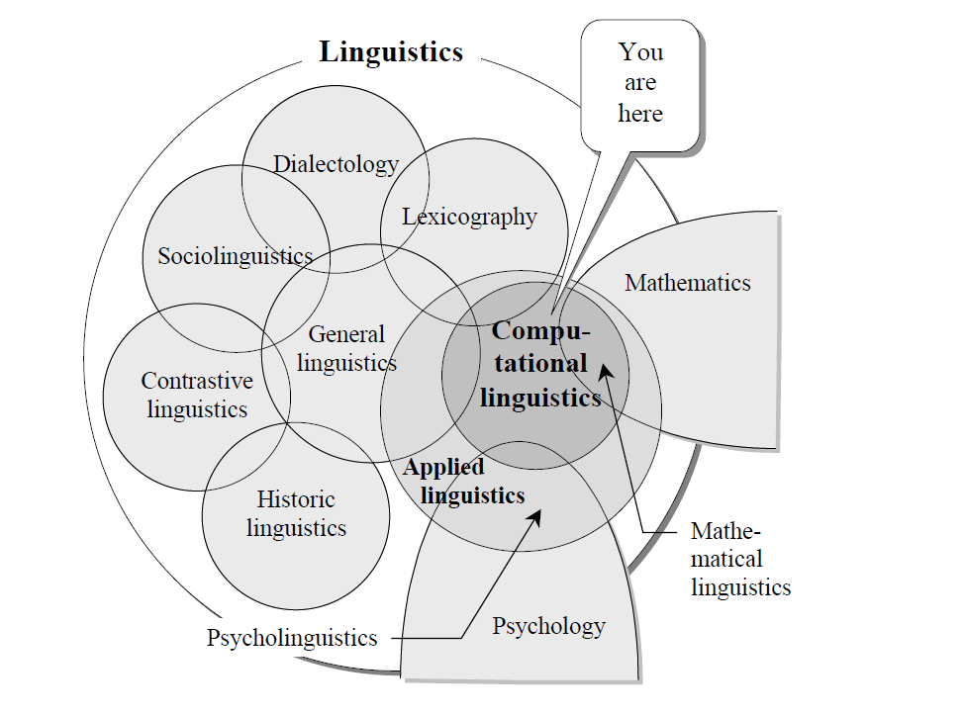
Computational Linguistics and Linguistics Models

Slide 10
Course Objectives
the formal description of language relevant to automatic language processing, rather than in purely algorithmic issues
the issues related to computer science only in an indirect manner
more linguistic than computational

Slide 11
Natural Language
Ferdinand de Saussure considers natural language as a structure of mutually linked elements, similar or opposed to each other.
Leonard Bloomfield claims for a fully “objective” description of natural languages, with special attention to superficially observable facts.
Thus, sentences are split into the so-called immediate constituents, or phrases, which are in their turn split into subconstituents, etc., down to single words.
Such a method of syntactic structuring was called the phrase structure, or constituency approach.

Slide 12
Noam Chomsky Study
The generative grammars produce strings of symbols, and sets of these strings are called formal languages (texts)
The phrase structures were formalized as context-free grammars (CFG) and became the basic tool for description of natural languages

Slide 13
Context-Free Grammar for Generating a Simple English Sentences
initial symbol S of a sentence to be generated and several other non-terminal symbols:
the noun phrase symbol NP
verb phrase symbol VP
noun symbol N
verb symbol V
determinant symbol D
All non-terminal symbols are interpreted as
grammatical categories.

Slide 14
Production Rules
S → NP VP
VP → V NP
NP → D N
NP → N

Slide 15
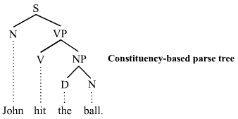
Constituency Tree
Syntactic structure of a sentence was identified with the so-called constituency tree (a nested structure subdividing the sentence into parts, then these parts into smaller parts, and so on).

Slide 16
Transformational Grammar
A transformational grammar is a set of rules for such insertions, permutations, movements, and corresponding grammatical changes. Such a set of transformational rules functions like a program. It takes as its input a string constructed according to some context-free grammar and produces a transformed string [Gelkbuch, 2014].

Slide 17
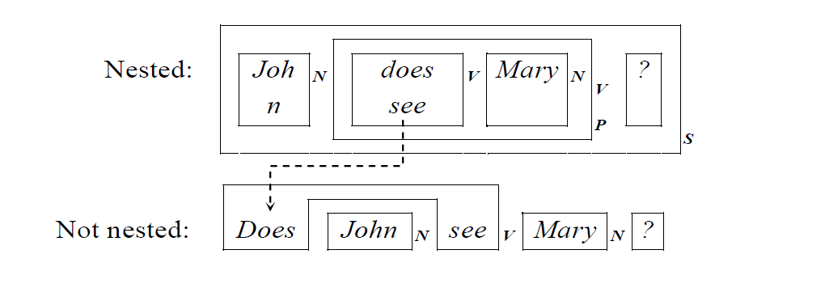
Transformational Grammar

