Slide 1
Lecture 3

Slide 2
Outline
Historical Outline.
Phrase Structure (Constituency).
The Meaning – Text Theory.

Slide 3
Historical Outline
Criteria
Linguistics 1
Linguistics 2
Linguistics 3
Linguistics 4

Slide 4
Historical Outline
the beginning of XX century – F.de Saussure: natural language as a structure of mutually linked elements, similar or opposed to each other
1920s-1950s – European structuralism
1920s-1950s – L. Bloomfield: a fully ‘objective’ description of natural languages with special attention to superficially observable facts

Slide 5
Phrase Structure (Constituency)
sentence
immediate constituents (phrases)
sub
constituents
single words

Slide 6
Contribution of N. Chomsky
The generative grammars produce strings of symbols, and sets of these strings are called formal languages (texts).
The phrase structures were formalized as context-free grammars (CFG) and became the basic tool for description of natural languages.
The idea of independent syntax arose and the problem of natural language processing was seen as determining the syntactic structure of each sentence composing a text.
Syntactic structure of a sentence was identified with the so-called constituency tree.

Slide 7
Contribution of N. Chomsky
great generality, mathematical elegance, and wide applicability of generative grammars
used not only for description of natural languages, but also for specification of formal languages, such as those used in mathematical logic, pattern recognition, and programming languages
transformational grammars aimed to better accommodate the formal tools to natural languages
mainly English-oriented and explained how to construct an interrogative or negative sentence from the corresponding affirmative one, how to transform the sentence in active voice to its passive voice equivalent, etc.

Slide 8
The Meaning – Text Theory (MTT): Multistage Transformer & Government Patterns
oversimplifications and inadequacies of the early Chomskian linguistics

Slide 9
The Meaning – Text Theory (MTT): Multistage Transformer & Government Patterns
In late 1960s in Russia
I. Mel’čuk, Yu. Apresian: deep and consistent descriptions of several languages of different families, Russian, French, English and German among them, were constructed and introduced to computational practice.

Slide 10
The Meaning – Text Theory (MTT): Multistage Transformer & Government Patterns
Language is a multistage, or multilevel, transformer of meaning to text and vice versa
Some inner representation corresponds to each level, and each representation is equivalent to representations of other levels
Surface morphologic, deep morphologic, surface syntactic, deep syntactic, and semantic levels, as well as the corresponding representations, were introduced into the model

Slide 11
The Meaning – Text Theory (MTT): Multistage Transformer & Government Patterns
“… Up to the present, the proper description of the word order and word agreement in many languages can be accomplished easier by means of the MTT. Moreover, it was shown that in many languages there exist disrupt and non-projective constructions, which cannot be represented through constituency trees or nested structures, but dependency trees can represent them easily …” [pp. 49-50]

Slide 12
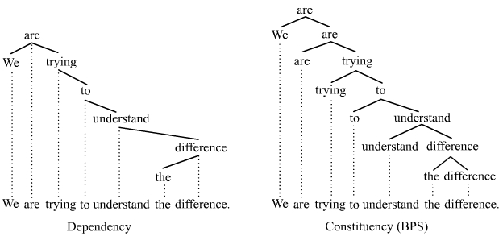
Dependency Tree
Lucien Tesnière, 1950’s

Slide 13
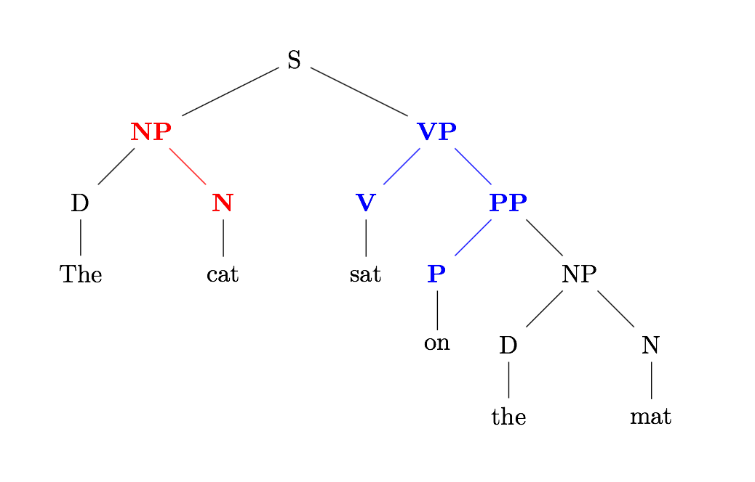
Dependency Tree

Slide 14
References
Allen, J. Natural Language Understanding. The Benjamin / Cummings Publ., Amsterdam, Bonn, Sidney, Singapore, Tokyo, Madrid, 1995.
Grishman, R. Computational linguistics. An introduction. Cambridge University Press, 1986.
Jurafsky, D., J. H. Martin. Speech and Language Processing: An Introduction to Natural Language Processing, Computational Linguistics, and Speech Recognition. Prentice-Hall, 2000; Source: www.cs.colorado.edu/~martin/slp.html.
Mel’čuk, I. A. Dependency Syntax: Theory and Practice. State University of New York Press, NY, 1988.
Sag, I. A., and T. Wasow. Syntactic theory: Formal Introduction. CSLI Publ., Stanford University of Chicago Press, Chicago and London, 1999; Source: http://hpsg.stanford.edu/hpsg.

Slide 15
Time to Practise

