Slide 1
The Notion of Country Study

Slide 2
Introduction
CS as a branch of Linguistics
The ties of CS with other branches of Linguistics
The main terms of CS
Realia

Slide 3
Questions
What does CS investigate?
What vocabulary is called background?
What does background knowledge mean?
When do we get acquainted with background knowledge?
What knowledge does the presupposition include?
How can you explain the word «realia» and its place in language?

Slide 4
Introduction

Slide 5
CS as a branch of Linguistics

Slide 6
CS as a branch of Linguistics

Slide 7
The ties of CS with other branches of Linguistics

Slide 8
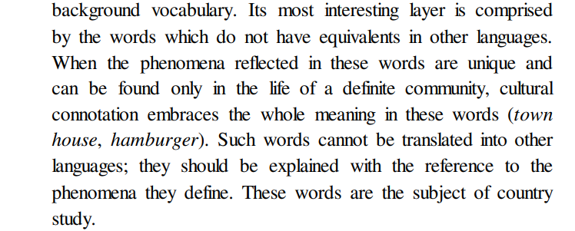
The main terms of CS

Slide 11
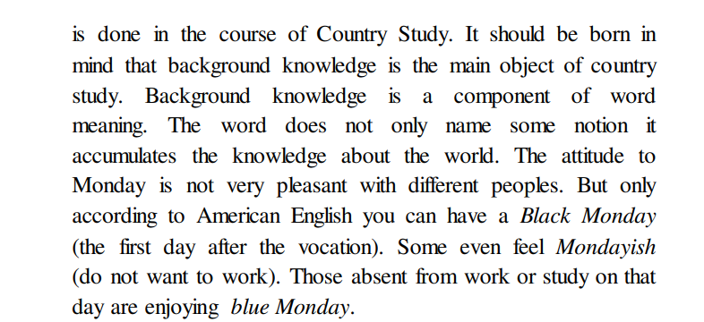

Slide 13
In linguistics the word realia is used to denote:

Slide 14
National-marked vocabulary

Slide 17
Thank you for your attention

Slide 18
Source
http://eprints.zu.edu.ua/31625/1/%D0%9B%D0%86%D0%9D%D0%93%D0%92%D0%9E%D0%9A%D0%A0%D0%90%D0%87%D0%9D%D0%9E%D0%97%D0%9D%D0%90%D0%92%D0%A1%D0%A2%D0%92%D0%9E.pdf

Slide 19
Seminar 1
England, Scotland, Wales, Northern Ireland, the USA, Canada, Australia, New Zealand, Hawaii, Alaska, Tasmania
Geography and history
Government and law
Education
Arts and culture
Customs and traditions
Language and cross cultural communication

