Slide 1
Government, political life and law

Slide 2
Outline
What is government?
What is law?
Great Britain and the United Kingdom. Government
Great Britain and the United Kingdom. England. Government, political life and law
Great Britain and the United Kingdom. Scotland. Government, political life and law
The USA. Government, political life and law

Slide 3
Government
the body of persons that constitutes the governing authority of a political unit or organization: such as
a: the officials comprising the governing body of a political unit and constituting the organization as an active agency
The government was slow to react to the crisis.
b: capitalized : the executive branch of the U.S. federal government
с: capitalized : a small group of persons holding simultaneously the principal political executive offices of a nation or other political unit and being responsible for the direction and supervision of public affairs
https://www.merriam-webster.com/dictionary/government

Slide 4
Law
a(1): a binding custom or practice of a community : a rule of conduct or action prescribed or formally recognized as binding or enforced by a controlling authority
(2): the whole body of such customs, practices, or rules
The courts exist to uphold, interpret, and apply the law.
https://www.merriam-webster.com/dictionary/law

Slide 5
Great Britain and the United Kingdom
The United Kingdom is a constitutional monarchy, with the executive power exercised by a government headed by the Prime Minister and his Cabinet.
The British Parliament is bicameral, composed of the 659-member elected House of Commons and the appointed House of Lords.
House of Parliament virtual tour
https://virtualtour.parliament.uk/palaceofwestminster

Slide 6
Great Britain and the United Kingdom England
England has no central government, instead using elements of the British system, which is itself rapidly becoming fragmented by the splitting-off of the Scottish Parliament, the Northern Irish Assembly, and to some extent, the Welsh Assembly.
The current Labour government favoured the establishment of regional administration, claiming that England was too large to be governed as a sub-state entity.

Slide 7
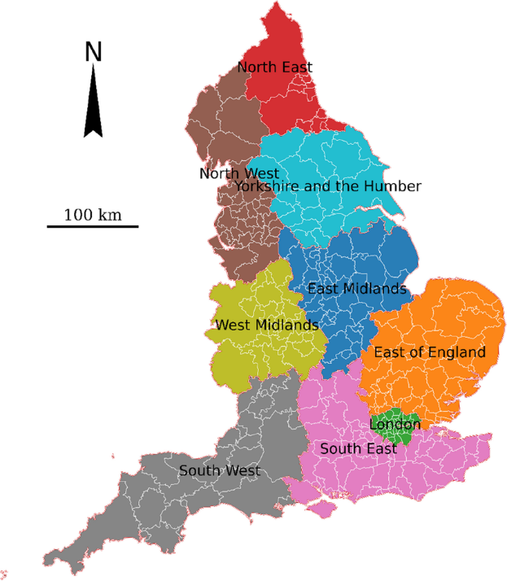
Local government
England is divided into 9 governmental regions:

Slide 8
Local Government is by councils, ranked by size and level of autonomy.
Large cities and conurbations have «Unitary» councils with one-level that combines the function of County and District council.

Slide 9
Law
English law, the law of England and Wales is known generally as the common law.
The essence of the common law is that it is made by judges sitting in court, applying their common sense and knowledge of legal precedent to the fact before them.
Emphasis on precedents
A fundamental concept is any legal dealing in England is that a person or organisation is innocent until proved guilty and they do not have to prove their innocence. The Central Criminal Court is a Crown Court in London dealing with major criminal cases for England and Wales, as well as Greater London.

Slide 10
Great Britain and the United Kingdom Scotland
Scotland Act 1998: There shall be a Scottish Parliament
The Parliament’s powers include legislative competence in elation to health, education, industry, local government, social work and housing, economic development and transport, criminal and civil law and home affairs, environment, agriculture, forestry and fishing, sport and the arts

Slide 11
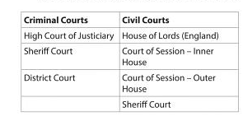
The Scots Legal system is unique
In haven three possible verdicts for a criminal trial: guilty, not guilty and not proven
The Scottish hierarchy and organisation of Courts is

Slide 12
Scottish Criminal Law is contained within Scotland but Civil Law has an ultimate court of appeal in England.

Slide 13
The USA. Government, political life and law
The United States of America consists of fifty states with limited autonomy in whish federal las takes precedence over state law.
The Federal government consists of three branches that are designed to check and balance each other: the executive branch (the President), the legislative branch(The U.S. Congress), the judicial branch (Supreme Court)

Slide 14
The federal and state governments are dominated by two major political parties: the Republican Parte and Democratic Party

Slide 15
Law
The law of the United States is derived from the common law of England, which was in force at the time of the Revolutionary War.
The judicial branch is headed by the Supreme Court
The United States Code
The Code of Federal Regulations

Slide 16
List of Literature Recommended
Береговино Н.С. Лінгвокраїнознавство країн першої іноземної мови (англійська) : навчально-методичний посібник. Біла Церква : БНАУ, 2021. 150 с.
Линтвар О.М. Лінгвокраїнознавство Сполучених Штатів Америки : методичні рекомендації до самостійної роботи. Київ, 2021. 24 с.
Линтвар О.М., Плетенецька Ю.М. Лінгвокраїнознавство : практикум. Київ, 2020. 76 с.
Цегельська Марина Great Britain. Geography, History, Language. Тернопіль : «Підручники і посібники», 2020. 208 с.
Howard LeRoy Malchow History and international relations: From the Ancient World to the 21st Century. Second Edition. The UK: Bloomsbury, 2020. 408 p.
Борисенко Н., Шевчук О. Лінгвокраїнознавство англомовних країн. Житомир : «Житомирський державний університет ім. Івана Франка», 2010. 154 с.
Гапонів О., Возна М. Лінгвокраїнознавство. Англомовні країни. Вид.2-ге. Вінниця : «Нова Книга», 2018. 352 с.

