Slide 1
Omnichannel Marketing in the evolution of Marketing

Slide 3
Plan
1. Marketing evolution:
from Marketing 1.0 to Marketing 4.0. Holistic Marketing
2. Digital marketing. The main drivers of the development of modern marketing: Tools and New-generation Technologies
3. Omnichannel Marketing and Management: Evolution and Basic Approaches

Slide 4
1. Marketing evolution: from Marketing 1.0 to Marketing 4.0
The evolution of marketing is based around three major disciplines:
product management,
customer management, and
brand management

Slide 5
Table 1. The main differences between Marketing 1.0, 2.0 and 3.0
 | Marketing 1.0 Product-centric | Marketing 2.0 Consumer-centric | Marketing 3.0 Value-centric
Period | 1950-1960 | 1970-1980 | 1990-2000
Objective | Sell products to the masses | Satisfaction and customer retention | Making the world a better place providing positive values
Enabling forces | Industrial revolution | Information technology | Connectedness of consumers (a new wave of technologies)
The way companies perceive the market | Mass customers with material needs | Intelligent customers driven by reasons and emotions | A man with reason, heart and soul
Marketing 1.0
Product-centric
Marketing 2.0
Consumer-centric
Marketing 3.0

Slide 6
 | Marketing 1.0 Product-centric | Marketing 2.0 Consumer-centric | Marketing 3.0 Value-centric
Key marketing concept | Product development | Differentiation | Providing higher values
Marketing guidelines | The specificity of the product | Positioning the company and product | Mission, vision and company values
Value proposition | Functional | Functional and emotional | Functional, emotional and spiritual
Interaction with consumers | Mass communication (one-to-many transactions) | Individual approach (one-to-one relations) | Consumers collaborate with each other (many-to-many)
Source: Kotler et al., 2010, 2017

Slide 7
Marketing 4.0

Slide 8
Distinctive features of Marketing 4.0
Period
Objective – Inspiring the client to co-create new content and products/services
Enabling forces – Digital Economy (Industry 4.0)
The way companies perceive the market – Netizen man (citizen of the network)
Key marketing concept – Anthropomorphization of brands

Slide 9
Marketing guidelines – Promoting content and creating brands
Value proposition – commitment and trust
Interaction with consumers – relations based on the functioning of the networking, an enormous generation of consumer

Slide 10
Marketing Management
Marketing management is the art and science of choosing target markets and getting, keeping and growing customers through creating, delivering and communicating superior customer values of management (Ph. Kotler)
Marketing Management is the process of planning and executing the conception, pricing, promotion, and distribution of ideas, goods, and services to create exchanges that satisfy individual and organizational goals.
4P (marketing mix) from 1948 to 1960 (E. Jerome McCarthy)

Slide 11
Holistic Marketing
The holistic marketing concept views a business as a unified entity, with all its different parts working together towards a common goal. The holistic approach seeks to create synergy across all the different components of marketing.
All marketing strategies and activities about the business should be consistent with its common goal. All the different departments in the company should have a good understanding of how their decisions and actions could affect other parts of the business.

Slide 12
Key Features of a Holistic Marketing
Common Goal: HM focuses on creating a shared goal that all stakeholders can strive to meet. Everyone involved in the process must understand their part in achieving a common objective.
Aligned Activities: All activities involved in an HM strategy should be aligned towards the same goal, namely messages, products/services, customer segments, channels, and tactics.
Integrated Activities: HM focuses on integrating all the activities involved in a marketing strategy. Everything needs to be connected and working together in harmony towards a common goal.

Slide 14
Relationship Marketing aims to build mutually satisfying long-term relationships with key constituents in order to earn and retain their business. Four key constituents for relationship marketing are (1) customers, (2) employees, (3) marketing partners (channels, suppliers, distributors, dealers, agencies), and (4) members of the financial community (shareholders, investors, analysts).
Integrated Marketing occurs when the marketer devises activities and programs to create, communicate, and deliver value for consumers such that “the whole is greater than the sum of its parts”, i. e. (1) many different marketing activities can create, communicate, and deliver value; and (2) marketers should design and implement each marketing activity with all other activities in mind.

Slide 15
Internal Marketing is the task of hiring, training, and motivating able employees who want to serve customers well. Marketing activities within the firm can be as important as, or even more important than, those directed outside the company.
Performance Marketing requires understanding the financial and non-financial returns to business and society from marketing activities and programs. Marketers are increasingly going beyond sales revenue to interpret what is happening to market share, customer loss rate, customer satisfaction, product quality, and other measures. They are also considering the legal, ethical, social, and environmental effects of marketing activities and programs.

Slide 16
2. Digital marketing. The main drivers of the development of modern marketing: Tools and New-generation Technologies
Digital is recording or storing information as a series of the numbers 1 and 0, to show that a signal is present or absent
Digitization is the conversion of specific products (e.g., photos, recordings) from analog format to a digital one
creating a digital version (information)

Slide 17
Digitalization is the use of digital technologies to transform the business model in order to increase revenues and achieve other goals
Digital transformation is a gradual transition of existing economic and social systems to using digital technologies
The digital economy is an economy based on digital computer technologies
ICT - Information and Communications Technologies

Slide 18
The goal of digitization is to make information easier to access, store, transfer, and share
The goal of digitalization is to change the way business is conducted and make it more efficient through the use of digitized data and digital technologies

Slide 19
Digital transformations
State / e-Governance
Public
Science
Business

Slide 20
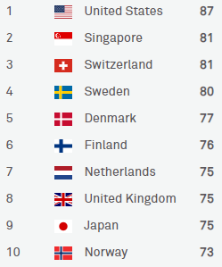
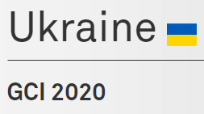
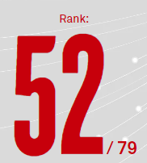
Global Connectivity Index
It was created to analyze a broad spectrum of indicators for ICT Infrastructure and digital transformation to provide a comprehensive map of the global digital economy.
Available at: https://www.huawei.com/minisite/gci/en/

Slide 21
Digital Marketing
Digital marketing is the use of digital or social channels to promote a brand or reach consumers. This kind of marketing can be executed on the Internet, social media, search engines, mobile devices, and other channels
Available at: https://www.ama.org/topics/digital-marketing/

Slide 22
Available at: https://www.snhu.edu/about-us/newsroom/business/types-of-digital-marketing

Slide 23
Search Engine Optimization (SEO). The goal of SEO is to get a business to rank higher in Google search results, ultimately increasing search engine traffic to the business’s website.
Pay-Per-Click (PPC) refers to paid advertisements and promoted search engine results. You will pay only when someone clicks on your ad and lands on your website.

Slide 24
Social Media Marketing (SMM) includes everything a business does via social media channels. SMM is a lot more complicated than managing your personal Facebook or Twitter profile. It requires a blend of creative thinking and objective, data-driven strategy, etc.
Content Marketing uses storytelling and information sharing to increase brand awareness. It is about building a sustainable, trusting relationship with your customers that can potentially lead to many sales over time, not just making a single transaction.

Slide 25
Email Marketing is still one of the most effective marketing techniques. It can be part of a content marketing strategy, providing value to consumers and over time converting an audience into customers.
Mobile Marketing focuses on reaching your target audience on their smartphone or tablet. It reaches people through text messages, social media, websites, email and mobile applications. Marketers can tailor offers or special content to a geographic location or time, such as when a customer walks into a store or enters an event.

Slide 26
Marketing Analytics. It allows marketers to track user behavior at a highly detailed level: how many times they click on a link, how much time they spend on a web page, how often they open emails, and much more. Understanding all of this data and using it to make strategic decisions is an important part of a digital marketer’s work.
Affiliate marketing (influencer marketing) utilizes the ever-growing popularity of industry experts and social media influencers. In working with these third-party influencers, your organization will collaborate to promote your products or services for compensation.

Slide 27
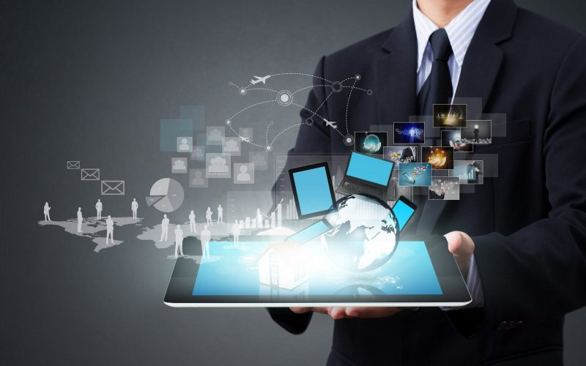
New generation technologies

Slide 28
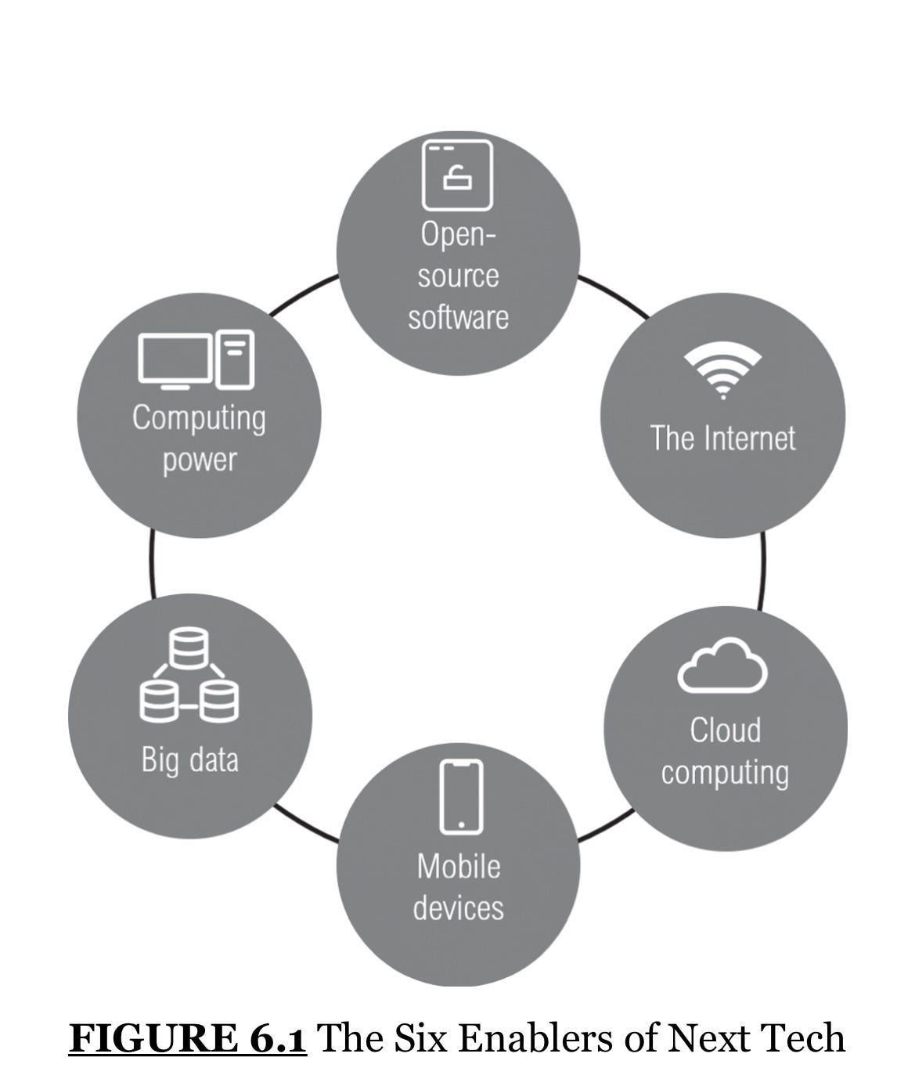
The Six Enablers of Next Tech
Source: Kotler et al., 2021

Slide 29
Computing Power. The increase in computing power has made it possible to operate power-hungry technology, such as artificial intelligence. It enables the AI machine to be small and local to empower applications that need a real-time response, such as in an autonomous car or a robot.
Open-Source Software. The software is distributed with its source code, making it available for use, modification, and distribution with its original rights. It leads to faster improvement and enhancement of the systems by the worldwide communities of developers.

Slide 30
The Internet. Internet bandwidth is significantly increasing (5G wireless technology). The Internet connects billions of not only people but also machines. It is also the foundation for networking-related technologies such as IoT and blockchain. Interactive technologies such as AR, VR, and voice assistants also rely immensely on high-speed Internet.
Cloud Computing. Shared access to computer systems, especially software and storage on the web, that allows users to work remotely. (Amazon, Microsoft, Google, Alibaba, and IBM)

Slide 31
Mobile Devices. High-end smartphones are now as powerful as a PC, making them the primary computing and Internet access device for most people. The portability of the devices empowers mobility and in turn, increases productivity on-the-go.
Big Data. It is a combination of structured, semi-structured and unstructured data collected by organizations that can be mined for information and used in machine learning projects, predictive modeling and other advanced analytics applications

Slide 32
Six Ways Technology Mimics Humans

Slide 33
Artificial Intelligence. A branch of computer science that focuses on building and managing technology that can learn to autonomously make decisions and carry out actions on behalf of a human being
Natural Language Processing (NLP) refers to the branch of computer science (the branch of AI) concerned with giving computers the ability to understand the text and spoken words in much the same way human beings can.
Sensor Tech is a technology that uses sensors to acquire information by detecting the physical, chemical, or biological property quantities and converting them into a readable signal (In-store Sensor Tech)

Slide 34
Robotics involves the design, construction, operation, and use of robots. The goal of robotics is to design machines that can help and assist humans.
Mixed Reality (MR) is an emergent technology that blends virtual reality (VR) and augmented reality (AR).
VR consists of entering a computer-generated simulation. VR completely blocks your view of the real world, immersing you in entirely virtual worlds.
.
AR layers digital objects onto the real world in front of you

Slide 35
IKEA Place as an example of AR

Slide 36
Internet of Things (IoT) and Blockchain
Internet of Things (IoT) describes the network of physical objects - “things” - that are embedded with sensors, software, and other technologies for the purpose of connecting and exchanging data with other devices and systems over the Internet. These devices range from ordinary household objects to sophisticated industrial tools.
Blockchain is a distributed database or ledger that is shared among the nodes of a computer network. As a database, a blockchain stores information electronically in a digital format.

Slide 37
«PrivatBank» completed the migration of IT systems to the «cloud» - it took 45 days
"PrivatBank" completely transferred IT systems from the physical data storage center to the "cloud". This allowed the company to minimize dependence on computer equipment, which is physically present in different regions of Ukraine and could be destroyed during the war.
The bank notes that the team did a titanic job to ensure clients' access to financial services. Under normal circumstances, a project of such scale would take 18 months or more. "PrivatBank" managed to do this in 45 days

Slide 38
How Technology Can Enhance Marketing
1. Make more informed decisions based on big data.
2. Predict outcomes of marketing strategies and tactics.
3. Bring the contextual digital experience to the physical world.
4. Augment frontline marketers’ capacity to deliver value.
5. Speed up marketing execution.

Slide 39
3. Omnichannel Marketing and Management: Evolution and Basic Approaches
Retailing is a pioneer sphere in Omnichannel (early 1990) that evolved from multichannel to O2O (online-to-offline)
The word multi-channel originated from the word Multus (multiple or many)
The word cross-channel emerged from the Latin word Crux (to go across)
The word omni comes from the word Omnis (universal)

Slide 40
Past
Single Channel
First Step
MultiChannel
Current
CrossChannel
Future
OmniChannel

Slide 41
The Evolution of Omni-Channel over the years (Shetty, 2018)
Single Channel (The Past) Retailers most often had only one channel, e. g. a shop or only catalogs (mail orders).

Slide 42
Multi-Channel (The First Step)
Channels are stand-alone
Customers are comforted with different assortment, prices, deals, etc.
E-commerce as a separate system is silo-ed
Inconsistencies in brand appearances
Online limited to must-have features, services
The online assortment is less purposefully defined
No specific price for the online market
Unconnected marketing

Slide 43
Cross Channel (The Current State)
Alignment in brand experience, assortment, prices etc.
Back office (Organization, systems) however not integrated.
Aligned brand messages and channel offerings.
Extended online capabilities
Comprehensive assortment concepts
Dynamic pricing
Focused marketing to specific segments

Slide 44
Omni-Channel (The Future)
Consistent experience across all channels.
Marketing is not scattered, systems are integrated, and customers have a seamless experience while moving between channels.
Brand experience Different responsibilities for each channel
Assortment strategies aligned with how customers shop
Flexible order and fulfillment
Individualized marketing Personalized customer service
Cross-channel organizational structure and metrics

Slide 45
The main approaches to omnichannel
Omnichannel retailing
A significant part of scientists consider omnichannel in terms of retailing and focus mainly on the integration of all available channels (online and offline, physical and digital, traditional and new ones), as well as the integration of the activities performed in the different channels as apparent to the consumer, and the one that requires operational efforts from the organization.

Slide 46
Current approaches to omnichannel retailing define it as a joint consumer–brand relationship and customers’ experience and engagement as indicators that are influenced by omnichannel.
There is also an approach to defining O2O commerce as a specific form of omnichannel retailing, wherein consumers search and purchase online and then consume offline. Moreover, there exists an approach to omnichannel as a paradigm in retail that establishes signal congruency – all the channels are aligned and convey a consistent message to customers.

Slide 47
Omnichannel Marketing
The importance of creating a seamless and consistent CX across all channels comes first, and it requires integration of those channels. Omnichannel marketing is also defined as a marketing strategy for brands, but it is worth noting that the focus is on promoting either products and services or the brand.

Slide 48
Omnichannel management
The activity of managing the numerous available channels and customer touchpoints, in which seamless CX is achieved through the optimization of customer interaction over the channels and the company’s profit is maximized. At the same time, a distinctive feature of omnichannel management is the achievement of synergy.

Slide 49
Omnichannel Strategy is to create an integrated system with all the touchpoints and achieve homogeneous and holistic CX.
Omnichannel Business is a firm that can exploit integrated processes and information systems to realize a seamless and consistent consumer experience across a plenitude of digital and physical channels.

Slide 50
Thank you for your attention

