Slide 1
The integration of channels in Omnichannel management

Slide 2
Plan
1. The Digital-Ready Organization
2. Service blueprint mapping
3. The Rise of Omnichannel Marketing

Slide 3
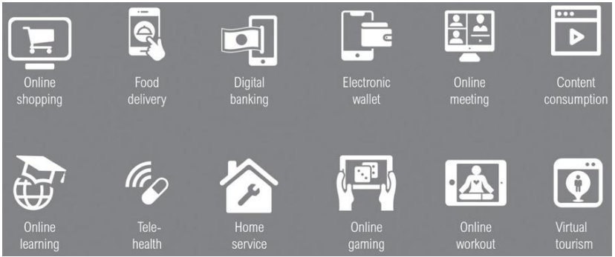
1. The Digital-Ready Organization
Kotler et al, 2021
Covid-19 as the digitalization accelerator. Shifts in the customer behavior

Slide 4
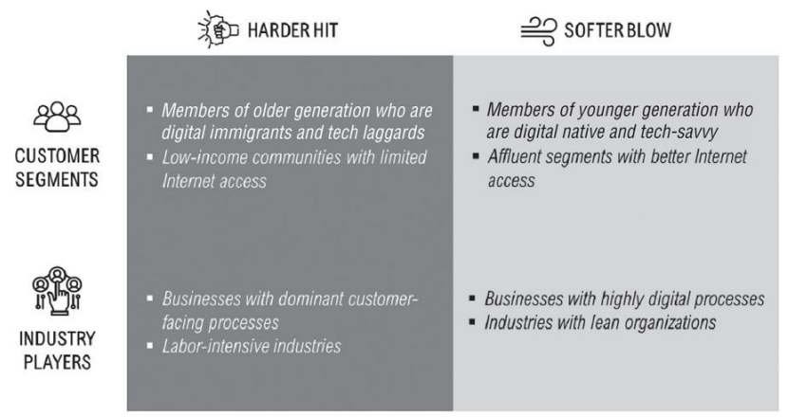
How COVID-19 Has Affected Different Customer Segments and Industry Players

Slide 5
The different degree of readiness dictates the digitalization strategy to pursue. Thus, it is essential to establish a diagnostic tool for readiness assessment. The assessment must take into account both the supply and demand sides. The first step is to determine if the market - the demand side - is ready and willing to migrate to more digital touchpoints. The next step - from the supply side - is to evaluate the ability of companies to digitalize their business processes to take advantage of the migration. The two considerations make up a matrix that maps a company's position in the digital readiness quadrants.

Slide 6
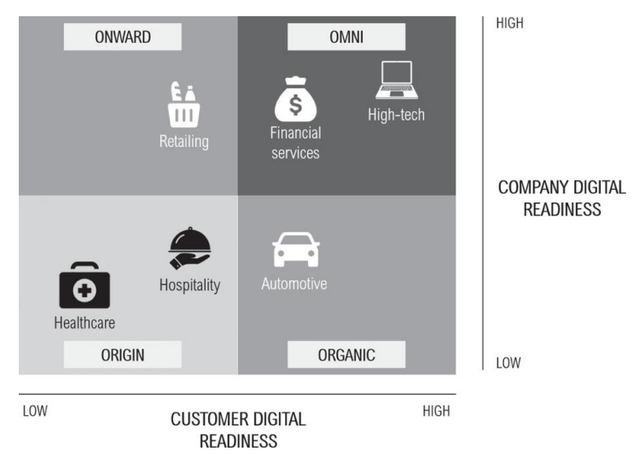
Digital Readiness by Industry

Slide 7
#1 “Origin” Quadrant. The hardest hit industries during the pandemic. Companies were less ready to face this crisis mainly because their business processes still included significant physical interactions (hard to eliminate or substitute for). At the same time, it is also unlikely for them to migrate customers to digital touchpoints, mostly due to the lack of urgency for purchase during a crisis. Ex.: the hospitality and healthcare industries. Strategies (a chicken-and-egg dilemma): invest in digitalization or wait for customers to migrate to digital behavior.
#2 “Onward” Quadrant. Industries have difficulty migrating customers despite having invested in significant digitalization of their business processes. Industries have digital ecosystems in place and have been incentivizing customers to go digital. But most customers are still stuck in inertia and digital adoption has been limited. Ex.: Retailing (e-commerce). Strategies: monitor the trend closely

Slide 8
#3 “Organic” Quadrant. Industries that deliver products and services with a high degree of physical touchpoints. These industries are also labor-intensive and thus have difficulty managing their employees remotely. On the other hand, most of the customers are ready to migrate to go digital. They will become primary drivers, forcing companies to adopt digital technologies. Ex.: the automotive industry (webrooming). Strategies: pushing companies’ online presence via MR, and e-platform.
Cars have increasingly become high-tech products, but the buying process in the customer journey is still traditional. Customer expectations toward the automotive industry digitalization are not only restricted to an e-commerce platform for online test-drive reservations and purchase but also the adoption of other digital sales and marketing tools. With VR, e.g., potential buyers can explore car options visually. More importantly, AI can provide additional features such as predictive vehicle maintenance and preventive safety monitoring by utilizing connected car data.

Slide 9
#4 “Omni” Quadrant. It belongs to industries that are experiencing a softer blow during the COVID-19 crisis, with high-tech and financial services. Tech companies are naturally the readiest for social distancing policy and stay-at-home behavior (Amazon, Microsoft, Netflix, Zoom, and Salesforce). Digital financial services also grow when customers avoid trips to the banks, and cashless payments have become the norm. But the digitalization goes far deeper. Financial services have been exploring the use of chatbots for reducing the call center workload, blockchain for enhancing transaction security, and AI to detect fraud. It has become one of the most digital industries aside from the high-tech and media businesses.

Slide 10
Criteria in the self-assessment of a company in terms of readiness for digitalization (what quadrant is yours )
Company digital readiness
 | Digital CX
1 | the company can engage with customers digitally to a large extent across customer journeys
2 | all the digital touchpoints can be integrated into a seamless and frictionless customer experience
3 | the company can create value and capture revenue through Digital Business models
 | Digital infrastructure
1 | technologies to capture, store, manage, analyze a large volume of customer data in real-time are available
2 | business process are digitalized and re-engineered to fit the new digital Business model
3 | the digitalization of physical assets, such as buildings, fleet, and equipment with IoT, is implemented

Slide 11
 | Digital organization
1 | most employees are empowered with digital tools to work remotely and collaborate with others virtually
2 | building digital talents, such as data scientists, UX designers and it architect, is a key priority
3 | strong digital cultural exists enabling alignment between business managers and digital talents

Slide 12
Customer digital readiness
 | Digital customer base
1 | majority of the customer base are generation Y and generation Z who are digital savvy
2 | most customers already engaged and transact with the company via digital platforms
3 | when consuming or using the products and services customers are required to interact with digital interfaces
 | Digital customer journey
1 | the customer journeys are already entirely or partially online (webrooming or showrooming)
2 | physical touch points that customers find frustrating can be replaced and enhanced by digital technologies
3 | a wealth of information is available on the internet for customers to make well informed decisions by the themselves

Slide 13
 | Customer propensity to go digital
1 | customers deem physical interactions with the company to be unnecessary, irrelevant or of no value
2 | the products and services are considered less complicated and thus the risks and trust issues are limited
3 | most customers have more incentives to go digital more choices better prices higher quality better convenience

Slide 14
Strategies to Migrate Customers to Digital Channels (the Origin and Onward quadrants)
#1 Provide the Incentive to Go Digital. Positive and negative incentives to encourage digital migration. Positive incentives - cashback, discounts, and consumer promotions on digital platforms. Negative incentives - additional charges upon selecting an offline method during interactions, or companies can make the offline mode unavailable to access. A company can inform customers about its digital capabilities and how it would improve the way to do business.
#2 Address Frustration Points with Digital. Companies need to identify customer frustration points across the customer journey and address them with digitalization. A leading cause of frustration is a long wait time or queue in offline touchpoints. Complicated processes also often lead to confusion and a waste of customers’ time. For customers who want quick and straightforward resolutions, digital can take over some of the processes. Moreover, human interactions have high risks of service failure.

Slide 15
#3 Recreate Desired Physical Interactions with Digital. When human-to-human interactions create value and are still desirable, businesses can utilize digitally enabled communications. Customers can connect with frontline staff, who can work from anywhere, via a video platform. Examples include video banking in financial services and virtual consultation in telehealth. The approach saves costs while still preserving the benefits of human touchpoints. A more advanced approach is to use a chatbot that can replace the frontline staff for basic inquiries and consultations.

Slide 16
Strategies to Build Digital Capabilities (the Origin and Organic quadrants)
#1 Invest in Digital Infrastructure. Companies need to start their digital investment by building customer data infrastructure. Digitalization unlocks many new tactics, such as one-to-one personalization and predictive marketing. But the foundation for these is the rapid and dynamic understanding of customers. Thus, companies need technologies to manage and analyze big data in real-time. Companies must also transform their business processes.
#2 Develop Digital CX. Digitalization must be all-encompassing across customer touchpoints from marketing to sales, distribution, product delivery, and service. These digital touchpoints must be orchestrated into a synchronized CX. Companies need to rethink their ways of creating value - how to generate revenue from the CX. Digital businesses have entirely different sets of economics. Companies must consider emerging business models such as everything-as-a-service subscription, electronic marketplace, or on-demand models.

Slide 17
#3 Establish Strong Digital Organization. Employees must be empowered with digital tools to work remotely and collaborate with others virtually. In traditional companies in the process of transforming, these new digital tools need to integrate with the legacy IT systems. To accelerate the organizational learning process, companies need to recruit new digital talents such as data scientists, UX designers, and IT architects. Companies must also focus on the culture, which is often the main barrier to digital transformations. What they need to build is an agile culture with rapid experimentation as well as continuous collaboration between business managers and digital talents.

Slide 18
Strategies to Strengthen Digital Leadership (the Omni quadrant)
#1 Adopt the Next Tech. Content marketing on social media and e-commerce platforms are considered hygiene factors without which they cannot compete. To step up their game, companies need to adopt more advanced technologies that are not yet mainstream. They must consider using AI to power up their marketing activities (chatbots and voice assistants).
#2 Introduce the New CX. With digitalization, the frictionless customer experience - in which the whole value is greater than the sum of its parts - can finally be a reality. This is the new CX. Companies must focus on delivering the new CX at three different levels: informative, interactive, and immersive (relational). Whenever customers seek for answers, long for conversations, and surround themselves with sensory experiences, companies should be ready to deliver.

Slide 19
#3 Strengthen Position as the Digital-First Brand. Being a digital-first brand means putting all the resources to serve the needs of digital customers before addressing the rest. It is not about being a high-tech company or having the best IT infrastructure. It is about having the overall vision and strategy that puts everything digital at the core. CX design should center around bridging between the physical and the digital world. Building digital assets becomes the number-one priority. Digital products are first in the pipeline. And most importantly, every person and every process in the organization is digital-ready.

Slide 21
2. Service blueprint mapping
A service blueprint is a diagram that visualizes the relationships between different service components - people, props (physical or digital evidence), and processes - that are directly tied to touchpoints in a specific customer journey.
Think of service blueprints as part two of customer journey maps.
A service blueprint corresponds to a specific customer journey and the specific user goals associated to that journey. This journey can vary in scope. Thus, for the same service, you may have multiple blueprints if there are several different scenarios that it can accommodate. For example, with a restaurant business, you may have separate service blueprints for the tasks of ordering food for takeout versus dining in the restaurant.
https://www.nngroup.com/articles/service-blueprints-definition/

Slide 23
https://www.lucidchart.com/blog/what-is-a-service-blueprint
5 categories that illustrate the main components of the service being mapped out
1. Physical and digital evidence
What customers (and employees) come in contact with. Though first in line, it’s usually the last element added.
Ex.: Locations, like a physical store or the company website, but also any signage, receipts, notification or confirmation emails, etc.
2. Customer actions
What customers do during the service experience.
Ex.: Customers might visit the website, talk to an employee (in person or online), make a purchase, place an order, accept an order, or receive something.

Slide 24
3. Frontstage or visible employee actions
What customers see and who they interact with. For tech-heavy businesses, add in or replace this category with the technology that interacts with the customer.
Ex.: Employees might greet a customer visiting a physical location, respond to questions through chat, send emails, take an order, or provide status information.
4. Backstage or invisible contact employee actions
All other employee actions, preparations, or responsibilities customers don’t see but that make the service possible.
Ex.: Employees might write content for the website/email/etc., provide approval, complete a review process, make preparations, package an order, etc.
5. Support processes
Internal/additional activities that support the employees providing the service.
Ex.: Third-party vendors who deliver supplies, a carrier service, equipment or software used, delivery or payment systems, etc.

Slide 25
Lines
Service blueprints also include lines to separate each category, clarifying how components in a service process interact with each other. This allows employees and managers to better understand their role and, most importantly, possible sources of customer dissatisfaction within a service experience.
Optional categories
If you need more detail, you could also add a timeline to show how long each step takes, some kind of success metric to measure goals, or the customer’s emotions throughout the process.

Slide 26
How to create a service blueprint
1. Come up with a customer scenario
Whether you are creating a new process or mapping out an existing one, start with the customer service scenario you want to explore. It may be beneficial, at this point, to include real customers in the conversation.
2. Map out the customer experience
Whatever scenario you decide on, plot out the actions the customer will take in chronological order.
3. Built out from the customer’s actions
Following full customer service experience, add the other categories - frontstage and backstage actions, support processes, physical and digital evidence, time, etc. to the customer actions. What do employees do during each action the customer takes? What support processes come into play?

Slide 27
4. Clarify lanes of responsibility and action
Use the different lines of separation to keep each category in its own clearly marked lane and to illustrate the ways different actors interact during the service process:
Line of interaction: Where the customer interacts with the service and employees.
Line of visibility: Where the employee or organizational processes become invisible to the customer.
Line of internal action: Where partners or employees who don’t have contact with the customer step in to support the service.
5. Clarify cross-functional relationships
After mapping out each category, add another level of detail to your service blueprint by including arrows. While you will already have laid out the steps in chronological order within each lane, you can also show the relationships and dependencies that run across different categories through arrows. If a shape has a single arrow, the exchange occurs in the direction indicated. A double arrow shows that some agreement must be reached or that the two shapes depend on each other in some way.

Slide 28
Benefits of using service blueprints
Service blueprints empower organizations to optimize their service processes. Additional benefits include:
Scalability and flexibility: Service blueprints accommodate as much or as little detail as needed. They can show high-level overviews or intricate steps.
Cross-functionality and knowledge transferability: Employees and managers in long-standing or complex processes can easily lose sight of the bigger picture or how each action affects other departments, fellow employees, or even the customer. Service blueprints clarify interactions and reduce siloes.
Competition: Service blueprints allow you to compare what you want your service to look like with what it looks like now, or you can compare your company’s services with a competitor’s.

Slide 29
Failure analysis: Once you can see who is (or should be) doing what, it’s much easier to diagnose what’s going wrong.
Service blueprints create a visible structure for implementing and achieving operational goals. Their cross-functionality likewise fosters better communication between customers, employees, and management, which increases the chances that companies will understand their customers and respond to their needs while keeping their service processes free from unnecessary complications and redundancies.
Add resource https://www.lucidchart.com/blog/what-is-a-service-blueprint

Slide 30
3. The Rise of Omnichannel Marketing
Trend 1: Focusing on Mobile Commerce in the “Now” Economy (WWW Economy)
As customers become increasingly mobile and connected, time becomes the scarcest resource in their lives. They choose brands that provide the convenience of access and transaction. The speed of delivery is often as important as the products and services themselves.
Mobile phones are arguably responsible for this. No other channels are as personal and convenient as mobile phones.
The next big category, wearables, can potentially fuel this trend further. Like mobile phones, wearables are almost always in close proximity to customers. In fact, customers are supposed to wear them at all times. Because wearables are attached to the customers, they can also help marketers collect data on customer-path patterns.

Slide 31
Trend 2: Bringing “Webrooming” into Offline Channels
Offline customers often face the daunting task of browsing through a multitude of choices on the shelves and making a purchase decision. Marketers need to assist customers to discover and ultimately purchase their brands within stores. Sensor technologies (e.g., beacon, near field communication (NFC), and radio frequency identification (RFID)) provide solutions to this problem by bringing “webrooming” into the stores.
Retailers can place beacons strategically throughout their stores. The beacons can communicate with customers’ smartphones using Bluetooth technology, creating machine-to-machine connections, when they are in close proximity. Thus, beacons allow retailers to track where customers are located inside a store. Retailers can monitor which departments customers often visit and how much time they spend there. The beacons also trigger retailers to send customized offers to customers' smartphones based on the location.

Slide 32
Even though customers are interested in highly targeted offers from marketers, they sometimes still feel the need to evaluate the offers. Hence, they search for more information online. When the information “validates” their interest, they will ultimately take the offers. With sensor technologies, retailers are able to facilitate this seamlessly. Burberry, for example, uses sensor technologies in its stores. Clothing items in its stores are equipped with radio frequency identification (RFID) tags, which activate changing room mirrors when customers try them on. On the mirror, customers can watch a video describing the product.
The approach of using machine-to-machine connectivity (the internet of things) brings the simplicity and immediacy of the “webrooming” experience into the offline shopping experience. It allows offline channels to engage customers with relevant digital content that facilitates purchase decisions, such as product details and reviews from peer customers. It significantly enhances the overall omnichannel experience and, more importantly, helps marketers improve sales.

Slide 33
Trend 3: Bringing “Showrooming” into Online Channels
Anyway, online channels will most likely never completely replace offline channels. Offline shopping is about using the five senses to experience products and services before committing to purchase. Moreover, brick-and-mortar shopping is all about social lifestyle and status. It is also about the human-to-human connections.
To bring the compelling benefits of offline shopping to online channels, marketers can adapt “showrooming” techniques. Tesco in South Korea is a prime example. As one of the busiest peoples in the world with the longest work hours, South Koreans find grocery shopping a major hassle. In response to this, Tesco creates virtual stores - essentially wallpapers resembling grocery store shelves - in public places such as subway stations. Busy customers can shop with their smartphones while waiting for their trains by simply scanning the products they want to buy with the Homeplus app. The products will then be shipped by Tesco and arrive moments after the customers reach home.
https://www.google.com/search?q=Tesco+Homeplus+app&oq=Tesco+Homeplus+app&gs_lcrp=EgZjaHJvbWUyBggAEEUYOTIHCAEQIRigATIHCAIQIRigATIHCAMQIRigATIHCAQQIRigAdIBCjEyMzAwajBqMTWoAgCwAgA&sourceid=chrome&ie=UTF-8#fpstate=ive&vld=cid:dfd6b9b0,vid:fGaVFRzTTP4,st:0

Slide 35
IKEA is another example. IKEA realizes that it is challenging for customers to find the furniture that fits their spaces. Thus, with its augmented reality app and printed catalog, IKEA helps customers solve this problem. By placing a printed catalog on the intended location for a piece of furniture and seeing it through the app screen, customers can preview having the furniture in their homes.
https://www.youtube.com/watch?v=UudV1VdFtuQ
This “showrooming” approach allows customers to shop and explore products in physical spaces, utilize their senses, and still have human-to-human connections while shopping. It brings the best of offline experiences to online channels. Moreover, it solves typical challenges associated with online shopping

Slide 37
Optimizing Omnichannel Experience with Big-Data Analytics
Beyond their role as interfaces, mobile devices are also effective data-capture tools. Mobile devices serve as the bridge that connects the digital world with the offline world. Marketers are now able to view a seamless picture of customers navigating across online and offline channels, something that was previously not possible. The rich customer data that marketers can potentially capture include customer demographics, customer journey patterns in offline channels, browsing patterns in online channels, social media activities, product and promotion preferences, and transaction records, among others. Capturing the data is extremely useful for marketers to optimize channel operations. Knowing where customers walk and spend their time inside a store allows marketers to optimize the store layout and visual merchandising. Understanding which promotion works for each individual customer allows marketers to tailor their messages accordingly and avoid sending irrelevant spam. Being able to know exactly where customers are located at any given time makes it possible for marketers to engage them with real-time offers.

Slide 38
Moreover, marketers can use collected data for predictive analytics. Tracking historical transaction patterns helps marketers predict what customers will buy next. It ultimately provides the opportunity for marketers to anticipate future customer demands and manage their inventories.
These trends involving mobile commerce, “webrooming,” “showrooming,” and channel analytics are important for marketers to understand given that they enhance and integrate brands' sales and communication channels to deliver a holistic omnichannel experience.

Slide 39
Thank you for your attention

